Slide 1


Current Drought & Soil Moisture Conditions
5/20/2024
Dr. Zachary Hoylman
Assistant State Climatologist - Montana Climate Office
Research Professor - University of Montana
Dr. Kelsey Jencso
State Climatologist - Montana Climate Office
Professor of Hydrology - University of Montana

Slide 2

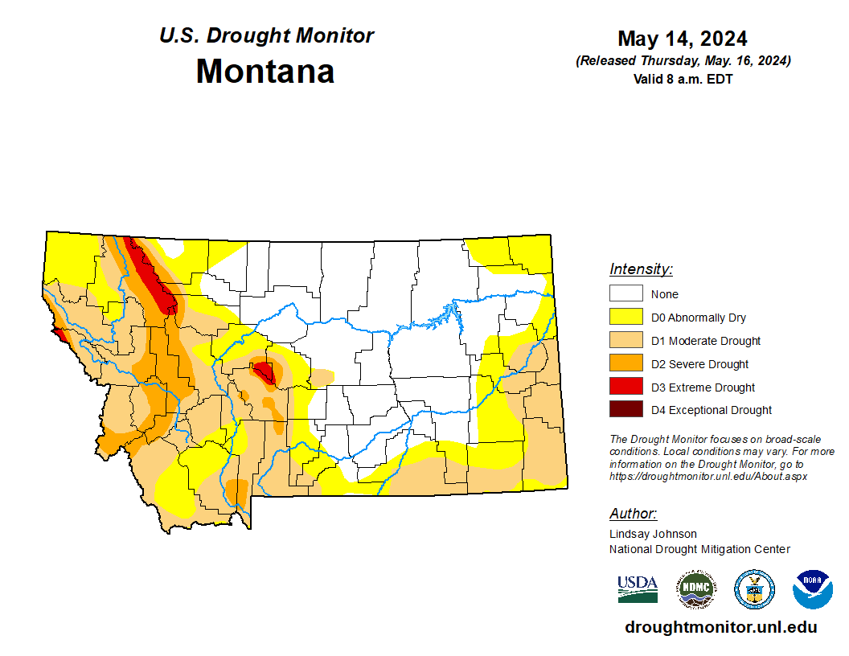
Current Drought Conditions
The U.S. Drought Monitor in Montana
Updated Weekly By Experts in Montana and at NDMC
Montana Climate Office, DNRC and State Library
Mountain Snowpack
6-month Precipitation
6-month Temperatures
Soil Moisture Recharge

Slide 3
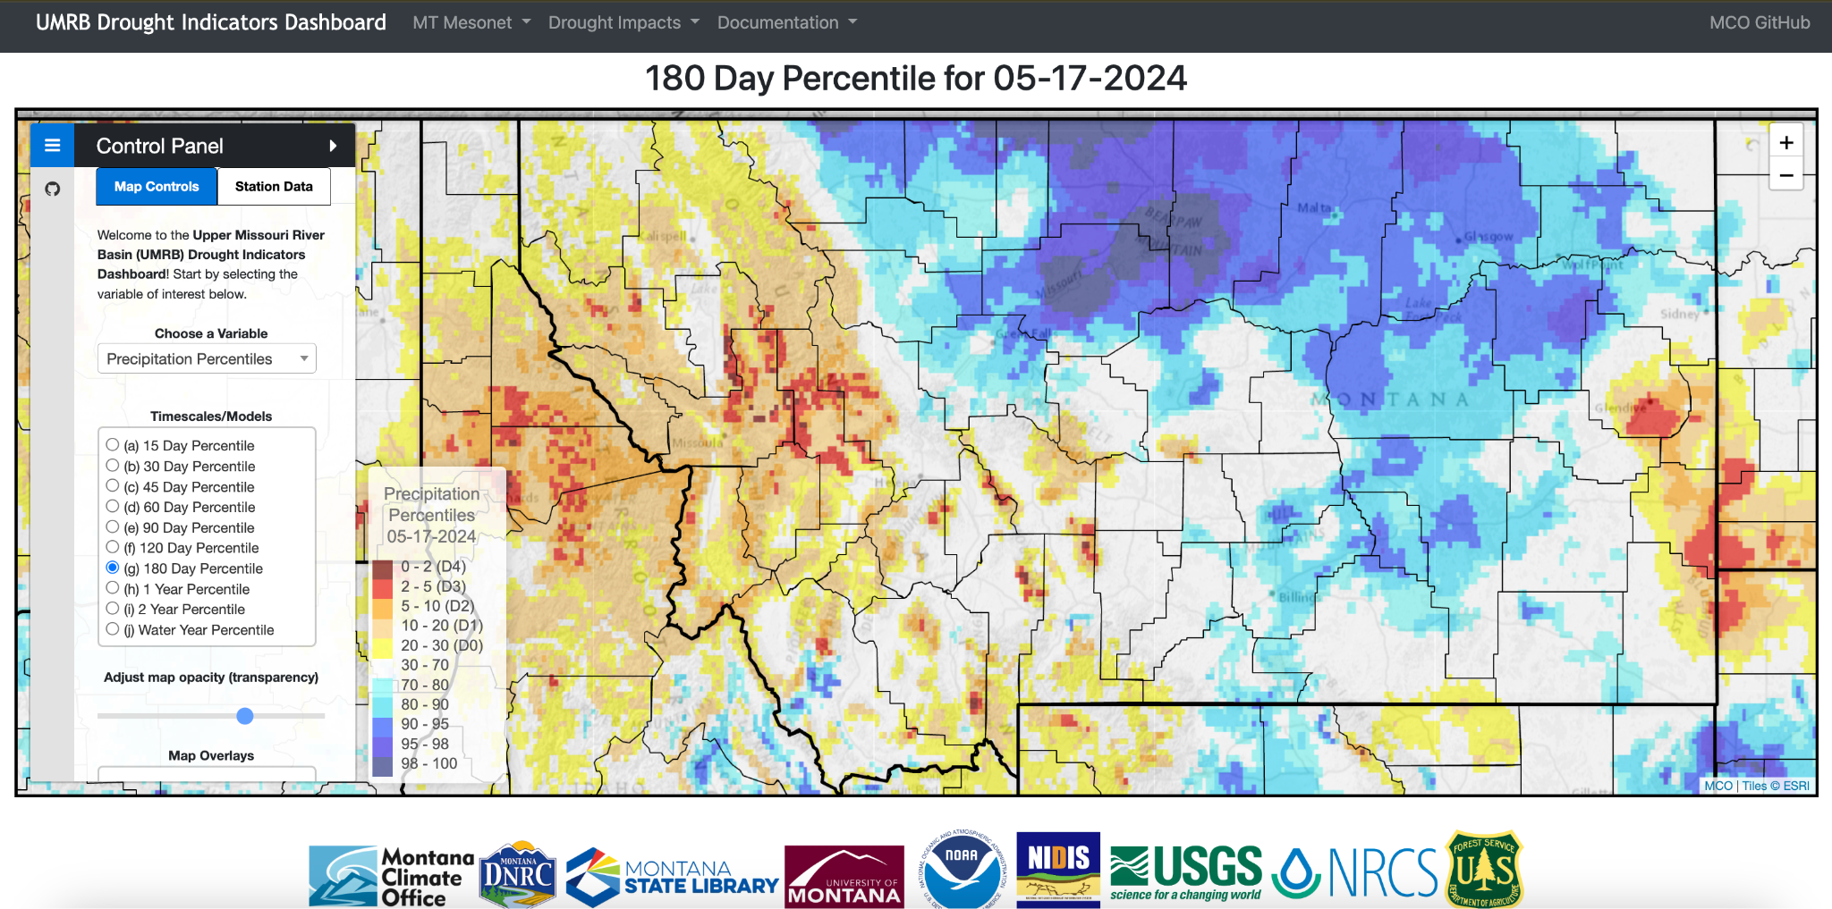
Current Drought Conditions
Track precipitation since mid November ‘23

Slide 4
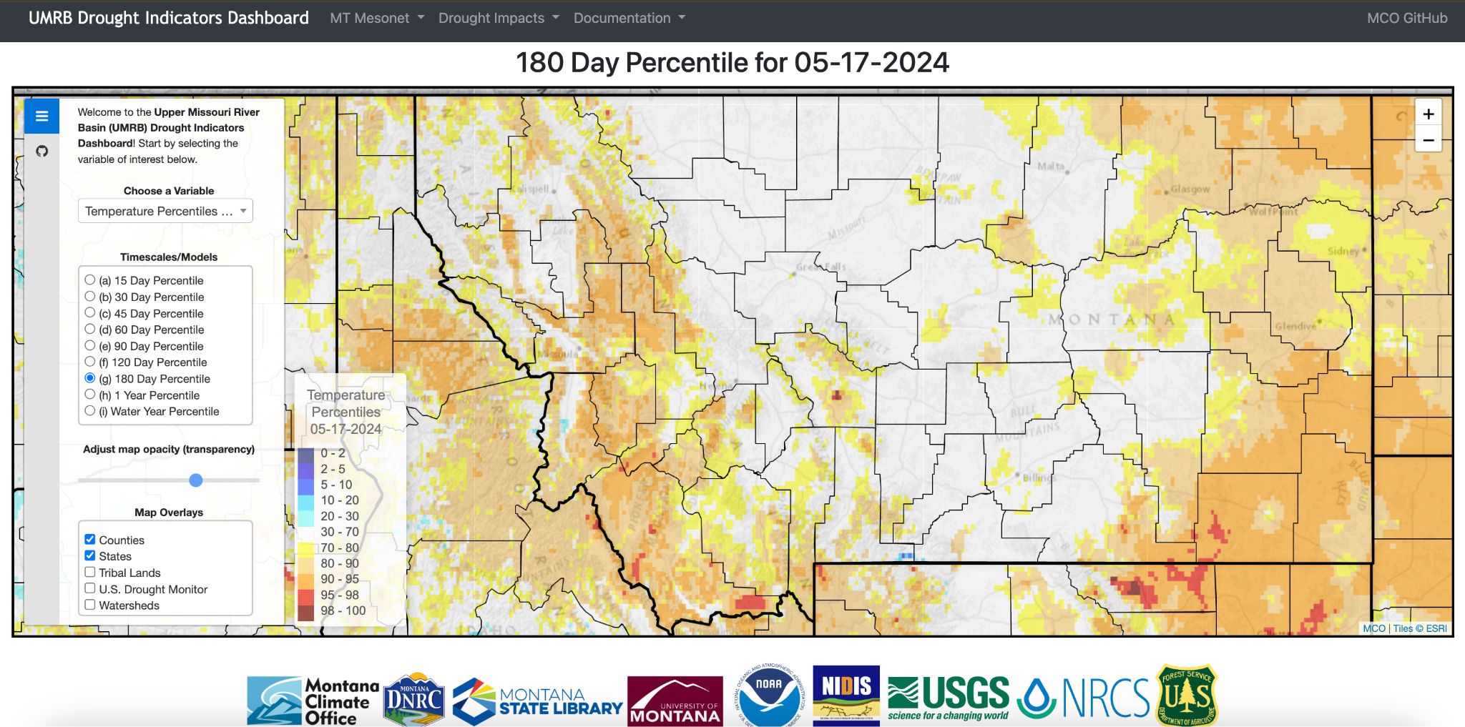
Current Drought Conditions
Warm to very warm temps since mid November ‘23
Drives rain vs snow, evap. & sublimation, soil moisture, etc

Slide 5
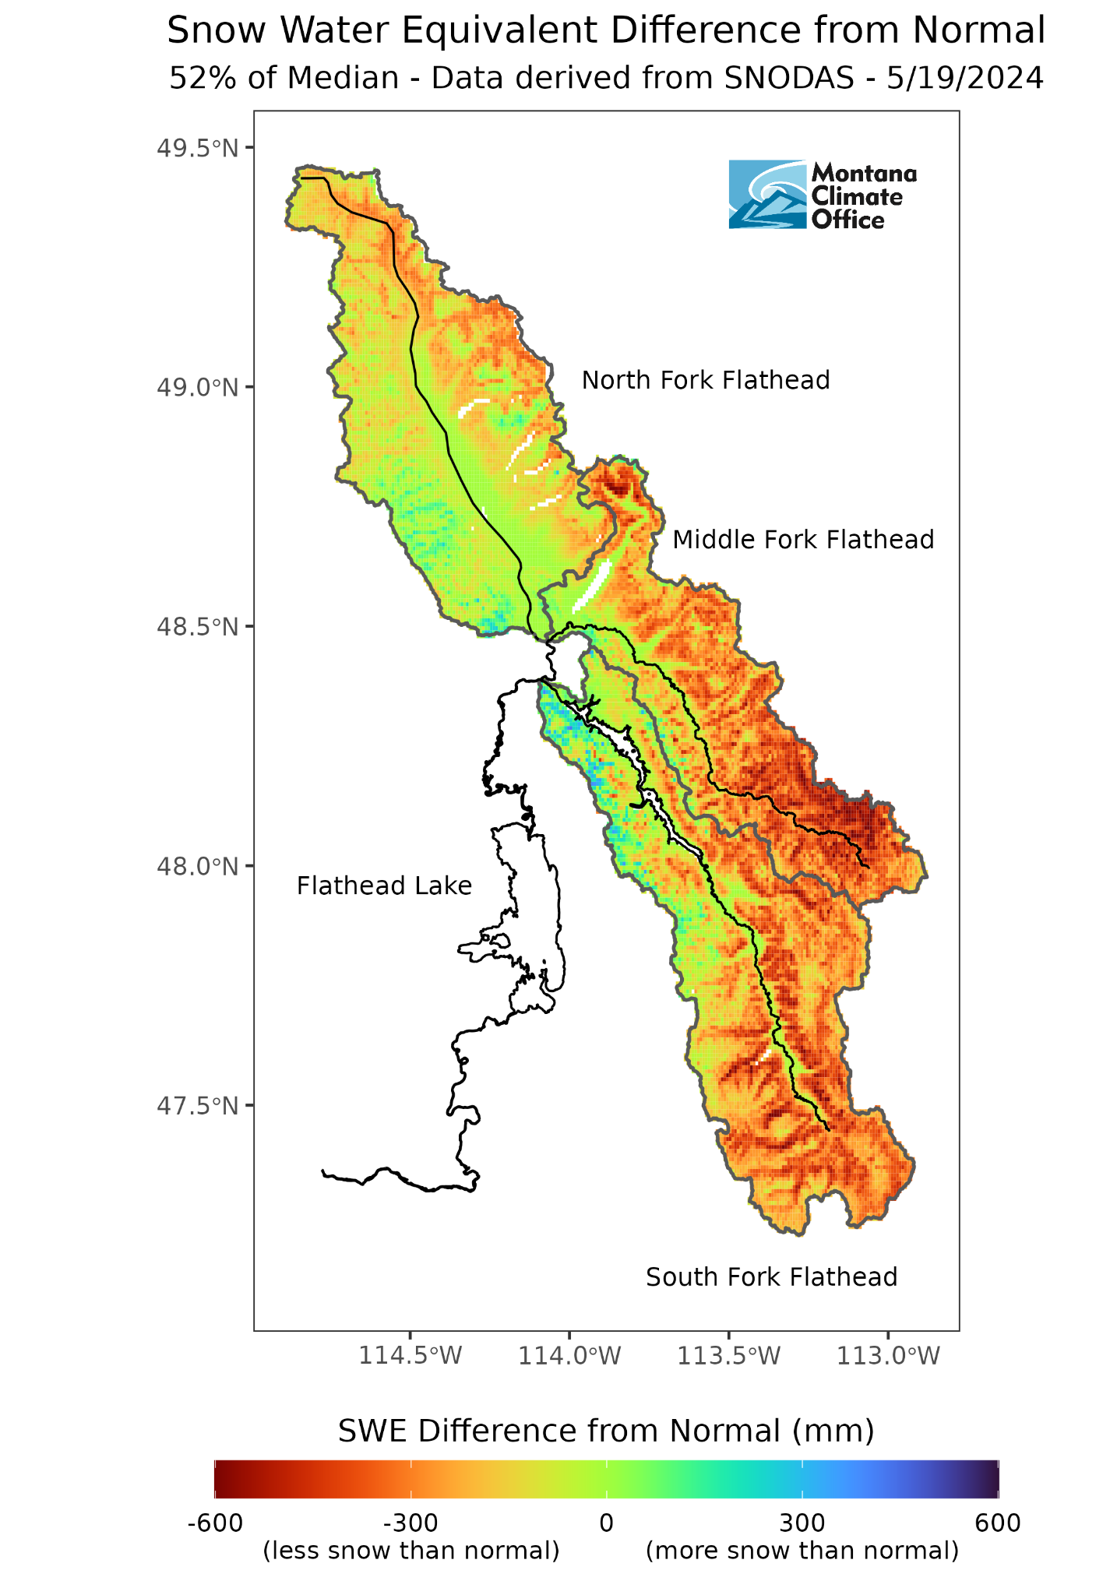
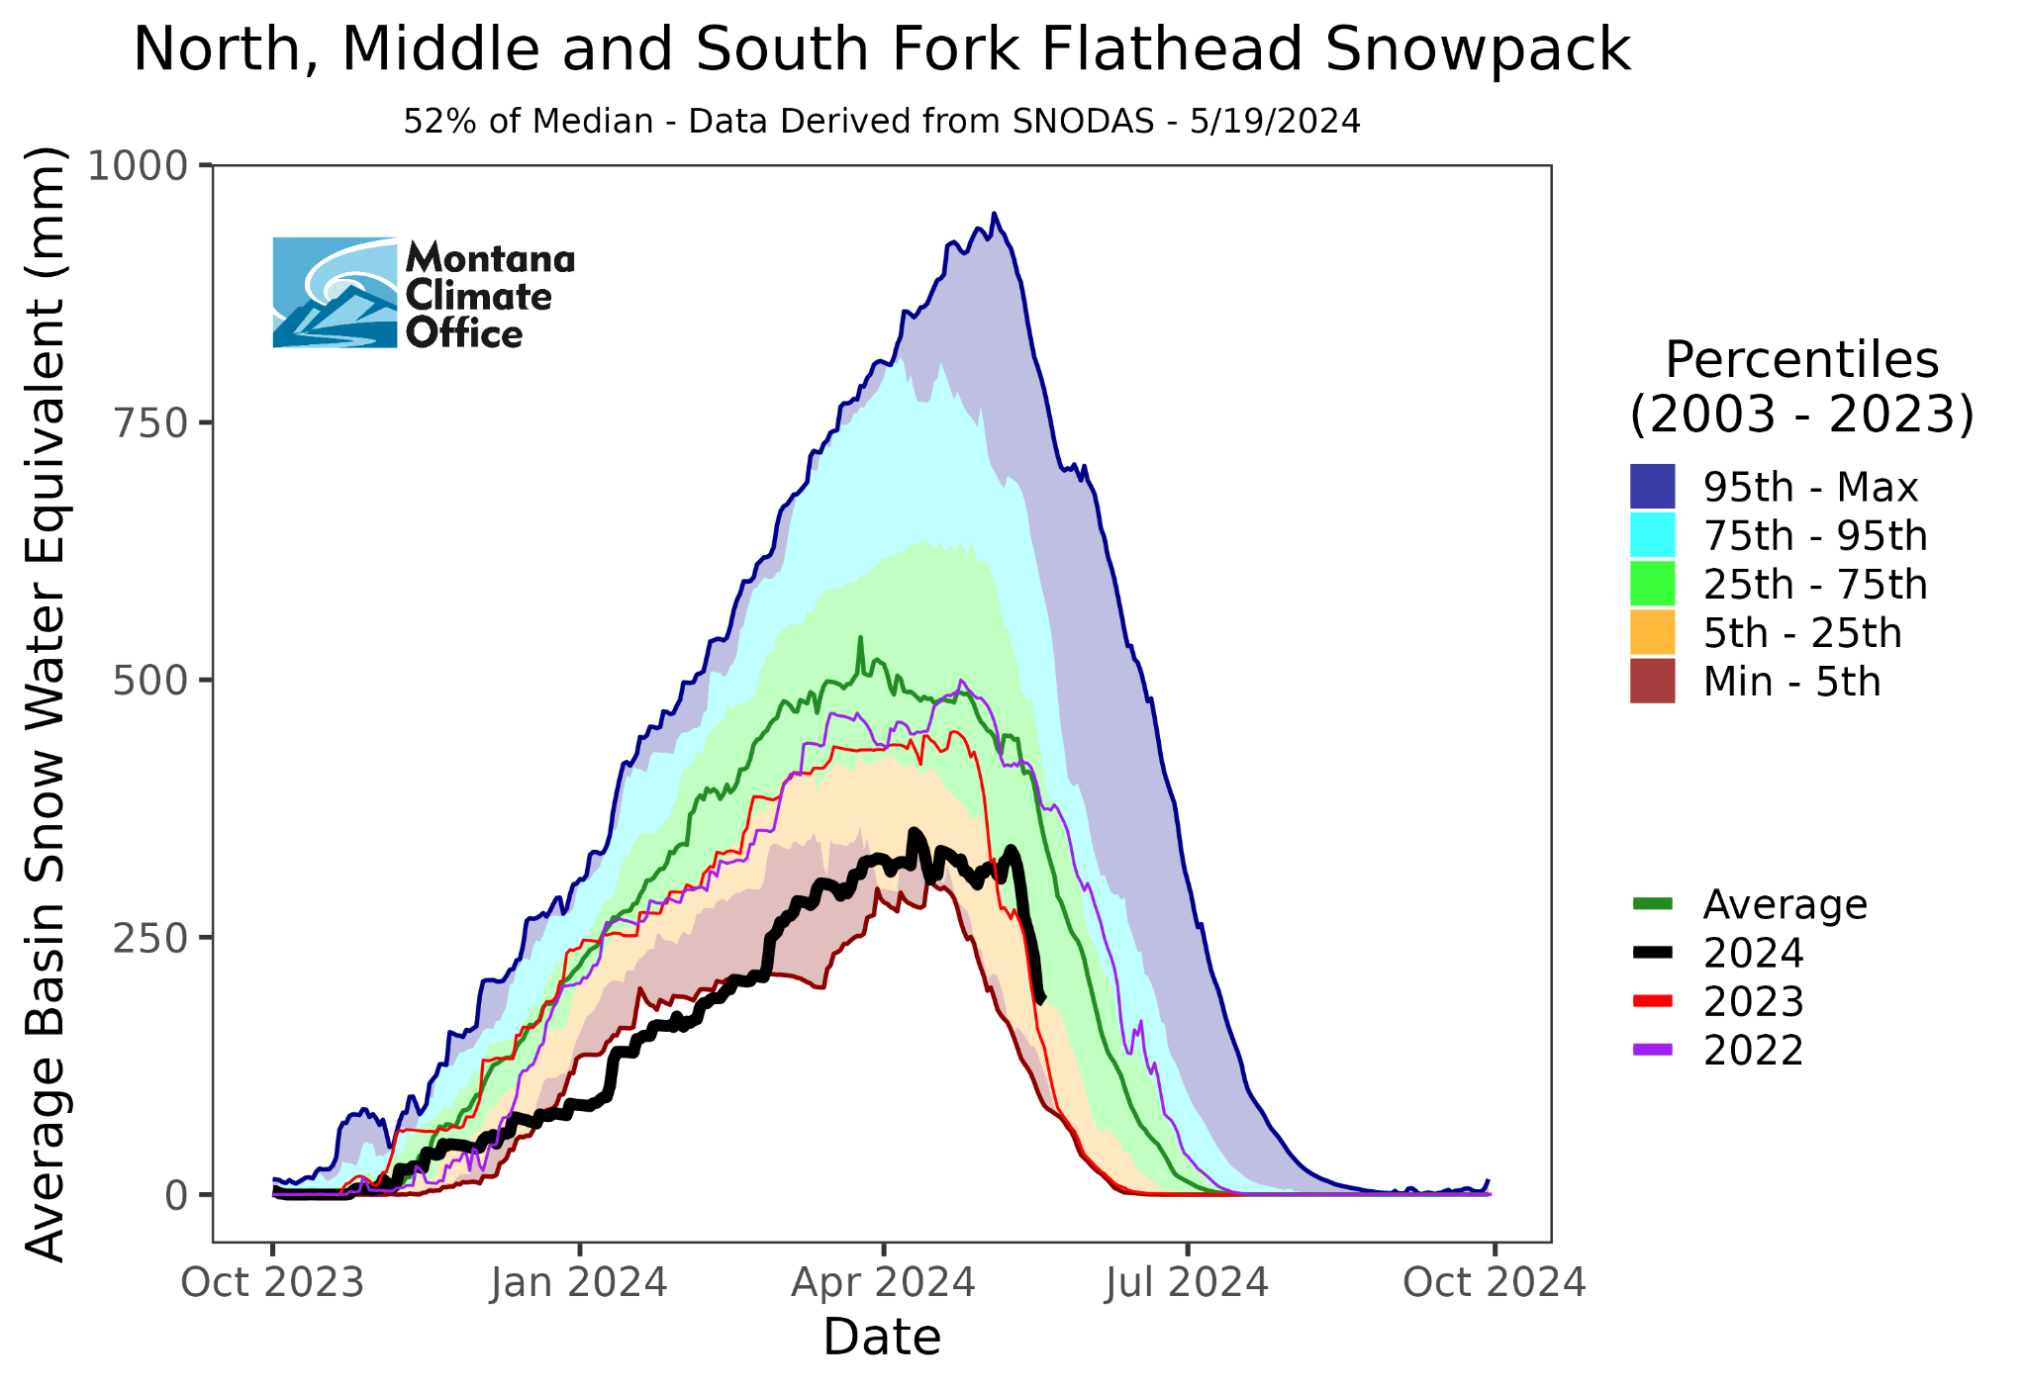
Mountain Snowpack
Flathead Basins
~1.7 Million acre-feet missing
Similar melt to ‘23 but less snow!
Rapid melt occuring

Slide 6
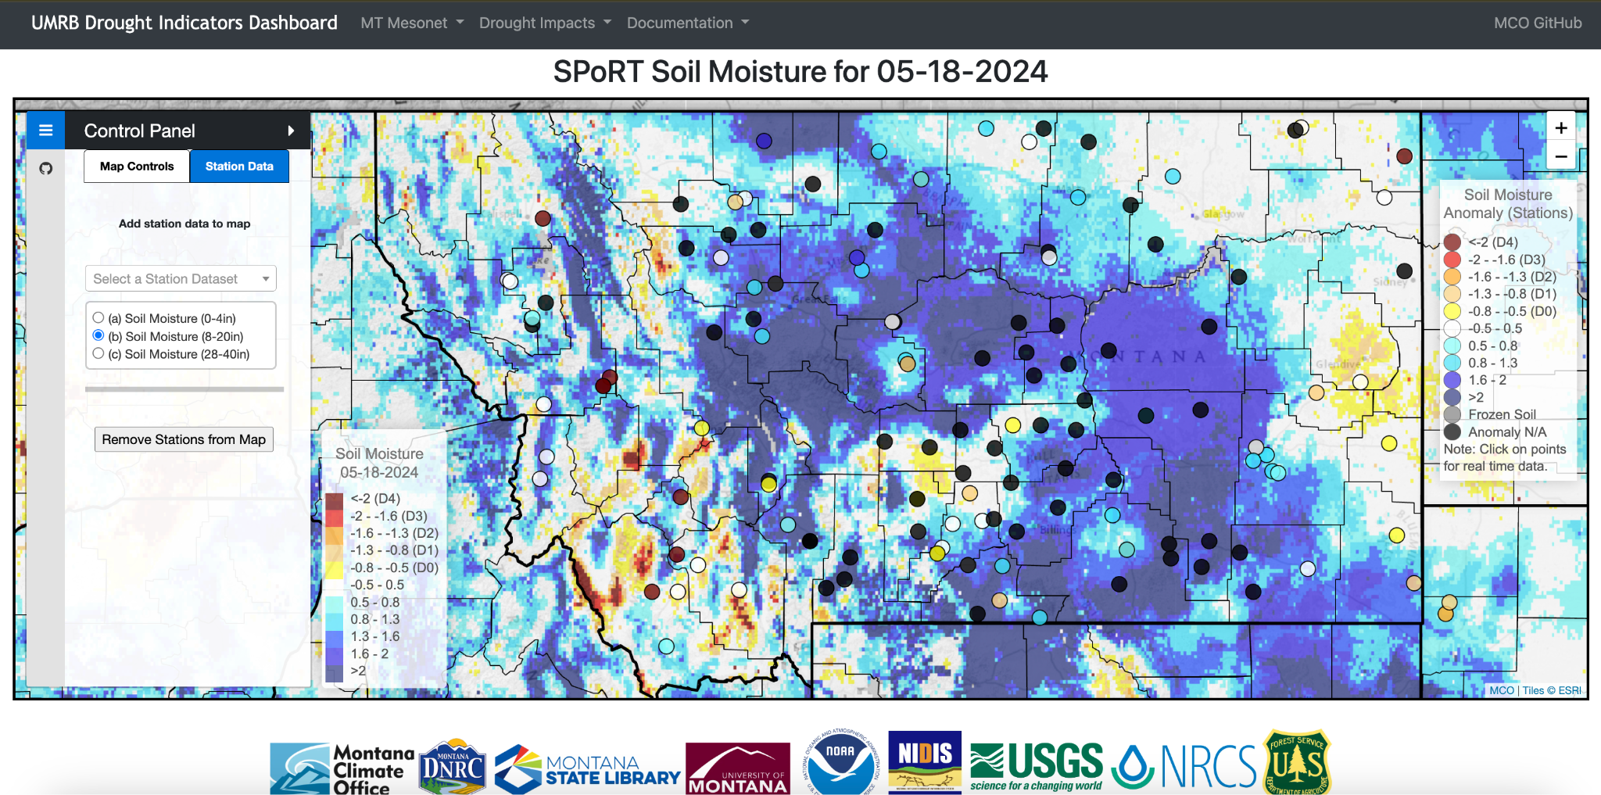
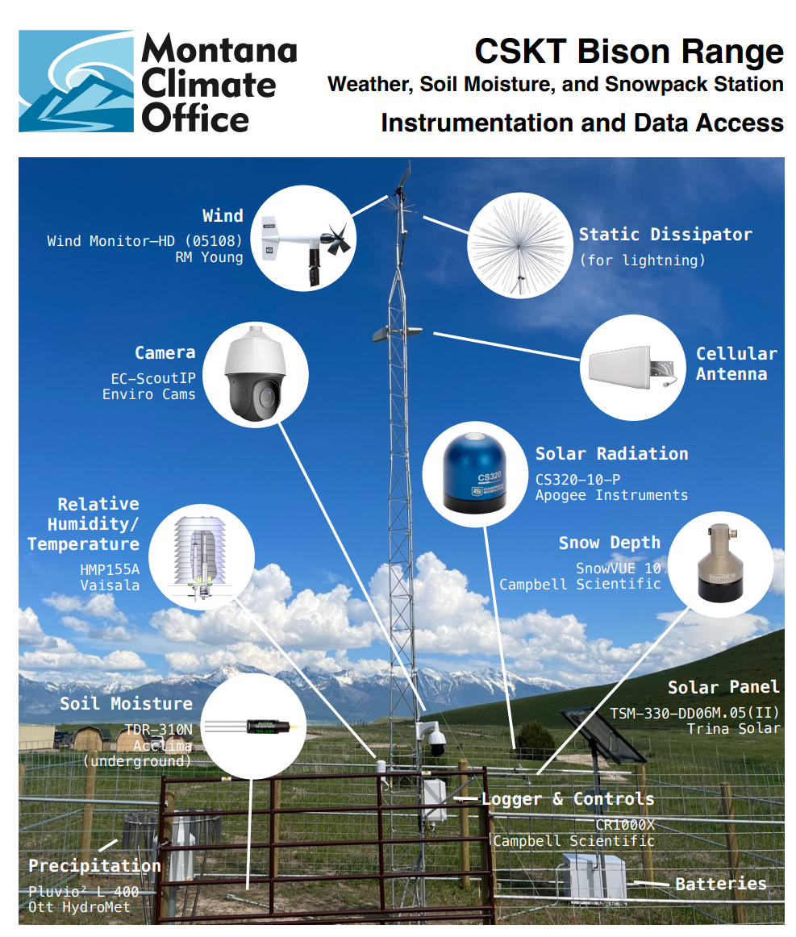
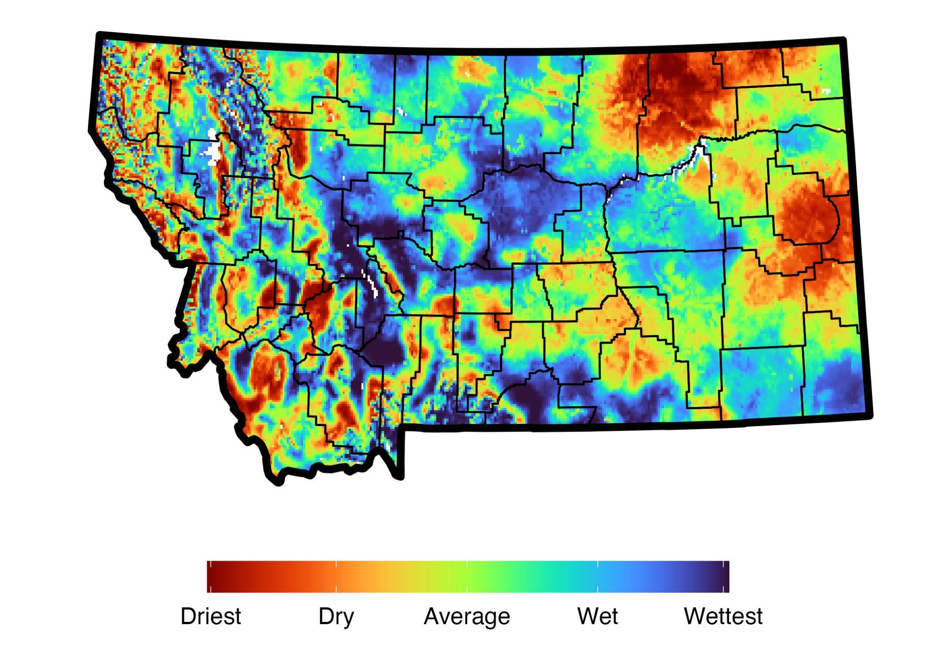
What about Soil Moisture?
Essential Hydrological Resource for Montanans
STATION DATA
Montana Mesonet
MODELLED DATA

Slide 7
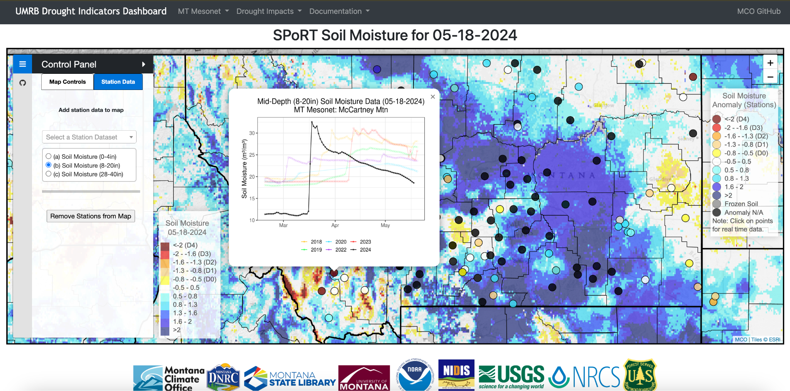
What about Soil Moisture?
Essential Hydrological Resource for Montanans

Slide 8
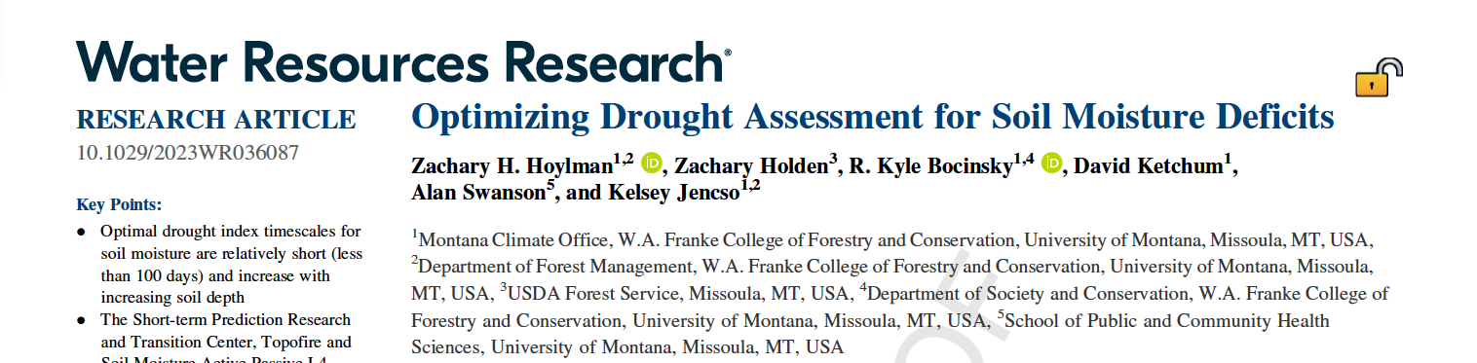
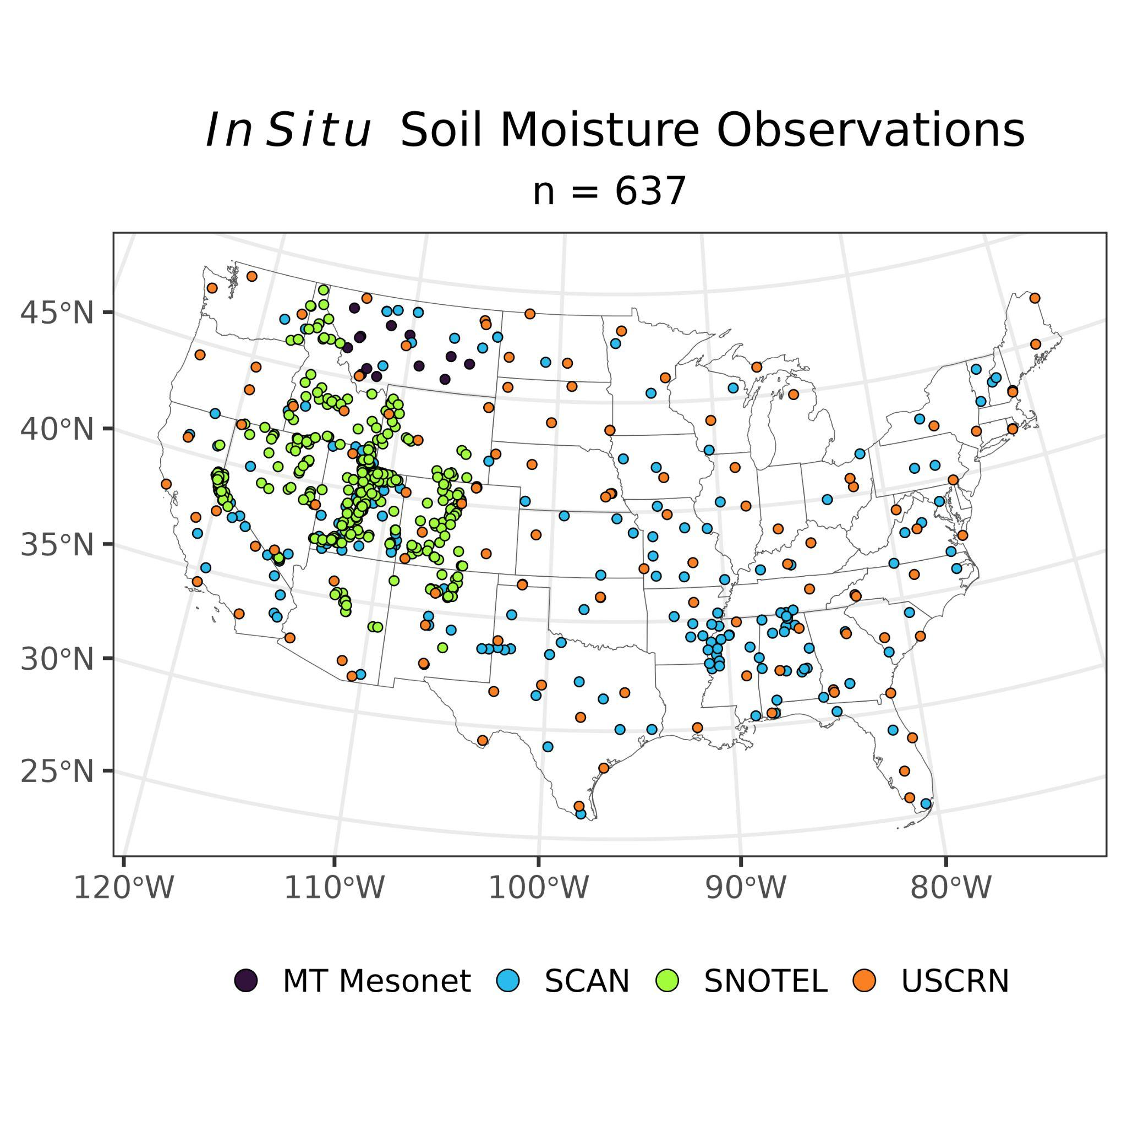
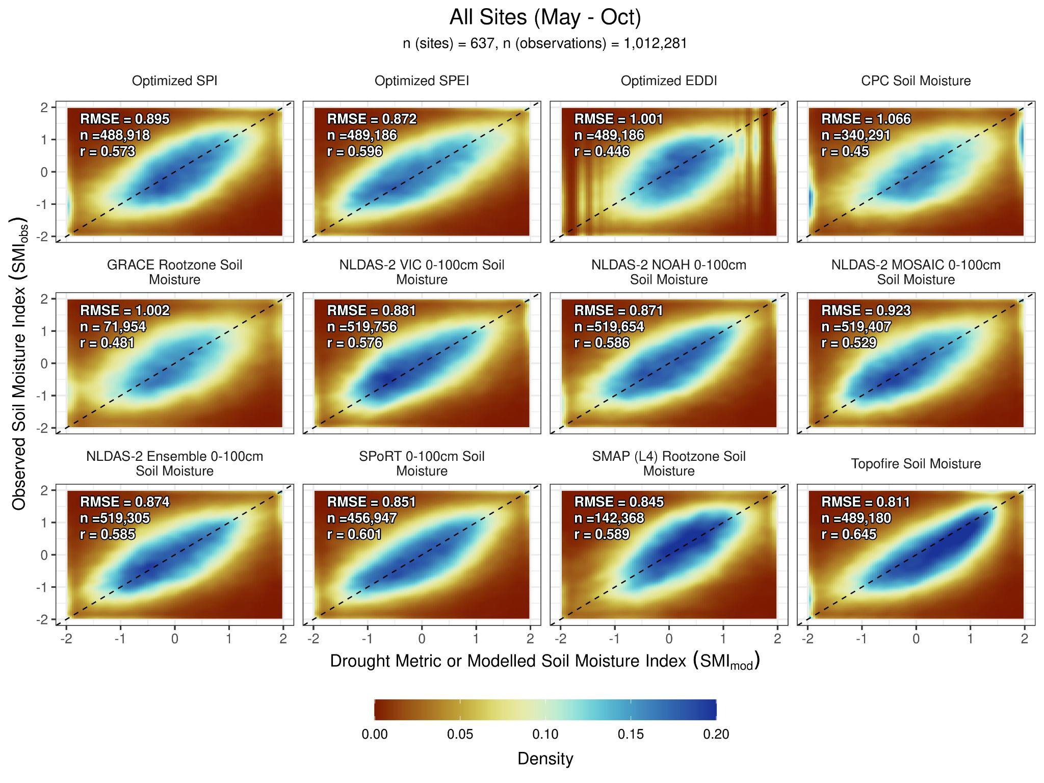
Which Models Work Best?
SPoRT LIS Soil Moisture is the best model for detecting drought

Slide 9
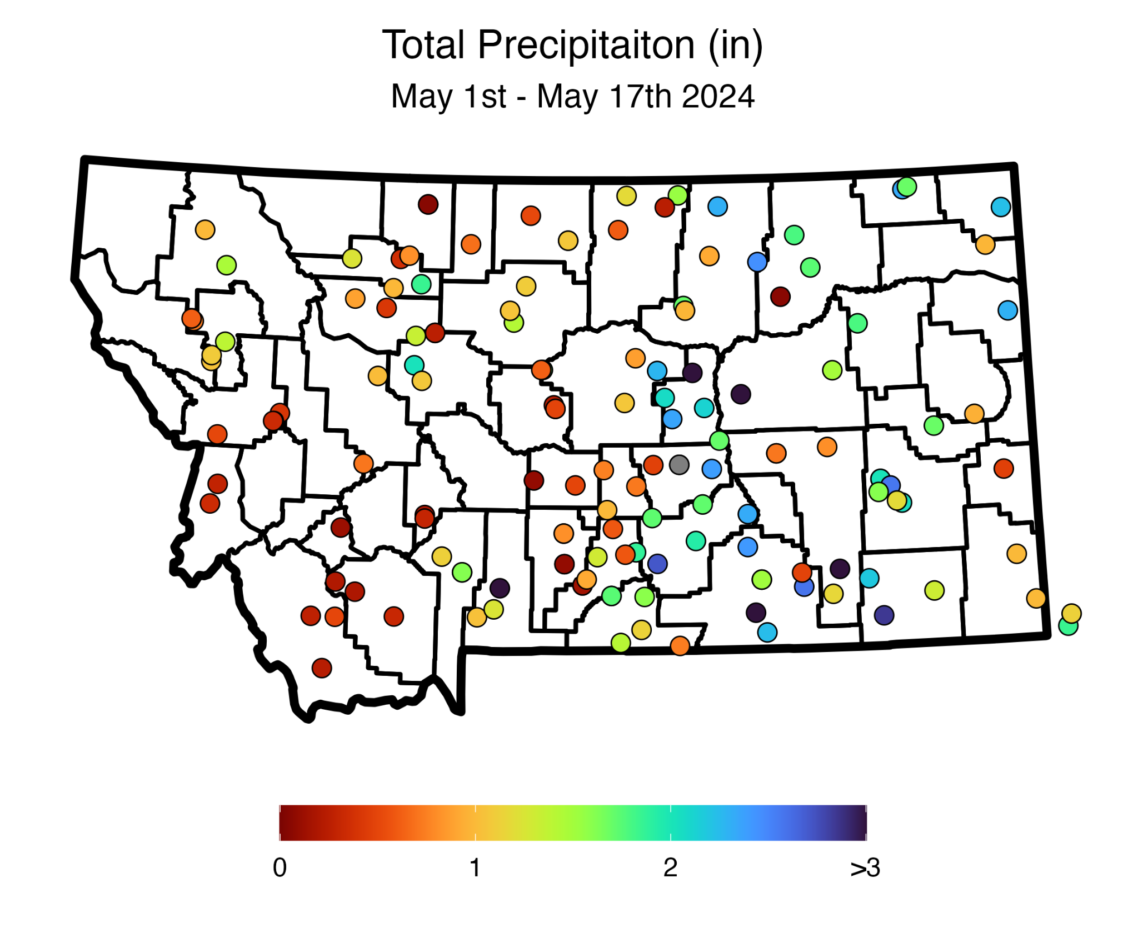
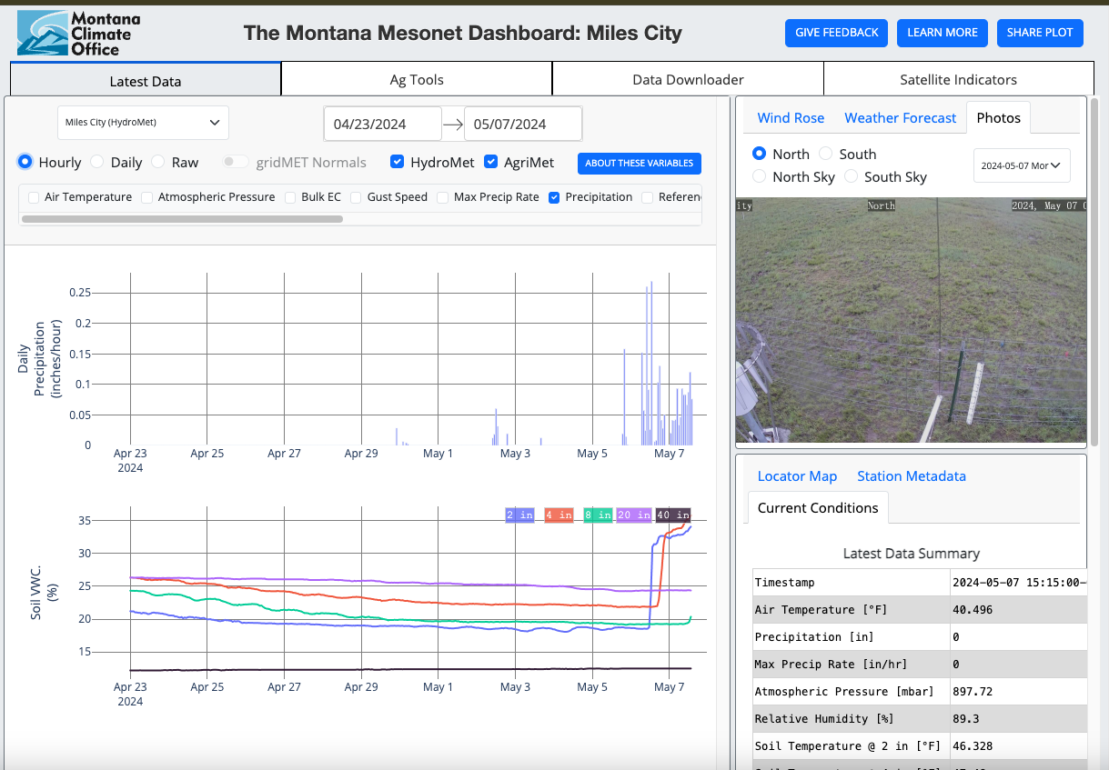
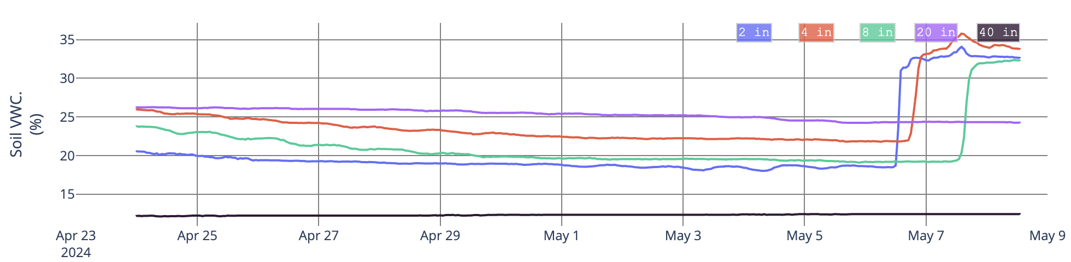
Current Conditions - Recent Changes
Using the Montana Mesonet
Montana Mesonet Dashboard
https://mesonet.climate.umt.edu/
Soil Moisture Recharge!
Soil Moisture

Slide 10
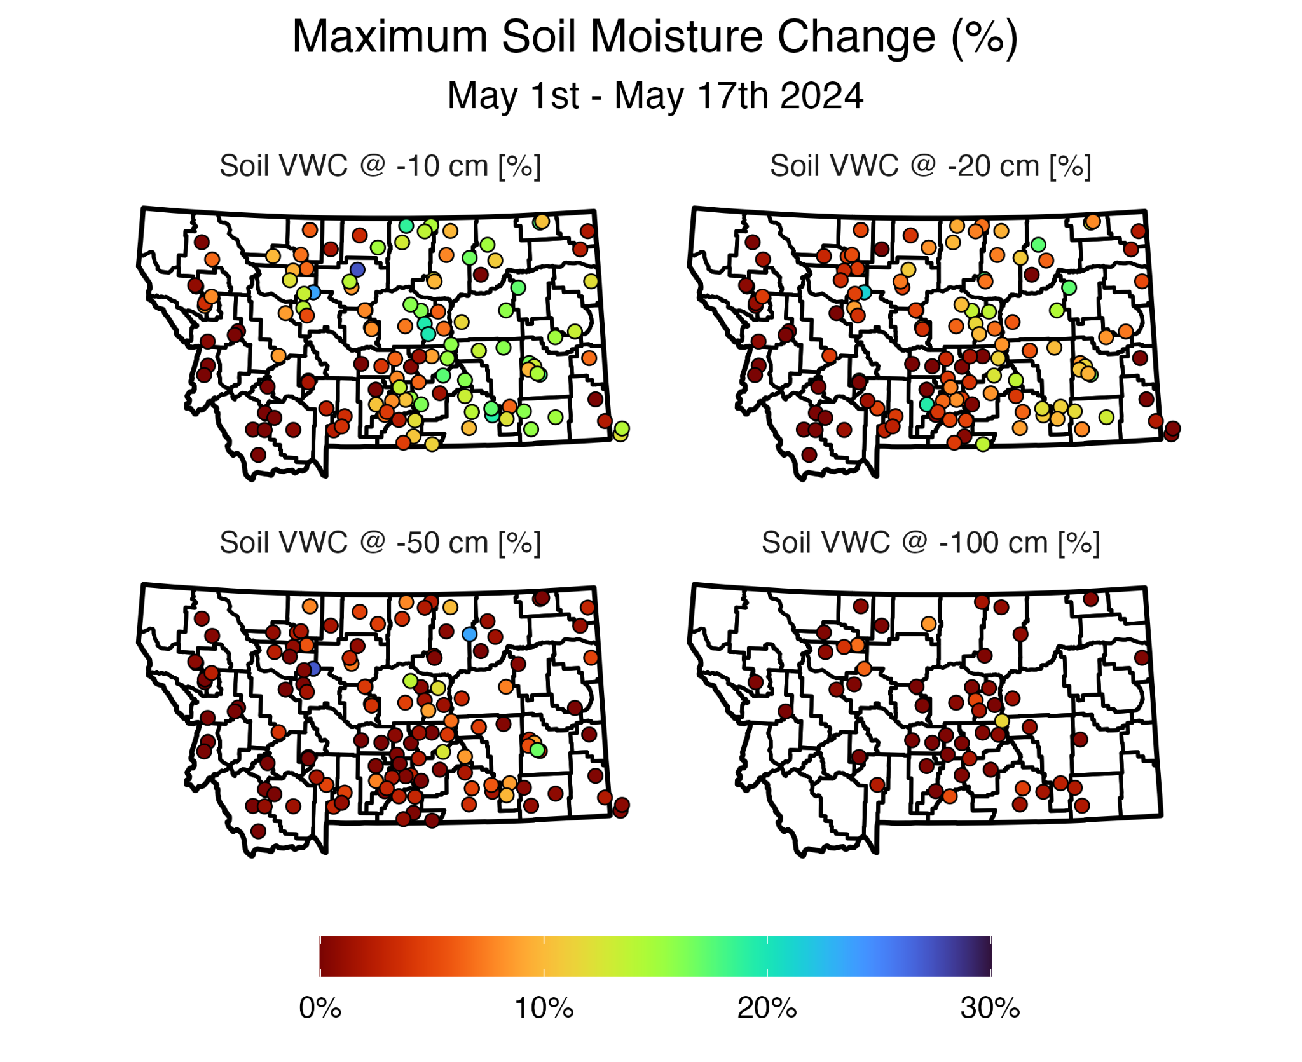
Current Conditions - Recent Changes
Using the Montana Mesonet

Slide 11
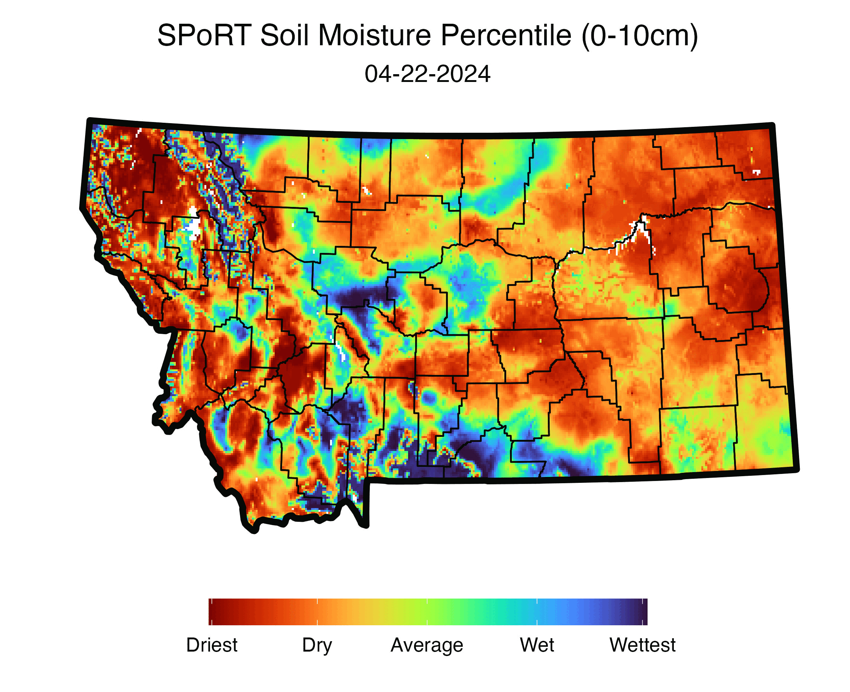
Current Conditions - Recent Changes
Using the SPoRT LIS Model (0-10cm)
Significant shallow recharge in east
Model agrees but over emphasizes in WC/NW MT & NE/SE corners

Slide 12
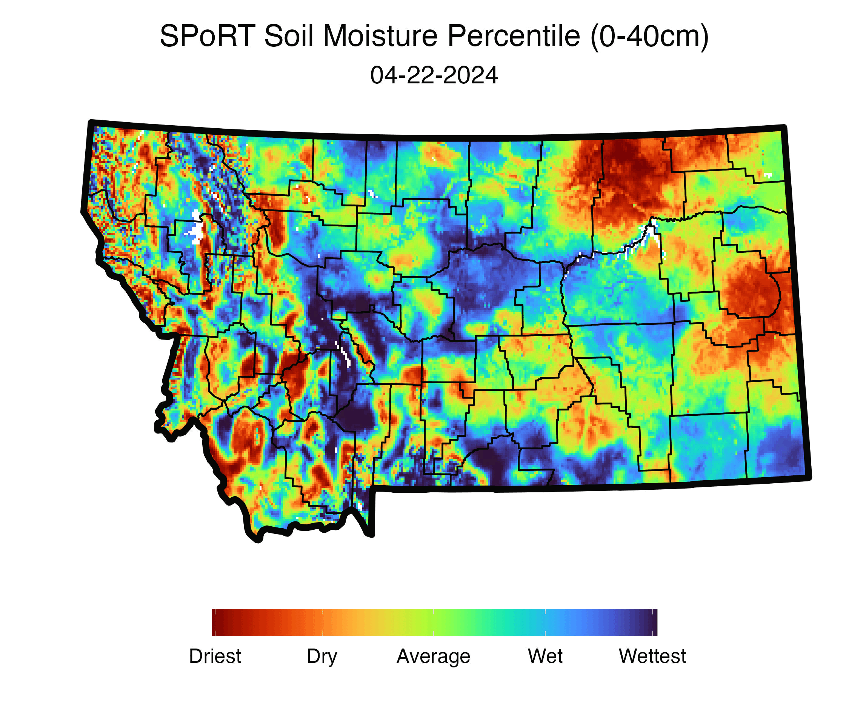
Current Conditions - Recent Changes
Using the SPoRT LIS Model (0-40cm)
Moderate mid-depth recharge in east
Models over emphasize in WC/NW & along the eastern front
Dryness in Glendive Persists

Slide 13
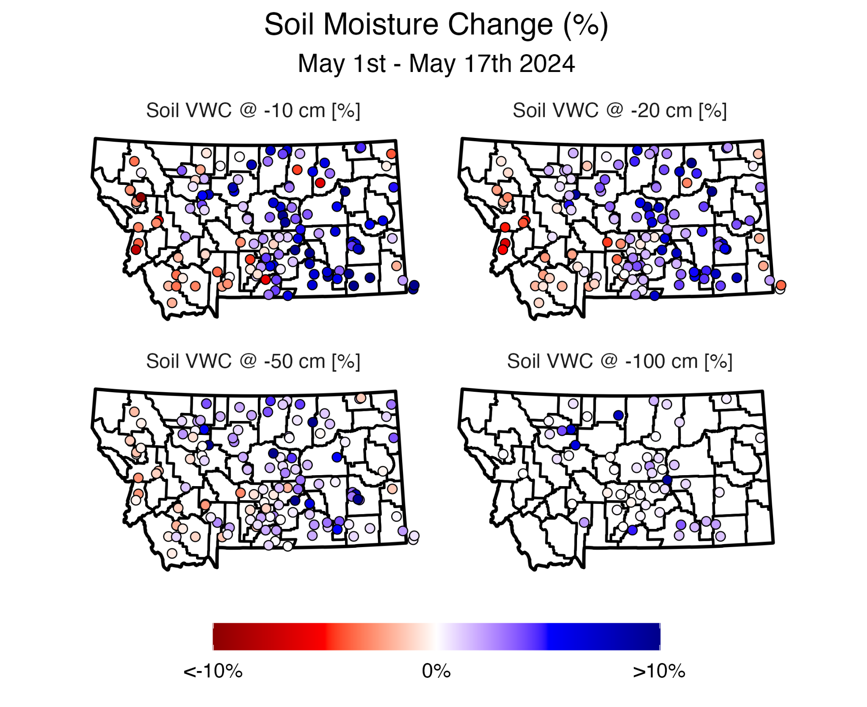
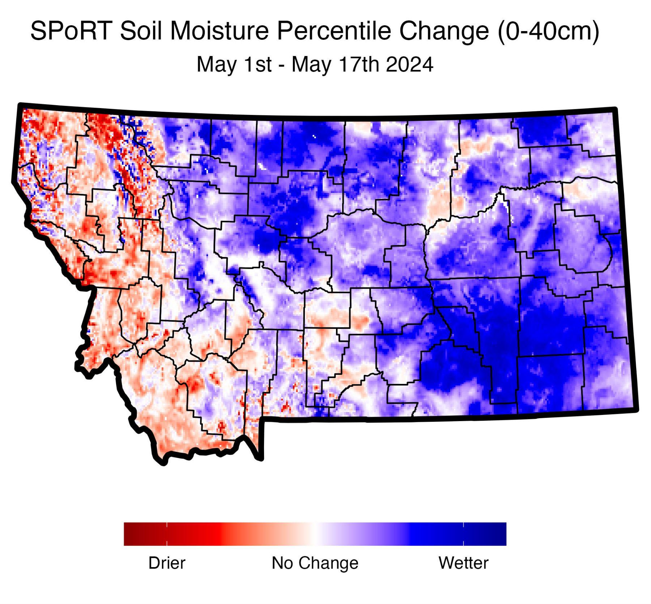
Persistent Changes
Using SPoRT and the Montana Mesonet

Slide 14
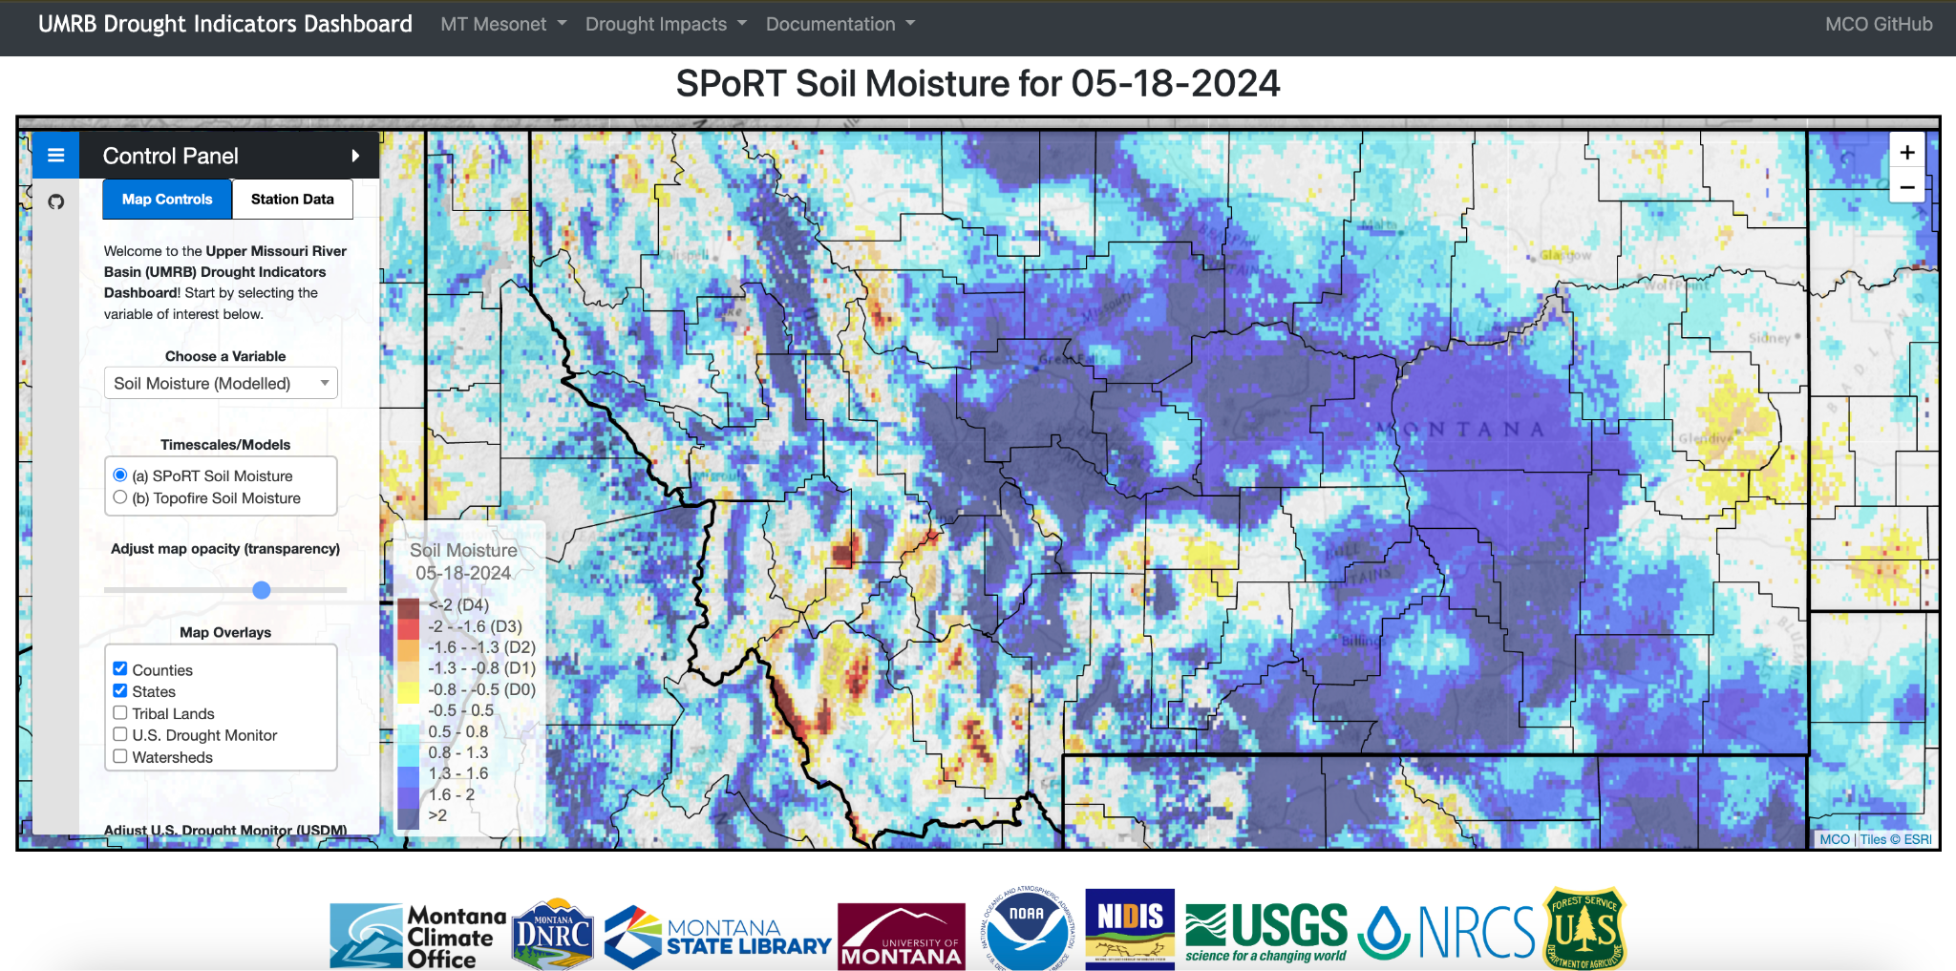
Current Conditions - Anomalies
Using the Montana Mesonet
UMRB Drought Dashboard
https://drought.climate.umt.edu/

Slide 15
Soil Moisture Recharge - Summary
Using SPoRT and the Montana Mesonet
Soil moisture has improved, but mostly above 20 in
  Localized improvements down 36 in
Continued moisture loss in West
  Response from recent heat
General model/station agreement, but some important differences
  Importance of matching station/model data (we need to be critical consumers)

Slide 16
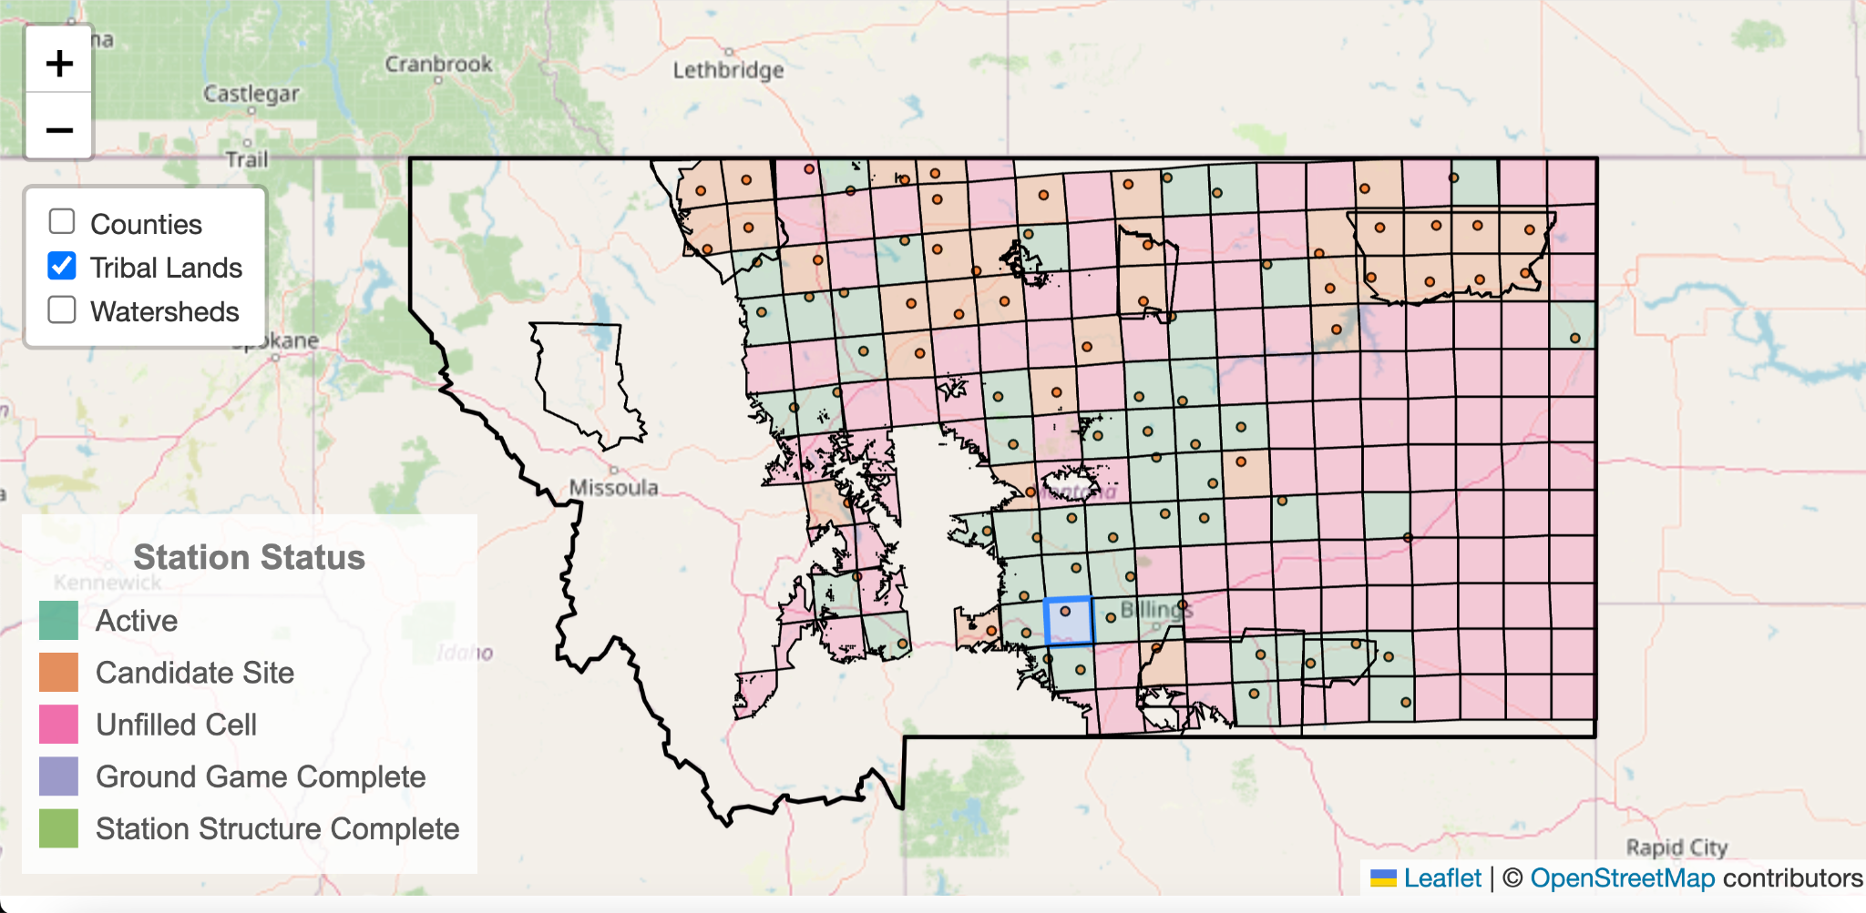
Mesonet Expansion Update - A resource for Montanans
Growing to ~ 300 Stations by 2028

Slide 17
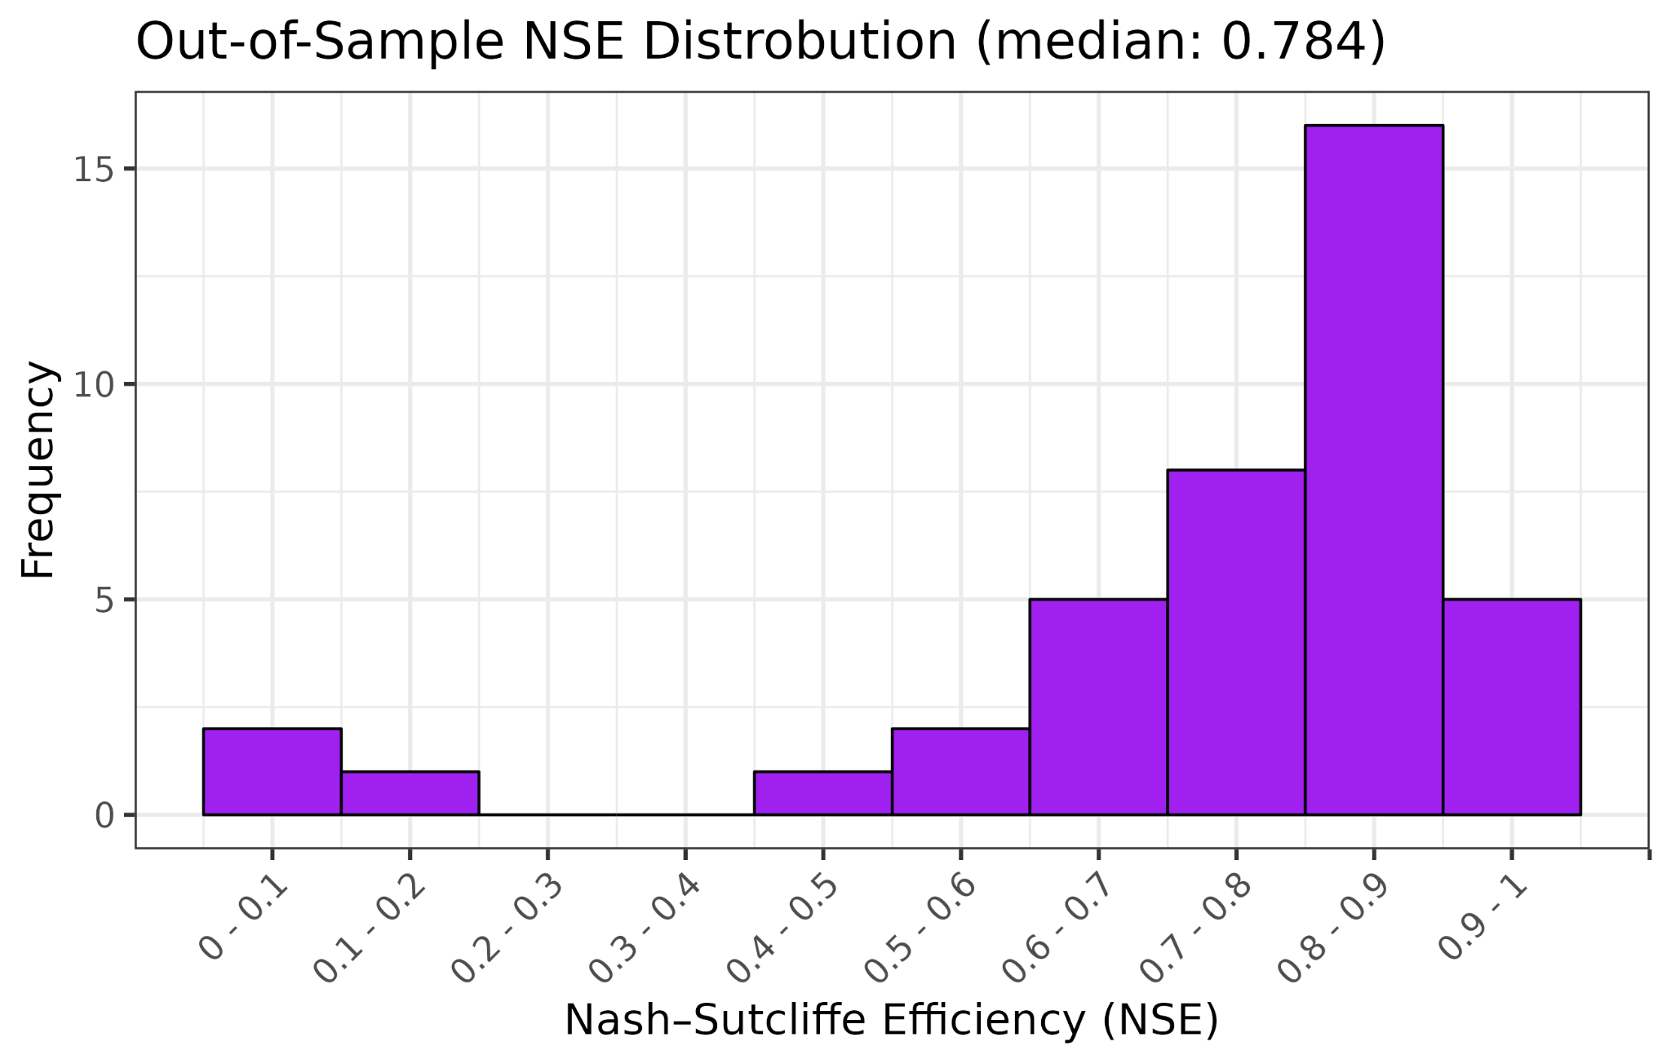
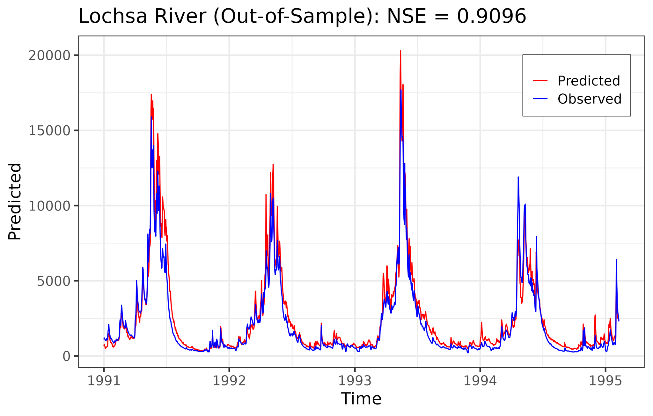
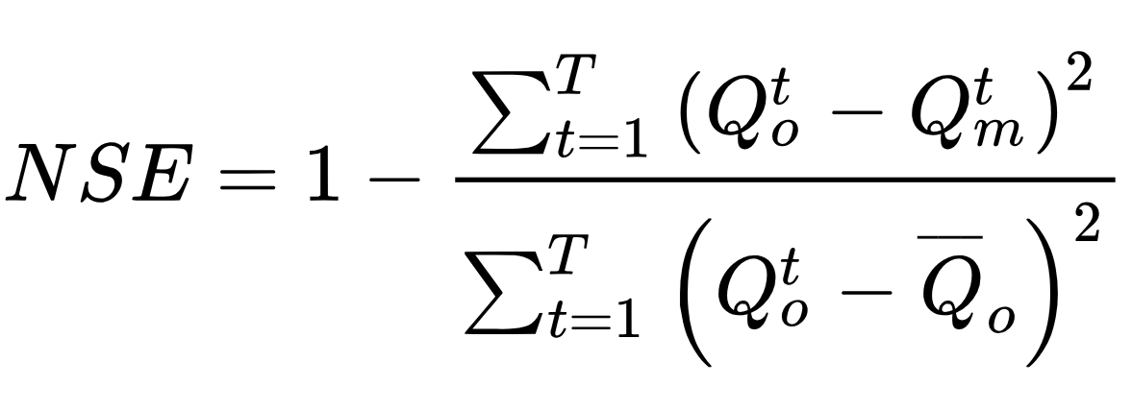
Using Neural Networks to Enhance Montana’s Integrated Hydrological Model
Nash–Sutcliffe Efficiency Coefficient (NSE)
Q_{O} = Obs, Q_{m} = Modeled

Slide 18

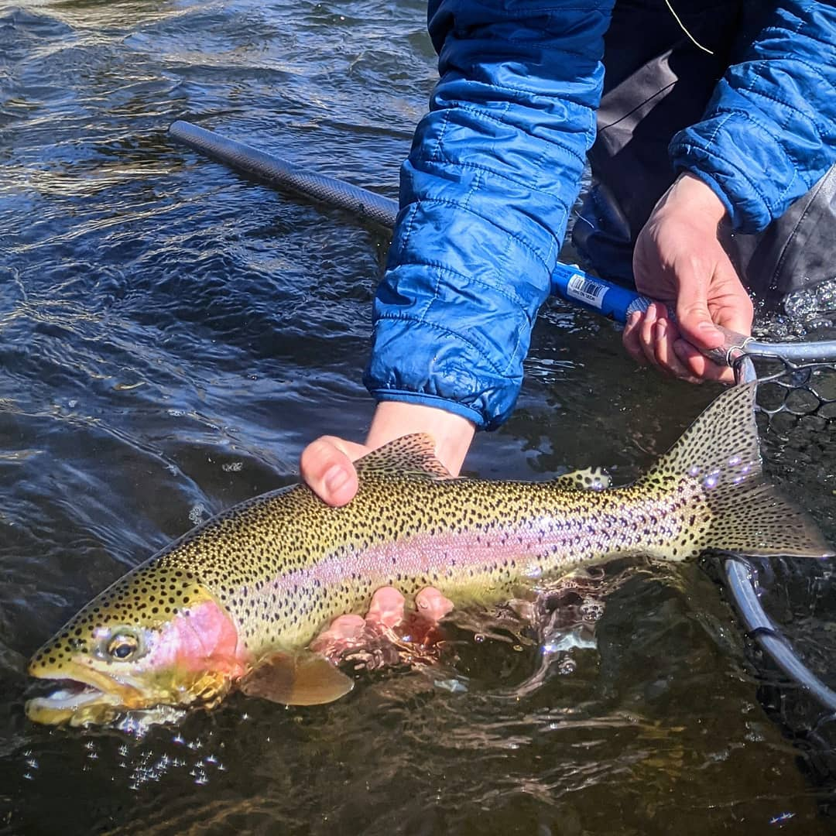

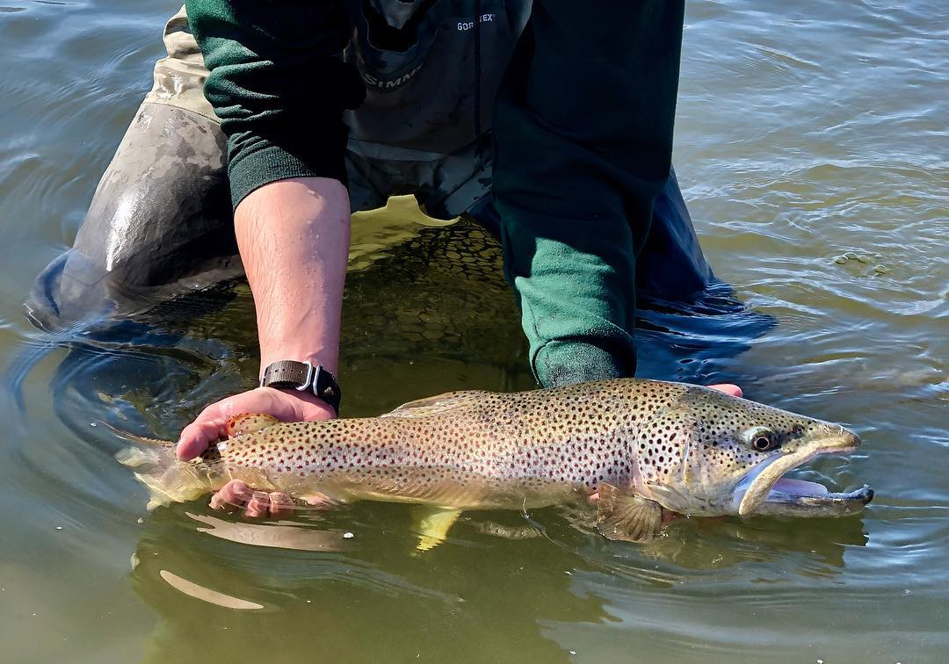
Questions?
zachary.hoylman@umontana.edu
Web Resources:
MCO Web Page: https://climate.umt.edu/
Climate Data Explorer: https://mco.cfc.umt.edu/datasets/
Drought Dashboard: https://drought.climate.umt.edu/
Montana Mesonet: https://climate.umt.edu/mesonet/

