Slide 1
The Montana Climate Office
Understanding Climate, Drought and Change Across Montana
Dr. Zachary H. Hoylman
Assistant State Climatologist - Montana Climate Office
Research Assistant Professor - Department of Forest Management

Slide 2
Montana's official climate data stewards.
Provides high quality, timely, relevant, and scientifically-based climate information and services to Montanans.
Operates the Montana Mesonet — an extensive and growing network of weather, soil moisture, and snowpack monitoring stations.
Climate, Drought & Change in MT
Dr. Zachary Hoylman
Montana Climate Office
NWS Partner Meeting (11/6/2024)

Slide 3
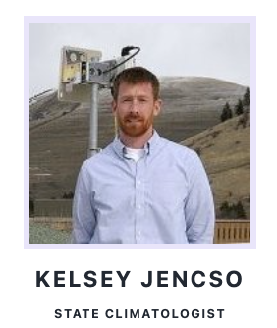
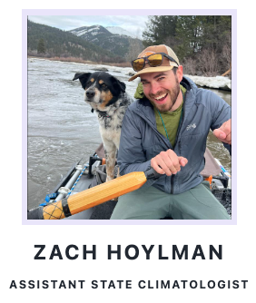
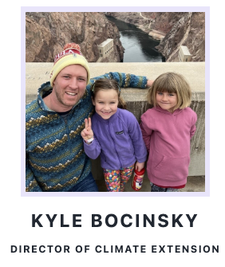
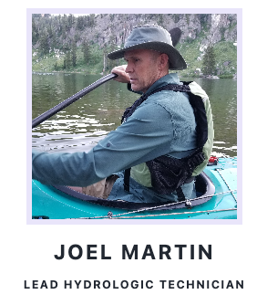
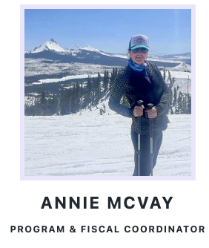
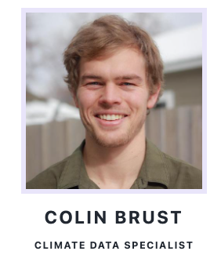
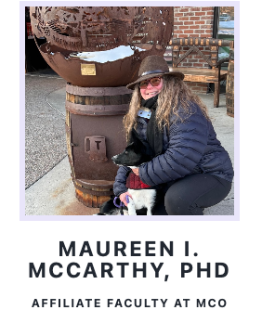
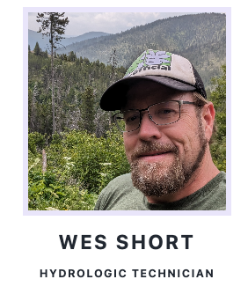
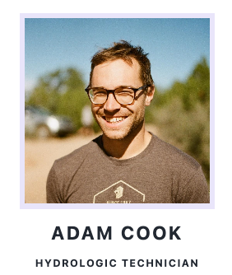
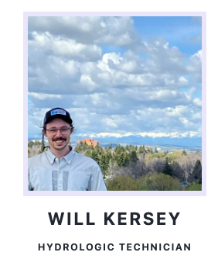
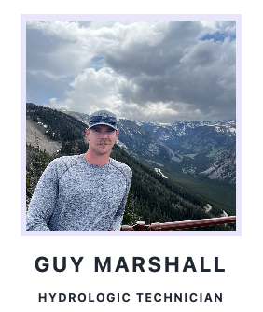
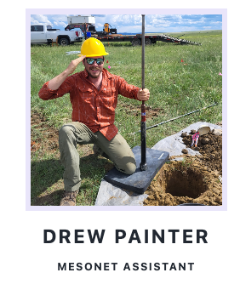
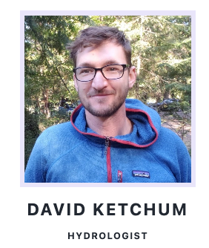
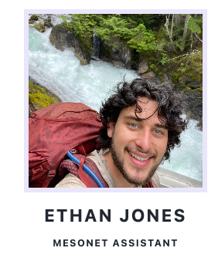
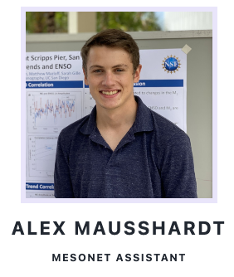
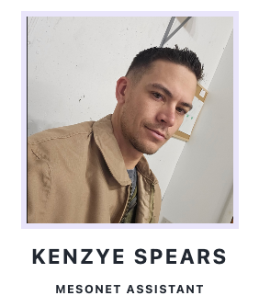
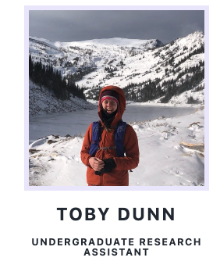
The Montana Climate Office
CHRISTINE LAYEUX
Climate, Drought & Change in MT
Dr. Zachary Hoylman
Montana Climate Office
NWS Partner Meeting (11/6/2024)

Slide 4
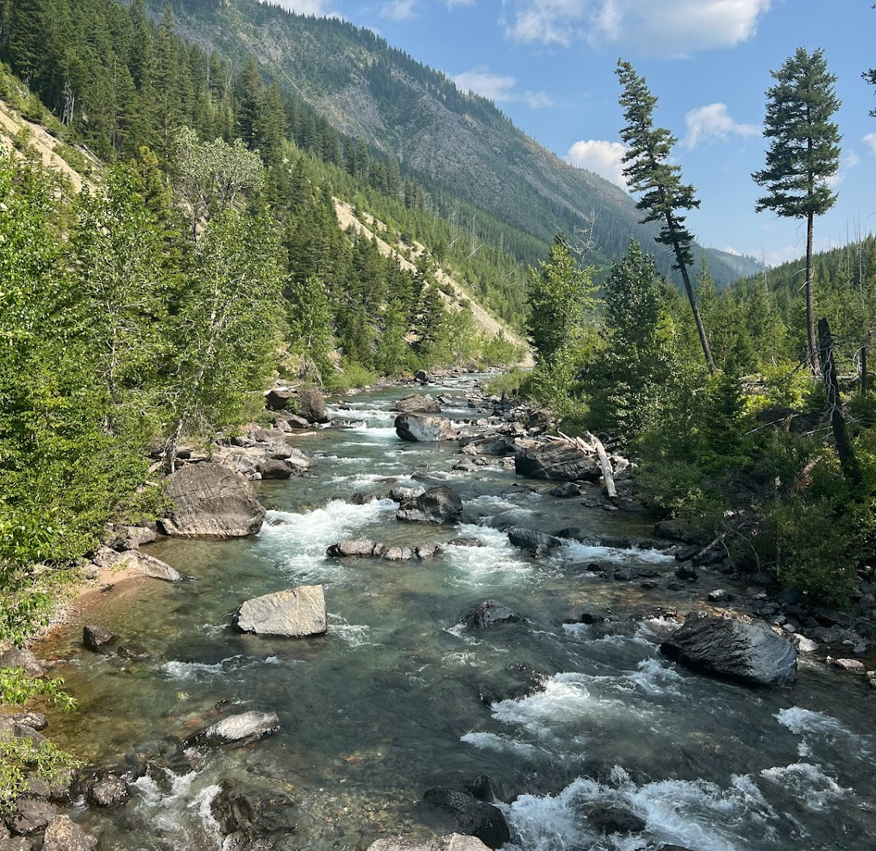
Climate, Drought and Change Across Montana
Deploying foundational climate infrastructure
Developing drought informatics for Montana
Assessing change and promoting future minded assessments
Climate, Drought & Change in MT
Dr. Zachary Hoylman
Montana Climate Office
NWS Partner Meeting (11/6/2024)

Slide 5
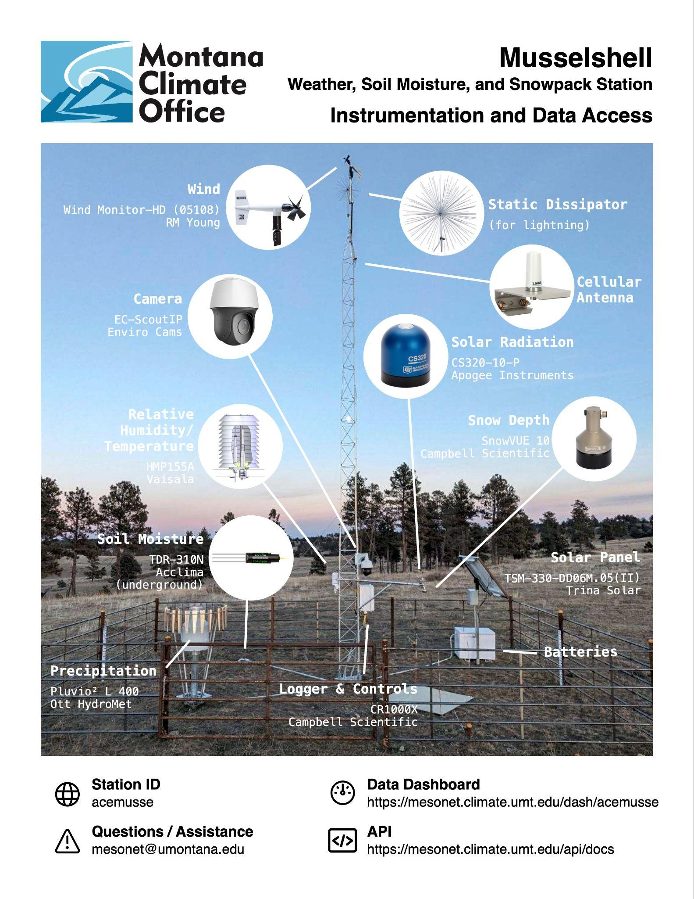
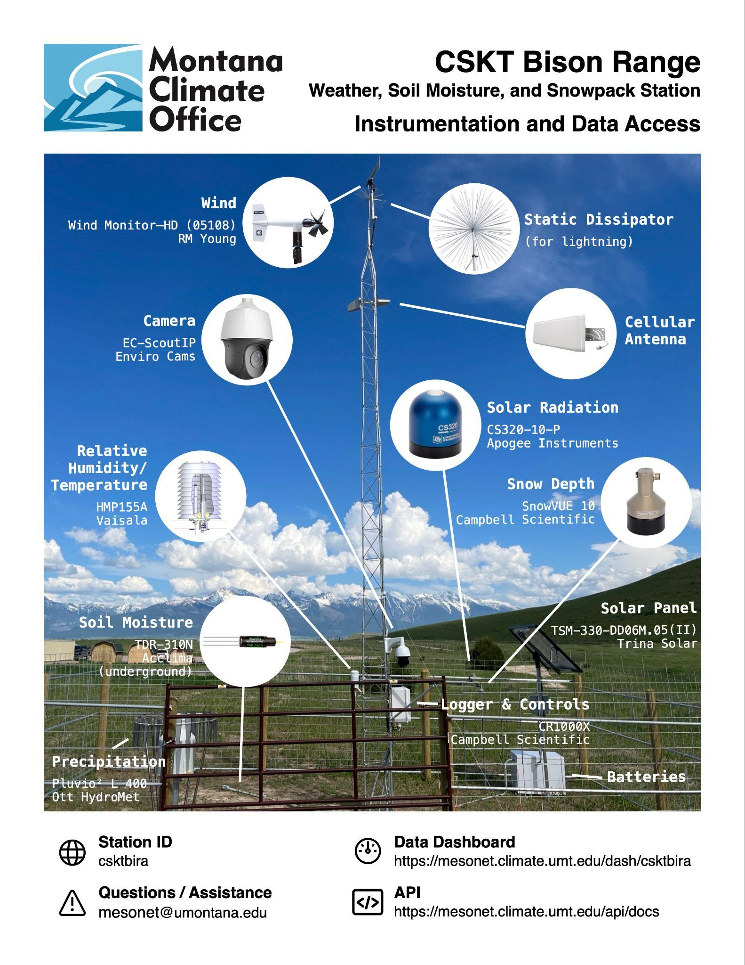
Deploying Foundational Climate Infrastructure
Climate, Drought & Change in MT
Dr. Zachary Hoylman
Montana Climate Office
NWS Partner Meeting (11/6/2024)

Slide 6
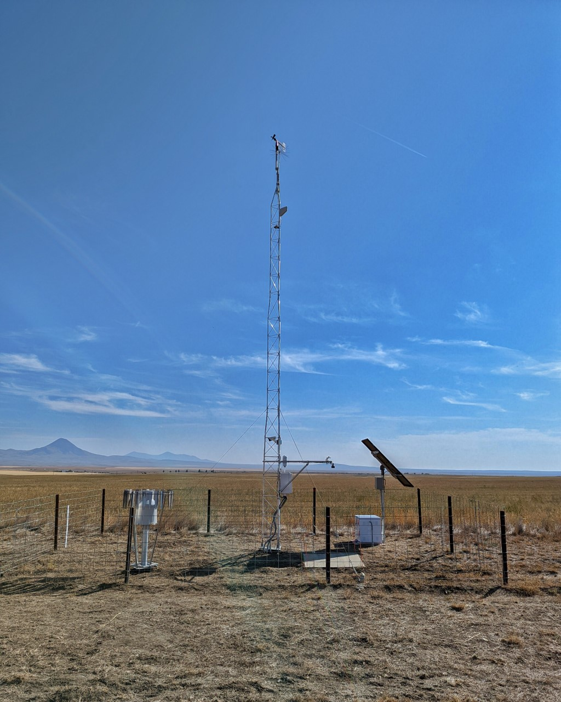
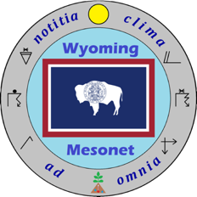
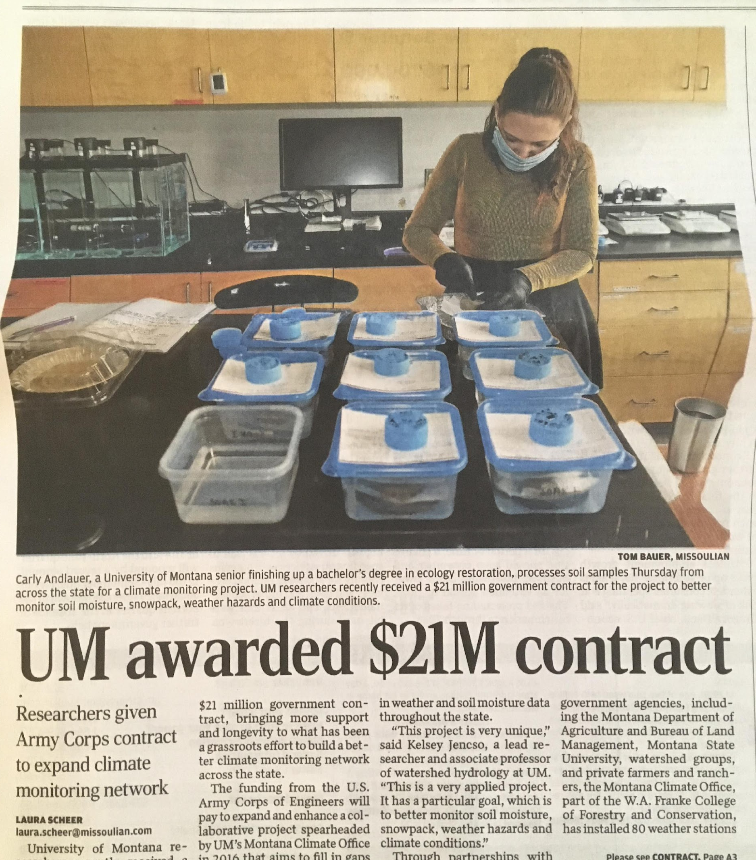
Montana Mesonet: Building the HydroMet
Climate, Drought & Change in MT
Dr. Zachary Hoylman
Montana Climate Office
NWS Partner Meeting (11/6/2024)

Slide 7
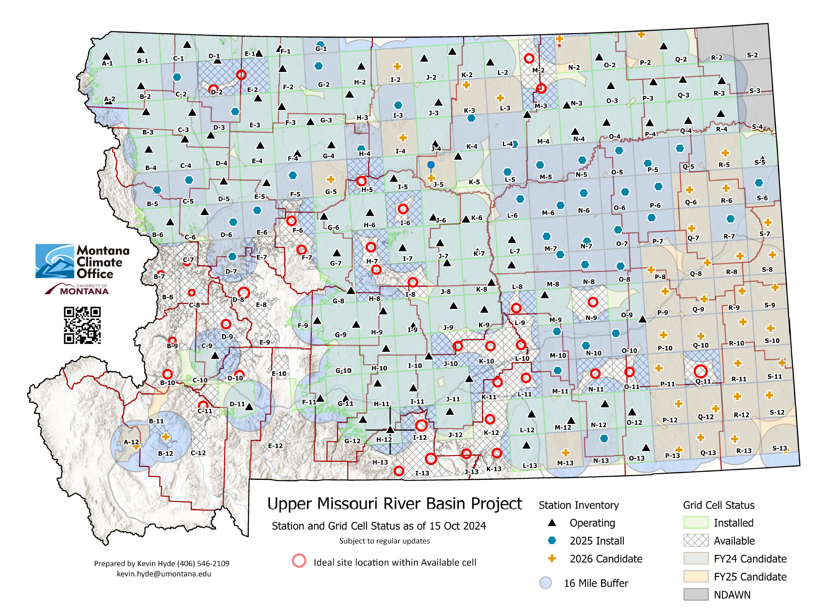
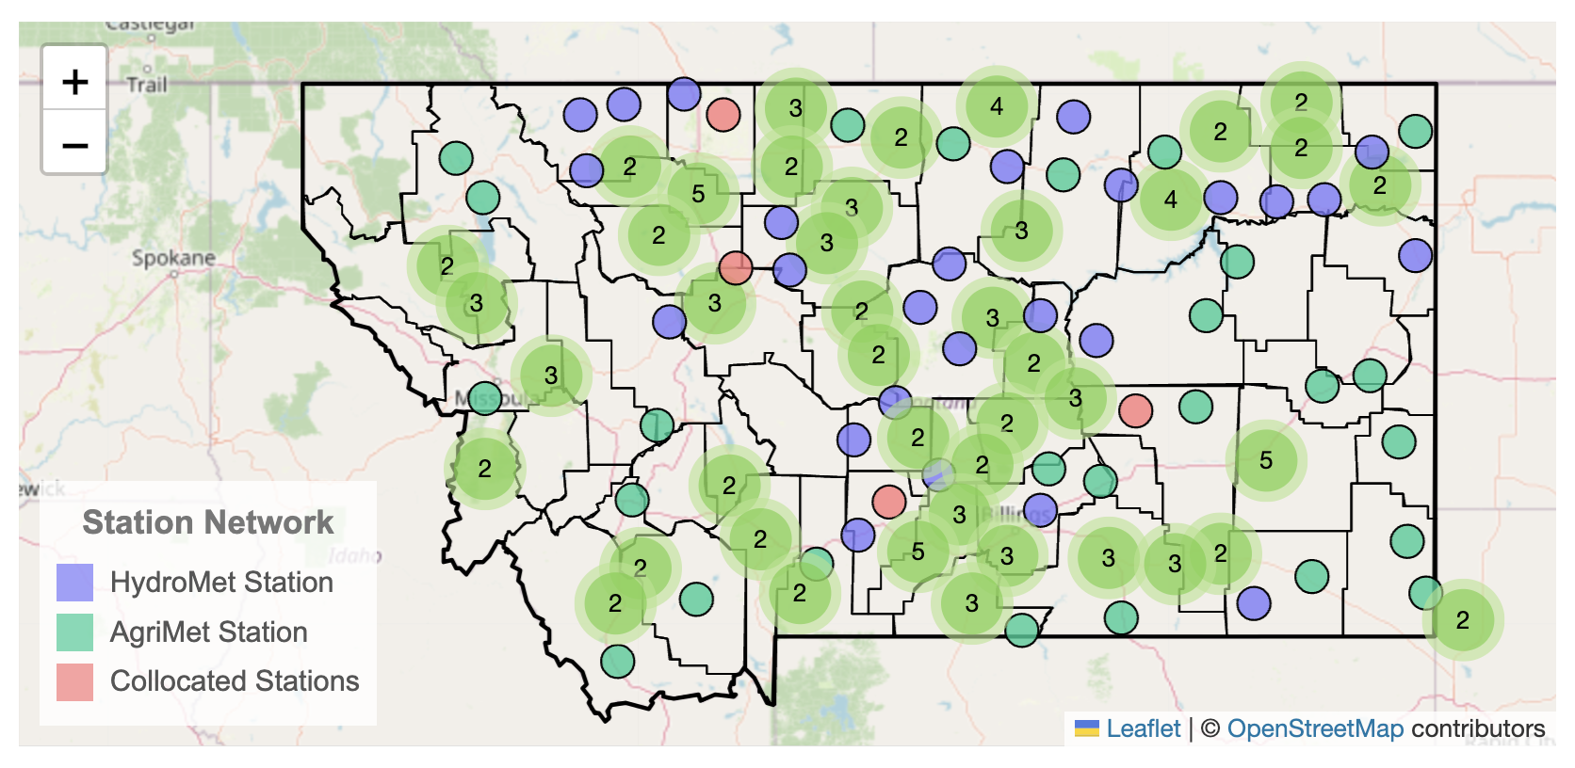
Montana Mesonet
Climate, Drought & Change in MT
Dr. Zachary Hoylman
Montana Climate Office
NWS Partner Meeting (11/6/2024)

Slide 8
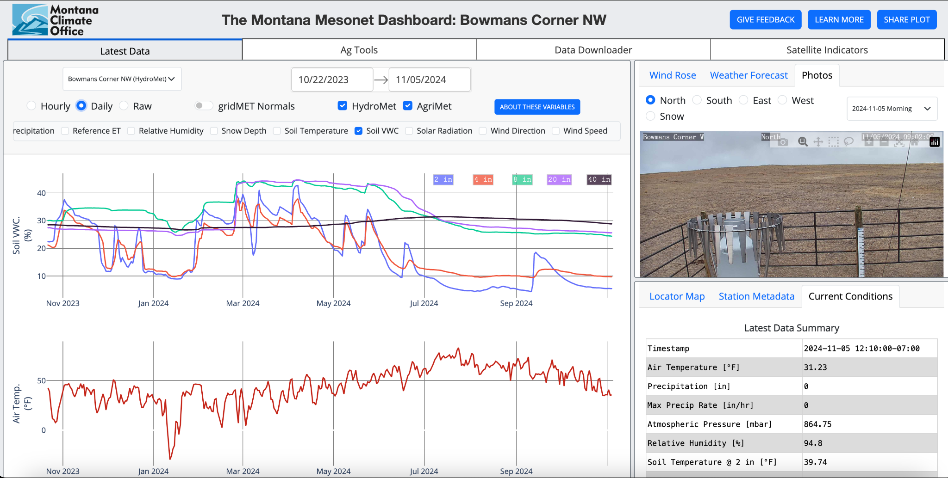
Mesonet Data at you Fingertips
https://mesonet.climate.umt.edu/dash/

Slide 9
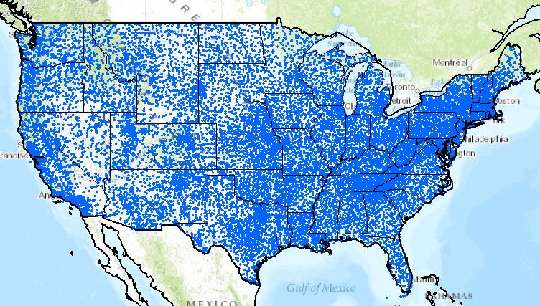
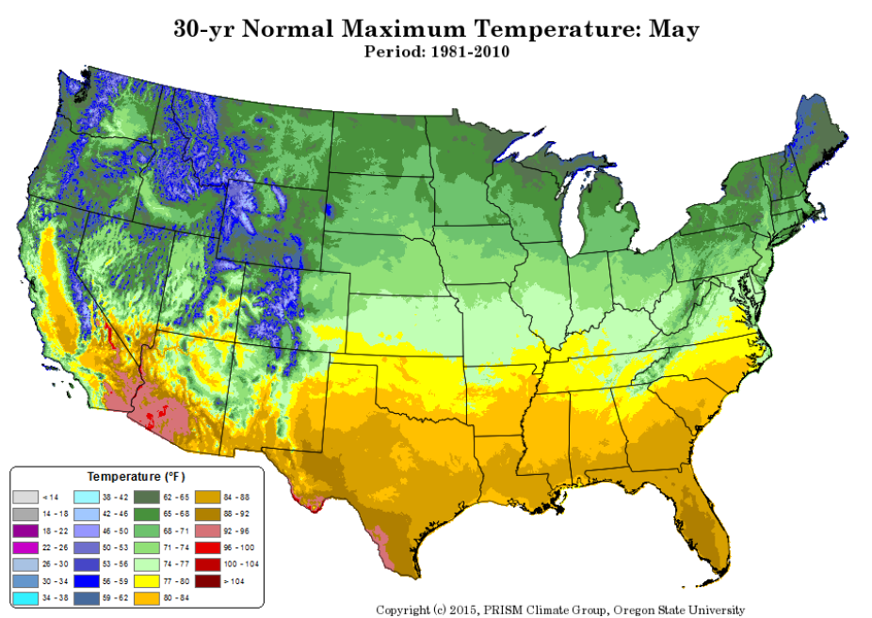
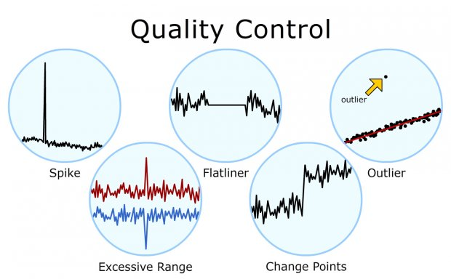
https://www.climate.gov/
Climate, Drought & Change in MT
Dr. Zachary Hoylman
Montana Climate Office
NWS Partner Meeting (11/6/2024)

Slide 10
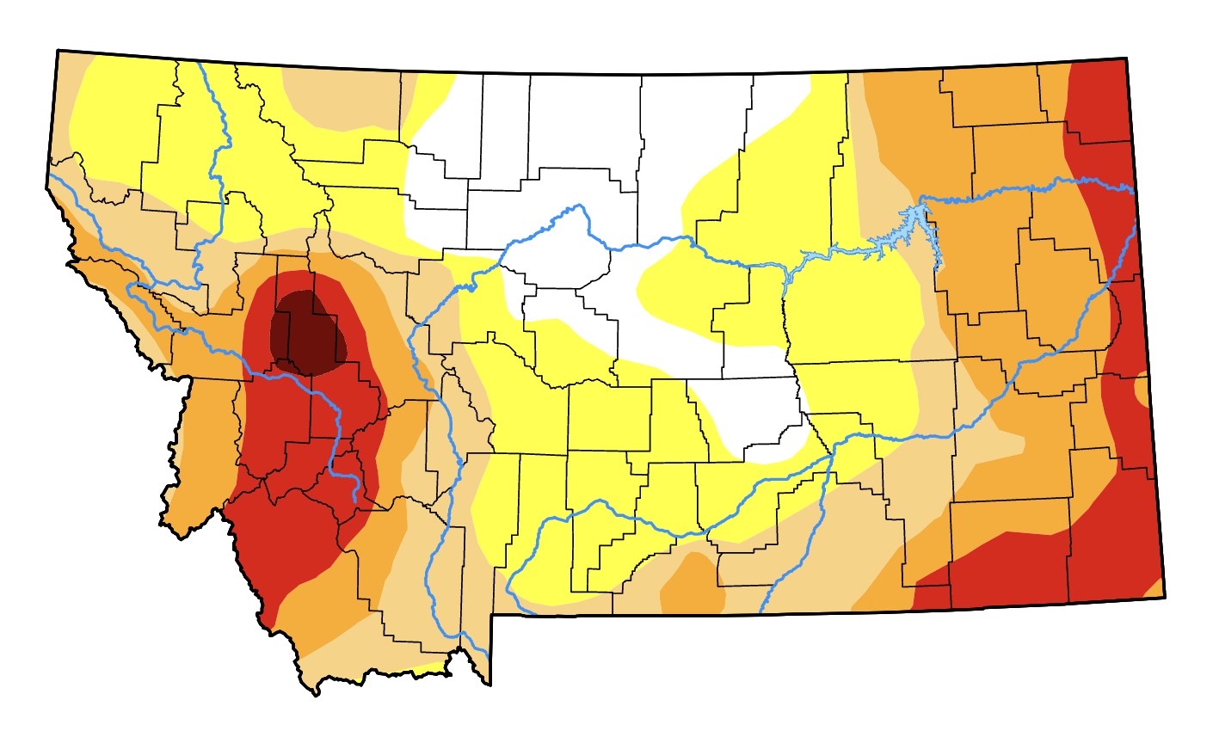
Developing Drought Informatics for Montana
?
Climate, Drought & Change in MT
Dr. Zachary Hoylman
Montana Climate Office
NWS Partner Meeting (11/6/2024)

Slide 11
Montana’s Drought Monitoring Process
Sunday & Monday Morning:
Montana author assembles proposed changes to USDM based upon analysis of station data, modelled data and impact reports –
Authorship rotates every two weeks between five volunteers: Michael Downey (DNRC), Jane Fogleman (NOAA), Troy Blanford (MSL), Zach Hoylman (MCO) and Kelsey Jencso (MCO).
Repeat this process 52 times each year
Monday Early Afternoon:
Author sends initial analysis and summary to Montana Drought Listserv for review and consensus.
Tuesday:
MT author makes changes and sends the proposed map with a justification to the National Drought Monitor author. The USDM author releases a series of 3 drafts with “back and forth” between state authors.
Wednesday:
USDM author makes final decisions, and the final national map is released Thursday morning.
It takes objective data, impact reports and a well justified argument to make our case to the USDM each week!
Notes:
Highlight that this process is new - 2017

Slide 12
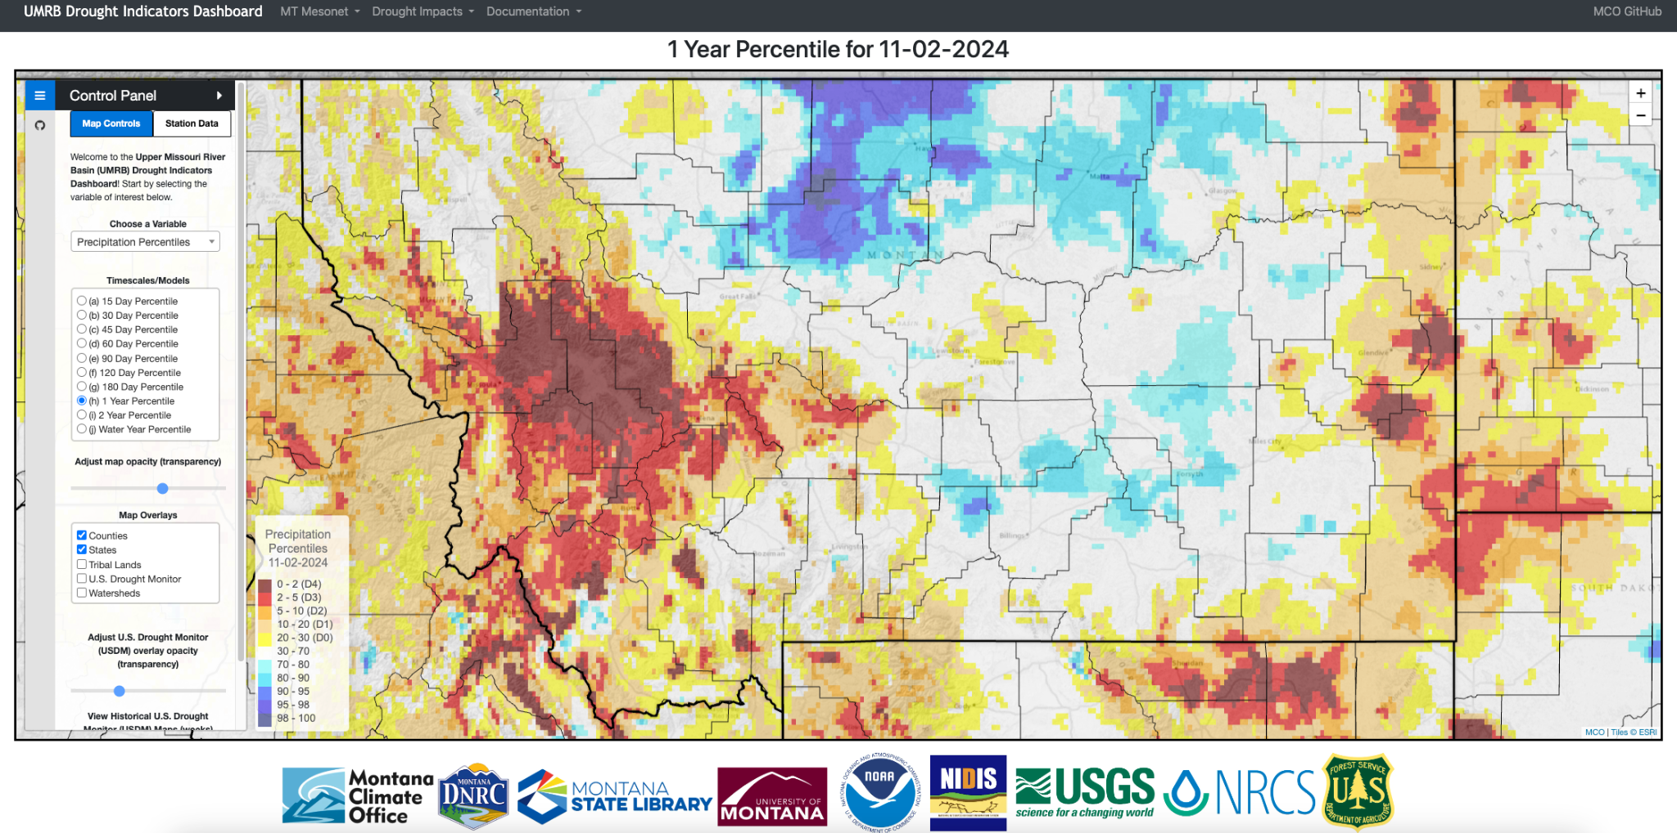
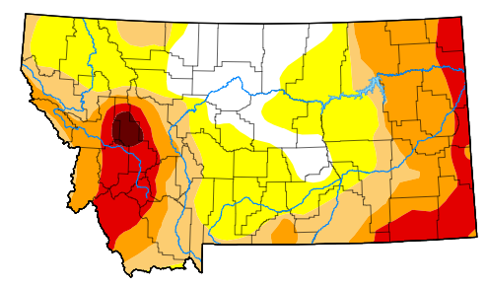
The UMRB Drought Dashboard
https://drought.climate.umt.edu/
Climate, Drought & Change in MT
Dr. Zachary Hoylman
Montana Climate Office
NWS Partner Meeting (11/6/2024)

Slide 13
The UMRB Drought Dashboard
Data, data & more data!
Daily drought metric calculations (abnormality)
Percentiles/Anomaly (temperature, precipitation, PET - P)
Soil Moisture Models
Snow (SNOTEL & SNODAS)
Streamflow (USGS/AI)
MT Mesonet
TIMESCALES!
Climate, Drought & Change in MT
Dr. Zachary Hoylman
Montana Climate Office
NWS Partner Meeting (11/6/2024)

Slide 14
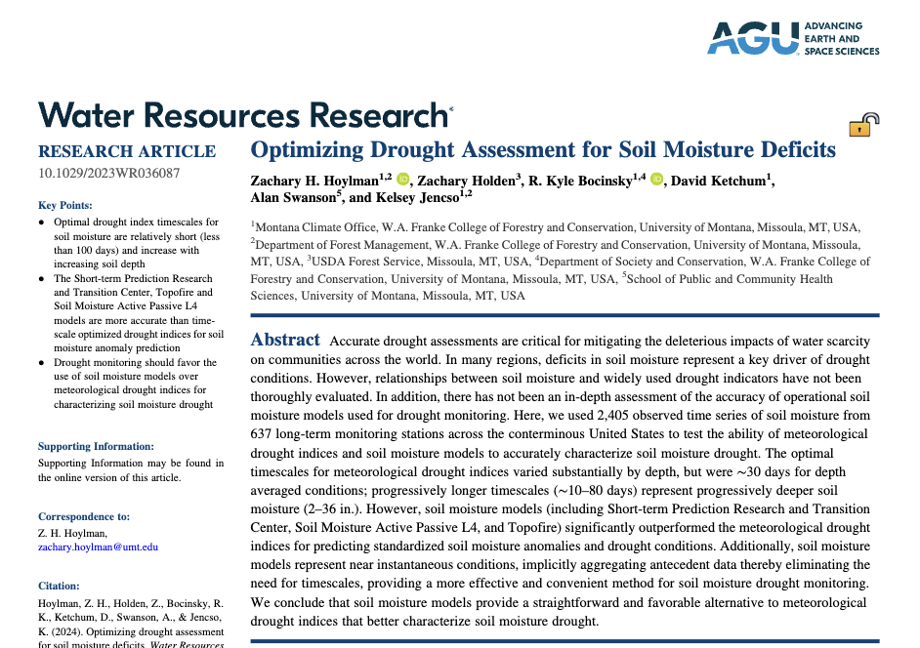
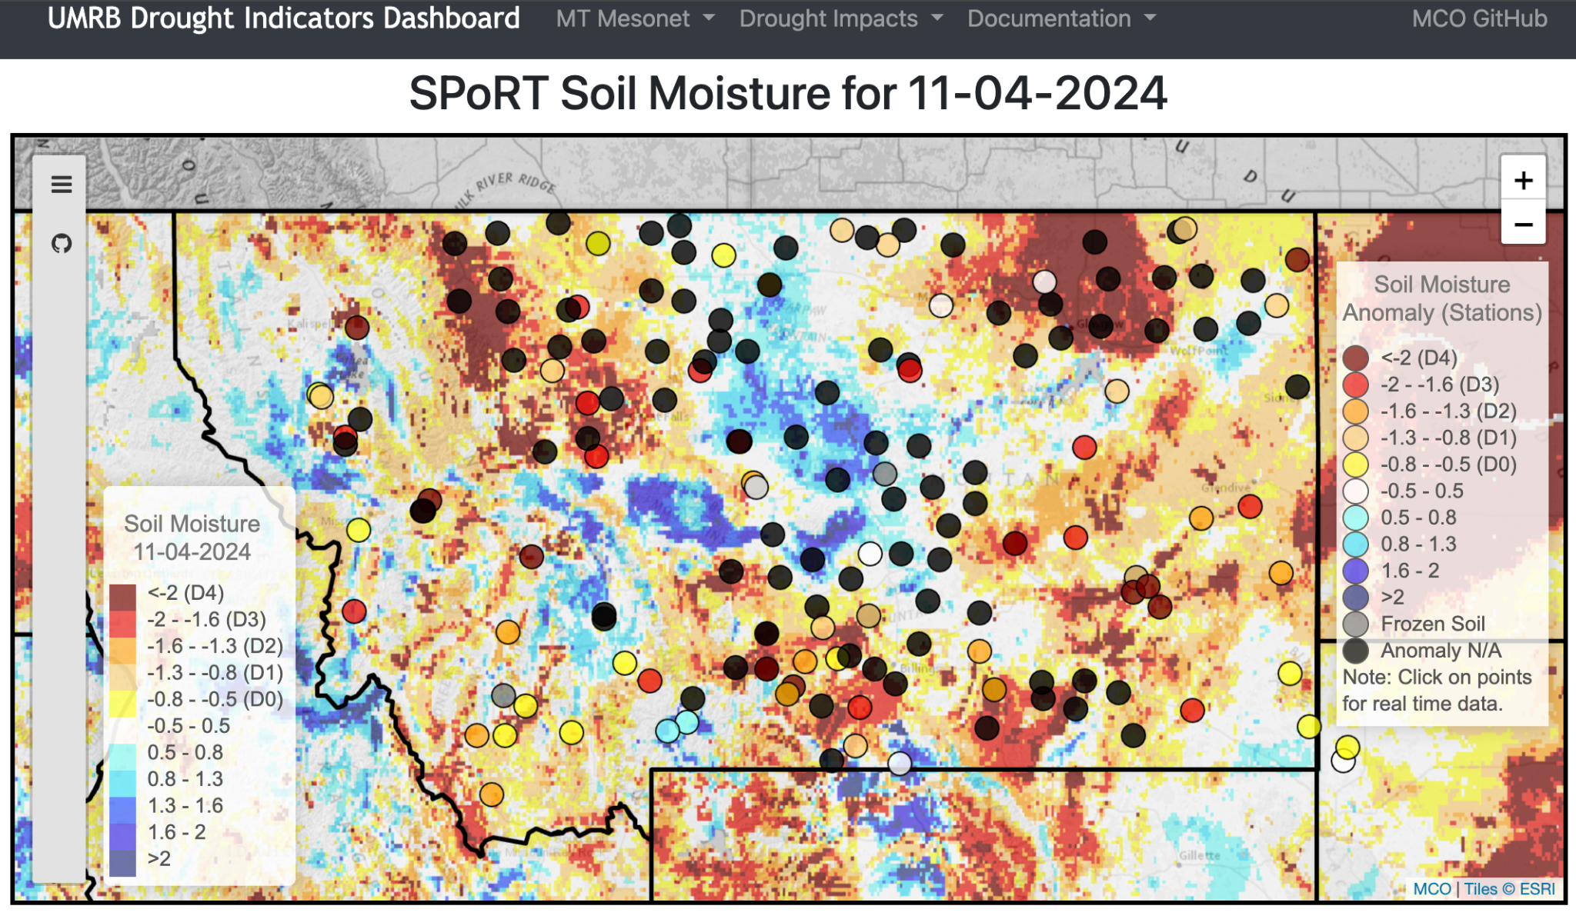
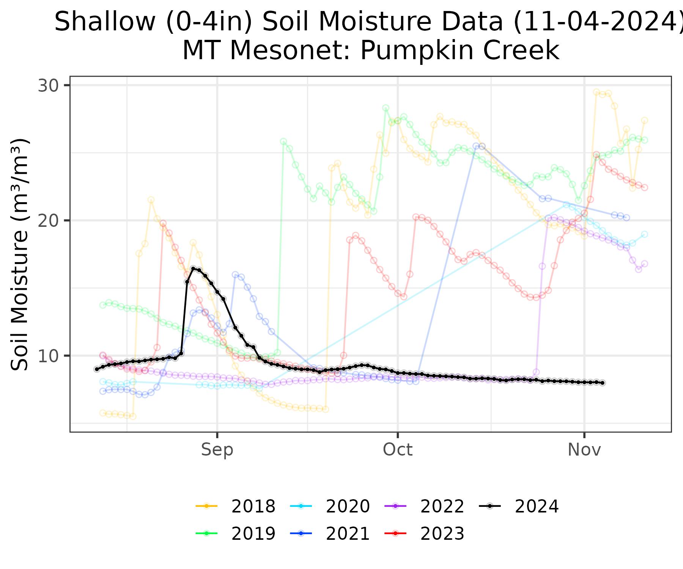
Soil Moisture in the UMRB
Mesonet <|> Models
Climate, Drought & Change in MT
Dr. Zachary Hoylman
Montana Climate Office
NWS Partner Meeting (11/6/2024)

Slide 15
Advancing Monitoring with AI
Non-Linear Transform
Memory Cell
Non-Linear Transform
Dropout
Memory Cell
Input Sequence
Lots of other nerdy stuff - Hyperparams
Transformations and context vector generation (encoder)
Context vector decoding and transformations
Climate, Drought & Change in MT
Dr. Zachary Hoylman
Montana Climate Office
NWS Partner Meeting (11/6/2024)

Slide 16
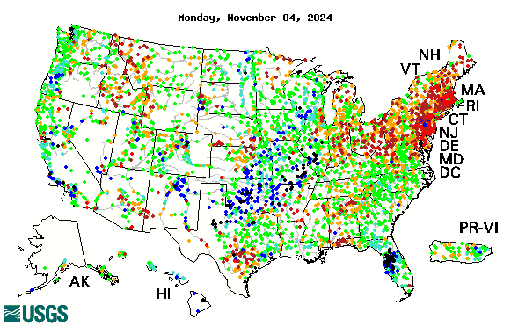
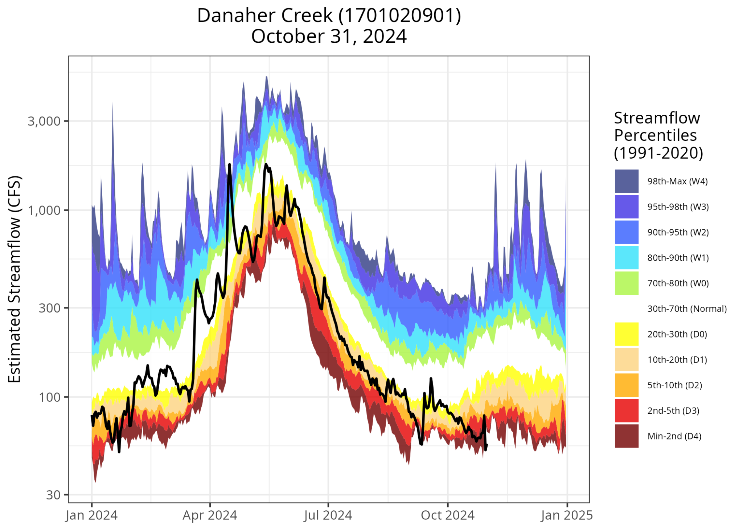
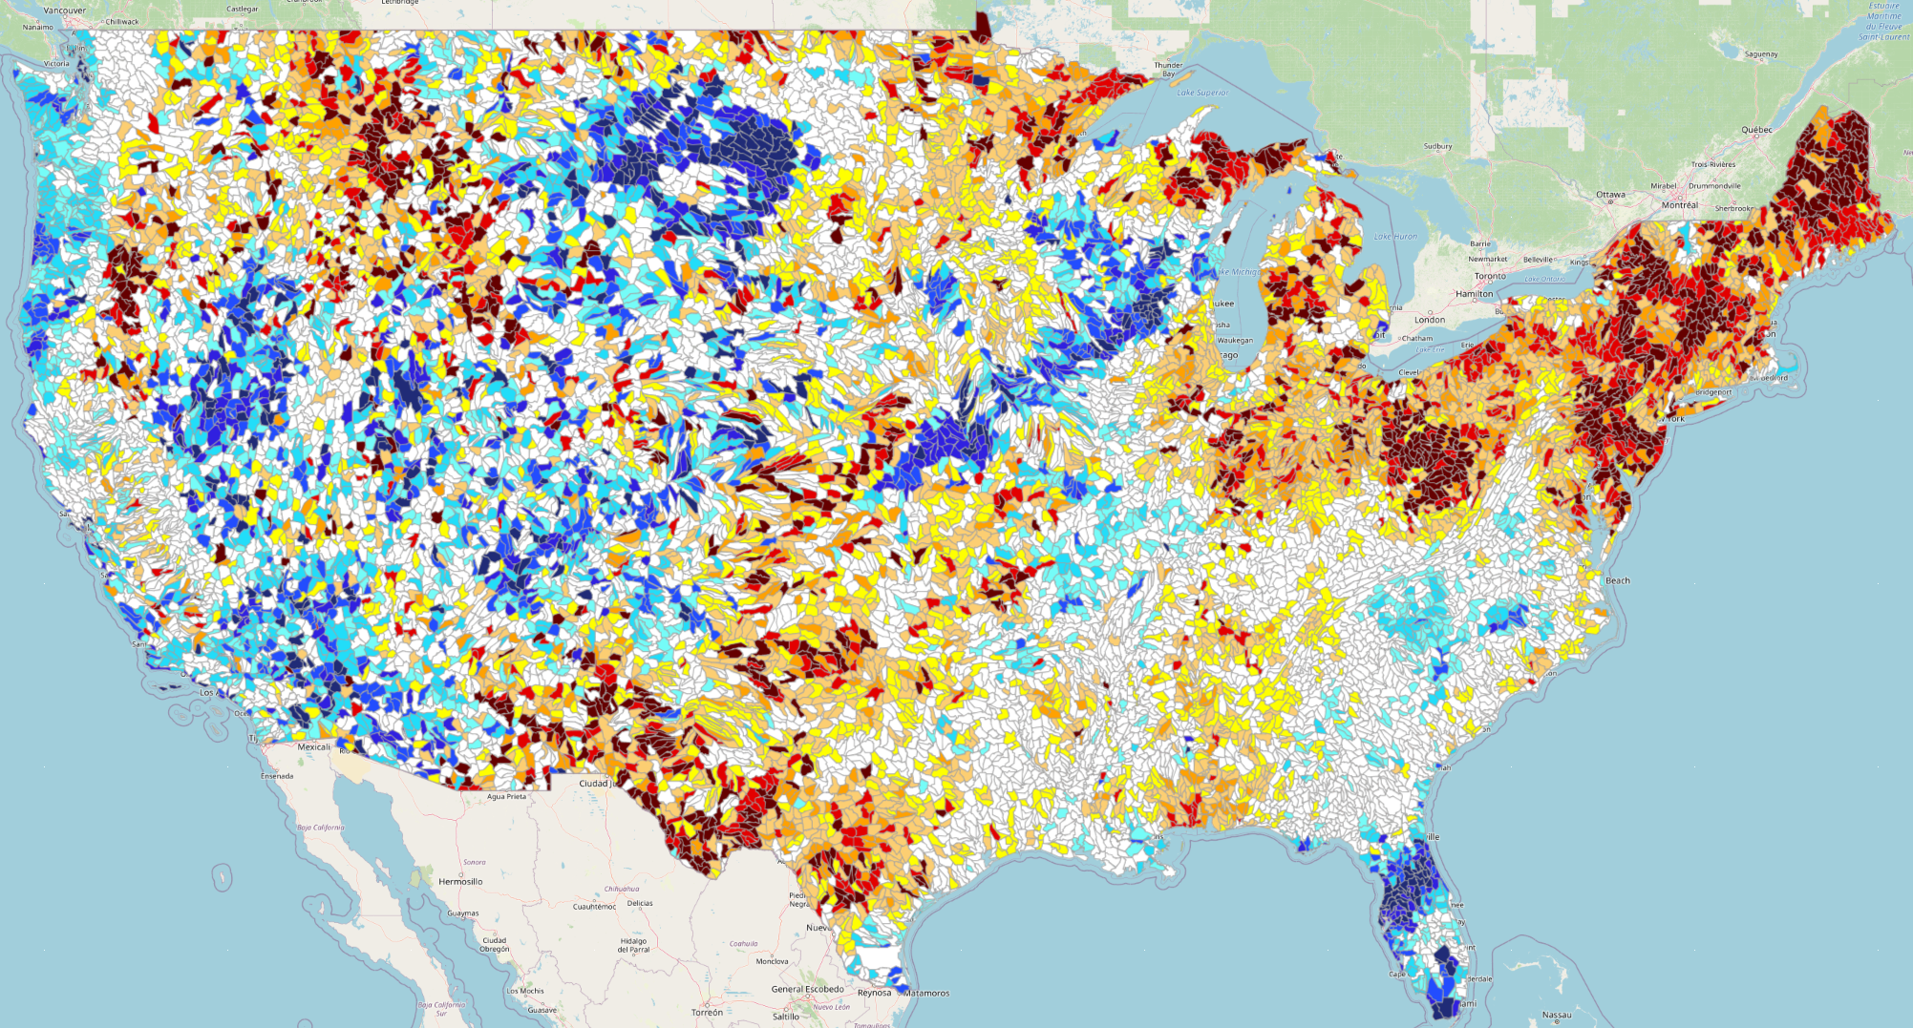
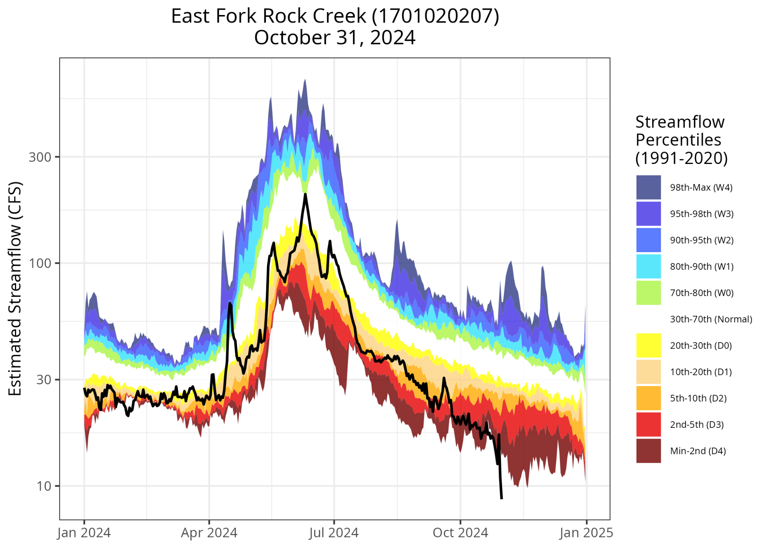
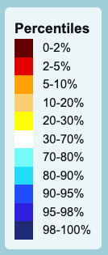
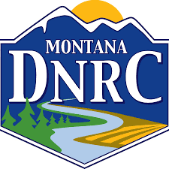
Real-Time Streamflow Percentiles in Ungaged Basins
Using AI & Deep Learning
Climate, Drought & Change in MT
Dr. Zachary Hoylman
Montana Climate Office
NWS Partner Meeting (11/6/2024)

Slide 17
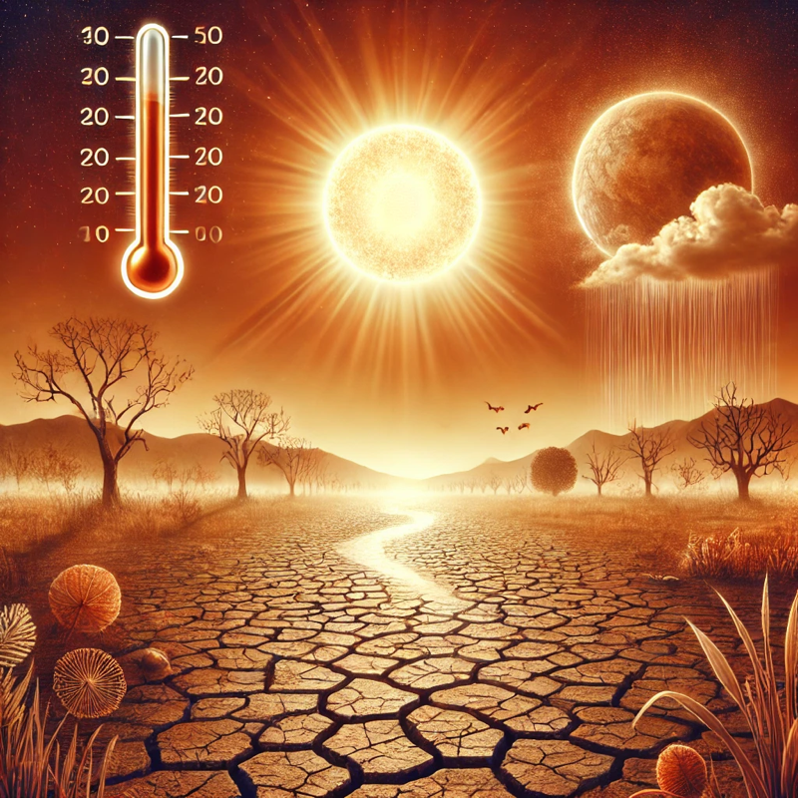
Assessing Change and Promoting Future-Minded Drought Assessments
ChatGPT: Drought and Climate Change

Slide 18
Forms of Climate Non-stationarity – 60 Years Idealized…
Trend in Variance Amplitude
Seasonal Signal (Stationary)
Linear Trend (Aridification)
Linear & Variance Amplitude Trend
Considering Non-stationarity in Drought Assessment
Dr. Zachary Hoylman
Montana Climate Office
NADM Forum 2024 – Victoria, BC (5/15/2024)

Slide 19
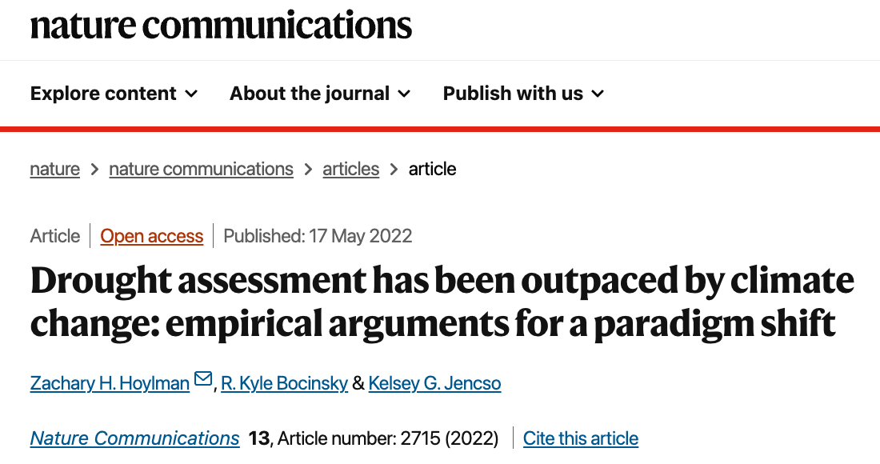
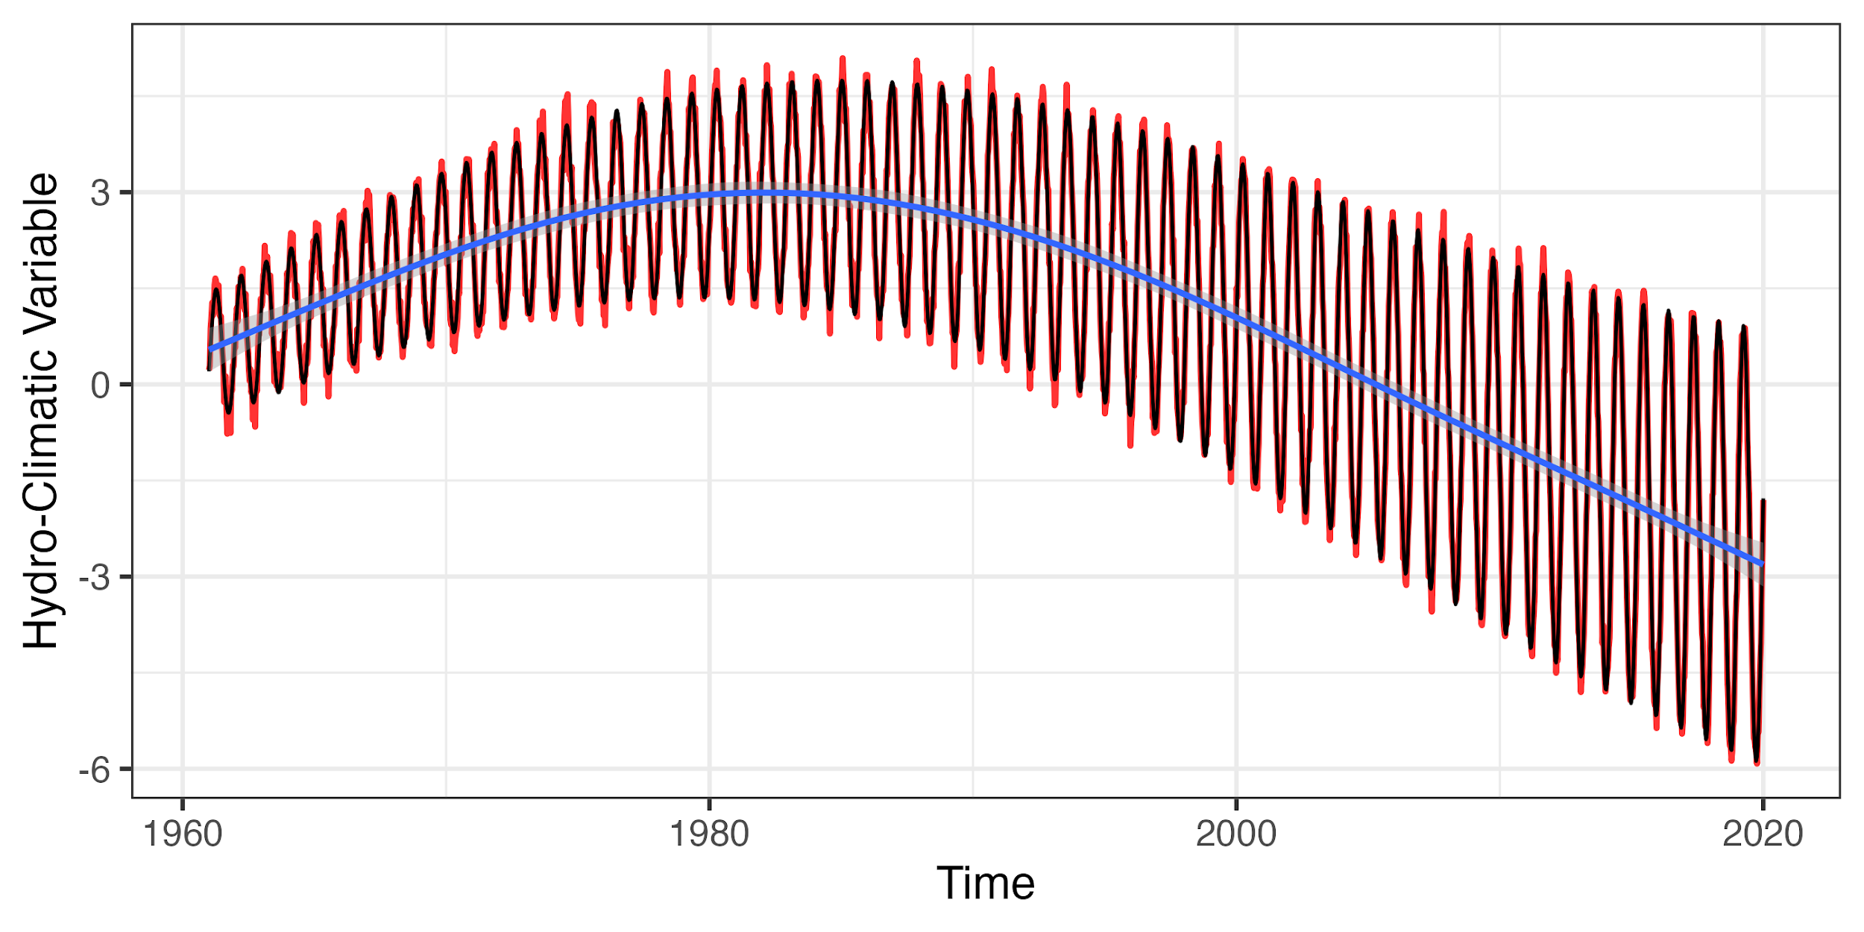
Non-stationarity is Complicated in Natural Systems
1991 - 2020
1925 - 2020
Conditions are perceived progressively drier over time
drier
So how does non-stationarity impact our assessment of ”contemporary” conditions?
Considering Non-stationarity in Drought Assessment
Dr. Zachary Hoylman
Montana Climate Office
NADM Forum 2024 – Victoria, BC (5/15/2024)

Slide 20
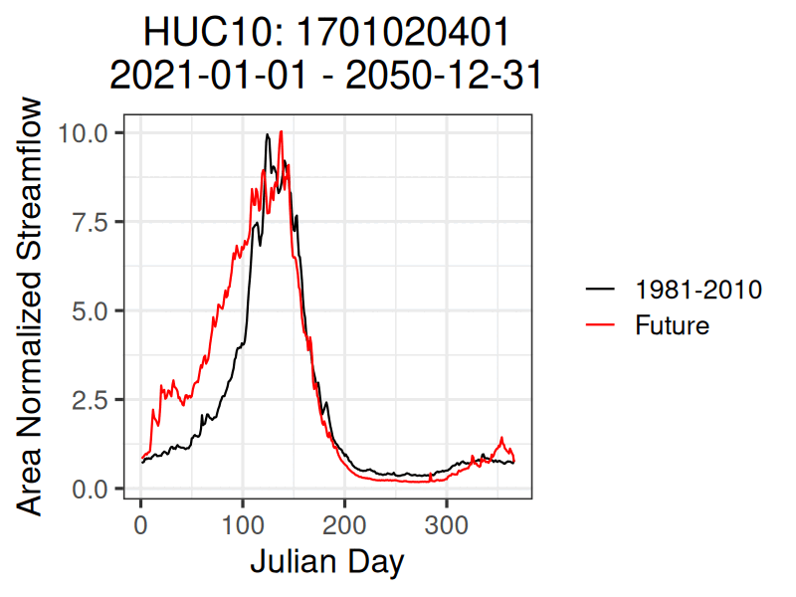
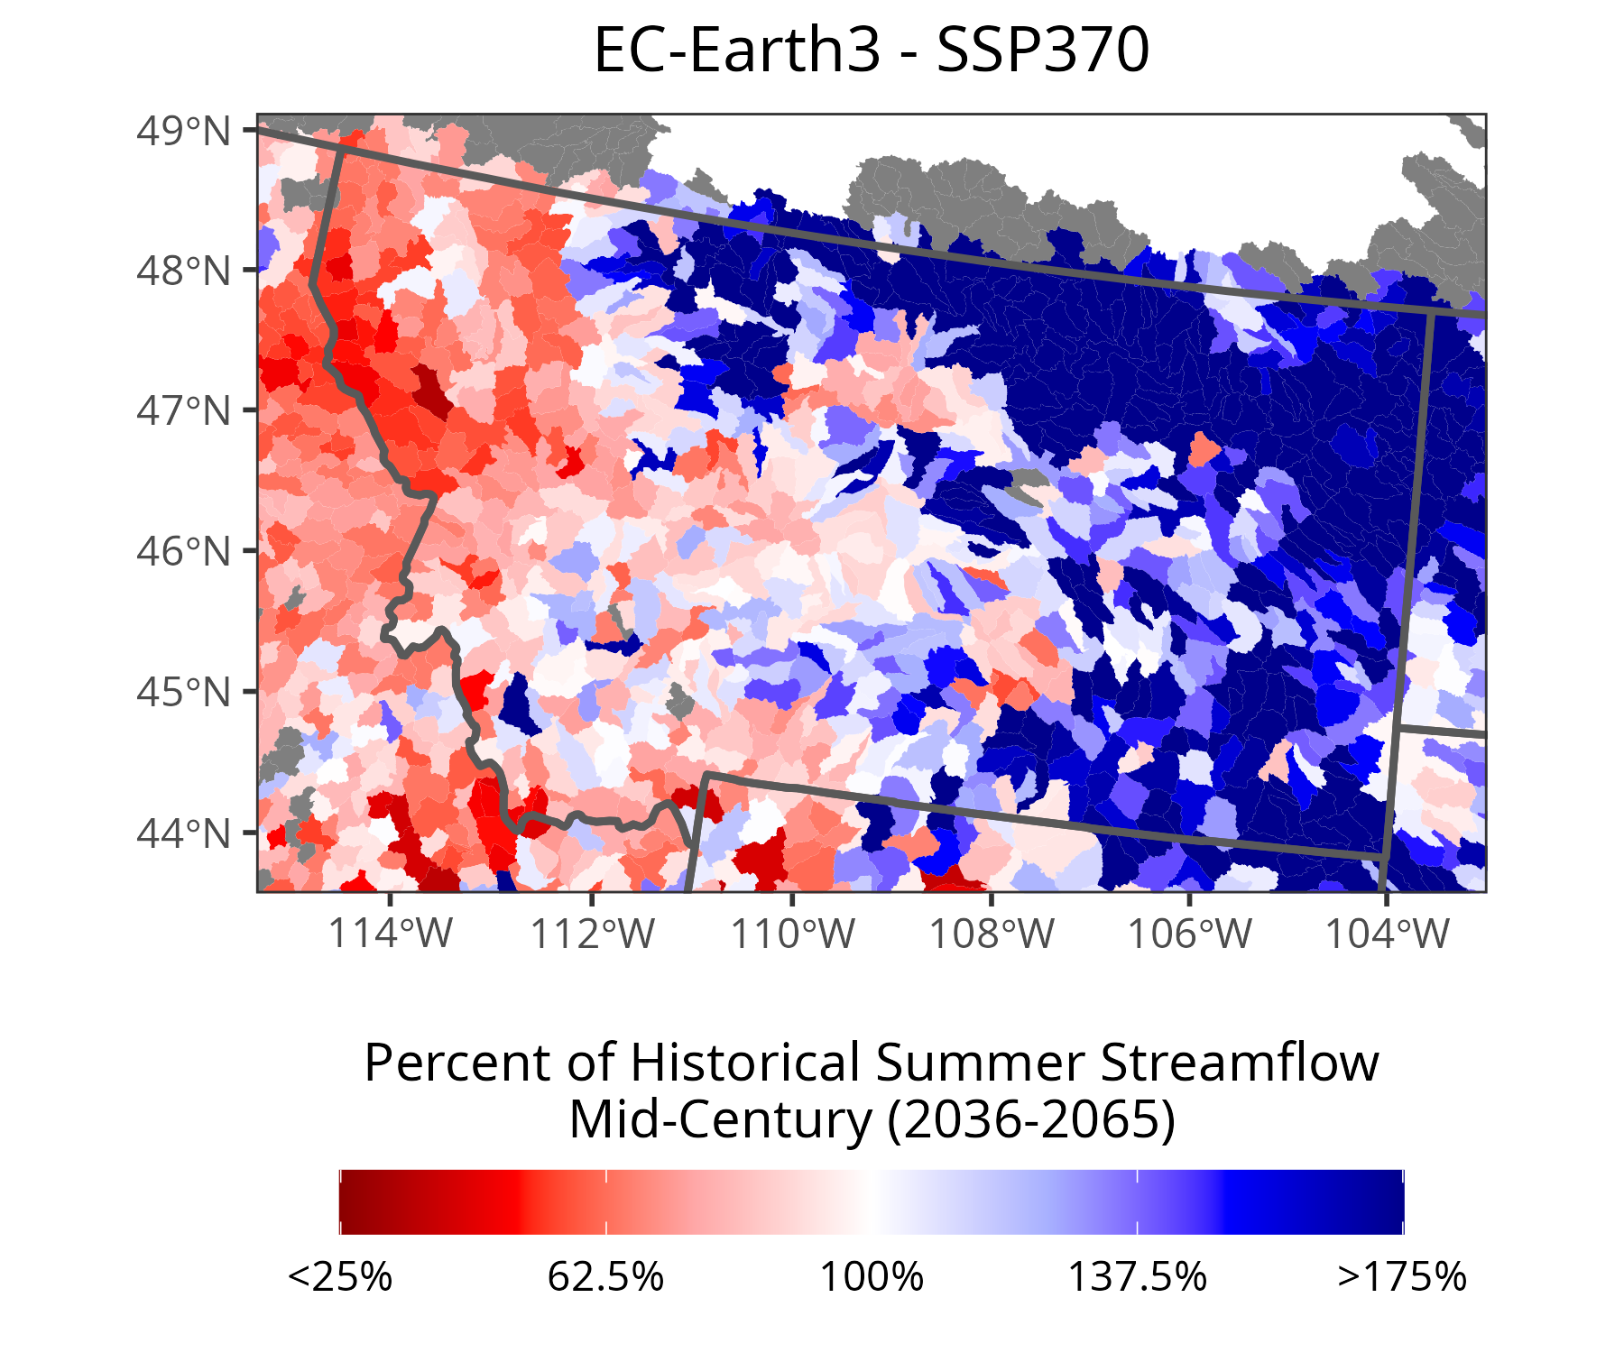
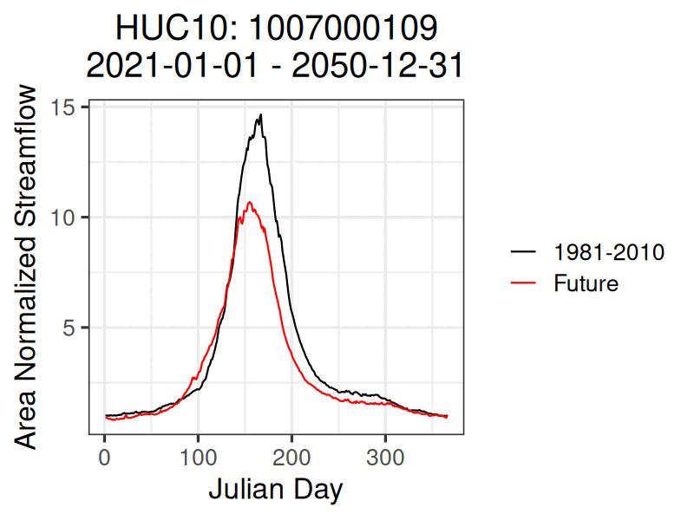
Non-stationarity in Surface Water: Appling Future Climate to Streamflow AI
Future Streamflow Across the U.S.
Dr. Zachary Hoylman
Montana Climate Office
UM Geosciences Seminar (10/21/2024)

Slide 21
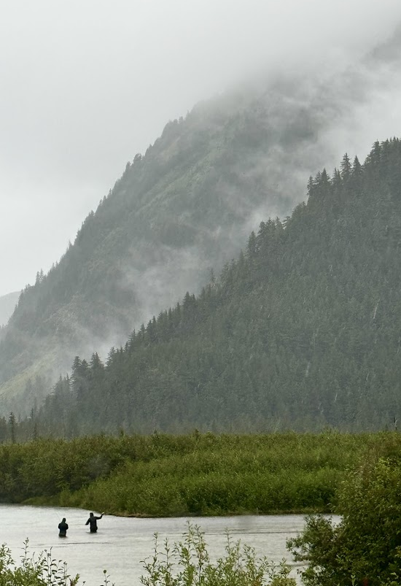
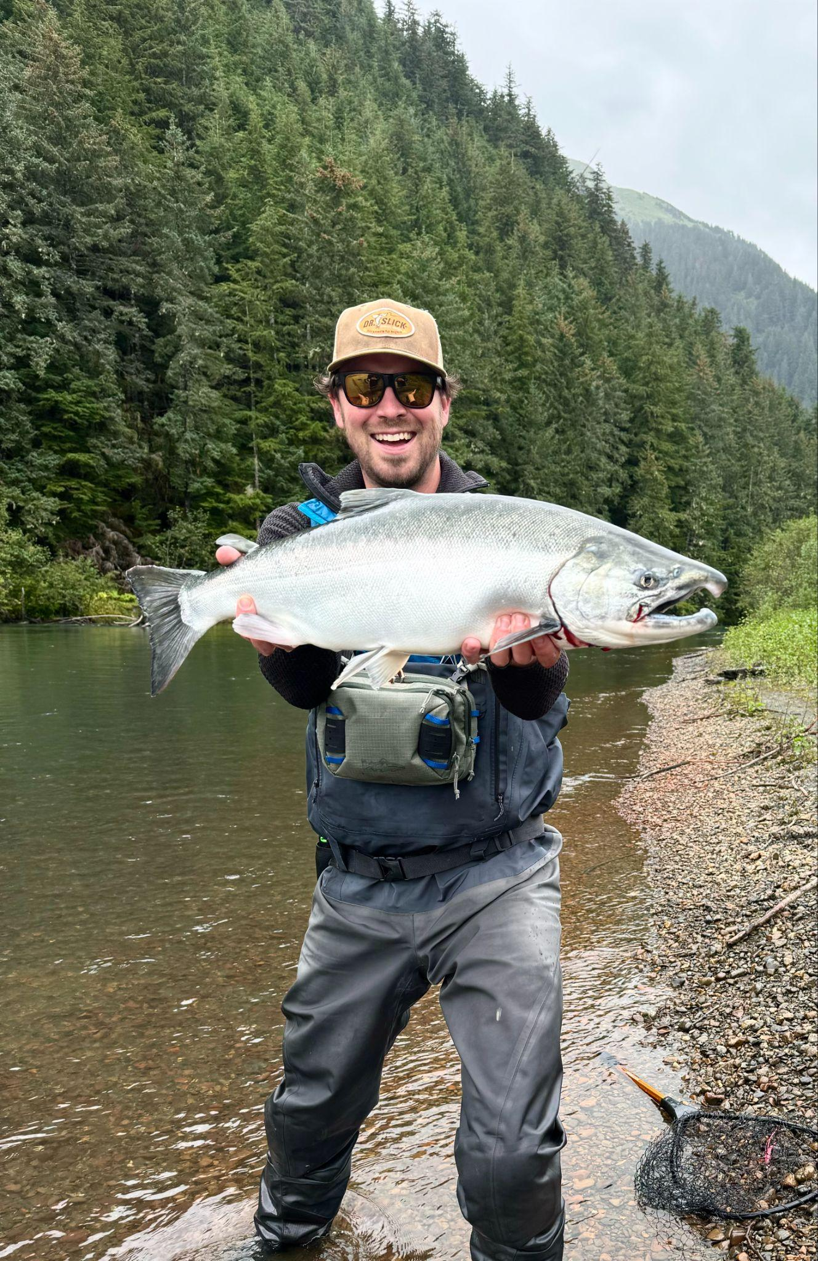
Questions?
zachary.hoylman@umontana.edu
Web Resources:
MCO Web Page: https://climate.umt.edu/
Climate Data Explorer: https://mco.cfc.umt.edu/datasets/
Drought Dashboard: https://drought.climate.umt.edu/
Montana Mesonet: https://climate.umt.edu/mesonet/

