Slide 1

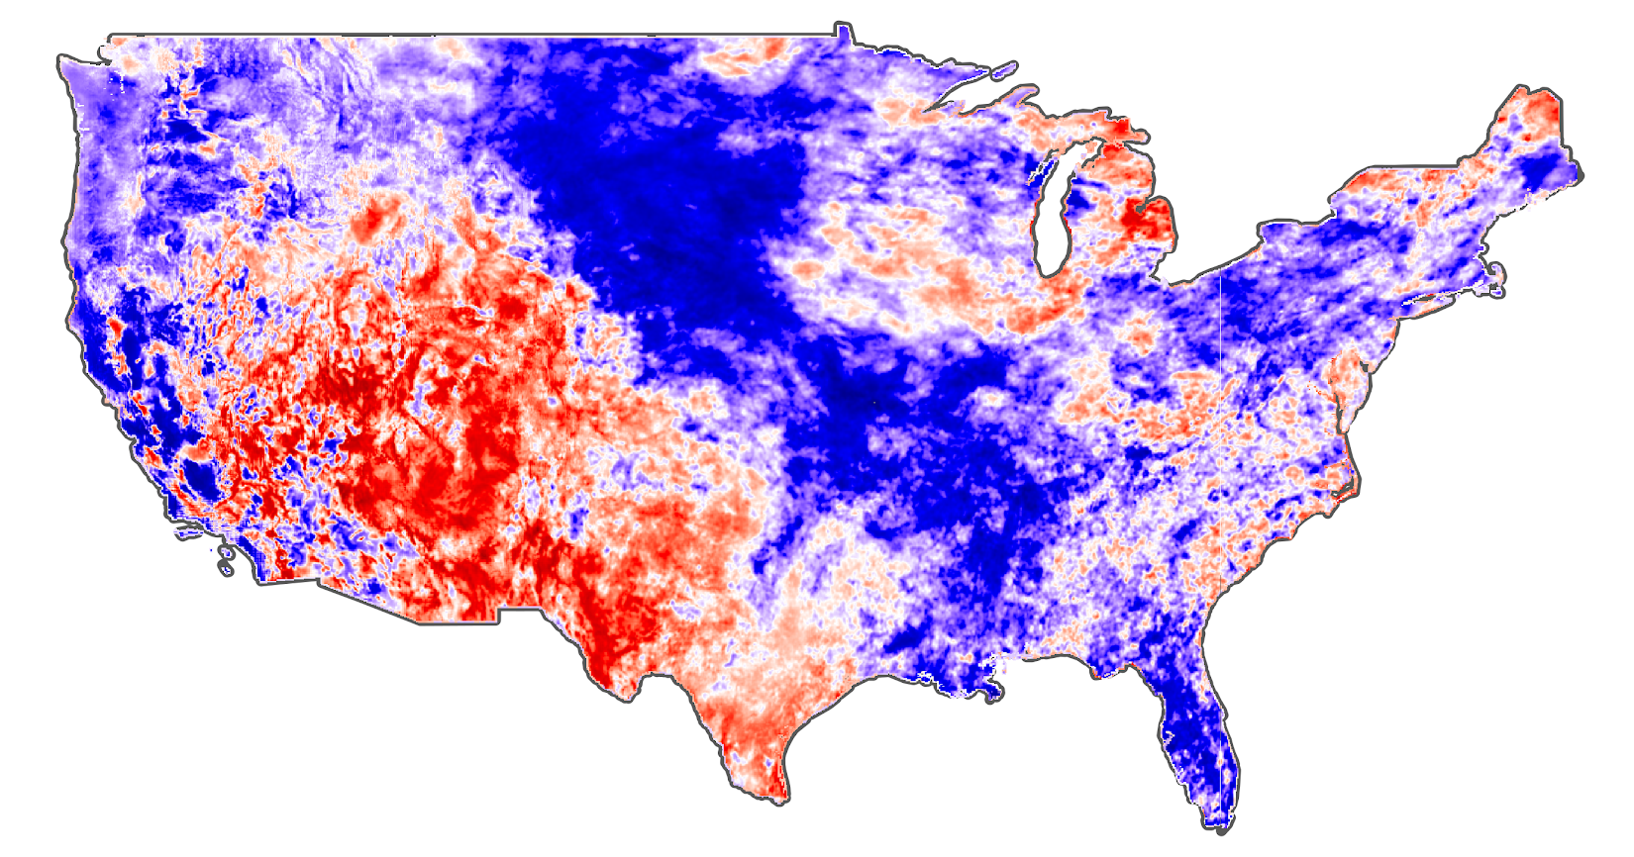



Considering Non-stationarity in Drought Assessment
Dr. Zachary Hoylman
Montana Climate Office
University of Montana
Considering Non-stationarity in Drought Assessment
Dr. Zachary Hoylman
Montana Climate Office
NADM Forum 2024 – Victoria, BC (5/15/2024)

Slide 2

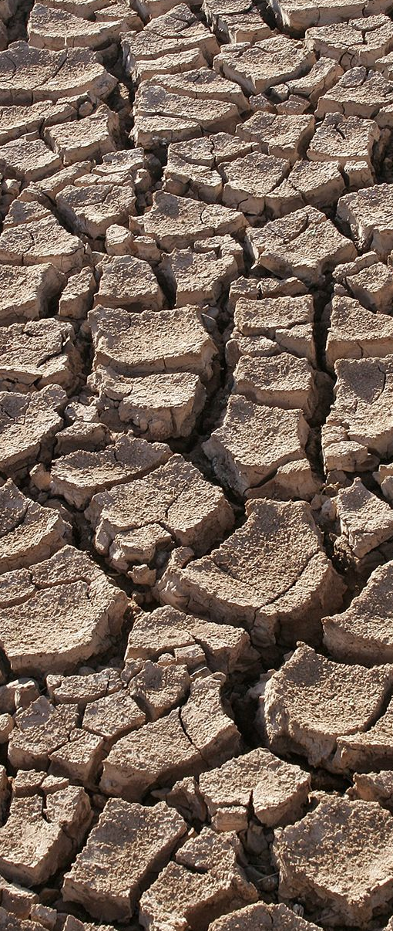
Drought methods do not commonly account for non-stationarity
Drought is abnormal dryness — it is a relative, temporary, and cyclic phenomena
“Climate normals” use 30-year reference periods (e.g. 1991–2020), but conventional drought assessment often uses long climate records to define drought (e.g. century-scale, 1895–present) - We do use short PORs in some cases
Drought assessment triggers aid that is meant for short term relief, but aridification is leading to more frequent drought declarations (non-stationarity)
The changing character of drought requires adjustments to monitoring, relief, and adaptation programs.
Considering Non-stationarity in Drought Assessment
Dr. Zachary Hoylman
Montana Climate Office
NADM Forum 2024 – Victoria, BC (5/15/2024)

Slide 3
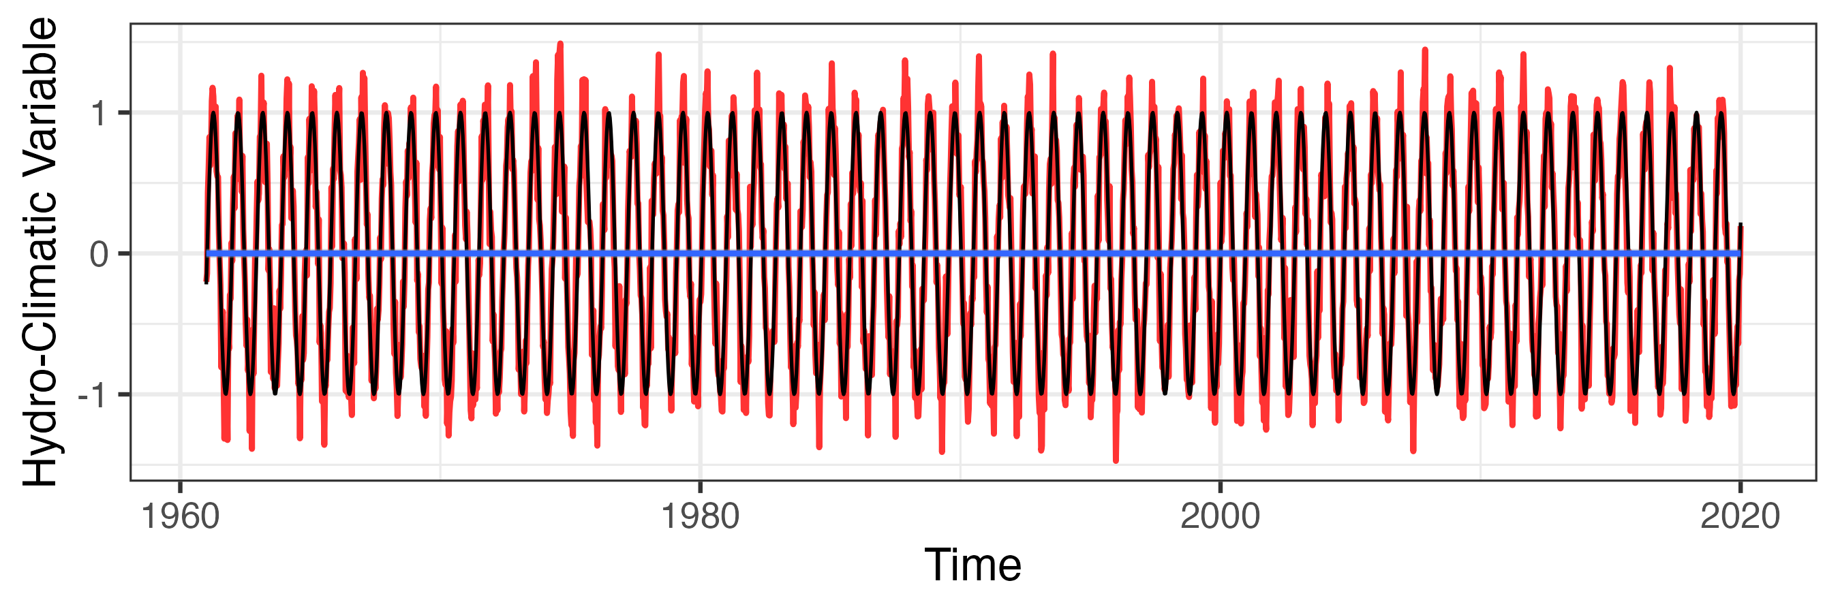
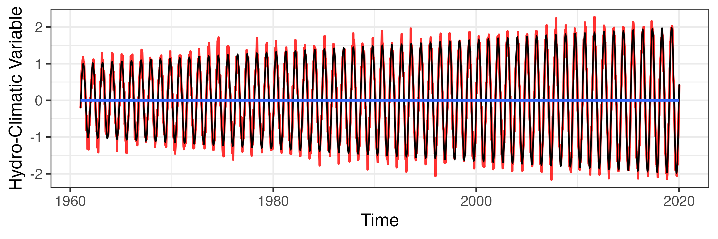
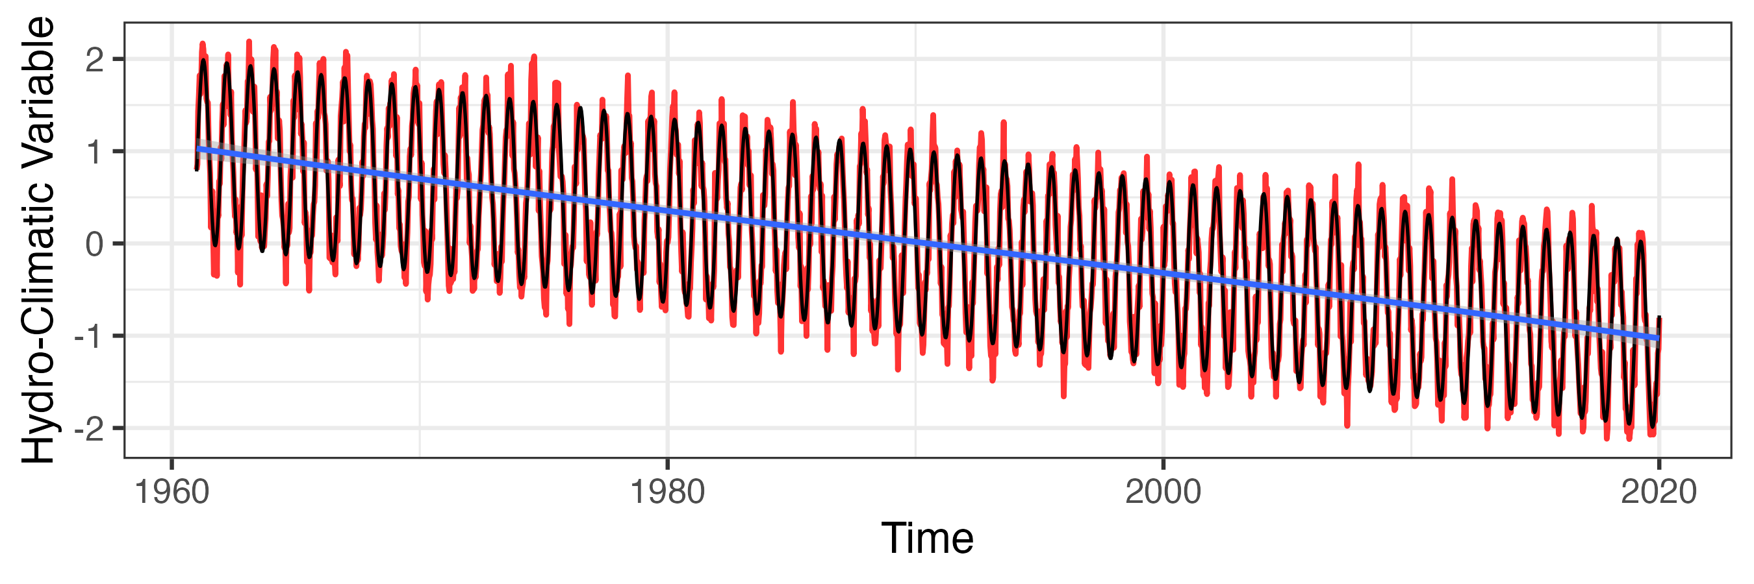
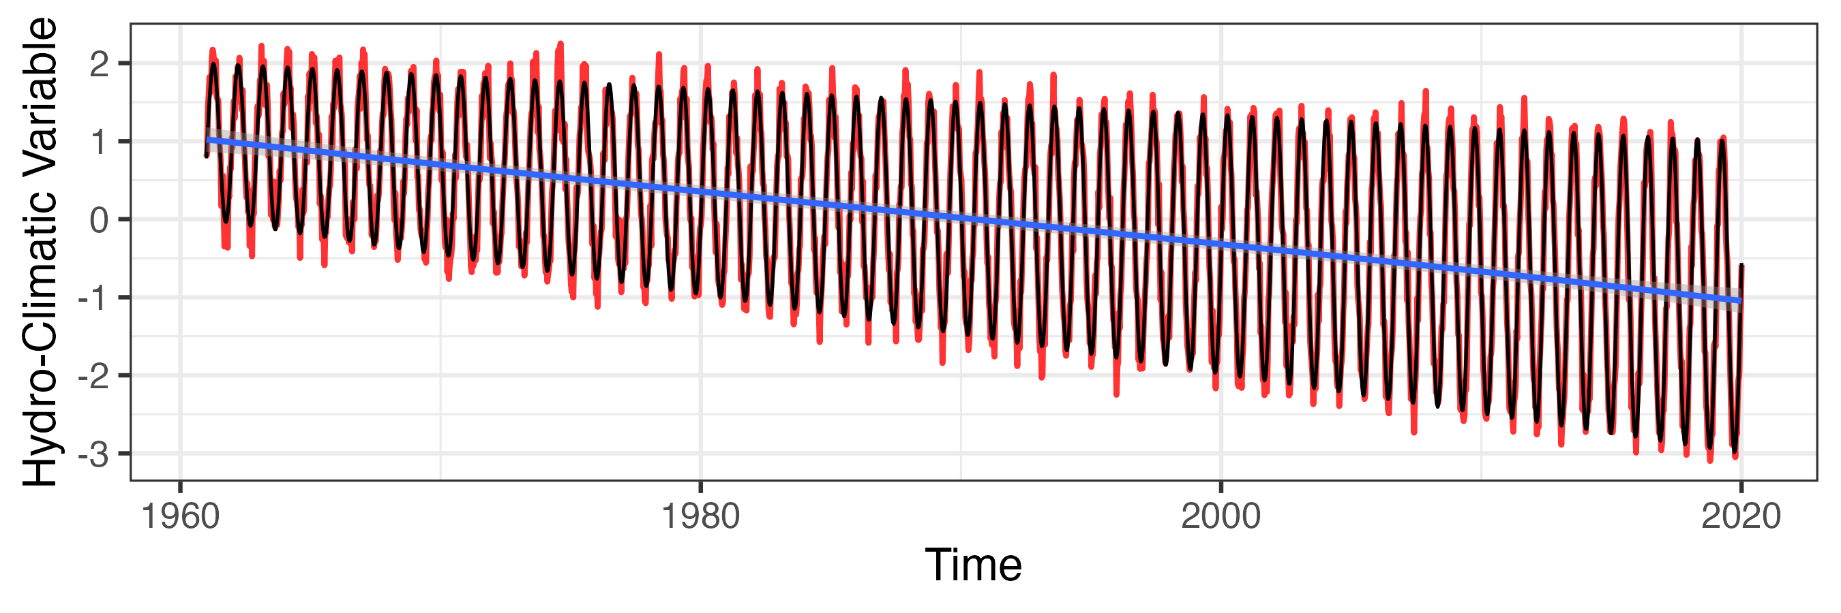
Forms of Climate Non-stationarity – 60 Years Idealized…
Trend in Variance Amplitude
Seasonal Signal (Stationary)
Linear Trend (Aridification)
Linear & Variance Amplitude Trend
Considering Non-stationarity in Drought Assessment
Dr. Zachary Hoylman
Montana Climate Office
NADM Forum 2024 – Victoria, BC (5/15/2024)

Slide 4
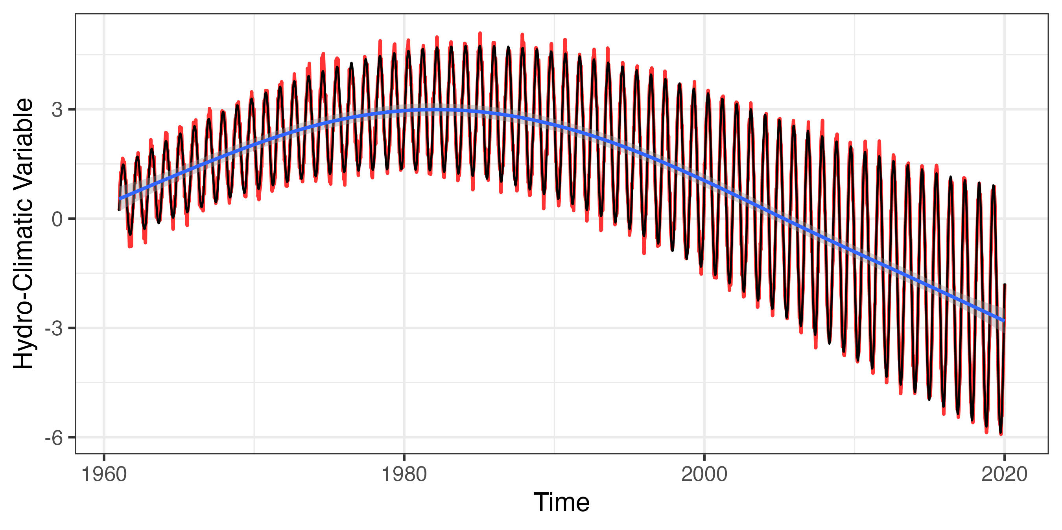
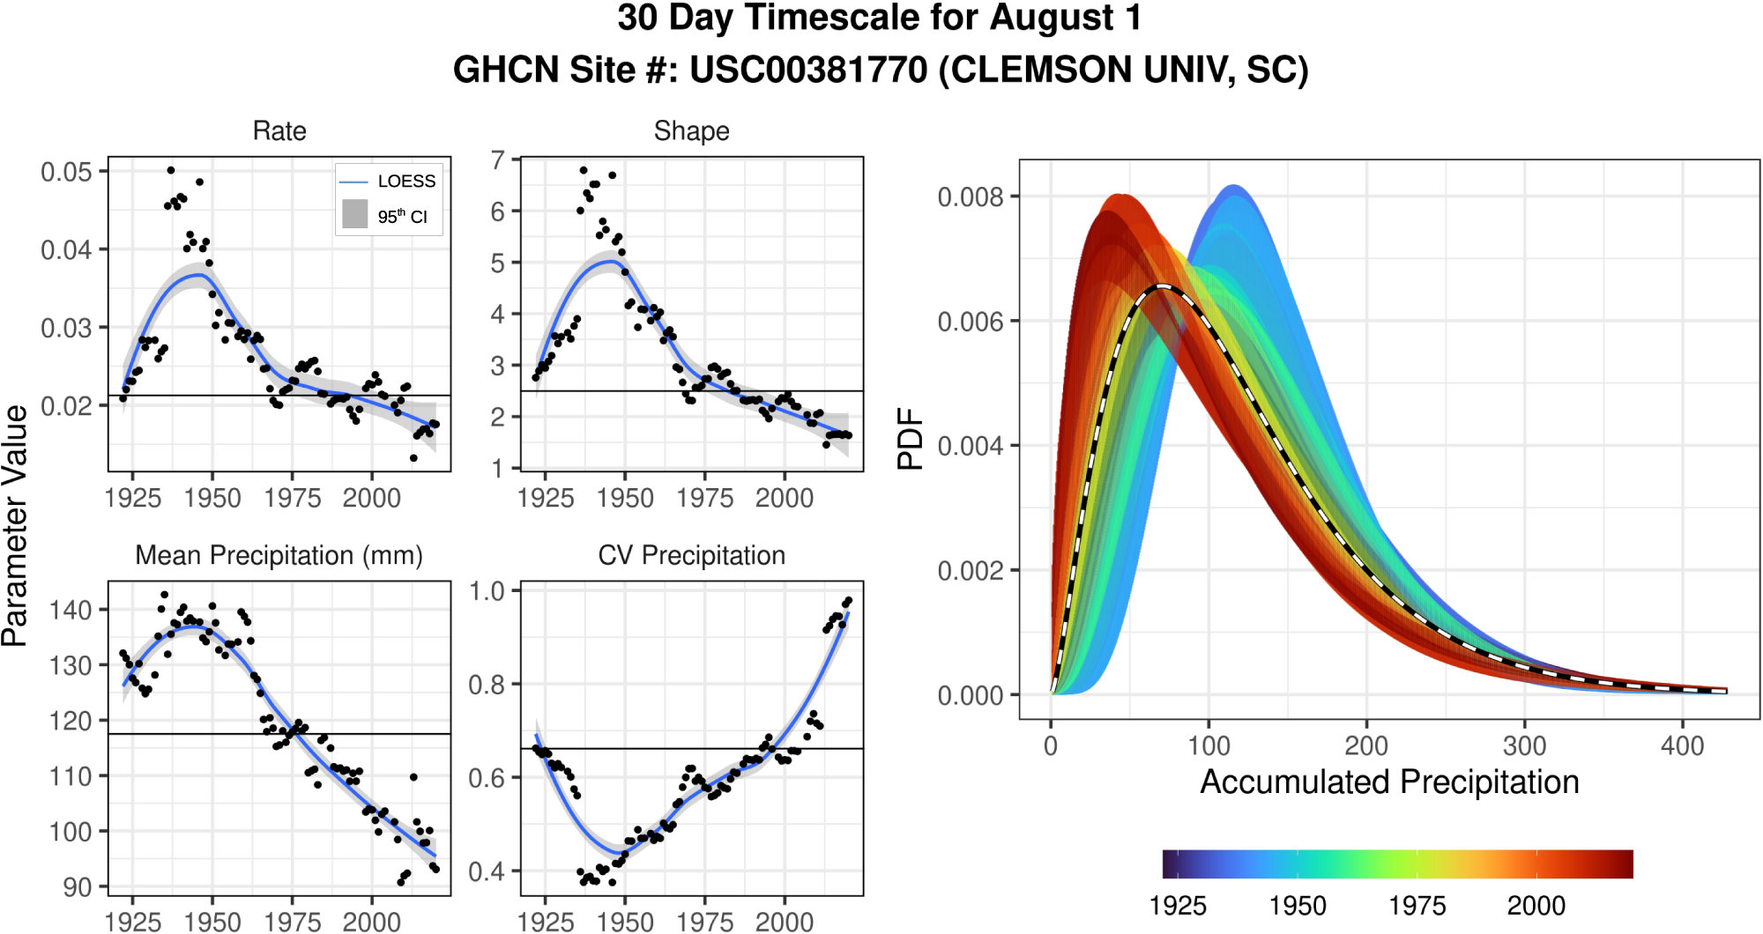
Non-stationarity is Complicated in Natural Systems
1991 - 2020
1925 - 2020
Conditions are perceived progressively drier over time
drier
So how does non-stationarity impact our assessment of ”contemporary” conditions?
Considering Non-stationarity in Drought Assessment
Dr. Zachary Hoylman
Montana Climate Office
NADM Forum 2024 – Victoria, BC (5/15/2024)

Slide 5
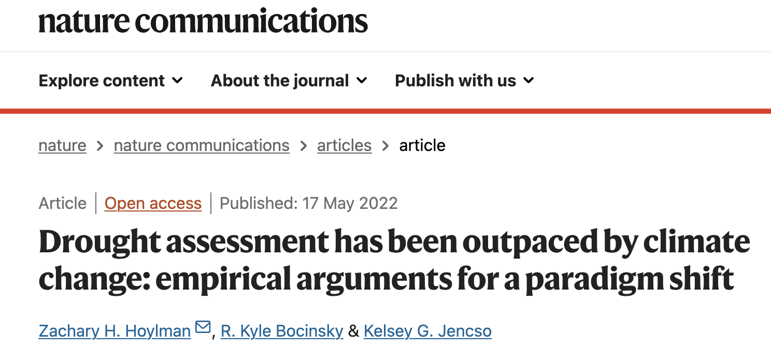
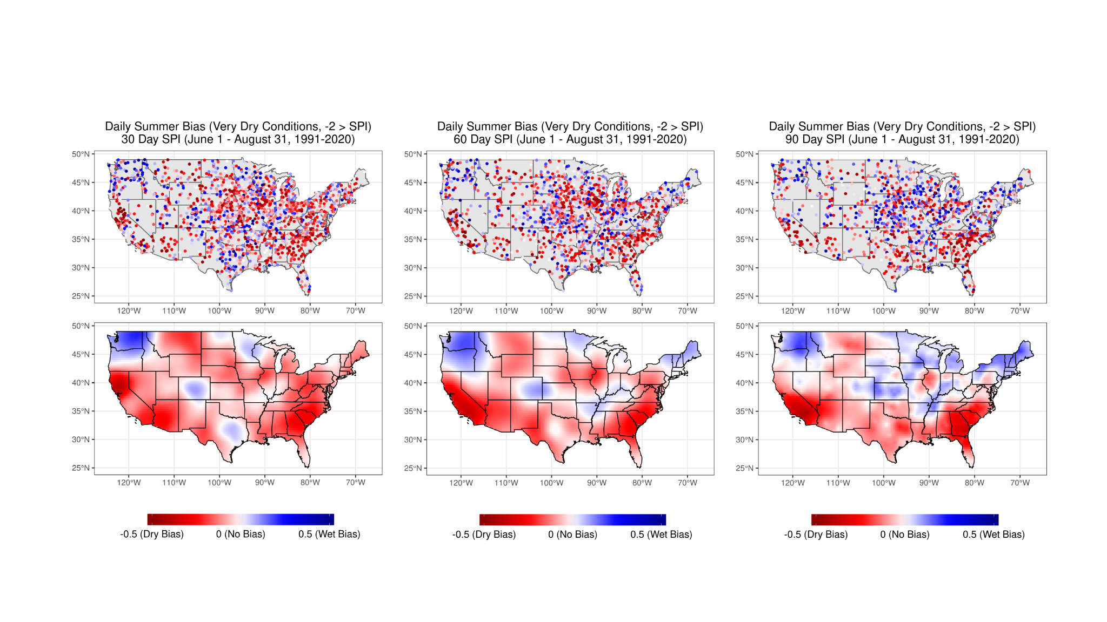
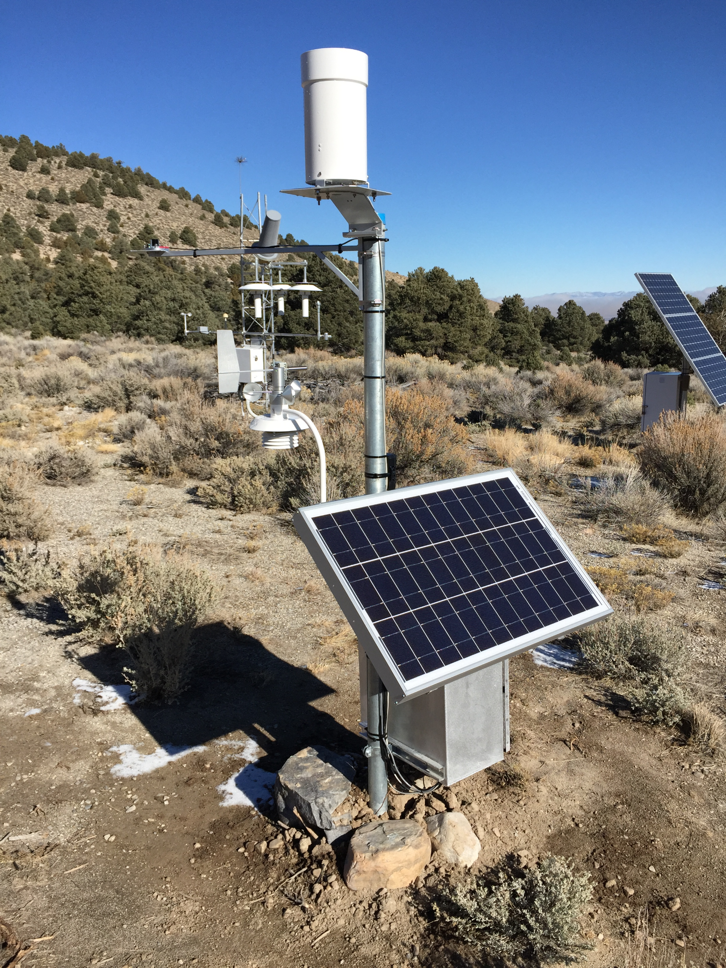
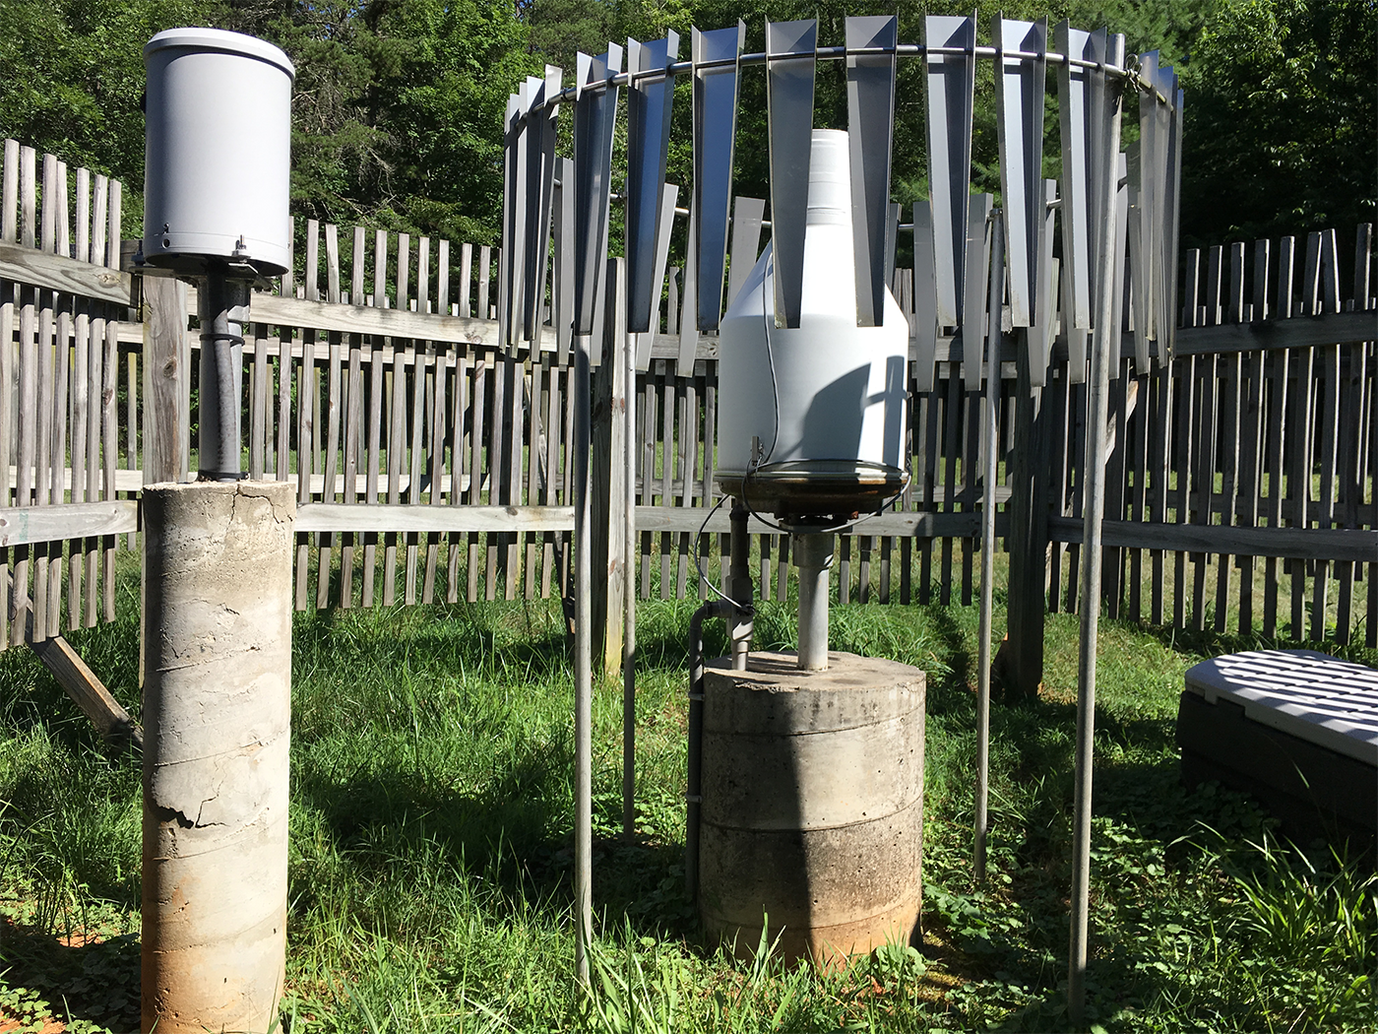
Drought metric bias due to non-stationarity
Comparing daily drought metric bias from 1991-2020
BIAS = SPI_{POR} - SPI₁₉₉₁₋₂₀₂₀ (Period of Record [POR] represents >70 years)
U.S. Climate Ref. Net.
Considering Non-stationarity in Drought Assessment
Dr. Zachary Hoylman
Montana Climate Office
NADM Forum 2024 – Victoria, BC (5/15/2024)

Slide 6
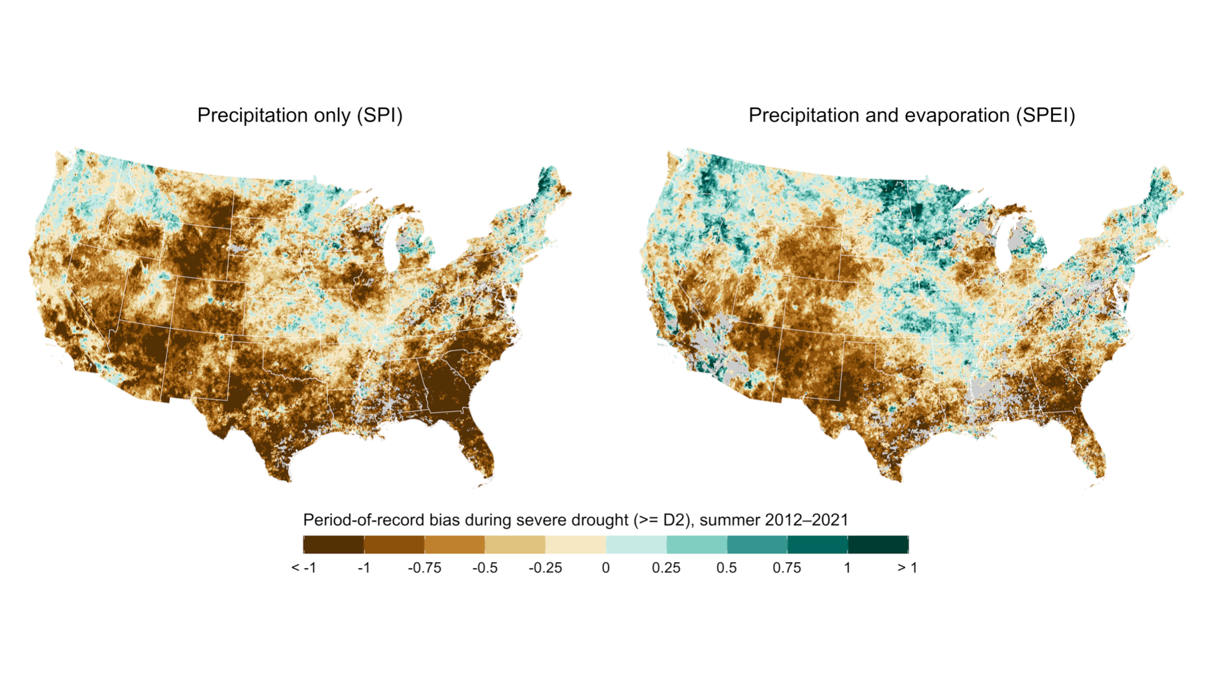
Drought bias exceeds +/-1 class during severe drought
Considering Non-stationarity in Drought Assessment
Dr. Zachary Hoylman
Montana Climate Office
NADM Forum 2024 – Victoria, BC (5/15/2024)

Slide 7
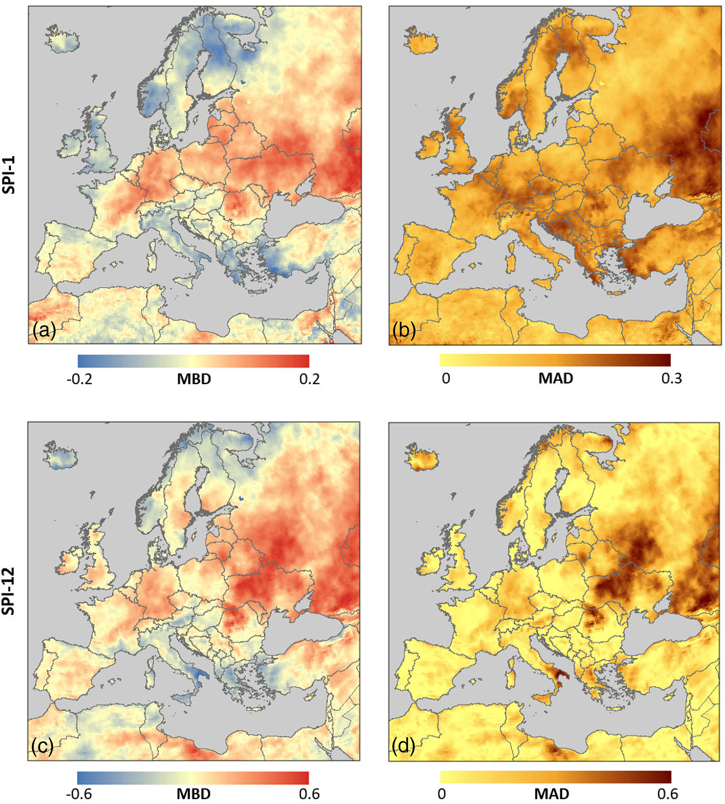
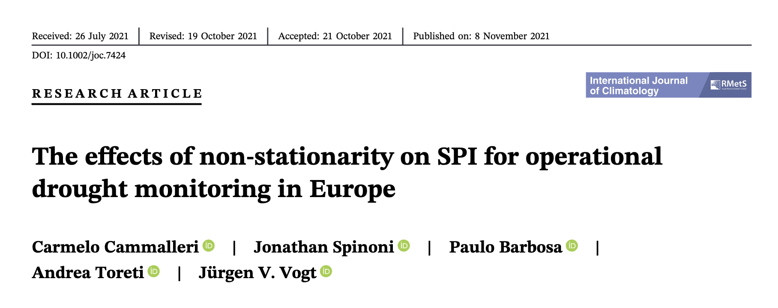
Bias Observed in Europe Due to Non-Stationarity
Bias is variable across time and space
Bias Co-Varies with Trends in Precip
Considering Non-stationarity in Drought Assessment
Dr. Zachary Hoylman
Montana Climate Office
NADM Forum 2024 – Victoria, BC (5/15/2024)

Slide 8
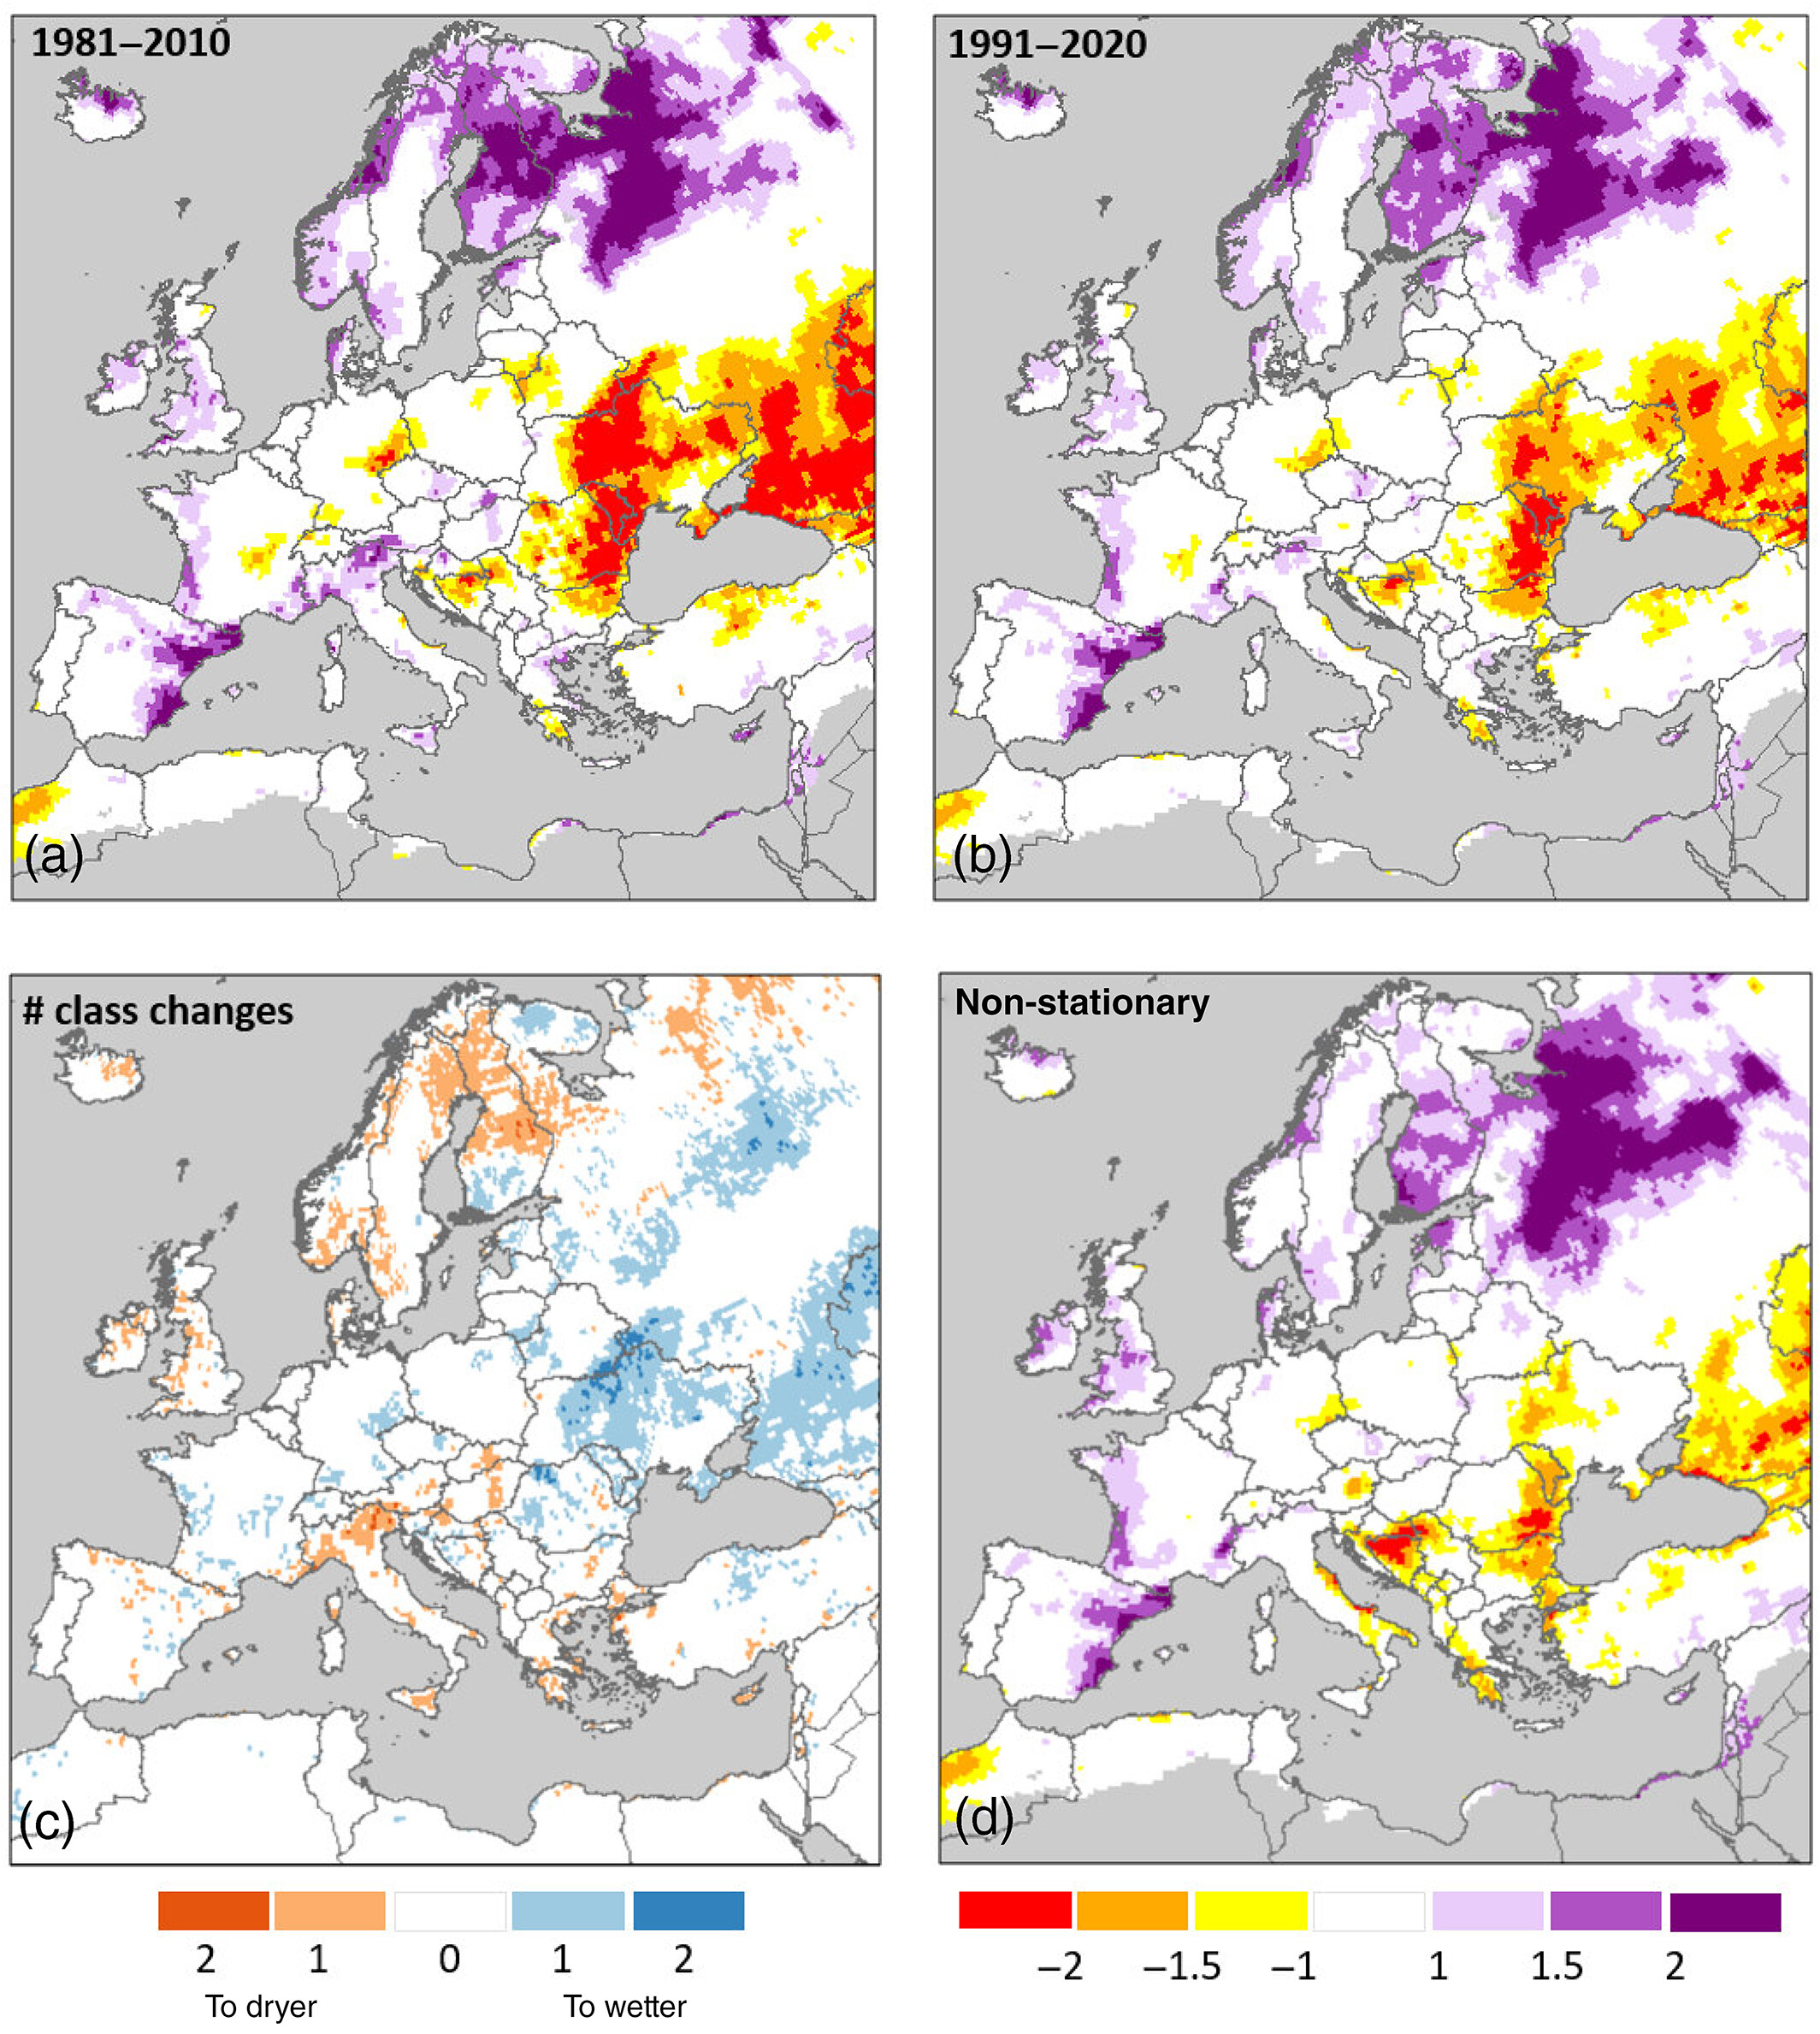
Bias Observed in Europe Due to Non-Stationarity
Examples from July 2020
Humidification in central Europe
Aridification in North and South
Considering Non-stationarity in Drought Assessment
Dr. Zachary Hoylman
Montana Climate Office
NADM Forum 2024 – Victoria, BC (5/15/2024)

Slide 9
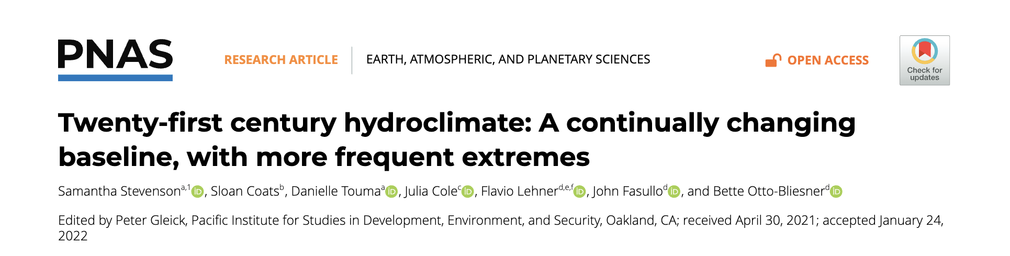
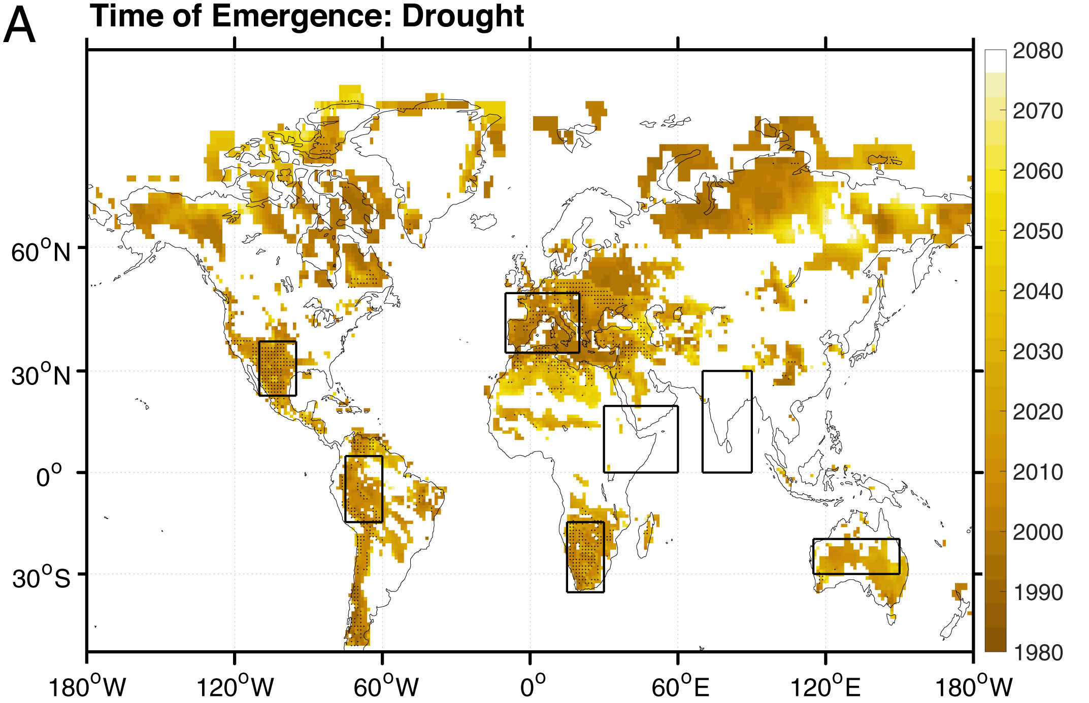
Mega-drought and Mega-pluvials Are Now Common
Based on total column soil moisture simulations
“In the southern United States/northern Mexico, the Amazon, the majority of Europe, and southern Africa, the large ensemble projections indicate that megadroughts become normal in the early 2000s”
Considering Non-stationarity in Drought Assessment
Dr. Zachary Hoylman
Montana Climate Office
NADM Forum 2024 – Victoria, BC (5/15/2024)

Slide 10
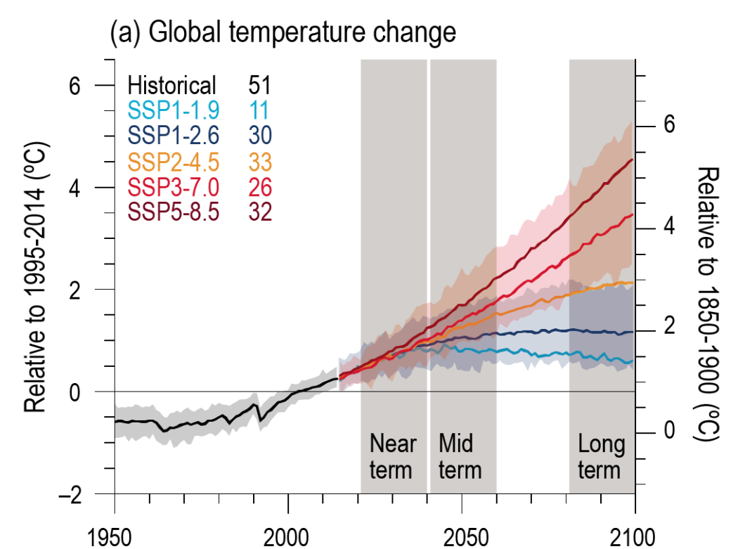
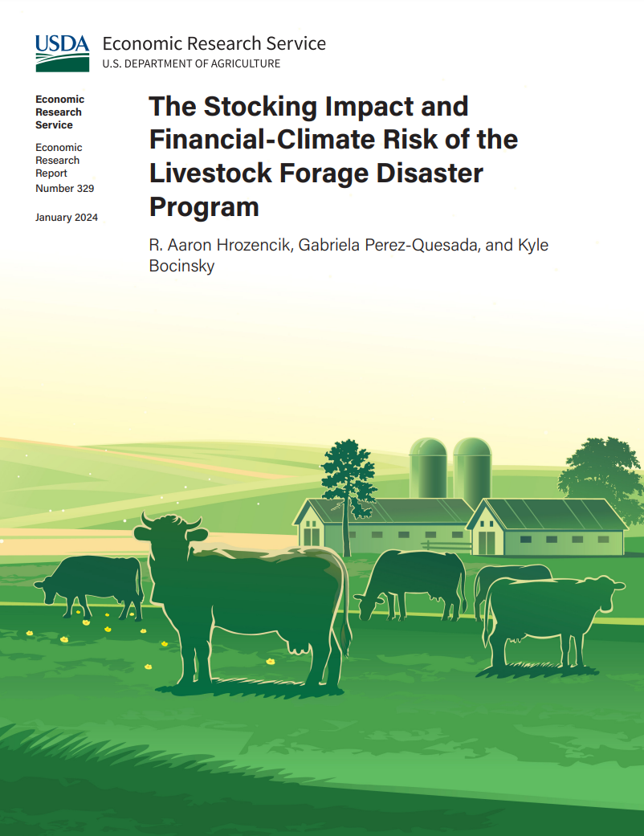
What about the future?
Considering Non-stationarity in Drought Assessment
Dr. Zachary Hoylman
Montana Climate Office
NADM Forum 2024 – Victoria, BC (5/15/2024)

Slide 11
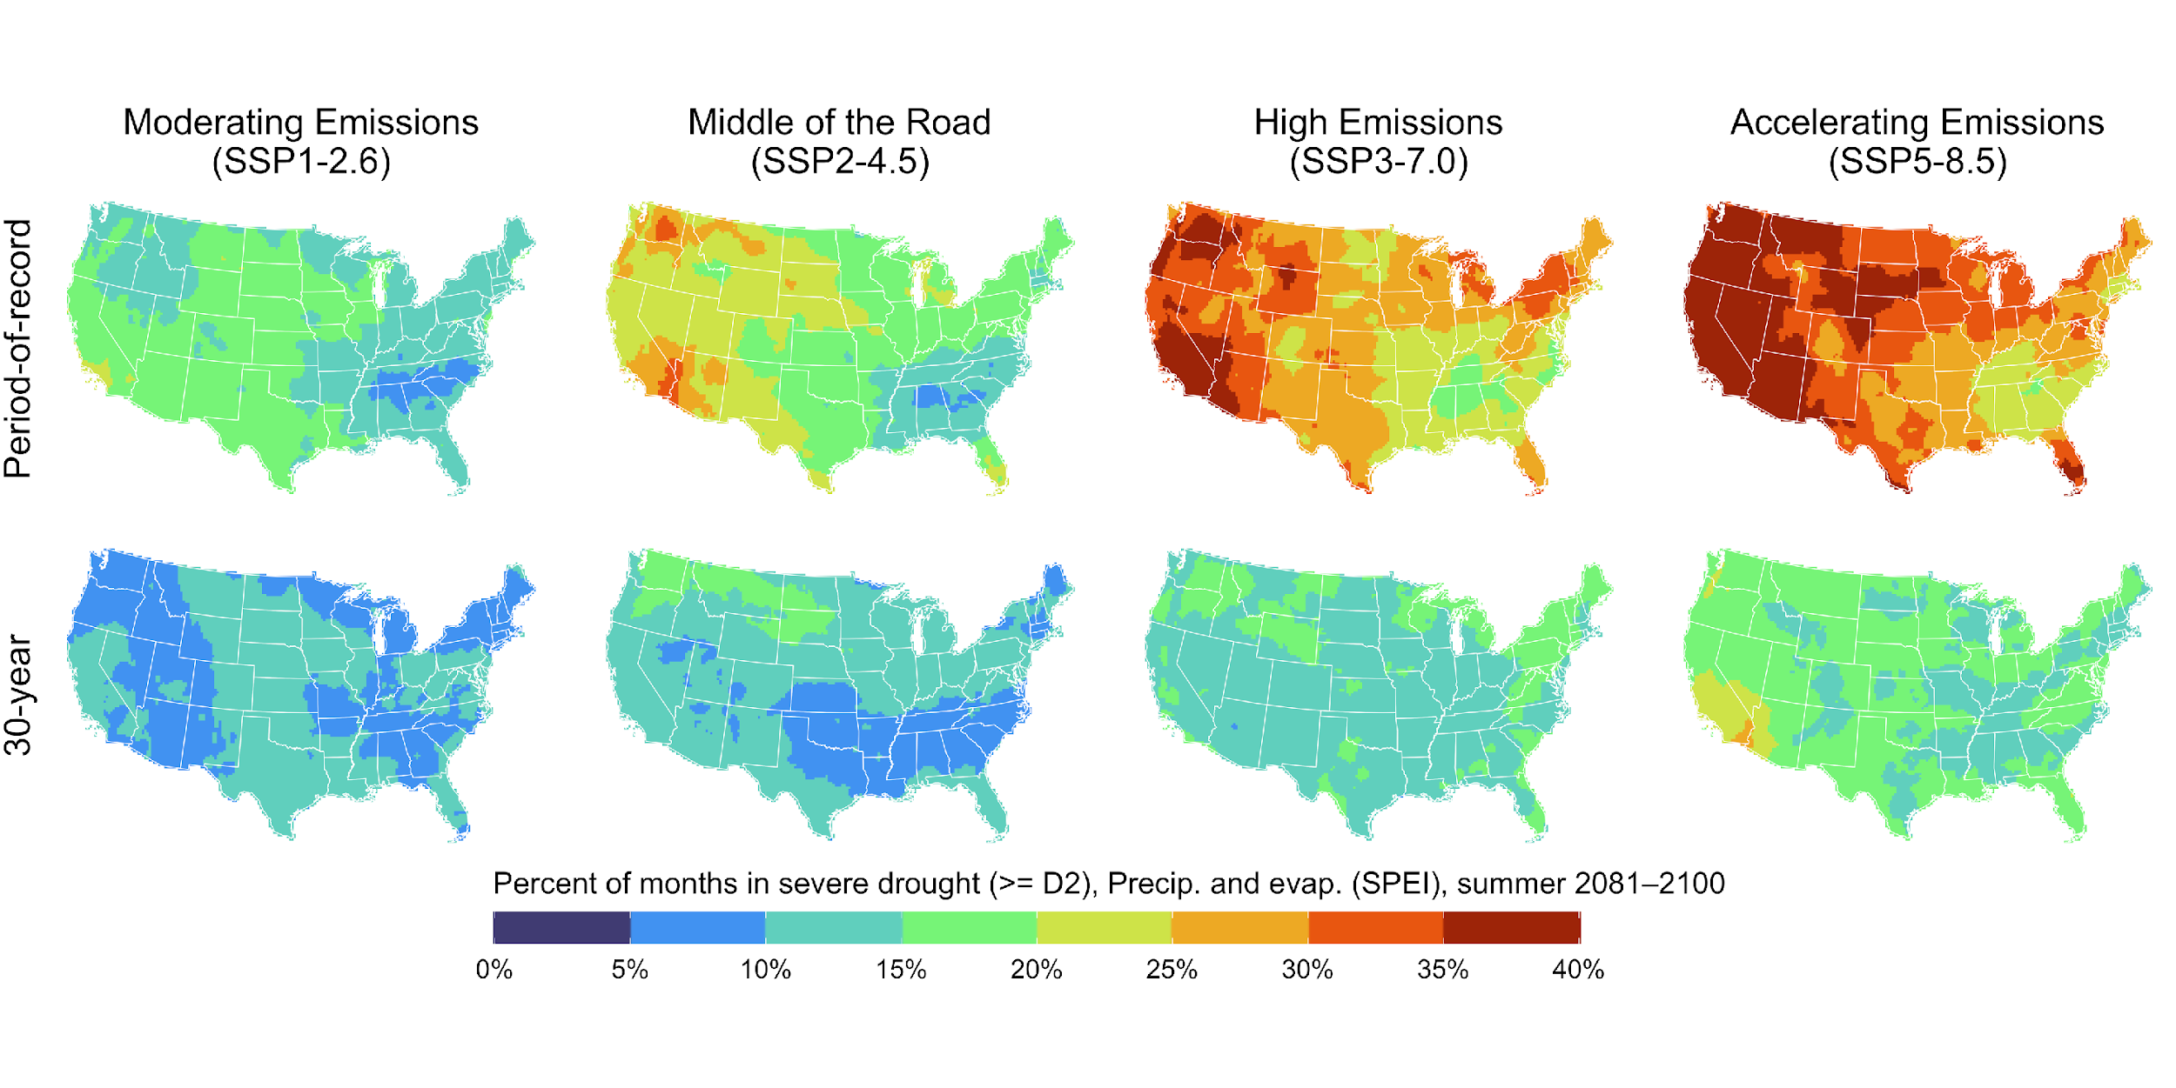
POR-based drought relief is unsustainable
POR-based drought declarations likely to enter a state of “perpetual drought” by the end of the century.
45–135% increase in LFP by 2100
Considering Non-stationarity in Drought Assessment
Dr. Zachary Hoylman
Montana Climate Office
NADM Forum 2024 – Victoria, BC (5/15/2024)

Slide 12

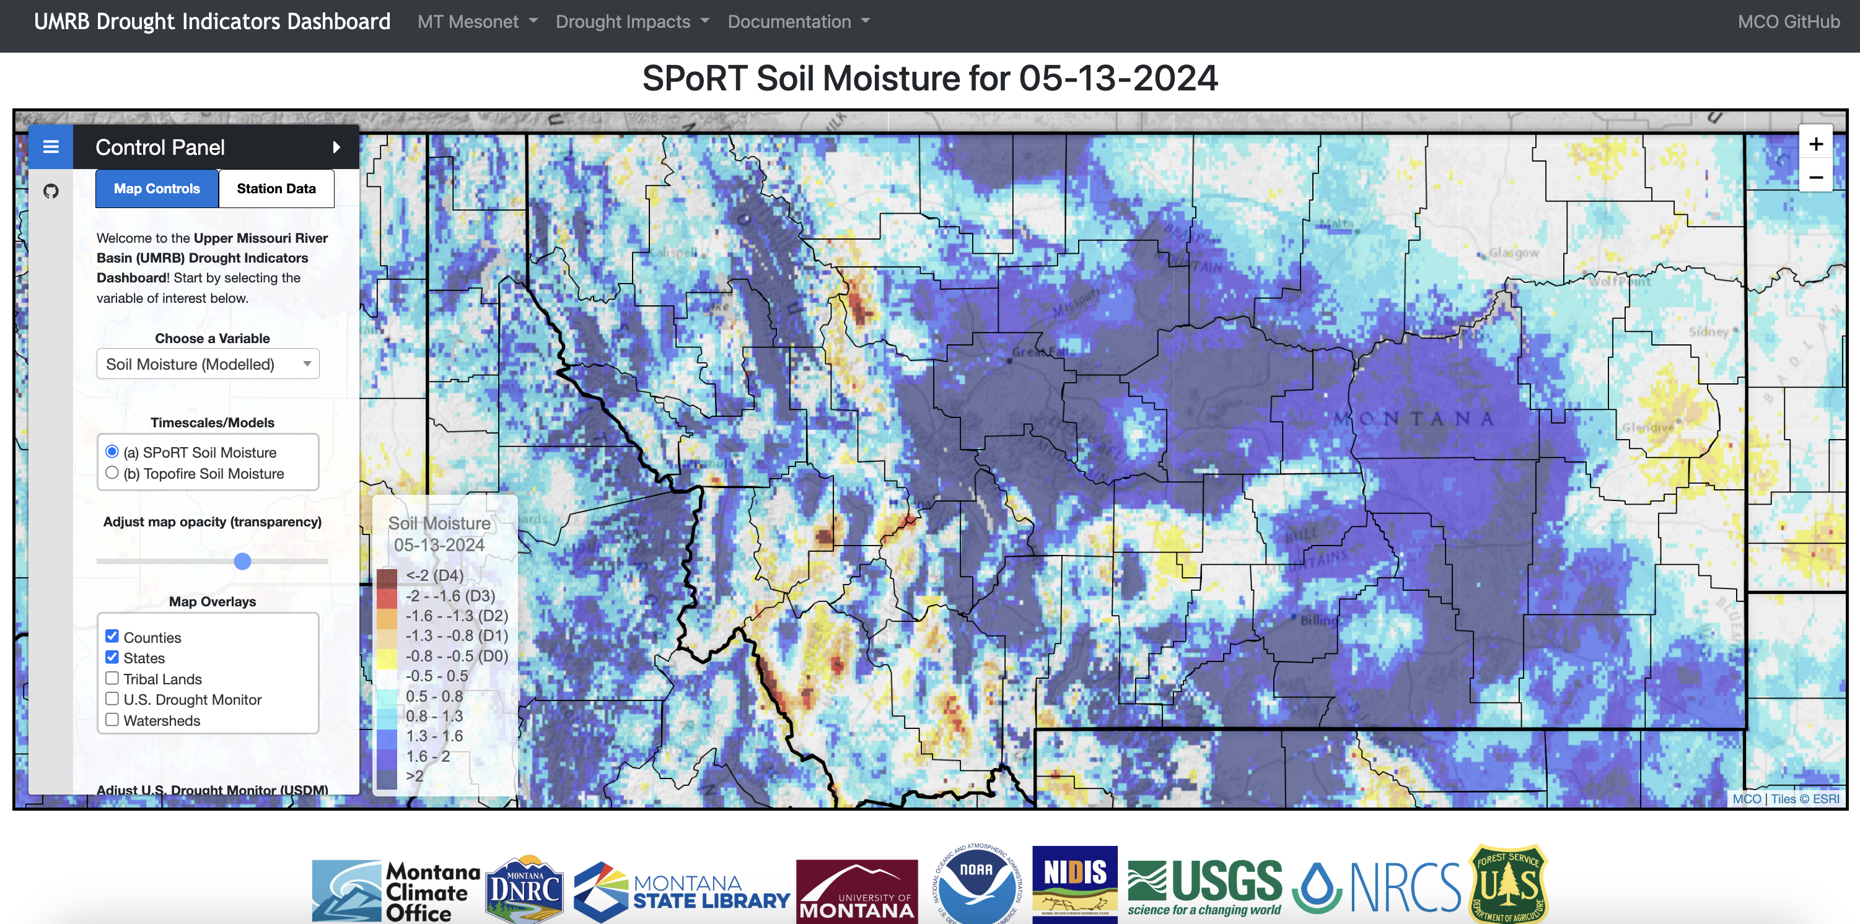
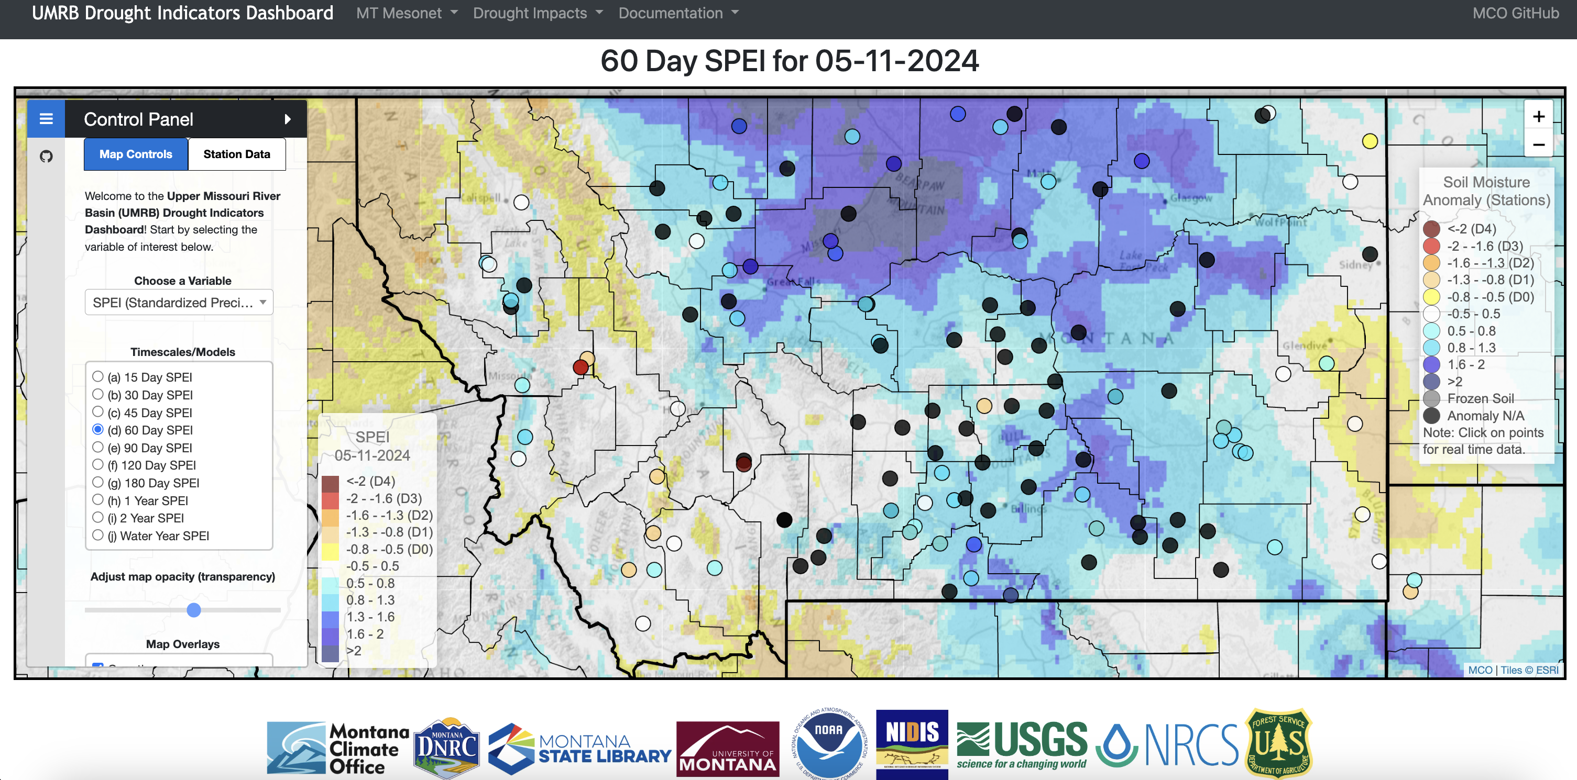
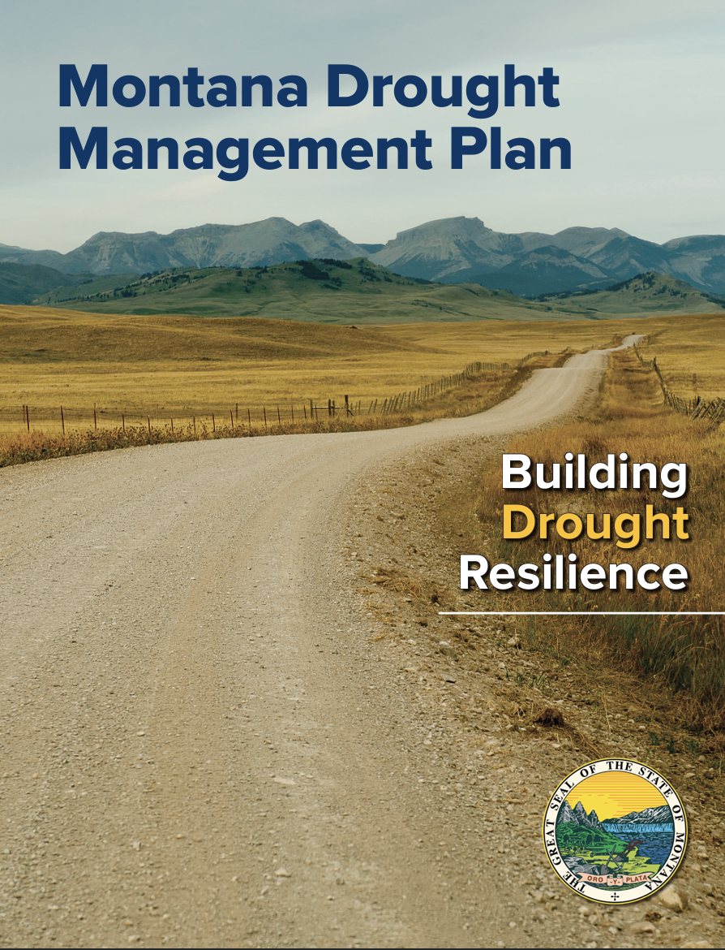
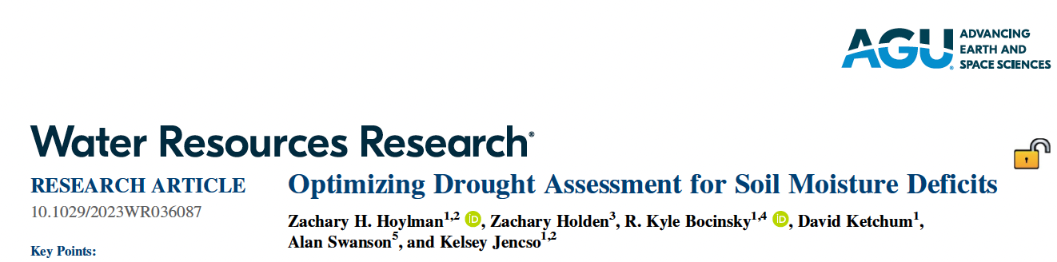
UMRB Drought Dashboard
Based on 30 Year Reference Periods - https://drought.climate.umt.edu/
Considering Non-stationarity in Drought Assessment
Dr. Zachary Hoylman
Montana Climate Office
NADM Forum 2024 – Victoria, BC (5/15/2024)

Slide 13
Drought monitoring impacted by non-stationarity
Under stationary assumptions, drought severity is exaggerated in locations that are experiencing aridification, and underrepresented in locations that are getting wetter.
This concept applies to other metrics commonly used in drought assessment.
Opportunity to develop targeted climate adaptation programs where drought is changing - shift from reactionary relief paradigm to adaptive paradigm
Many questions remain:
  What timescales are most relevant for different systems? (30-years is not absolute!)
  How can we use longer series? (GAMLSS)
  Should we include specific extreme events in shorter reference frames? (Does it help or hinder to capture tails?)
Considering Non-stationarity in Drought Assessment
Dr. Zachary Hoylman
Montana Climate Office
NADM Forum 2024 – Victoria, BC (5/15/2024)

Slide 14


Montana Climate Office
climate.umt.edu
Zachary Hoylman - zachary.hoylman@umt.edu
@mt_climate
Considering Non-stationarity in Drought Assessment
Dr. Zachary Hoylman
Montana Climate Office
NADM Forum 2024 – Victoria, BC (5/15/2024)

Slide 15
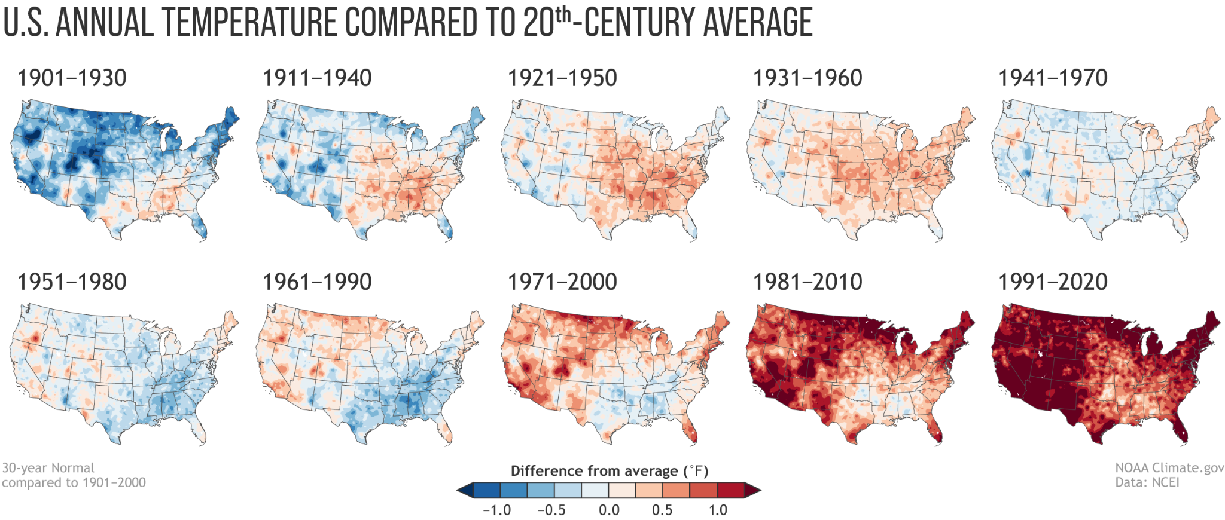
Climate change and reference periods — Why do we care?
Drought is a relative phenomena, in space and in time
  Without a shifting reference frame some places may eventually be in perpetual drought (or water “surplus”)
Shifting reference frames in climate science are common
  Critical to describe realistic expectations of climate variability
Considering Non-stationarity in Drought Assessment
Dr. Zachary Hoylman
Montana Climate Office
NADM Forum 2024 – Victoria, BC (5/15/2024)

Slide 16
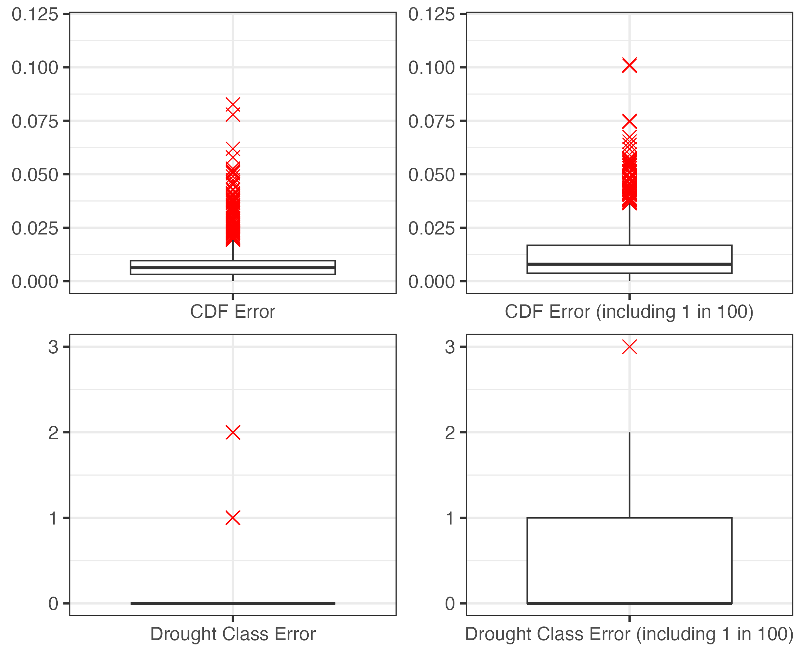
Considering Non-stationarity in Drought Assessment
Dr. Zachary Hoylman
Montana Climate Office
NADM Forum 2024 – Victoria, BC (5/15/2024)

Slide 17
Provider | Base Data | Reference Period | Documentation
West Wide Drought Tracker (SPI/SPEI) | PRISM | Full POR (1895-present) | https://wrcc.dri.edu/wwdt/about.php
Climate Prediction Center (SPI) | CPC (Unified Precipitation Analysis) | Full POR (1950-present) | https://www.cpc.ncep.noaa.gov/products/Drought/Monitoring/spi.shtml
NCEI/NOAA NADM (SPI) | ? | Full POR (1951-Last Full Year) | https://www.ncei.noaa.gov/access/monitoring/nadm/indices/spi/div
Western Regional Climate Center - WRCC (SPI) | NOAA/NWS/CPC NOAA/NESDIS/NCDC | Full POR (1895-present) | https://wrcc.dri.edu/Monitoring/spi_products.php https://wrcc.dri.edu/cgi-bin/spiFmap.pl?spi01
SPEI Global Drought Monitor (SPEI) | NOAA NCEP CPC GHCN_CAMS / GPCC | 1950 - 2010 | https://spei.csic.es/map/maps.html#months=1#month=7#year=2022
High Plains Regional Climate Center - HRPCC (SPI / SPEI) | Station data | POR of each station (truncated at 1900) 1980 - present (SPEI) | Email documentation
PSL - NOAA (EDDI) | NLDAS-2 | 1979-present | https://psl.noaa.gov/eddi/
Considering Non-stationarity in Drought Assessment
Dr. Zachary Hoylman
Montana Climate Office
NADM Forum 2024 – Victoria, BC (5/15/2024)

Slide 18
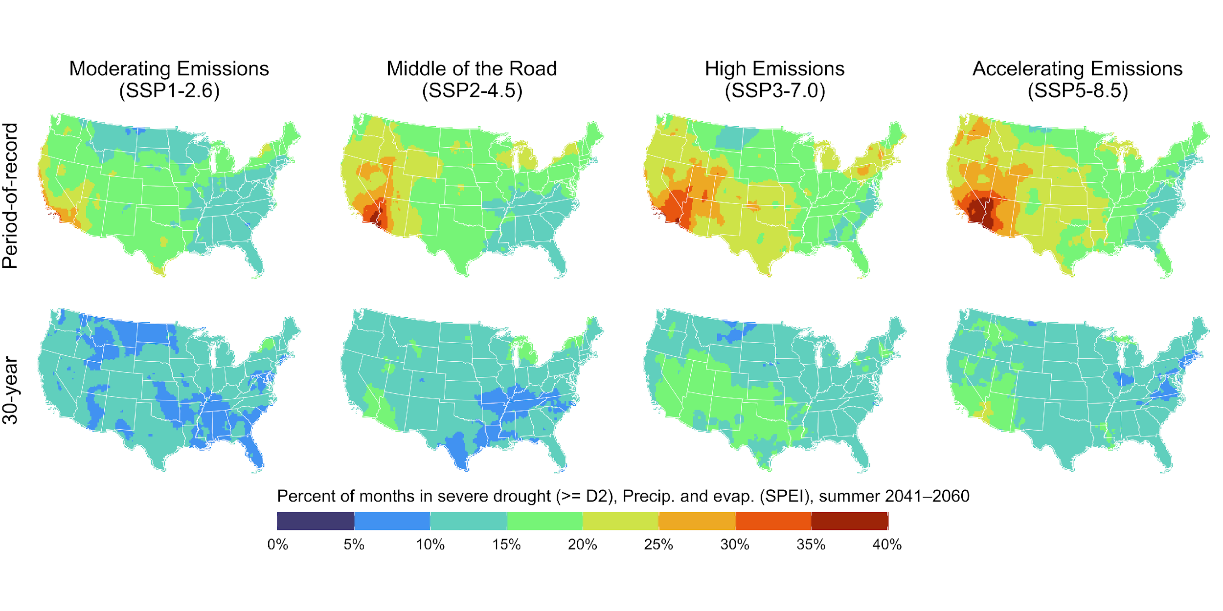
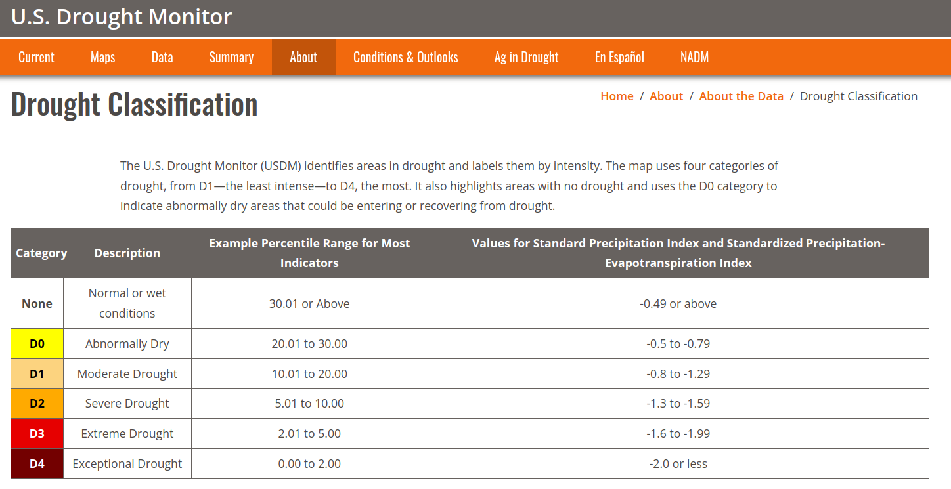
POR-based drought relief is unsustainable
Considering Non-stationarity in Drought Assessment
Dr. Zachary Hoylman
Montana Climate Office
NADM Forum 2024 – Victoria, BC (5/15/2024)

Slide 19
Drought metric bias due to climate change
Comparing daily drought metric bias from 1991-2020
BIAS = SPI_{POR} - SPI₁₉₉₁₋₂₀₂₀ (Period of Record [POR] represents >70 years)
Considering Non-stationarity in Drought Assessment
Dr. Zachary Hoylman
Montana Climate Office
NADM Forum 2024 – Victoria, BC (5/15/2024)

Slide 20
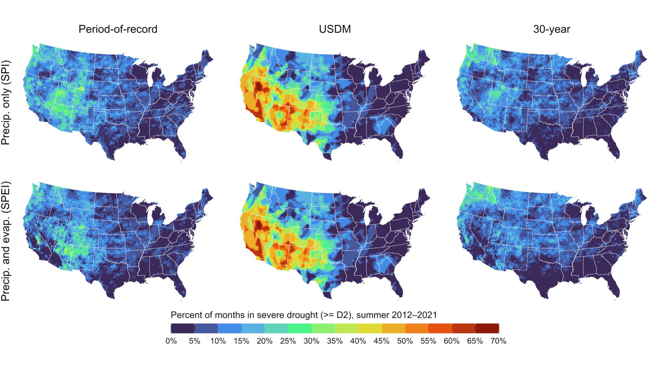
USDM patterns of declared drought align with POR
Considering Non-stationarity in Drought Assessment
Dr. Zachary Hoylman
Montana Climate Office
NADM Forum 2024 – Victoria, BC (5/15/2024)

Slide 21
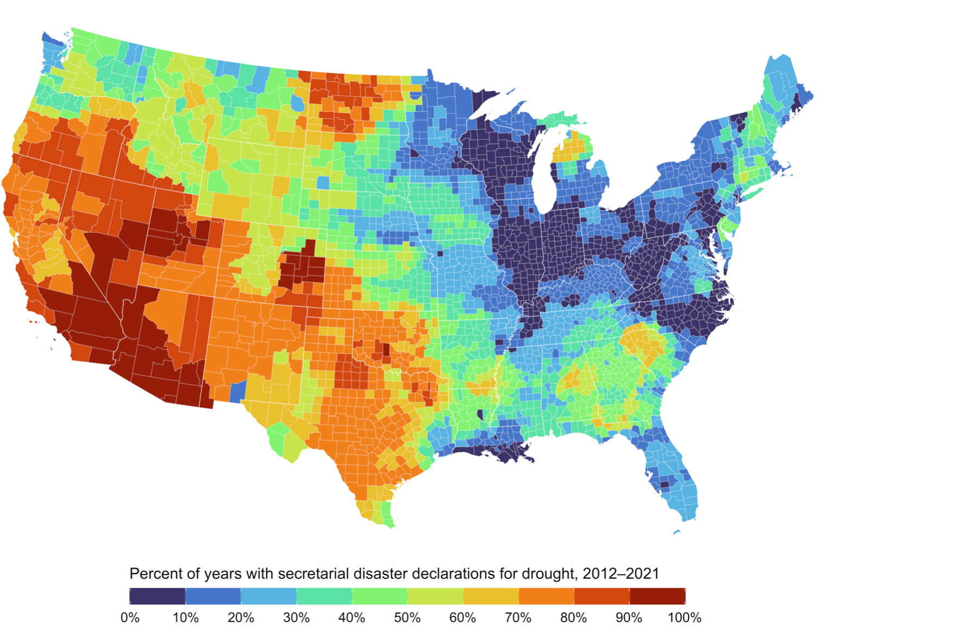
USDM triggers disaster declarations and relief
USDA Secretarial
Drought Disasters
“Fast Track” Secretarial disaster designations for severe drought provide for a nearly automatic designation when, during the growing season, any portion of a county meets the D2 (Severe Drought) drought intensity value for eight consecutive weeks or a higher drought intensity value for any length of time as reported in the U.S. Drought Monitor (https://droughtmonitor.unl.edu).
7 CFR § 759.5 - Secretarial disaster area determination and notification process
Considering Non-stationarity in Drought Assessment
Dr. Zachary Hoylman
Montana Climate Office
NADM Forum 2024 – Victoria, BC (5/15/2024)

Slide 22
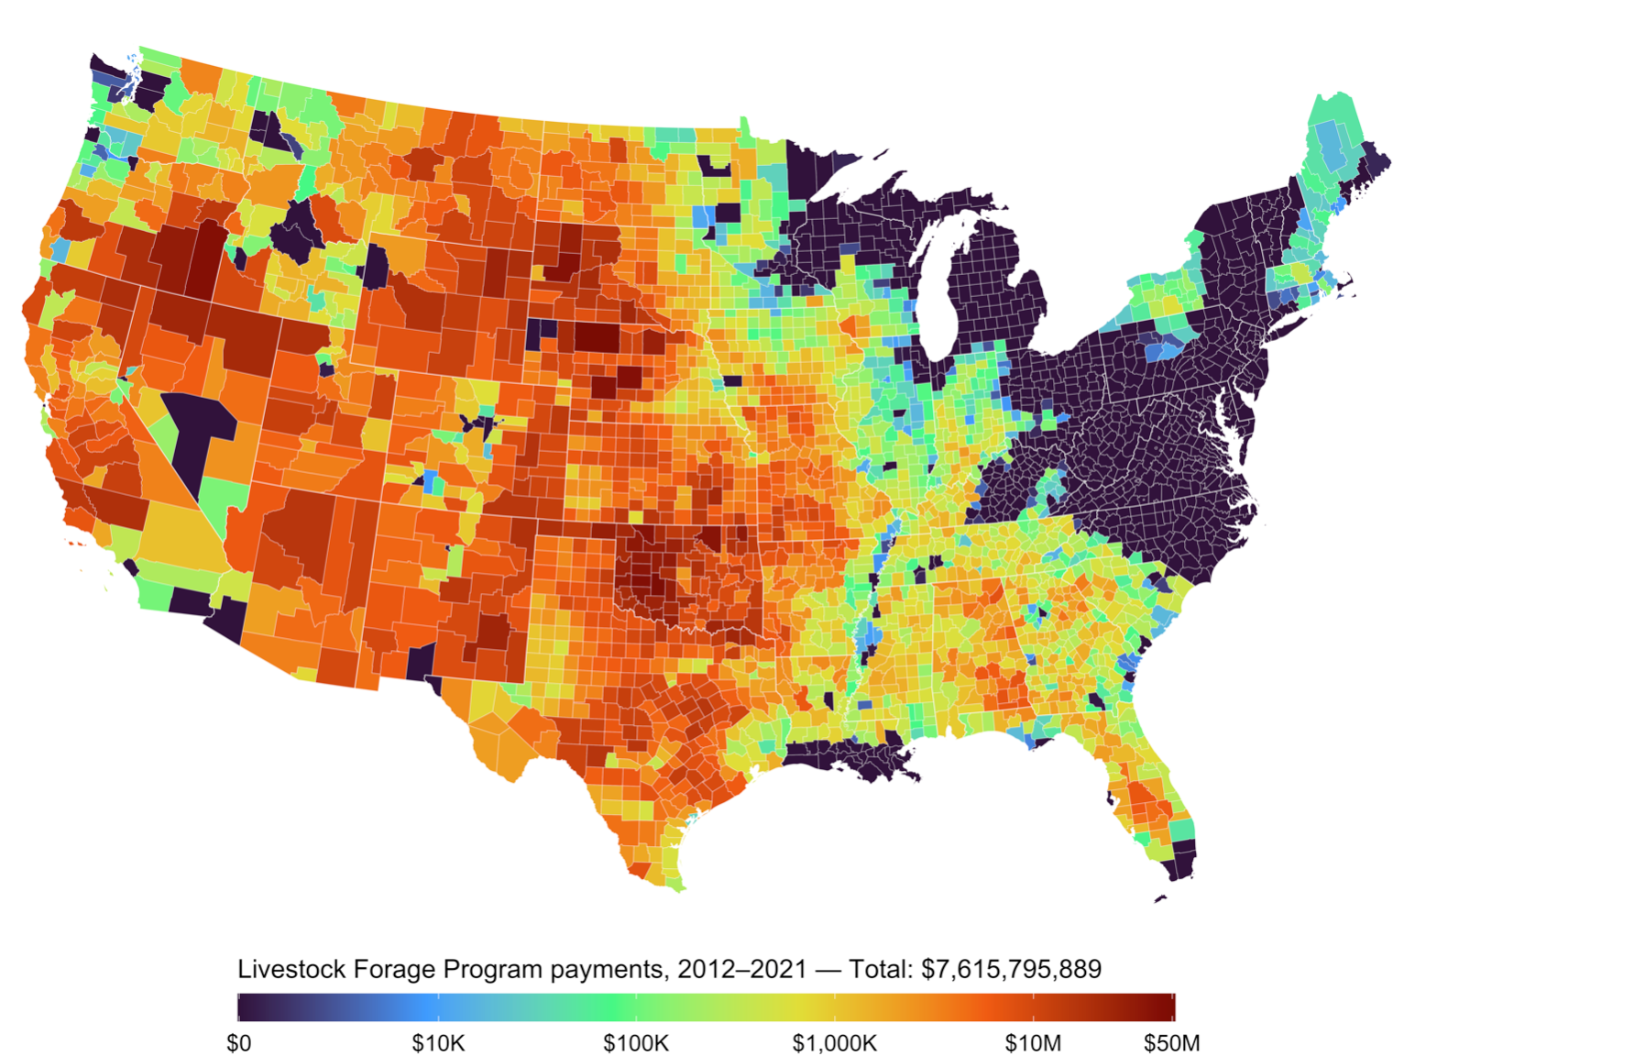
USDM triggers disaster declarations and relief
Livestock Forage Program
Eligibility Criteria
1 monthly payment:
D2 (severe drought) for at least eight consecutive weeks
3 monthly payments:
D3 (extreme drought) at any time
4 monthly payments:
D3 (extreme drought) for at least four consecutive weeks or D4 (exceptional drought) intensity at any time
5 monthly payments:
D4 (exceptional drought) for any four weeks
7 CFR § 1416.205 - Eligible grazing losses
Considering Non-stationarity in Drought Assessment
Dr. Zachary Hoylman
Montana Climate Office
NADM Forum 2024 – Victoria, BC (5/15/2024)

Slide 23
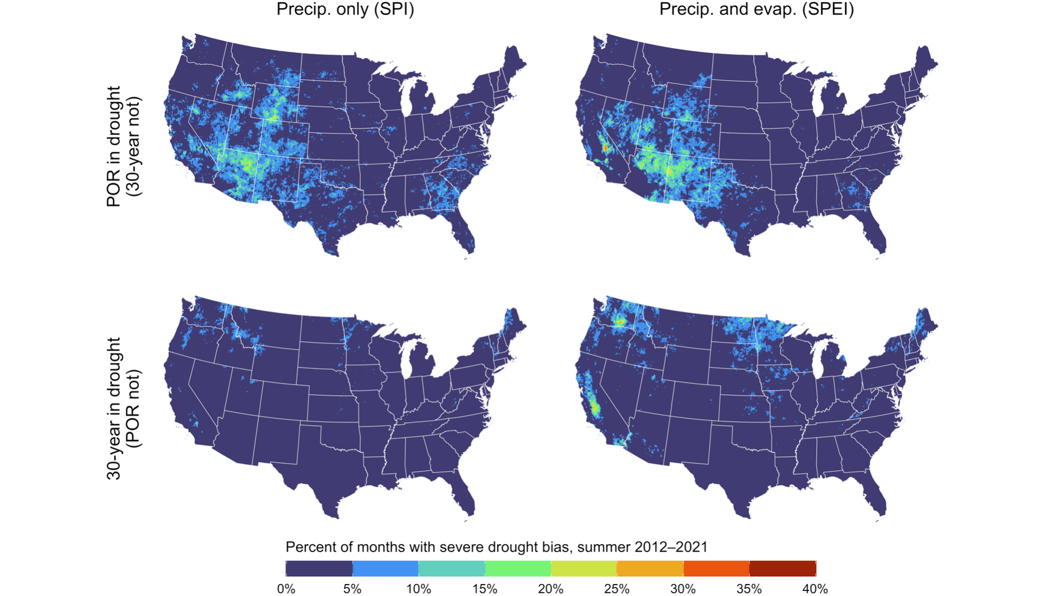
Drought bias affects disaster declarations and relief
Regions where aridification is occurring and climate adaptation needed most.
Climate patterns are shifting here too, leading to an under-assessment of drought conditions.
Considering Non-stationarity in Drought Assessment
Dr. Zachary Hoylman
Montana Climate Office
NADM Forum 2024 – Victoria, BC (5/15/2024)

Slide 24
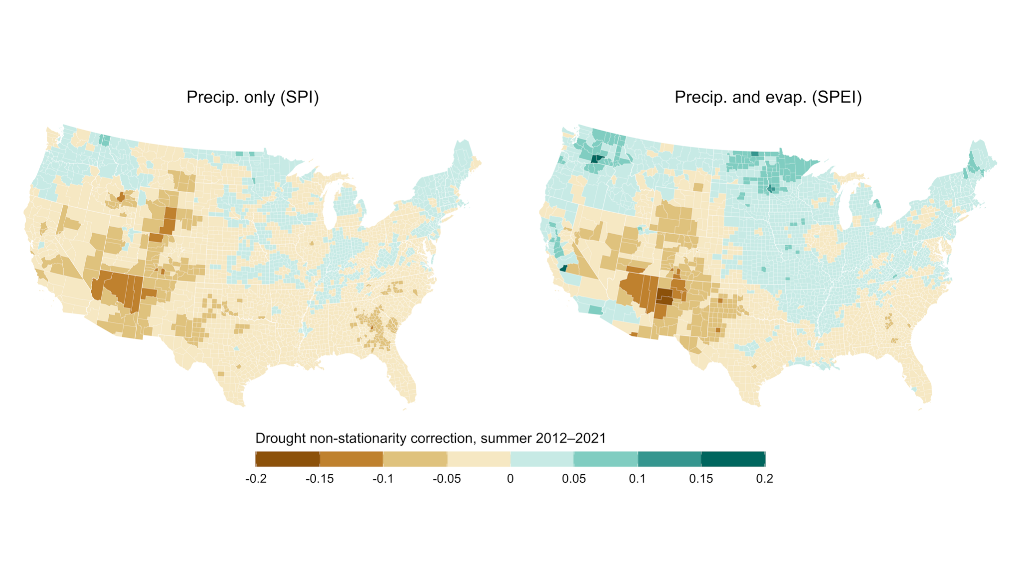
Changing drought requires adjustments to
monitoring, relief, and adaptation programs
Considering Non-stationarity in Drought Assessment
Dr. Zachary Hoylman
Montana Climate Office
NADM Forum 2024 – Victoria, BC (5/15/2024)

