Slide 1
Navigating the waters ahead –Update on improvements to Drought and Weather Monitoring in Montana
Kelsey Jencso
Montana State Climatologist
W.A. Franke Endowed Professor of Hydrology
Zachary Hoylman – Asst. Climatologist
Kevin Hyde – Mesonet Site Coordinator
Colin Brust - Data Scientist
Kyle Bocinsky – Dir. Climate Extension

Slide 2
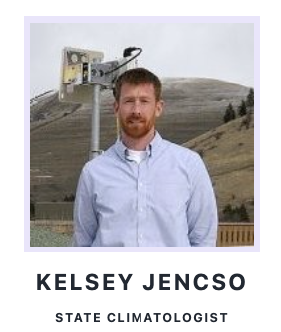
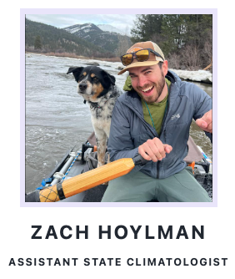
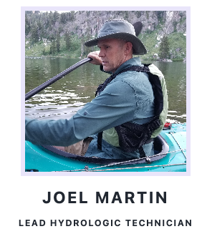
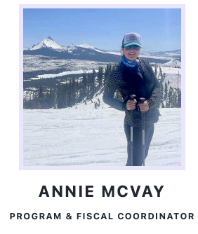
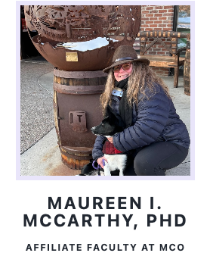
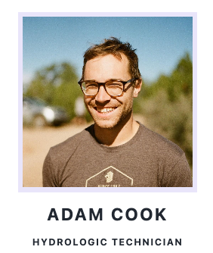
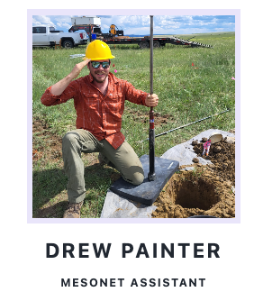
The Montana Climate Office
Staff at the Montana Climate Office
CHRISTINE LAYEUX

Slide 3
Provide high quality, timely, relevant, and scientifically-based climate, weather and water information and services to Montanans.
Operate the Montana Mesonet — an extensive and growing network of weather, soil moisture, and snowpack monitoring stations.
Support statewide drought monitoring efforts
Service oriented mission that is funded by competitive federal grants and contracts

Slide 4
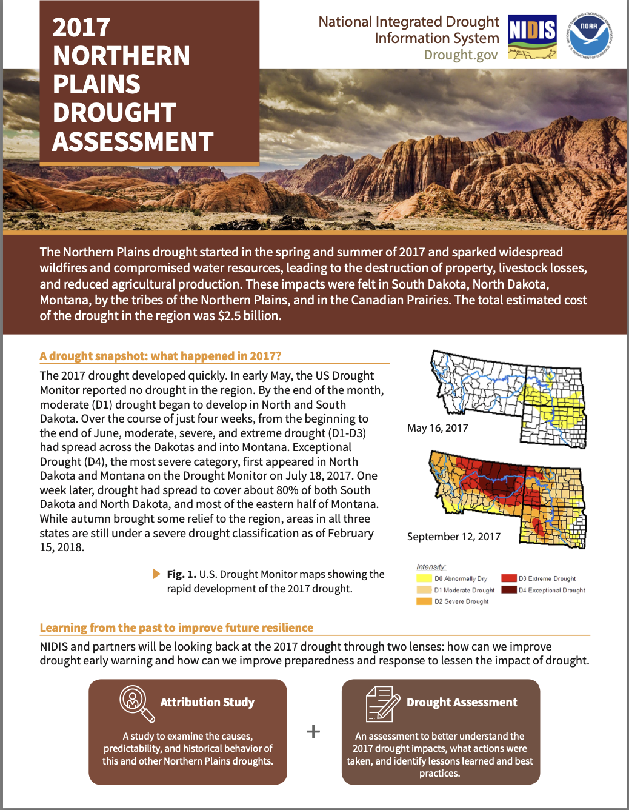
MCO Impetus: The 2017 Flash Drought
$2.5 billion in drought impacts across agricultural and natural resources sectors (drought & fires)
analysis that reviews the conditions leading to 2017 drought, its impacts and state, tribal, federal and provincial (Canada) responses
Identified much needed improvements for drought management and response by partners in each state

Slide 5
Lessons Learned and Priorities (2017)
1. Coordination – need for better communication, coordination and assessment of drought on a regular basis – The DWSAC Monitoring Sub-committee
2. Monitoring - more ground-based stations for verification of drought [flood] conditions and for filling monitoring gaps in the context of soil moisture – The Montana Mesonet
3. Drought Modeling: need to evaluate and develop continuous drought models for timely and accurate predictions of drought onset and magnitude – The Montana Drought Dashboard
Enhancing the Drought Early Warning System in the Upper Missouri River Basin
Notes:
POP UP ON NOAA NIDIS FUNDING

Slide 6
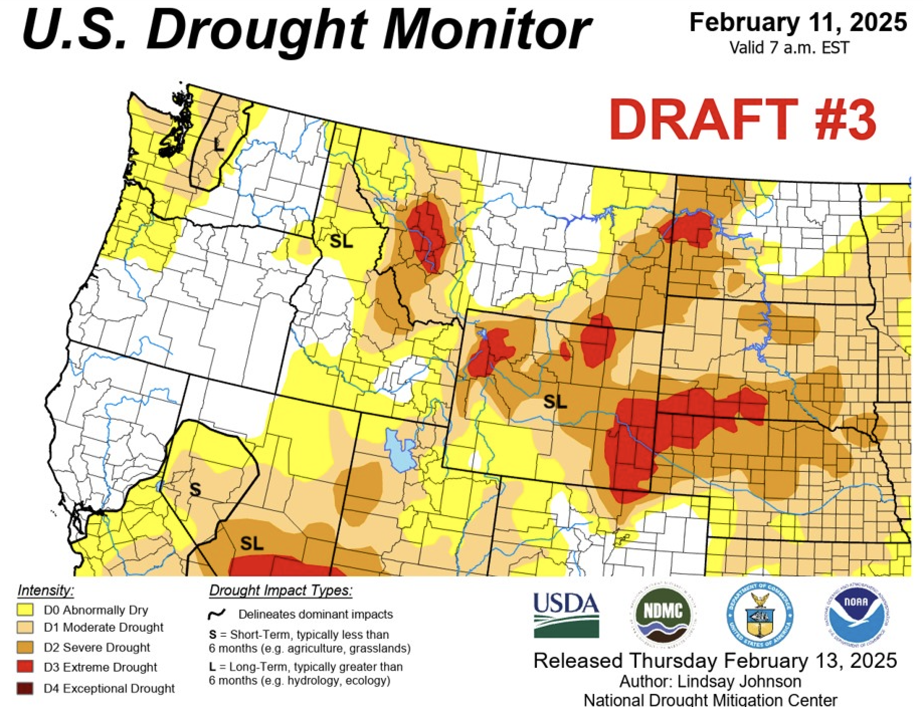
1. Updates to MT’s Drought Coordination Process
Sunday & Monday Morning:
Montana author assembles proposed changes to USDM based upon analysis of station data, modelled data and impact reports
Authorship rotates every two weeks for five volunteers: Michael Downey (DNRC), Jane Fogelman (NOAA), Troy Blanford (DNRC), Zach Hoylman (MCO) and Kelsey Jencso (MCO).
Repeat this process 52 times each year
Monday Early Afternoon:
Author sends initial analysis and summary to Montana Drought Listserv for review and consensus.
Tuesday:
MT author makes changes and sends the proposed map with a justification to the National Drought Monitor author. The USDM author releases a series of 3 drafts with “back and forth” between state authors.
Wednesday:
USDM author makes final decisions, and the final national map is released Thursday morning.
It takes objective data and a well justified argument to make our case to the USDM each week!
Notes:
Highlight that this process is new - 2017

Slide 7
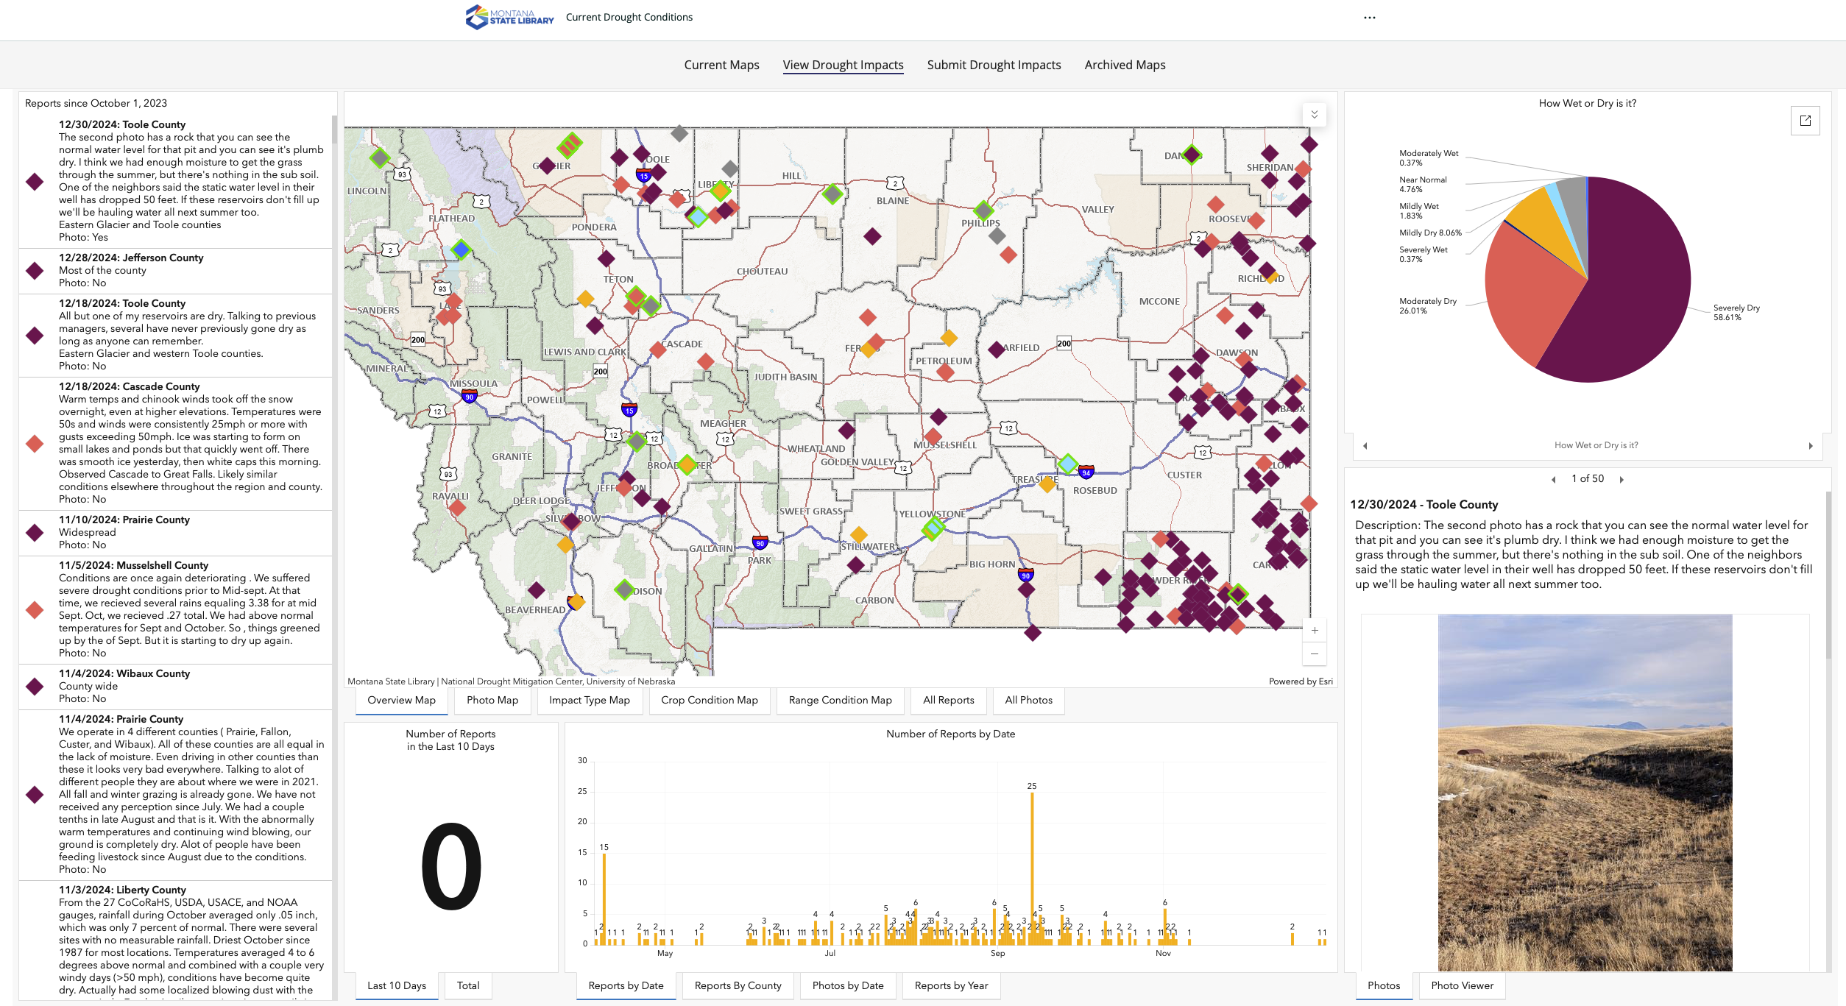
1. Updates to MT’s Drought Coordination Process – Drought Impacts Reporter
Mechanism for producers to report drought conditions and impacts across the state
Our Drought Committee monitors these impact reports on a weekly basis
This is a great way to incorporate feedback and we focus on areas where there is misalignment between indicators and impact reports
https://drought.climate.umt.edu - Select the Drought Impacts Tab

Slide 8
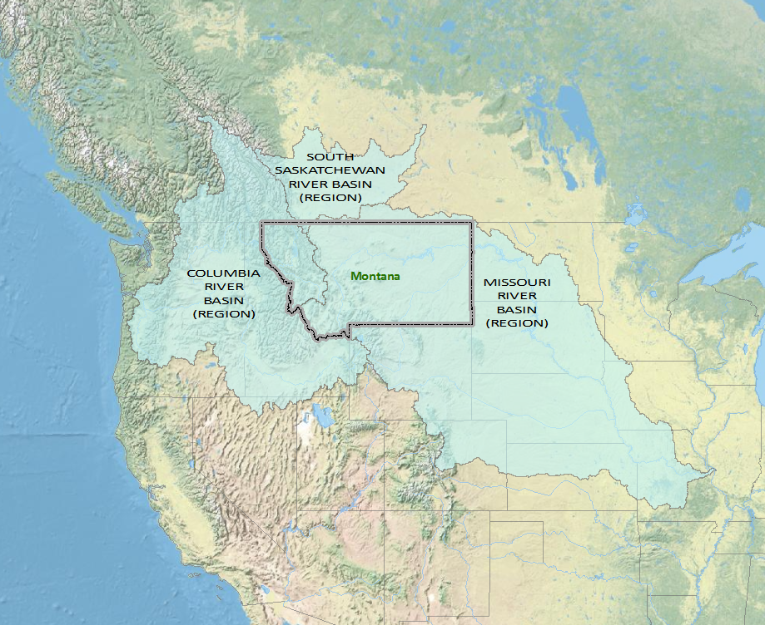
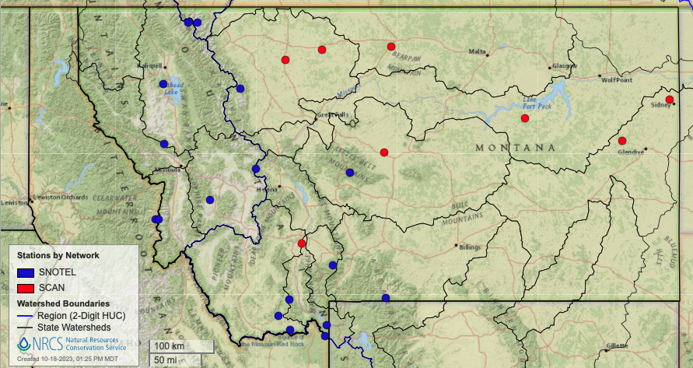
MONTANA AT THE HEADWATERS
Monitoring - more ground-based stations for verification of drought [flood] conditions and for filling monitoring gaps in the context of soil moisture – The Montana Mesonet
Western MT: 14 soil moisture stations Central-Eastern MT: 8 soil moisture stations
Notes:
Strategically, Montana sits at the headwaters of three major river basins in North America. Two of these, the Columbia River Basin and the Missouri River Basin, compose almost one-third of the land area of the United States. From a climatic standpoint, we are interested in all watersheds that are contained within Montana or intersect with its borders.

Slide 9
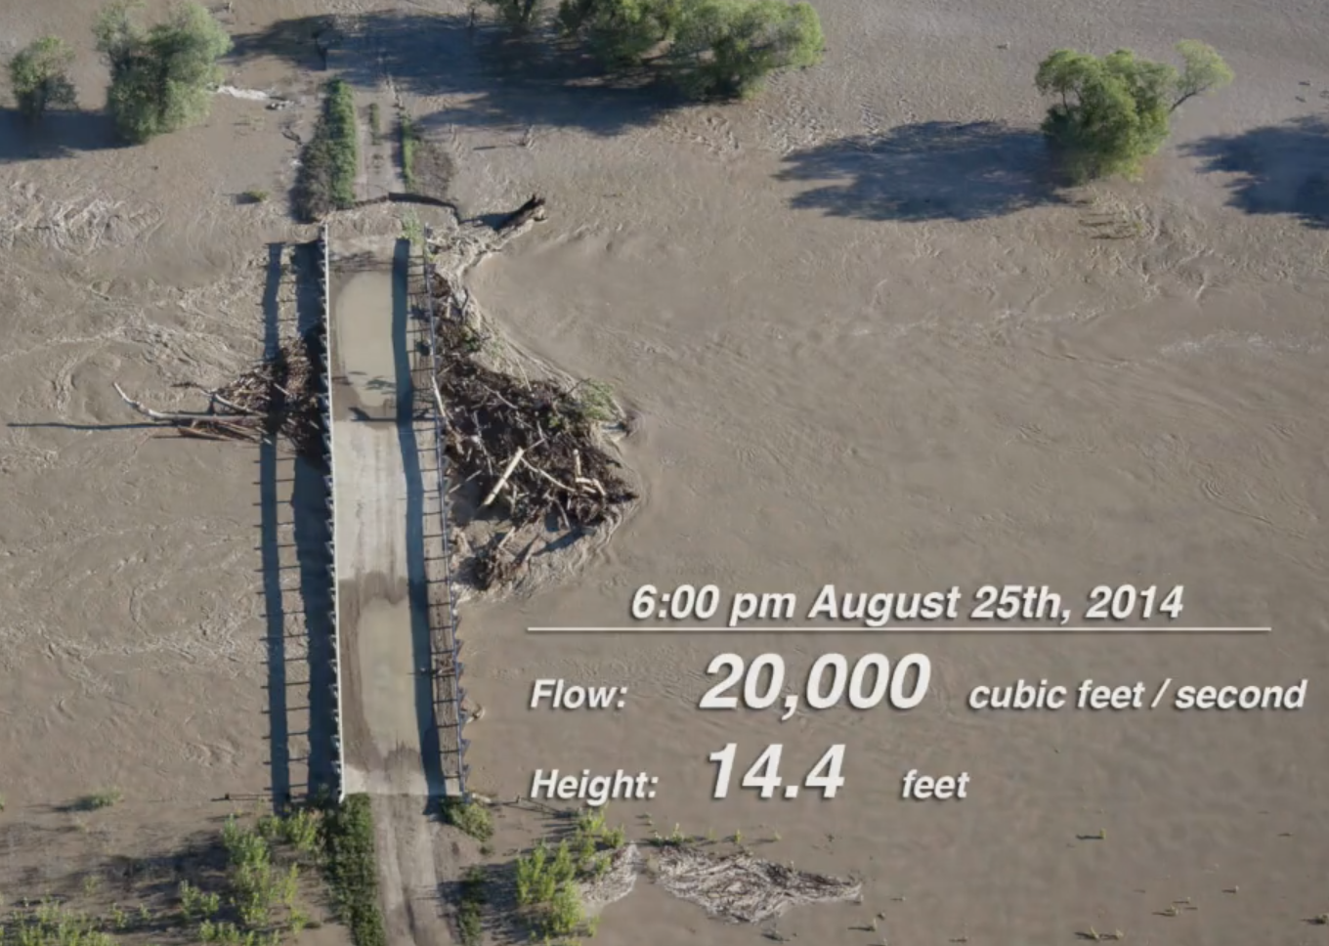
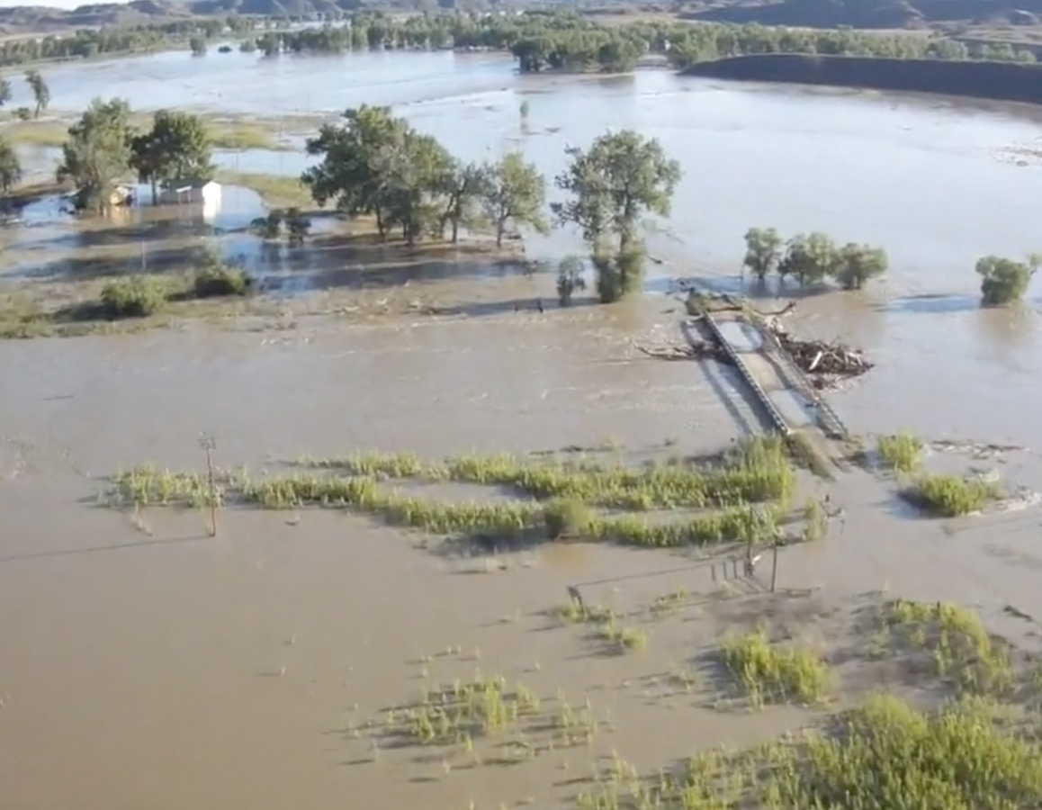
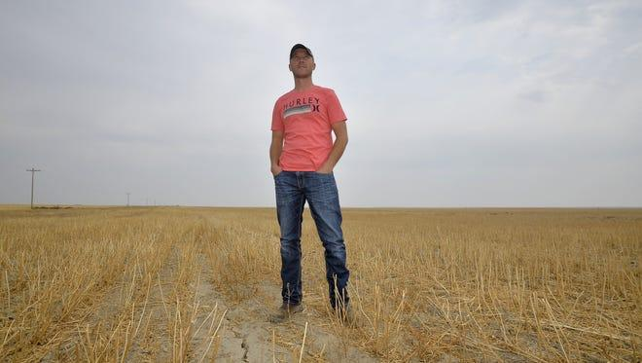
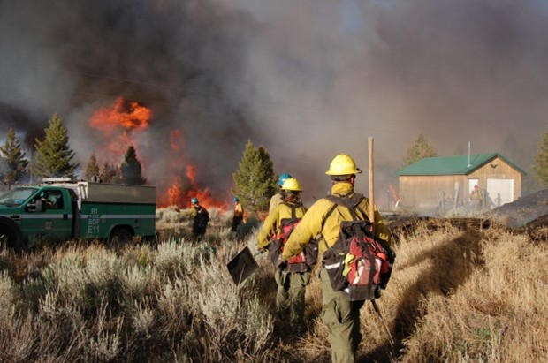
2. Why install more weather and soil moisture stations in Montana?
Flood Prediction and Early Warning
Improved knowledge of antecedent moisture conditions for modeling of flood potential
Timing and amounts of reservoir releases to mitigate downstream flooding
Musselshell
Drought Monitoring and Prediction
Improved knowledge of water availability in agricultural, range, and forest settings
Triggers state and federal emergency response
Documentation of conditions leading to crop loss
Infrastructure that forms the basis for additional measurements and tools
- eg. precision agriculture, air quality and natural resource management

Slide 10
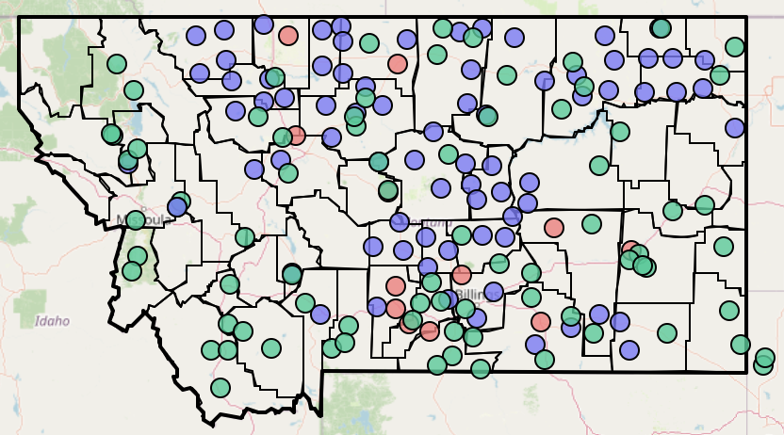
MT Mesonet - A Collaborative Framework
Federal, State, and Private Partnerships
United States Army Corps of Engineers
National Oceanographic and Atmospheric Administration (NOAA)
DOI Bureau of Land Management
USDA Forest Service
MT Department of Agriculture
Stillwater County
Montana Bureau of Mines and Geology
Crow Agency
Montana Department of Natural Resources and Conservation
Lolo Watershed Group
Blackfoot Challenge
Trout Unlimited
National Drought Resilience Partnership
Community Collaborative Rain, Hail and Snow Network (CoCoRahs)
Private landowners
Agrimet Stations
Hydromet Stations
Both
74 stations across the state
178 stations as of this fall
climate.umt.edu/mesonet
Notes:
A densely spaced network that serves landowners and agencies with local soil moisture and weather information required for daily to seasonal decisions
Conduct research and education for application of data
Co-develop user-guided applications and web-interfaces to share data and products
Use Mesonet data to verify drought conditions and improve gridded data sets across MT

Slide 11
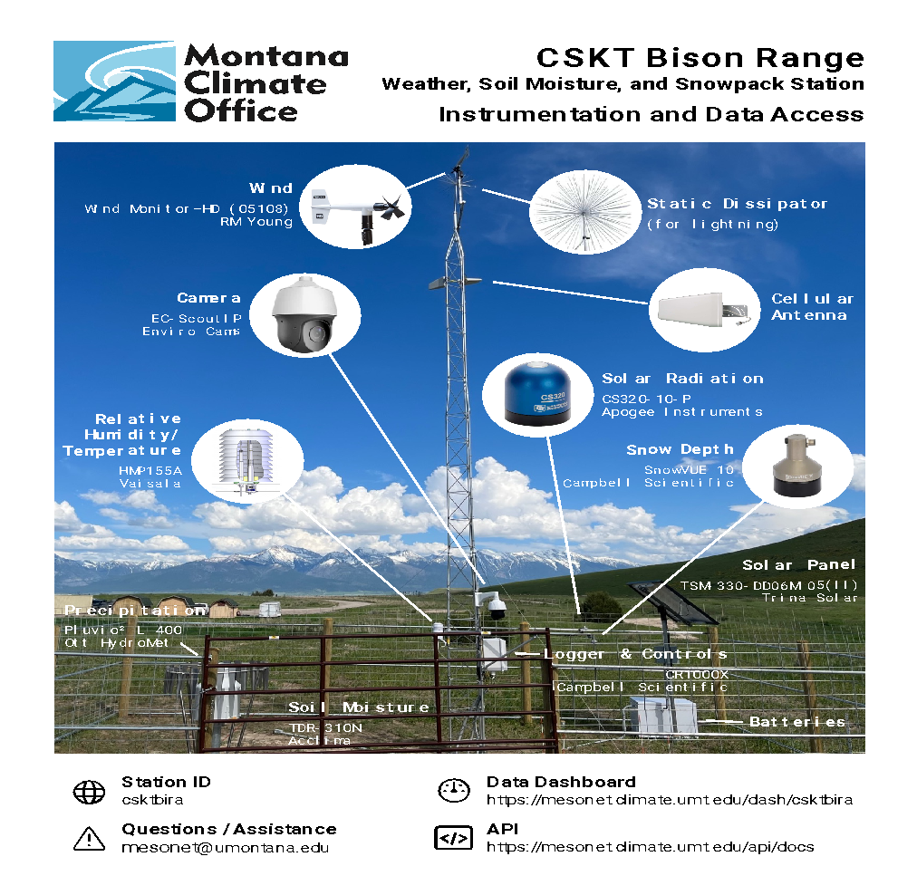
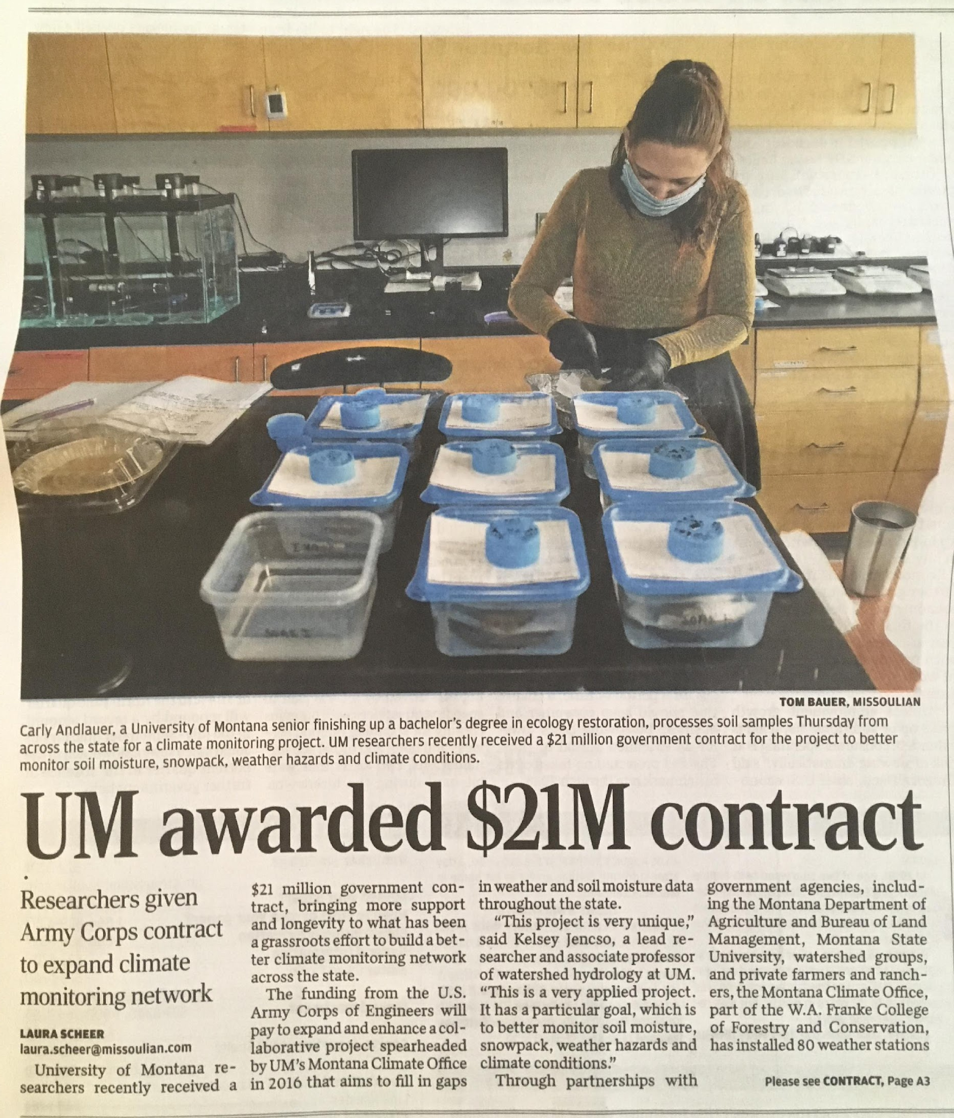
Expansion & Improvements to Drought Infrastructure
U.S. Army Corps
S.4444 - Missouri River Basin Drought and Snowpack Monitoring Act
Introduced by Senator Thune (SD) with bi-partisan support
Upper Missouri River Basin and elevations below 5,500 feet
205 more stations in MT and 500 total across the five-state region.
CSKT Bison Range Station

Slide 12
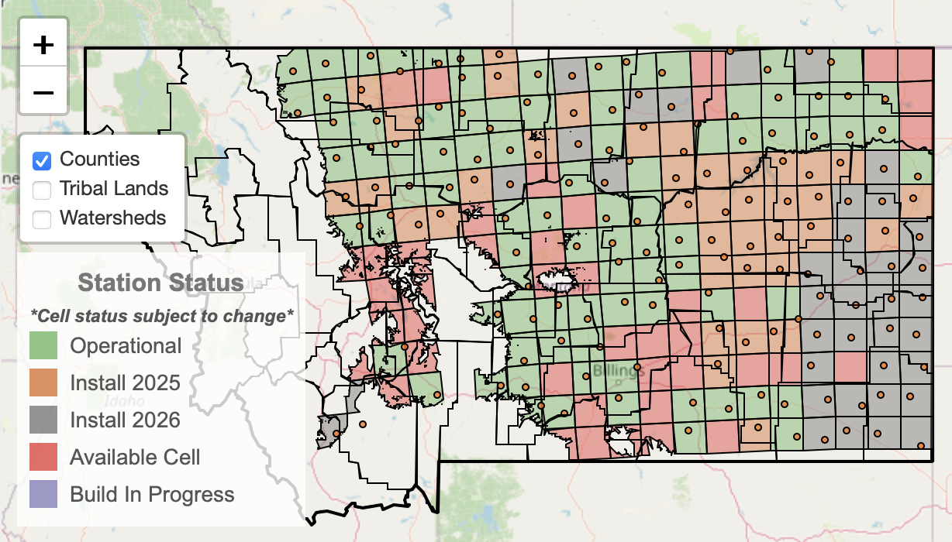
Mesonet Timeline and Progress
1 station every ~500 mi²

Slide 13
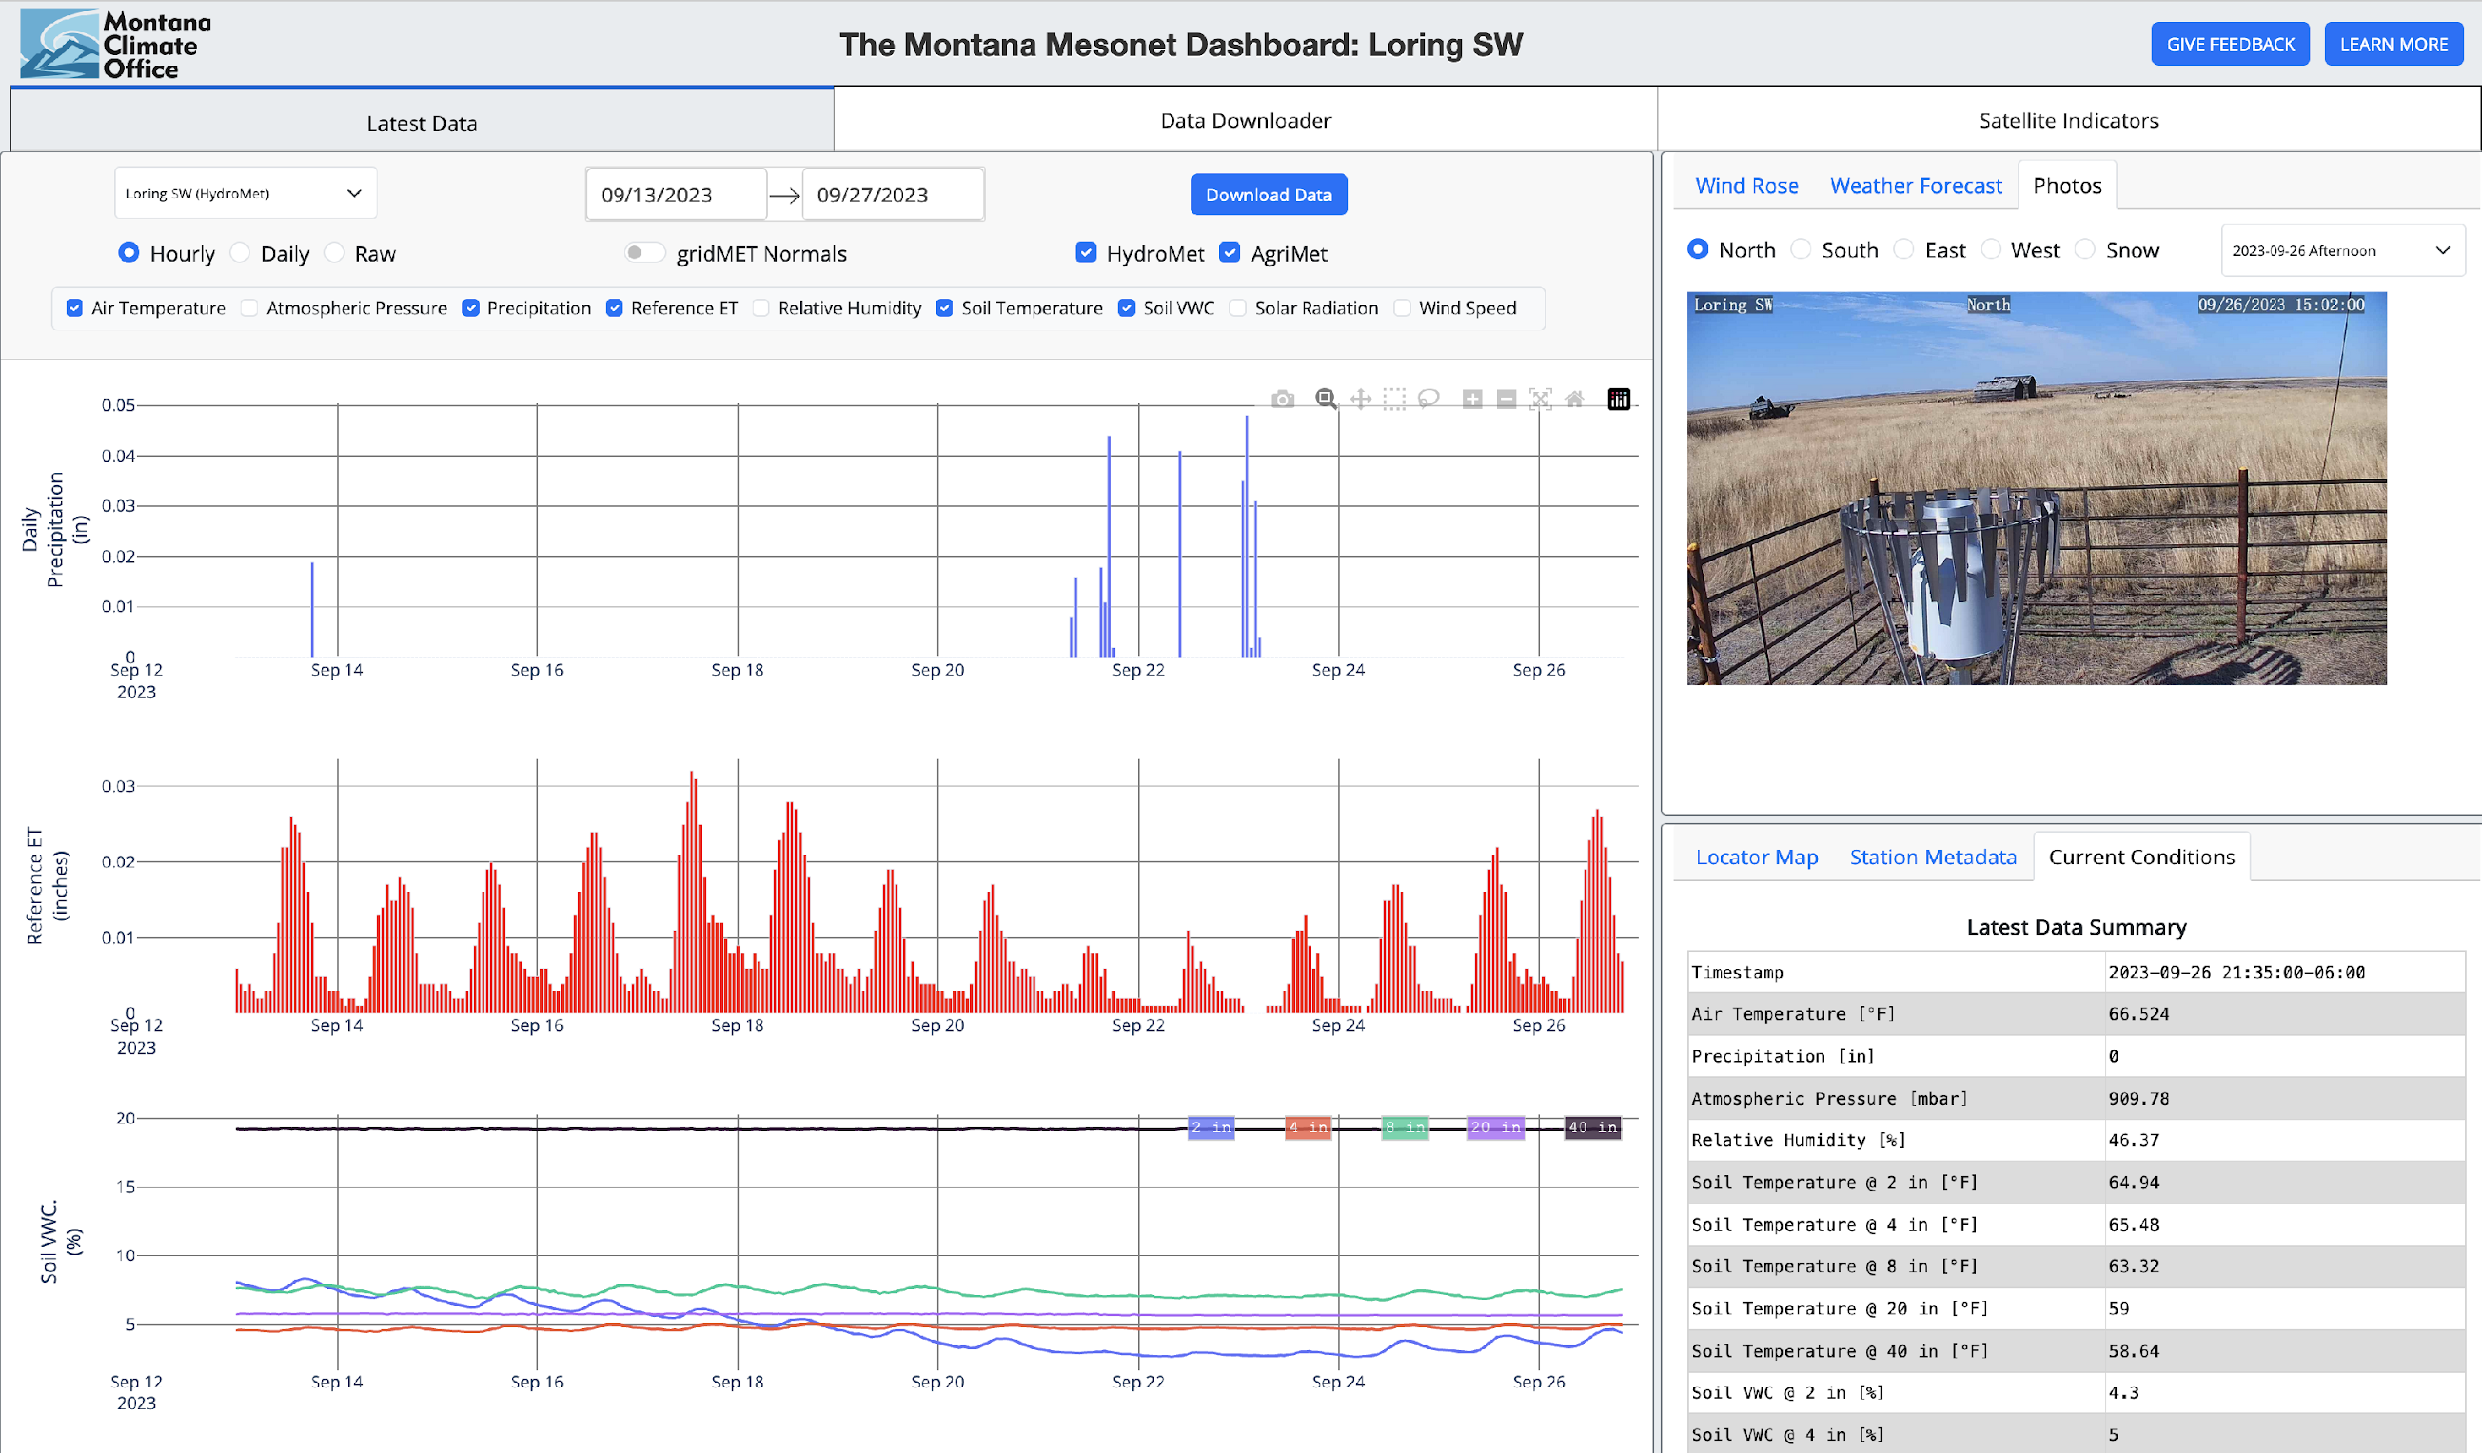
Mesonet Data Availability
Publicly available
Map based and graphical summaries
Updated every 5 minutes
Data used by NOAA and USACE for weather forecasting, flood prediction, and reservoir management
Colin Brust (MCO)
mesonet.climate.umt.edu/dash

Slide 14
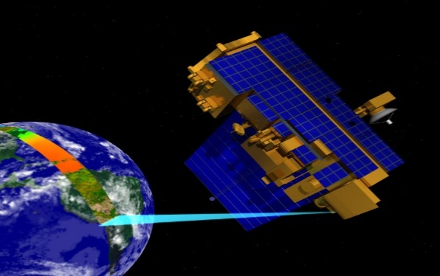
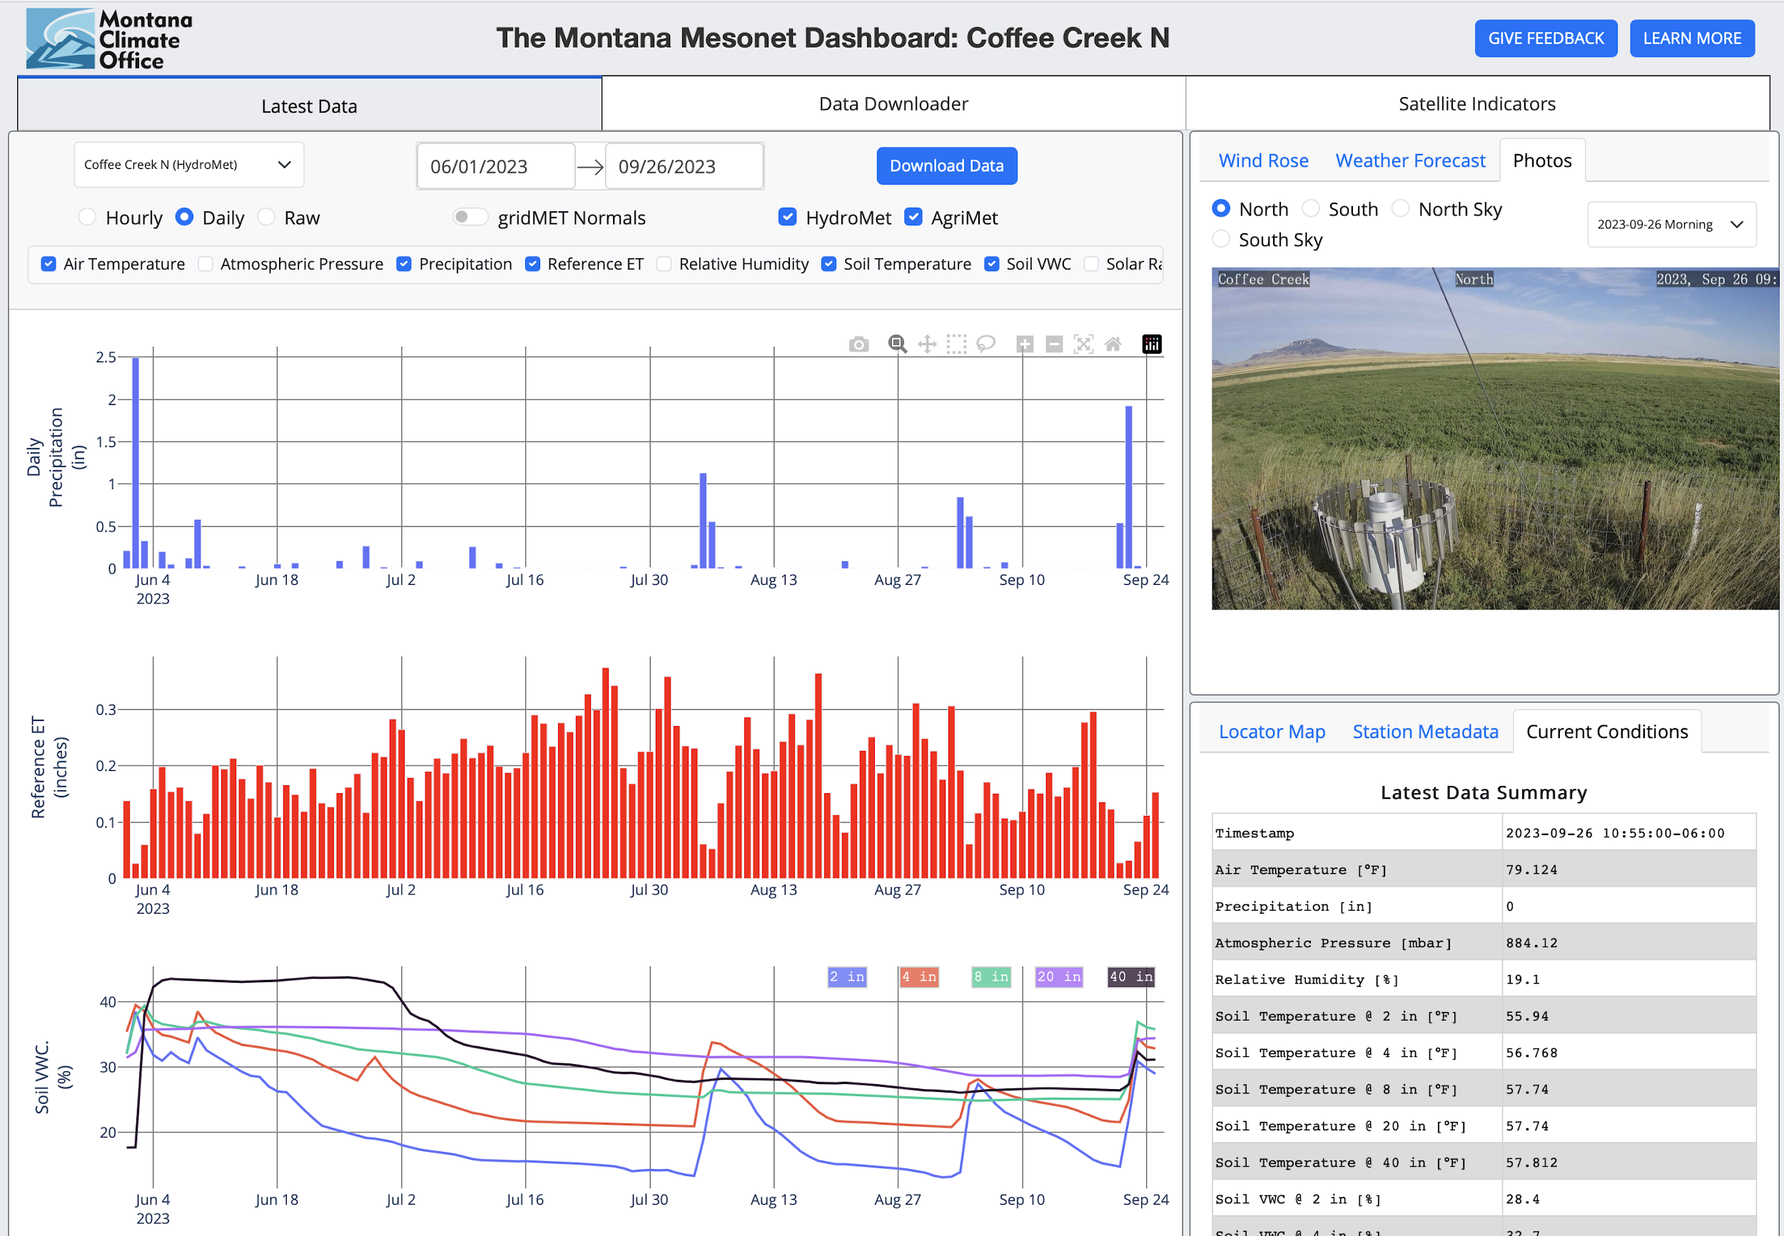
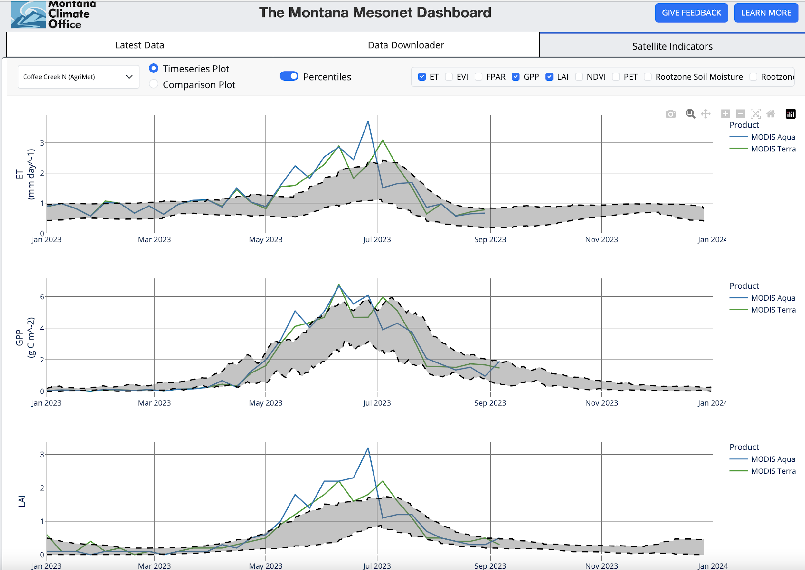
Mesonet Data – Precision Agriculture & Rangeland Management
Tureck Ranch – Denton, MT
”It’s been one of the most productive years (2023) that I can remember” – Judy Tureck

Slide 15
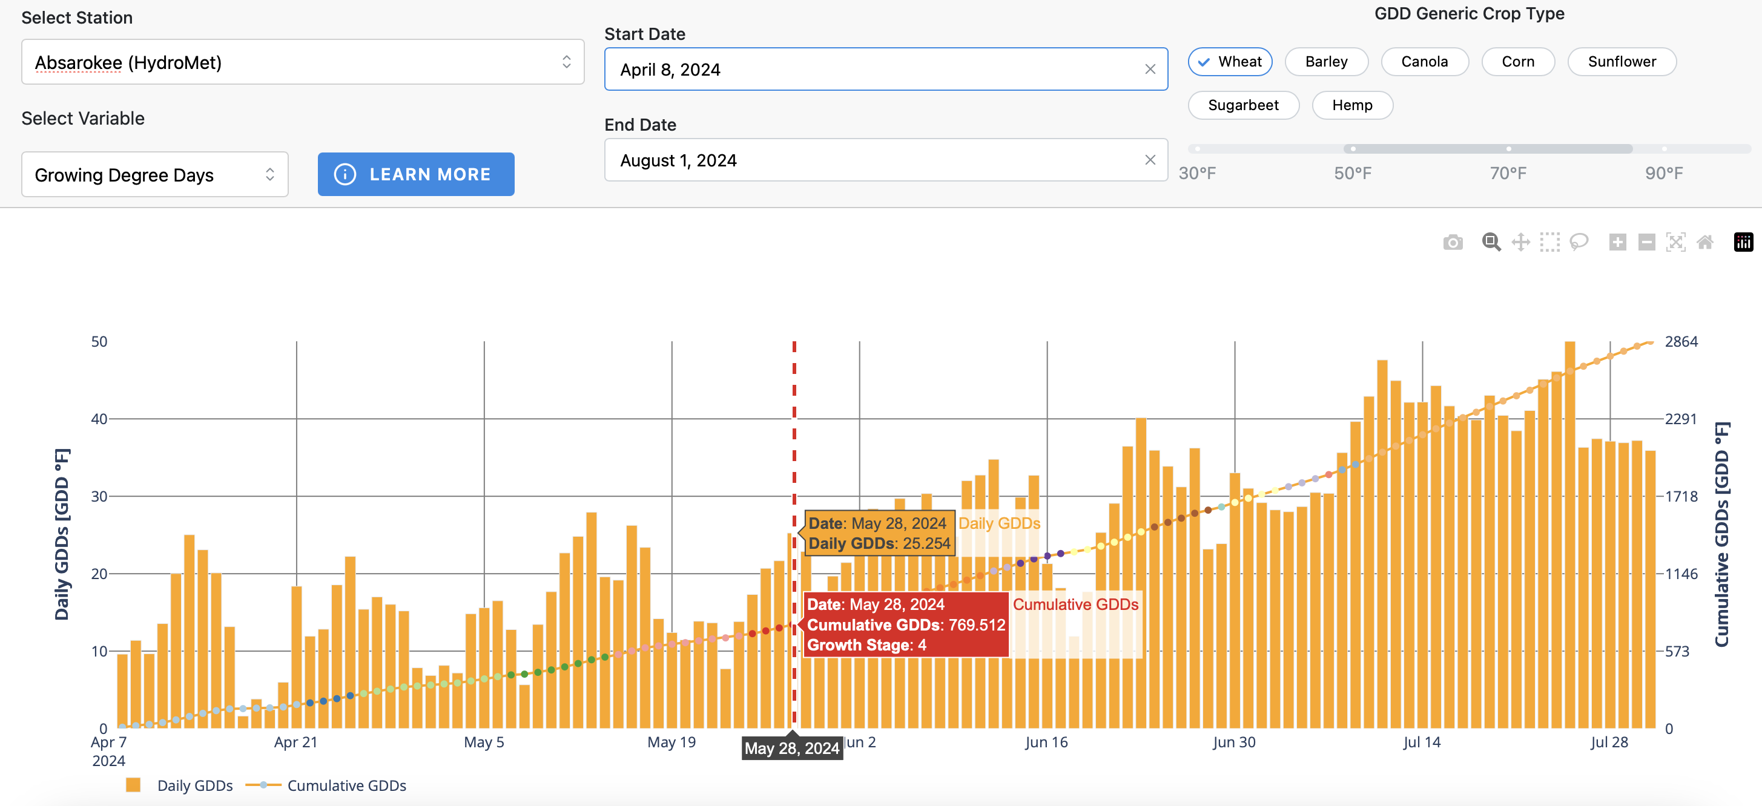
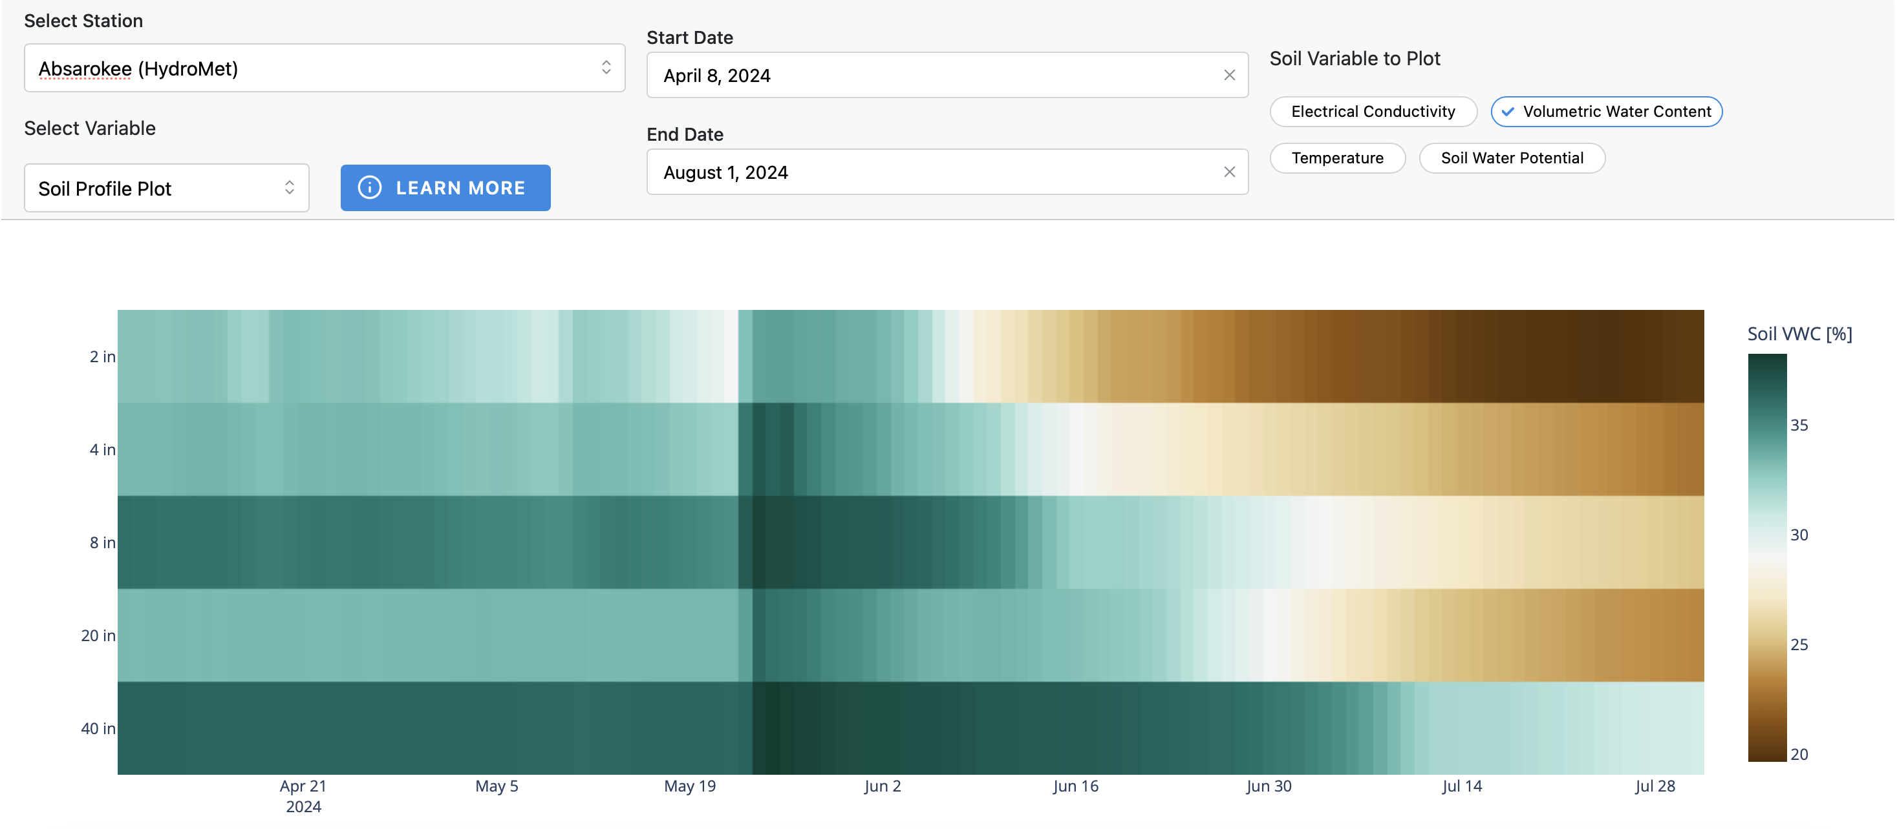
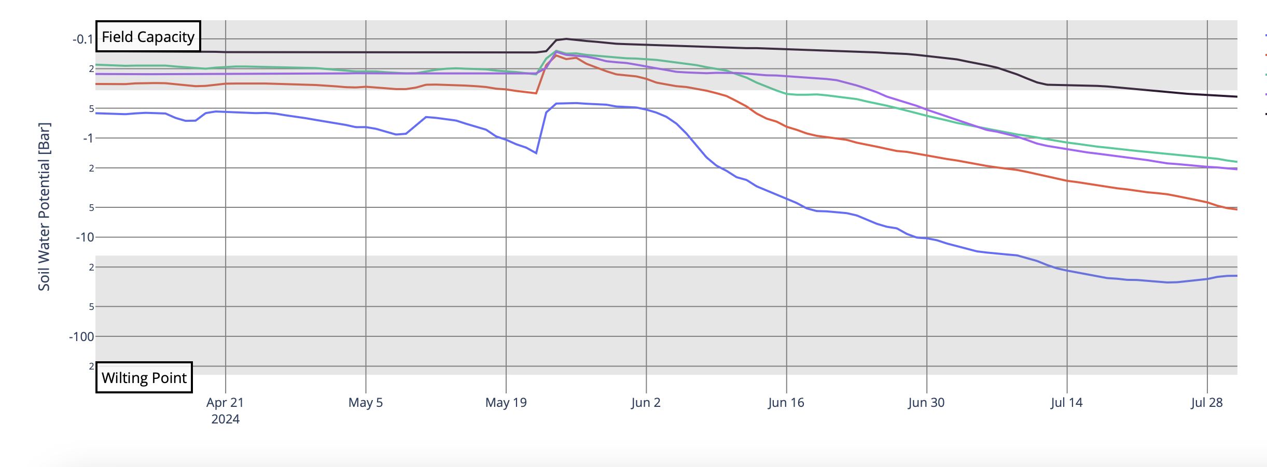
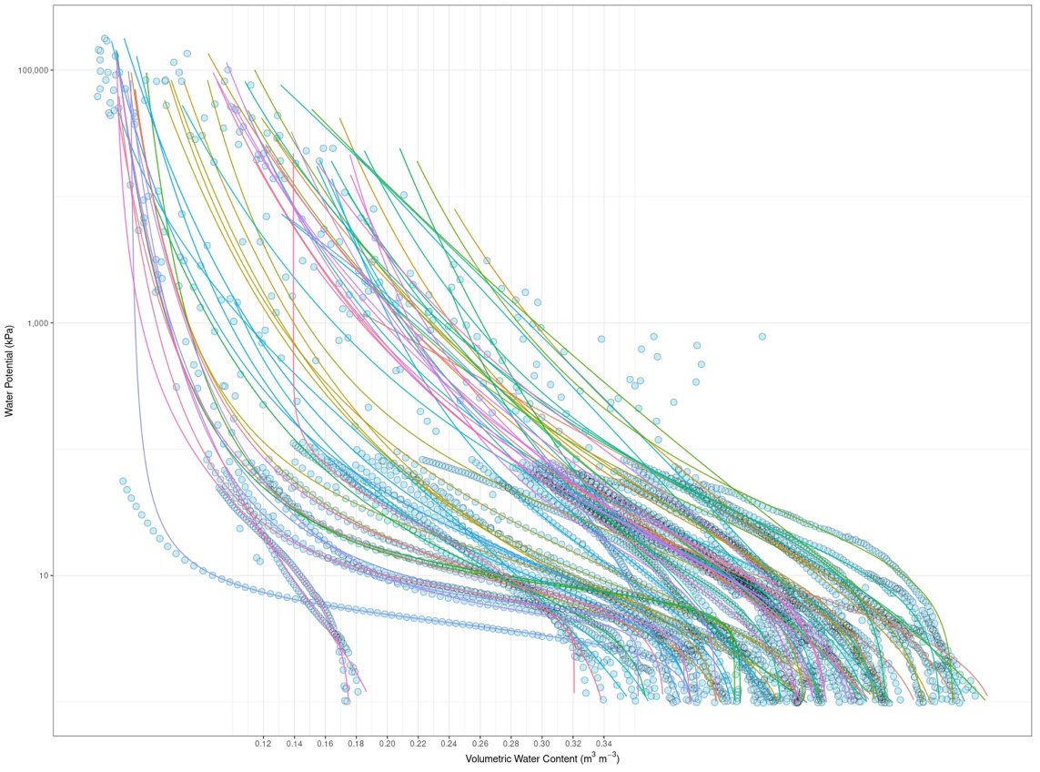
Mesonet Data – Precision Agriculture & Rangeland Management
Growing Degree Days for Crops
Soil Moisture Profiles
Reference ET for Irrigation Demands
Plant Available Water

Slide 16
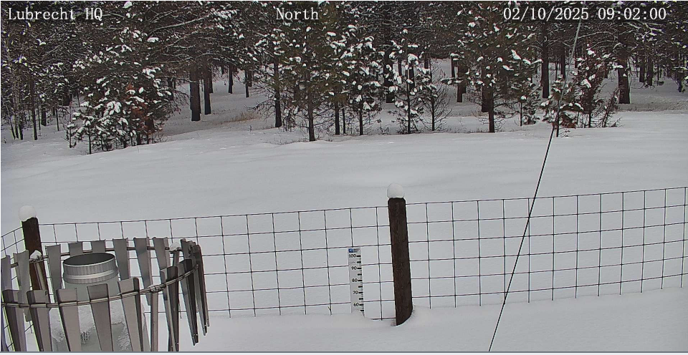
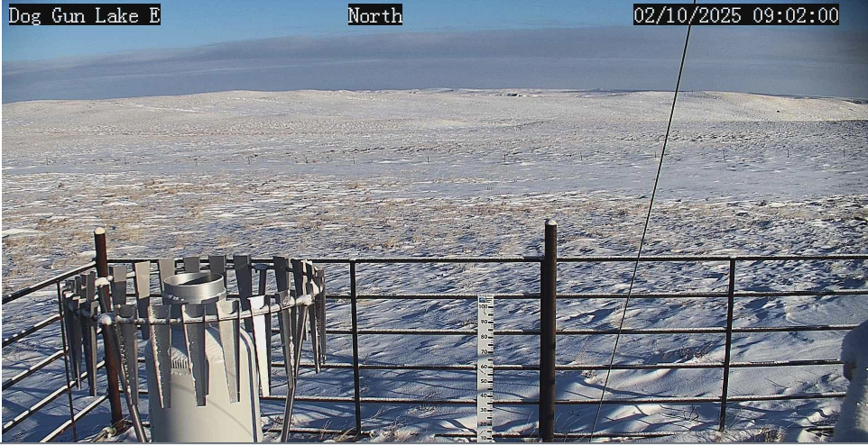
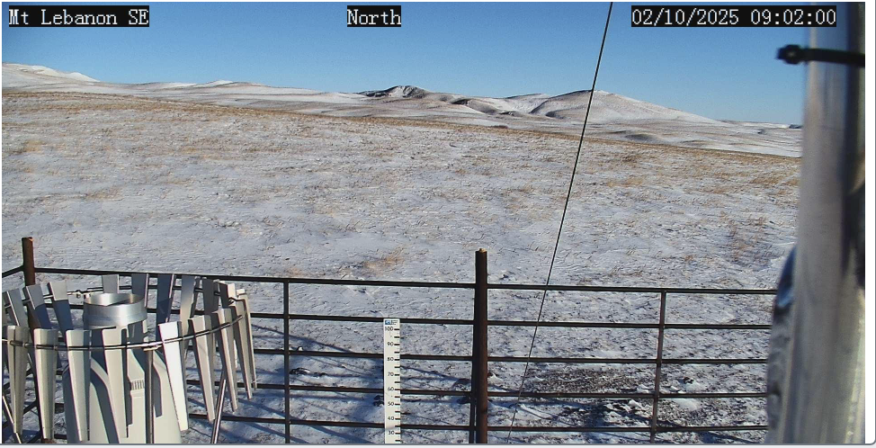
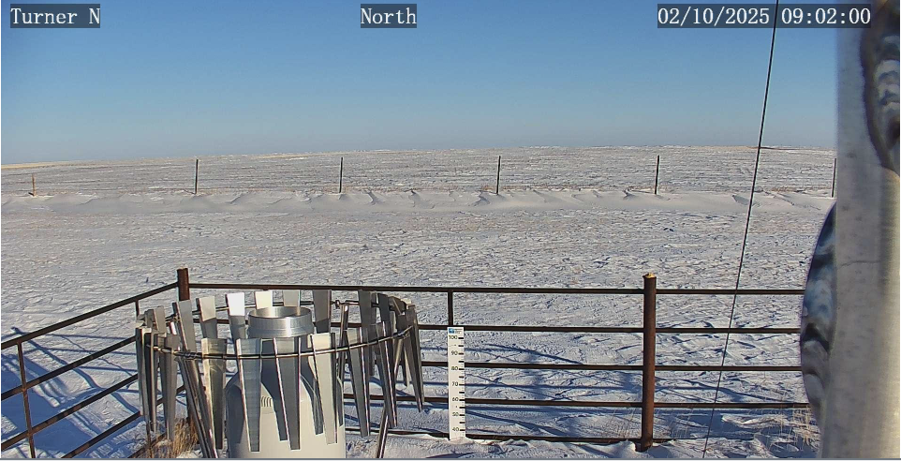
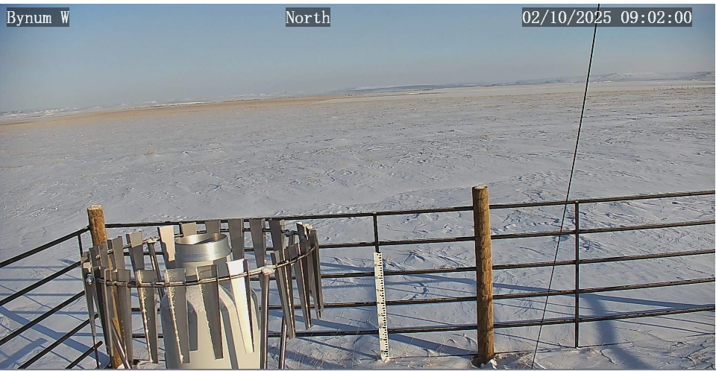
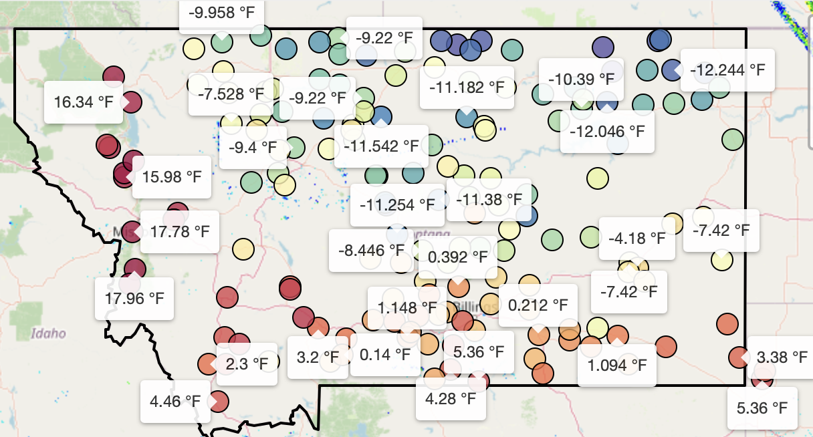
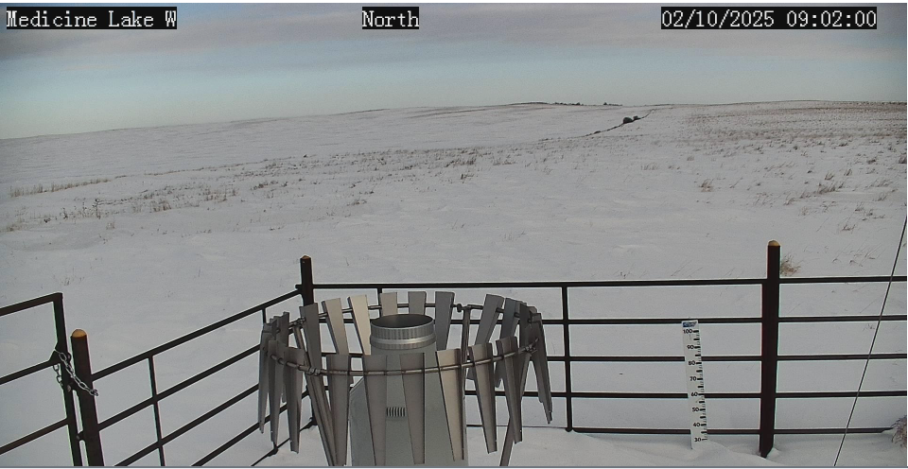
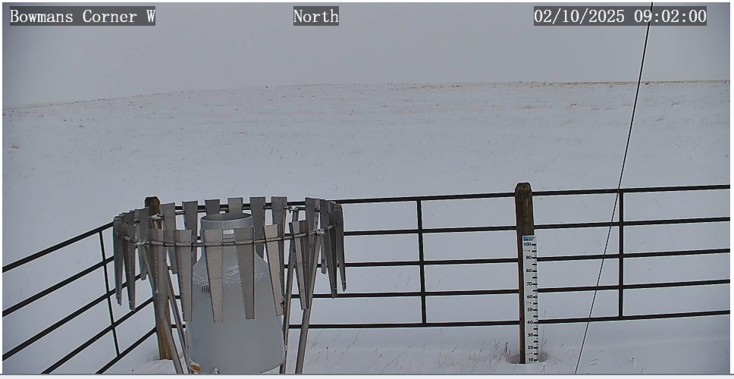
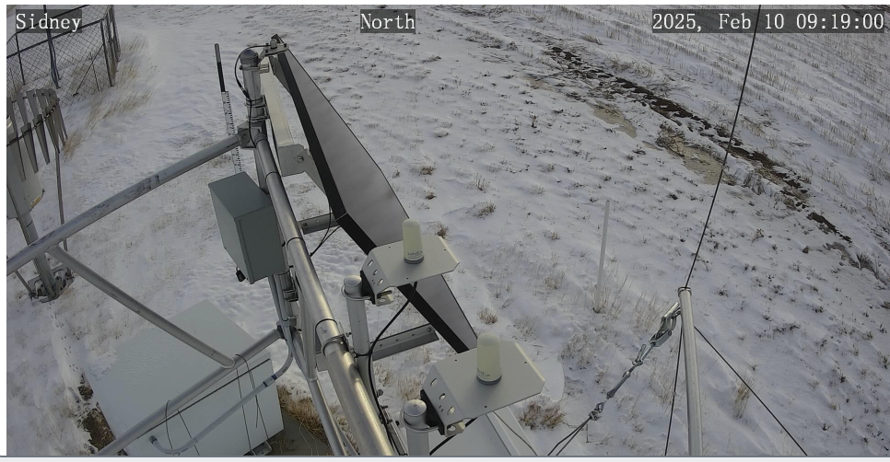
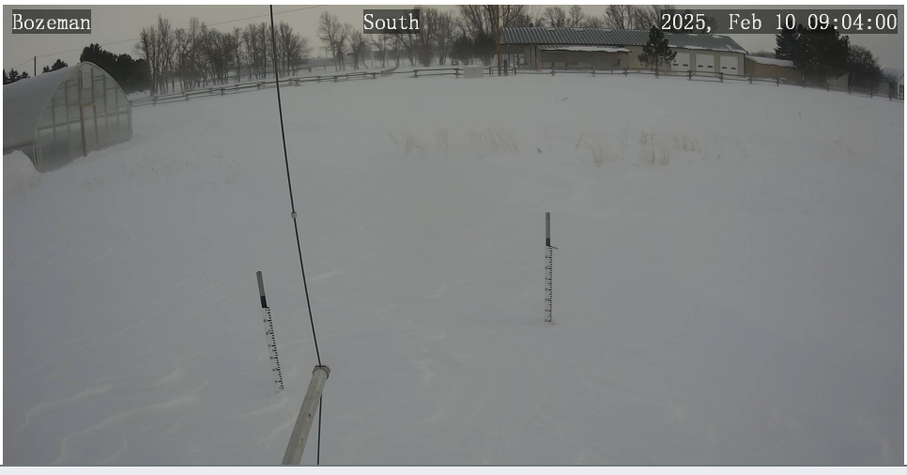
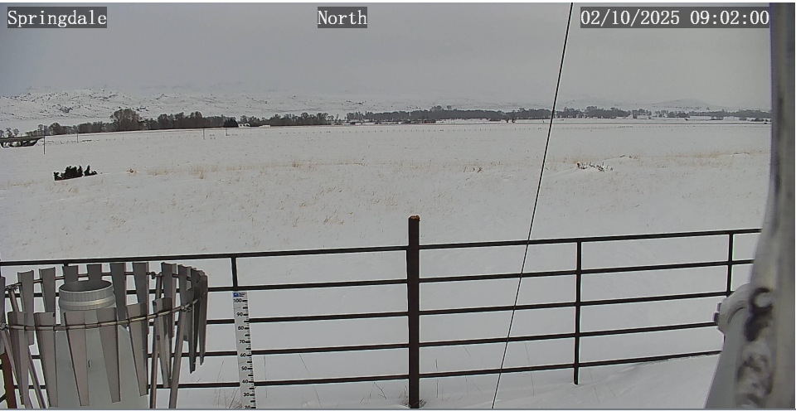
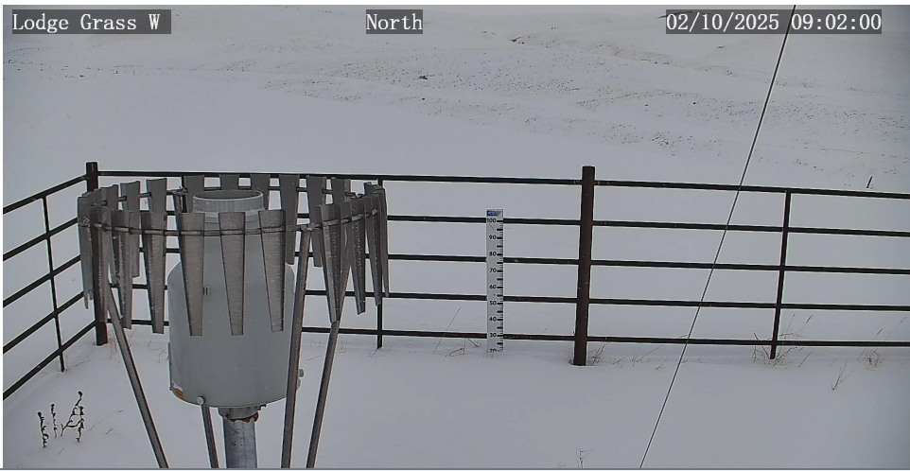
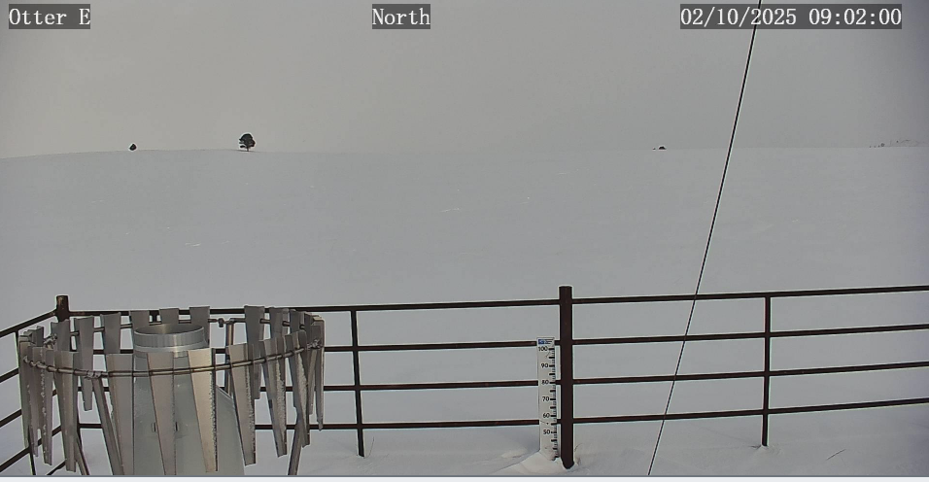
02/10/25 – Monday’s PTZ camera photos
How does the state look in terms of drought or weather?

Slide 17
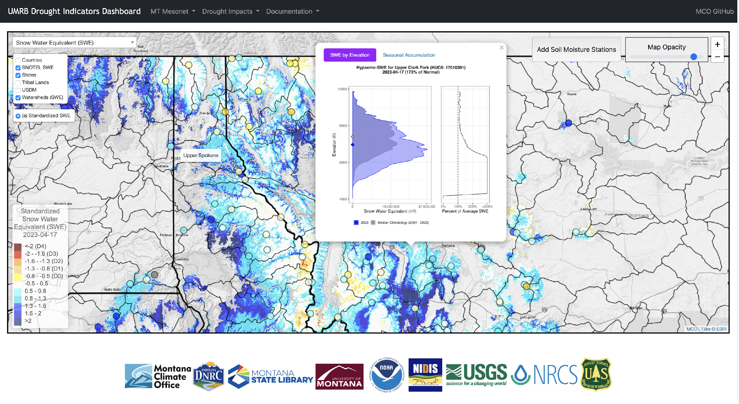
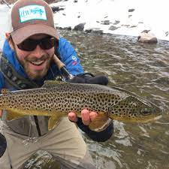
3. Better characterizations of drought & water supply conditions “No one trusts a model except the person who wrote it; everyone trusts an observation, except the person who made it.”
The UMRB Drought Dashboard
Daily modeling of precipitation, temperature, snow, soil moisture, evapotranspiration and drought models across Montana
Science based tool for drought mapping by the state of Montana and for evidence-based reporting to the USDM
Zach
Hoylman
drought.climate.umt.edu
Notes:
No one trusts a model except the man who wrote it; everyone trusts an observation, except the man who made it. Theories crumble, but good observations never fade.

Slide 18
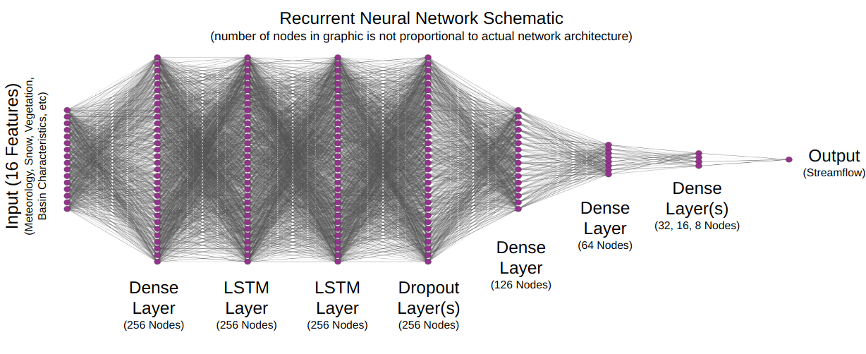
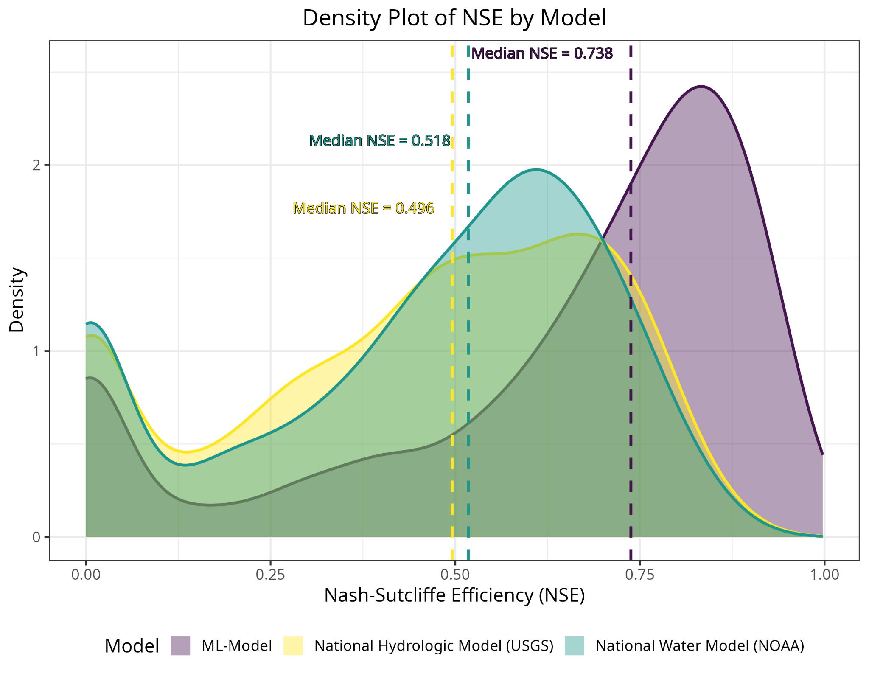
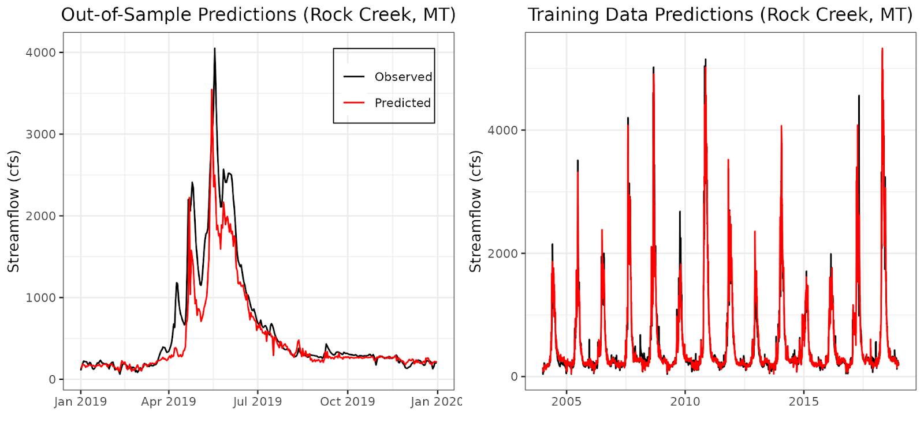
AI approaches to streamflow and soil moisture characterization
LSTM models for streamflow and soil moisture predictions
Daily streamflow predictions in all MT ungauged basins (HUC10)
Daily and weekly forecasts for flood early warning
Operational on the MT Drought Dashboard
Field scale soil moisture is on the way!

Slide 19
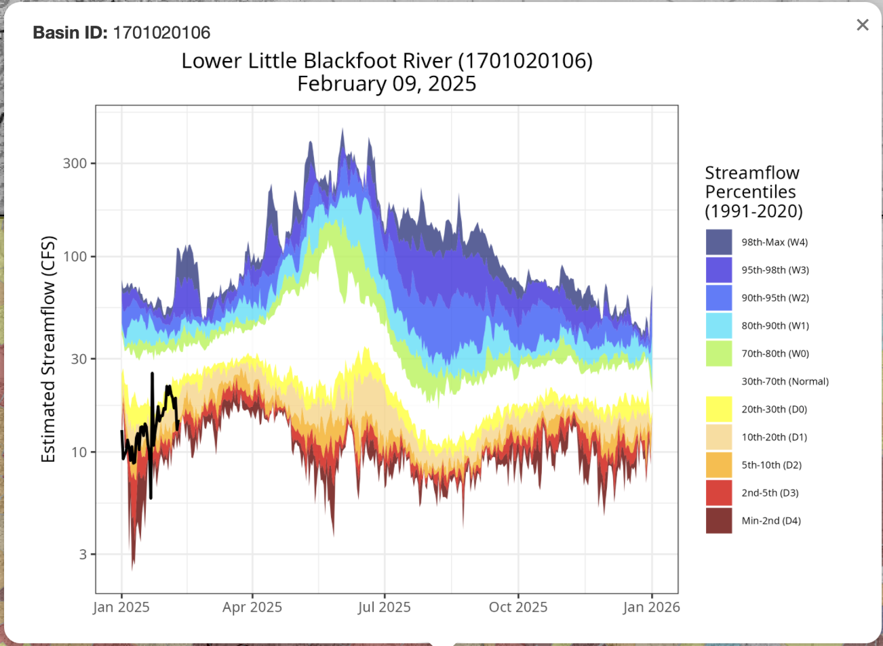
Machine Learning - Streamflow Everywhere

Slide 20
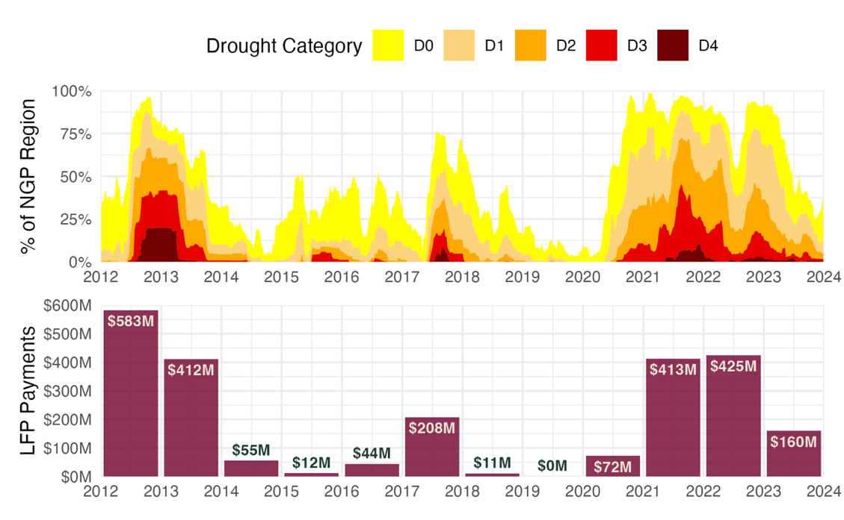
So why do valid data and models matter?
Livestock Forage Disaster Program alone has paid out $2,400,000,000 in MT, WY, SD, and ND since 2012
Ensuring the appropriate allocation of funds to support our food systems and rural communities across Montana!

Slide 21
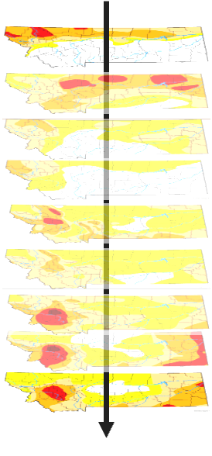
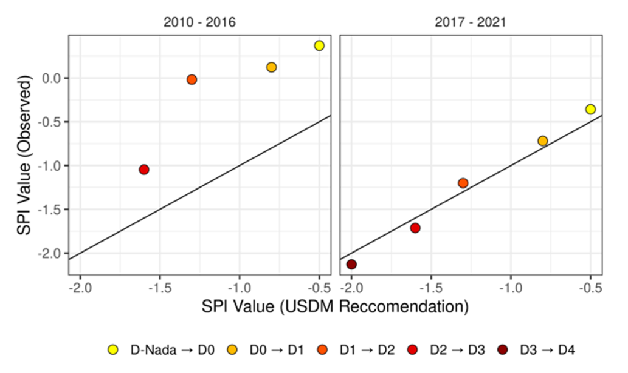
Progress towards better drought & water supply assessments
2010-2016
2018-2024
Median Precip. Anomaly Across Observed USDM Drought Maps
Precip. Anomaly Required for D1-D4 Drought
Improved observations, models, and coordination since the 2017 drought have contributed to more accurate drought predictions in Montana. We still have a long way to go……..

Slide 22
Summary
Our unique geography contributes to spatial differences in where, how often and how fast weather events impact Montanan’s livelihoods and our economy – and it’s a big state
Accurate monitoring and assessment are critical to informing our daily and seasonal response to drought
Your input and support is critical to the long-term sustainability of these efforts!

Slide 23
Questions?
state.climatologist@umontana.edu
Web Resources:
MCO Web Page: https://climate.umt.edu
Climate Data Explorer: https://mco.cfc.umt.edu/datasets
Drought Tracker: https://drought.climate.umt.edu
Seasonal Newsletters: https://climate.umt.edu/mtdrought
Montana Mesonet: https://climate.umt.edu/mesonet

