Slide 1


Navigating the waters ahead –Improvements to Drought and Weather Monitoring in Montana
Kelsey Jencso
Montana State Climatologist
W.A. Franke Endowed Professor of Hydrology
Zachary Hoylman – Asst. Climatologist
Kevin Hyde – Mesonet Site Coordinator
Colin Brust - Data Scientist
Kyle Bocinsky – Dir. Climate Extension

Slide 2
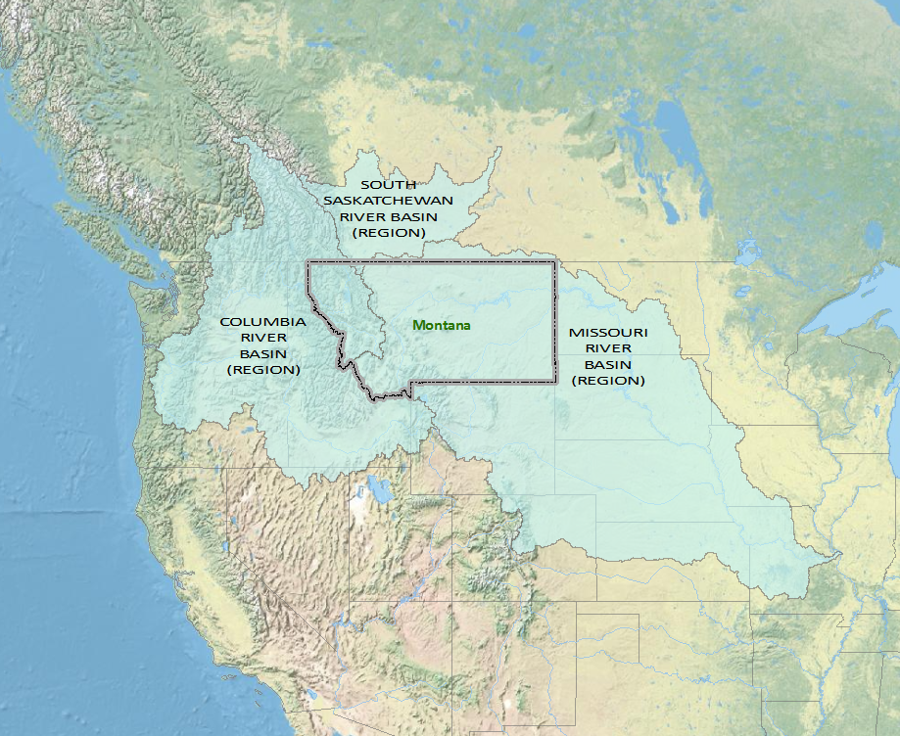
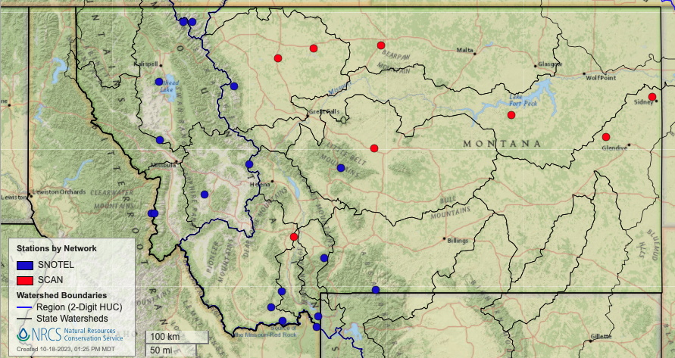
MONTANA AT THE HEADWATERS
Monitoring - more ground-based stations for verification of drought [flood] conditions and for filling monitoring gaps in the context of soil moisture
Western MT: 14 soil moisture stations Central-Eastern MT: 8 soil moisture stations
Notes:
Strategically, Montana sits at the headwaters of three major river basins in North America. Two of these, the Columbia River Basin and the Missouri River Basin, compose almost one-third of the land area of the United States. From a climatic standpoint, we are interested in all watersheds that are contained within Montana or intersect with its borders.

Slide 3
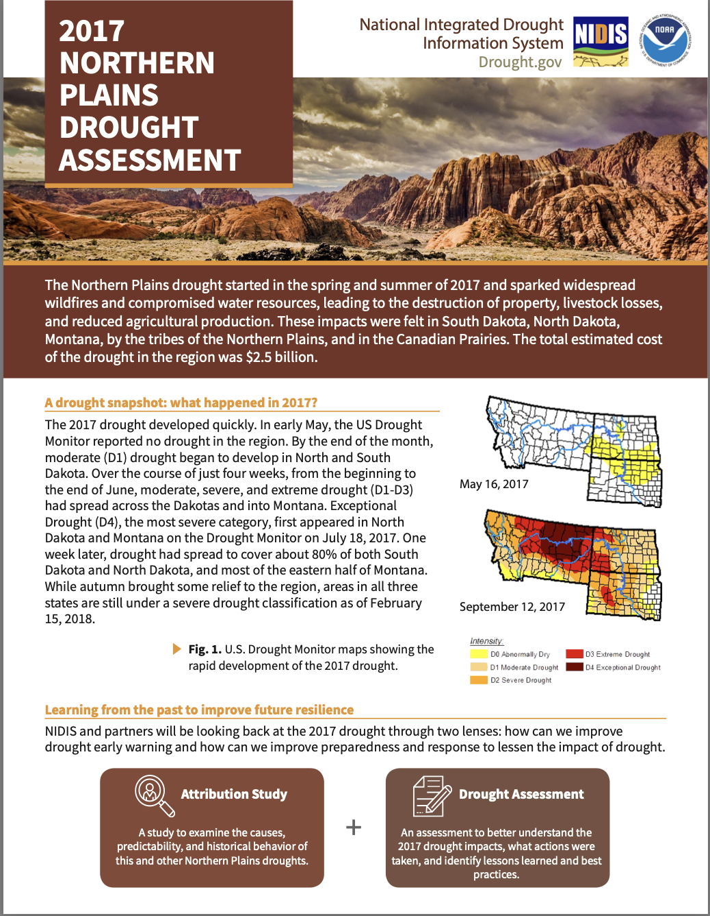
Impetus: The 2017 Flash Drought
$2.5 billion in drought impacts across agricultural and natural resources sectors (drought & fires)
Reviewed the conditions leading to 2017 drought, its impacts and state, tribal, federal and provincial (Canada) responses
Identified much needed improvements for drought management and response by partners in each state
Jencso, K., Parker, B., Downey, M., Hadwen, T., Howell, A., Leaf, J. R., et al. (2019). Flash drought: Lessons learned from the 2017 drought across the US Northern Plains and Canadian Prairies. NOAA National Integrated Drought Information System.

Slide 4
Lessons Learned and Priorities (2017)
Monitoring - more ground-based stations for verification of drought [flood] conditions and for filling monitoring gaps in the context of soil moisture – The Montana Mesonet
Drought Modeling: need to evaluate and develop continuous drought models for timely and accurate predictions of drought onset and magnitude – The Montana Drought Dashboard
Coordination – need for better communication, coordination and assessment of drought on a regular basis – The DWSAC Monitoring Sub-committee
Enhancing the Drought Early Warning System in the Upper Missouri River Basin
Notes:
POP UP ON NOAA NIDIS FUNDING

Slide 5
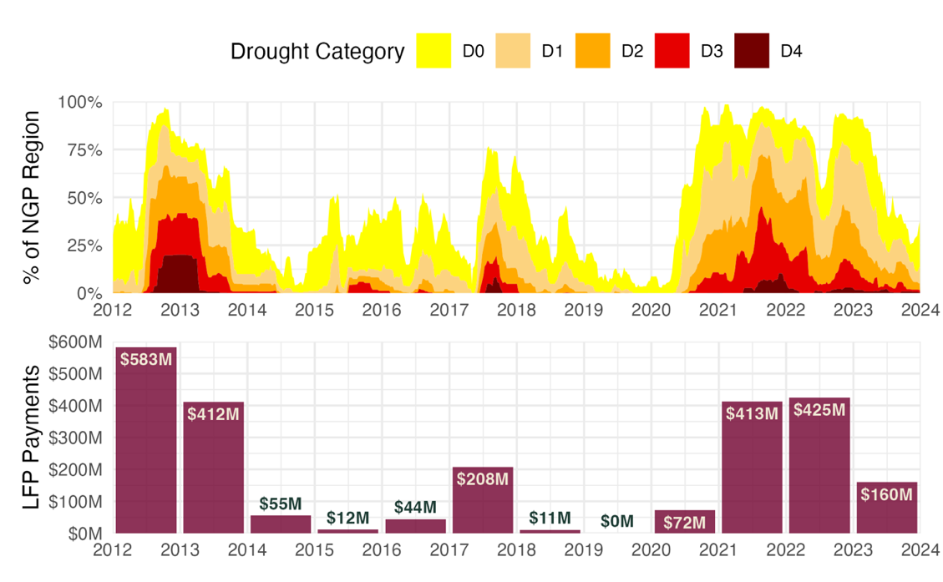
Why do valid data and models matter?
Livestock Forage Disaster Program alone has paid out $2,400,000,000 in MT, WY, SD, and ND since 2012
Ensuring accurate allocation of funds to support our food systems and rural communities across Montana!

Slide 6
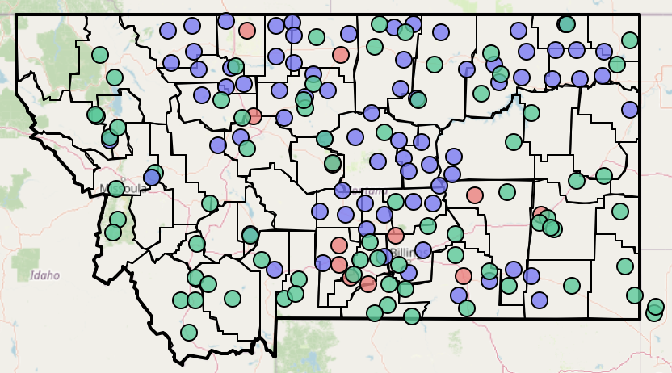
MT Mesonet - A Collaborative Framework
  Federal, State, and Private Partnerships
  United States Army Corps of Engineers
  National Oceanographic and Atmospheric Administration (NOAA)
  DOI Bureau of Land Management
  USDA Forest Service
  MT Department of Agriculture
  Stillwater County
  Montana Bureau of Mines and Geology
  Crow Agency
  Montana Department of Natural Resources and Conservation
  Lolo Watershed Group
  Blackfoot Challenge
  Trout Unlimited
  National Drought Resilience Partnership
  Community Collaborative Rain, Hail and Snow Network (CoCoRahs)
  Private landowners
Agrimet Stations
Hydromet Stations
Both
74 stations across the state
180 stations
climate.umt.edu/mesonet
Notes:
A densely spaced network that serves landowners and agencies with local soil moisture and weather information required for daily to seasonal decisions
Conduct research and education for application of data
Co-develop user-guided applications and web-interfaces to share data and products
Use Mesonet data to verify drought conditions and improve gridded data sets across MT

Slide 7
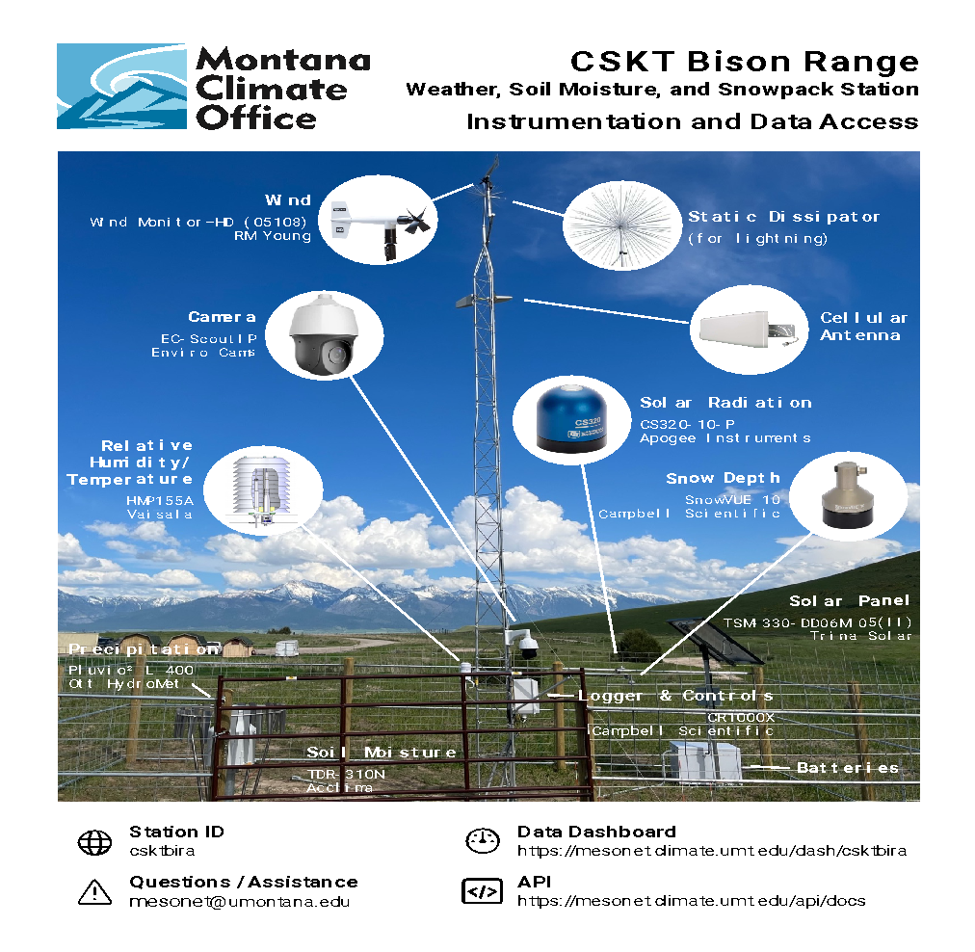
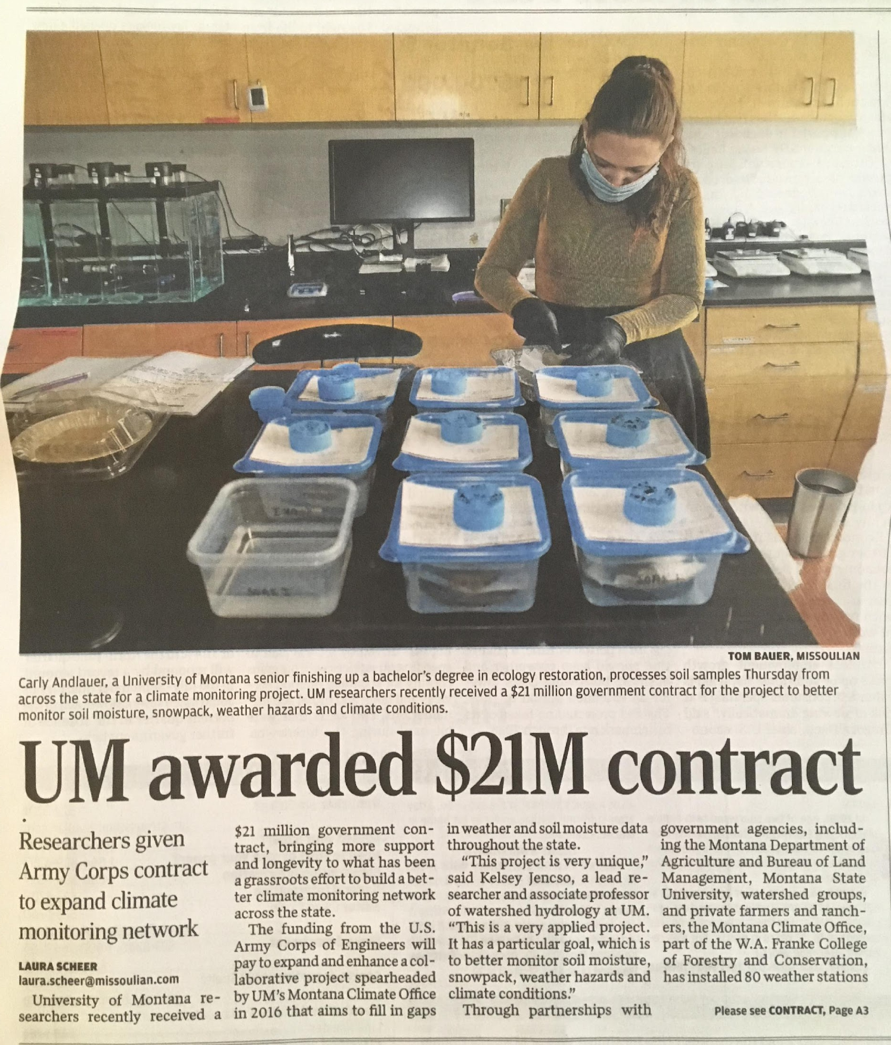
Expansion & Improvements to Drought Infrastructure
U.S. Army Corps
S.4444 - Missouri River Basin Drought and Snowpack Monitoring Act
Introduced by Senator Thune (SD) with bi-partisan support
Upper Missouri River Basin and elevations below 5,500 feet
205 more stations in MT and 500 total across the five-state region.
CSKT Bison Range Station

Slide 8
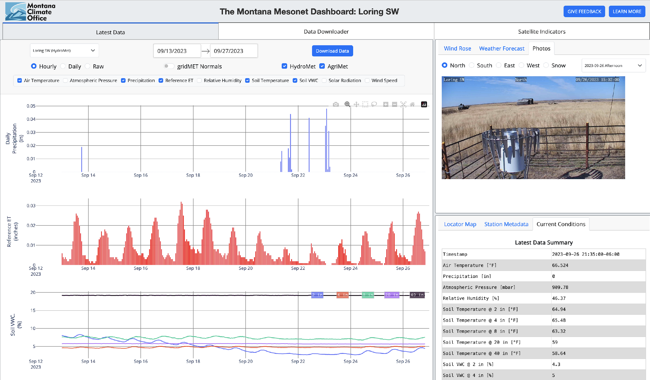
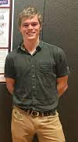

Mesonet Data Availability
Publicly available
Map based and graphical summaries
Updated every 5 minutes
Data used by NOAA and USACE for weather forecasting, flood prediction, and reservoir management
Colin Brust (MCO)
mesonet.climate.umt.edu/dash

Slide 9

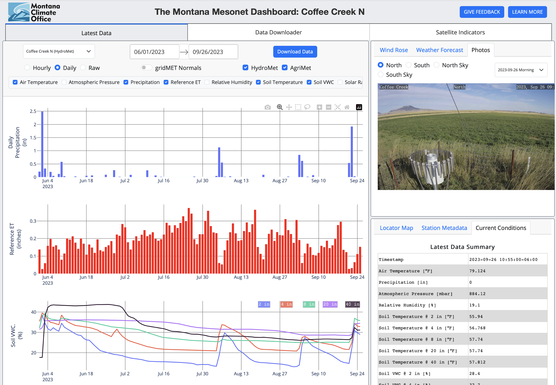
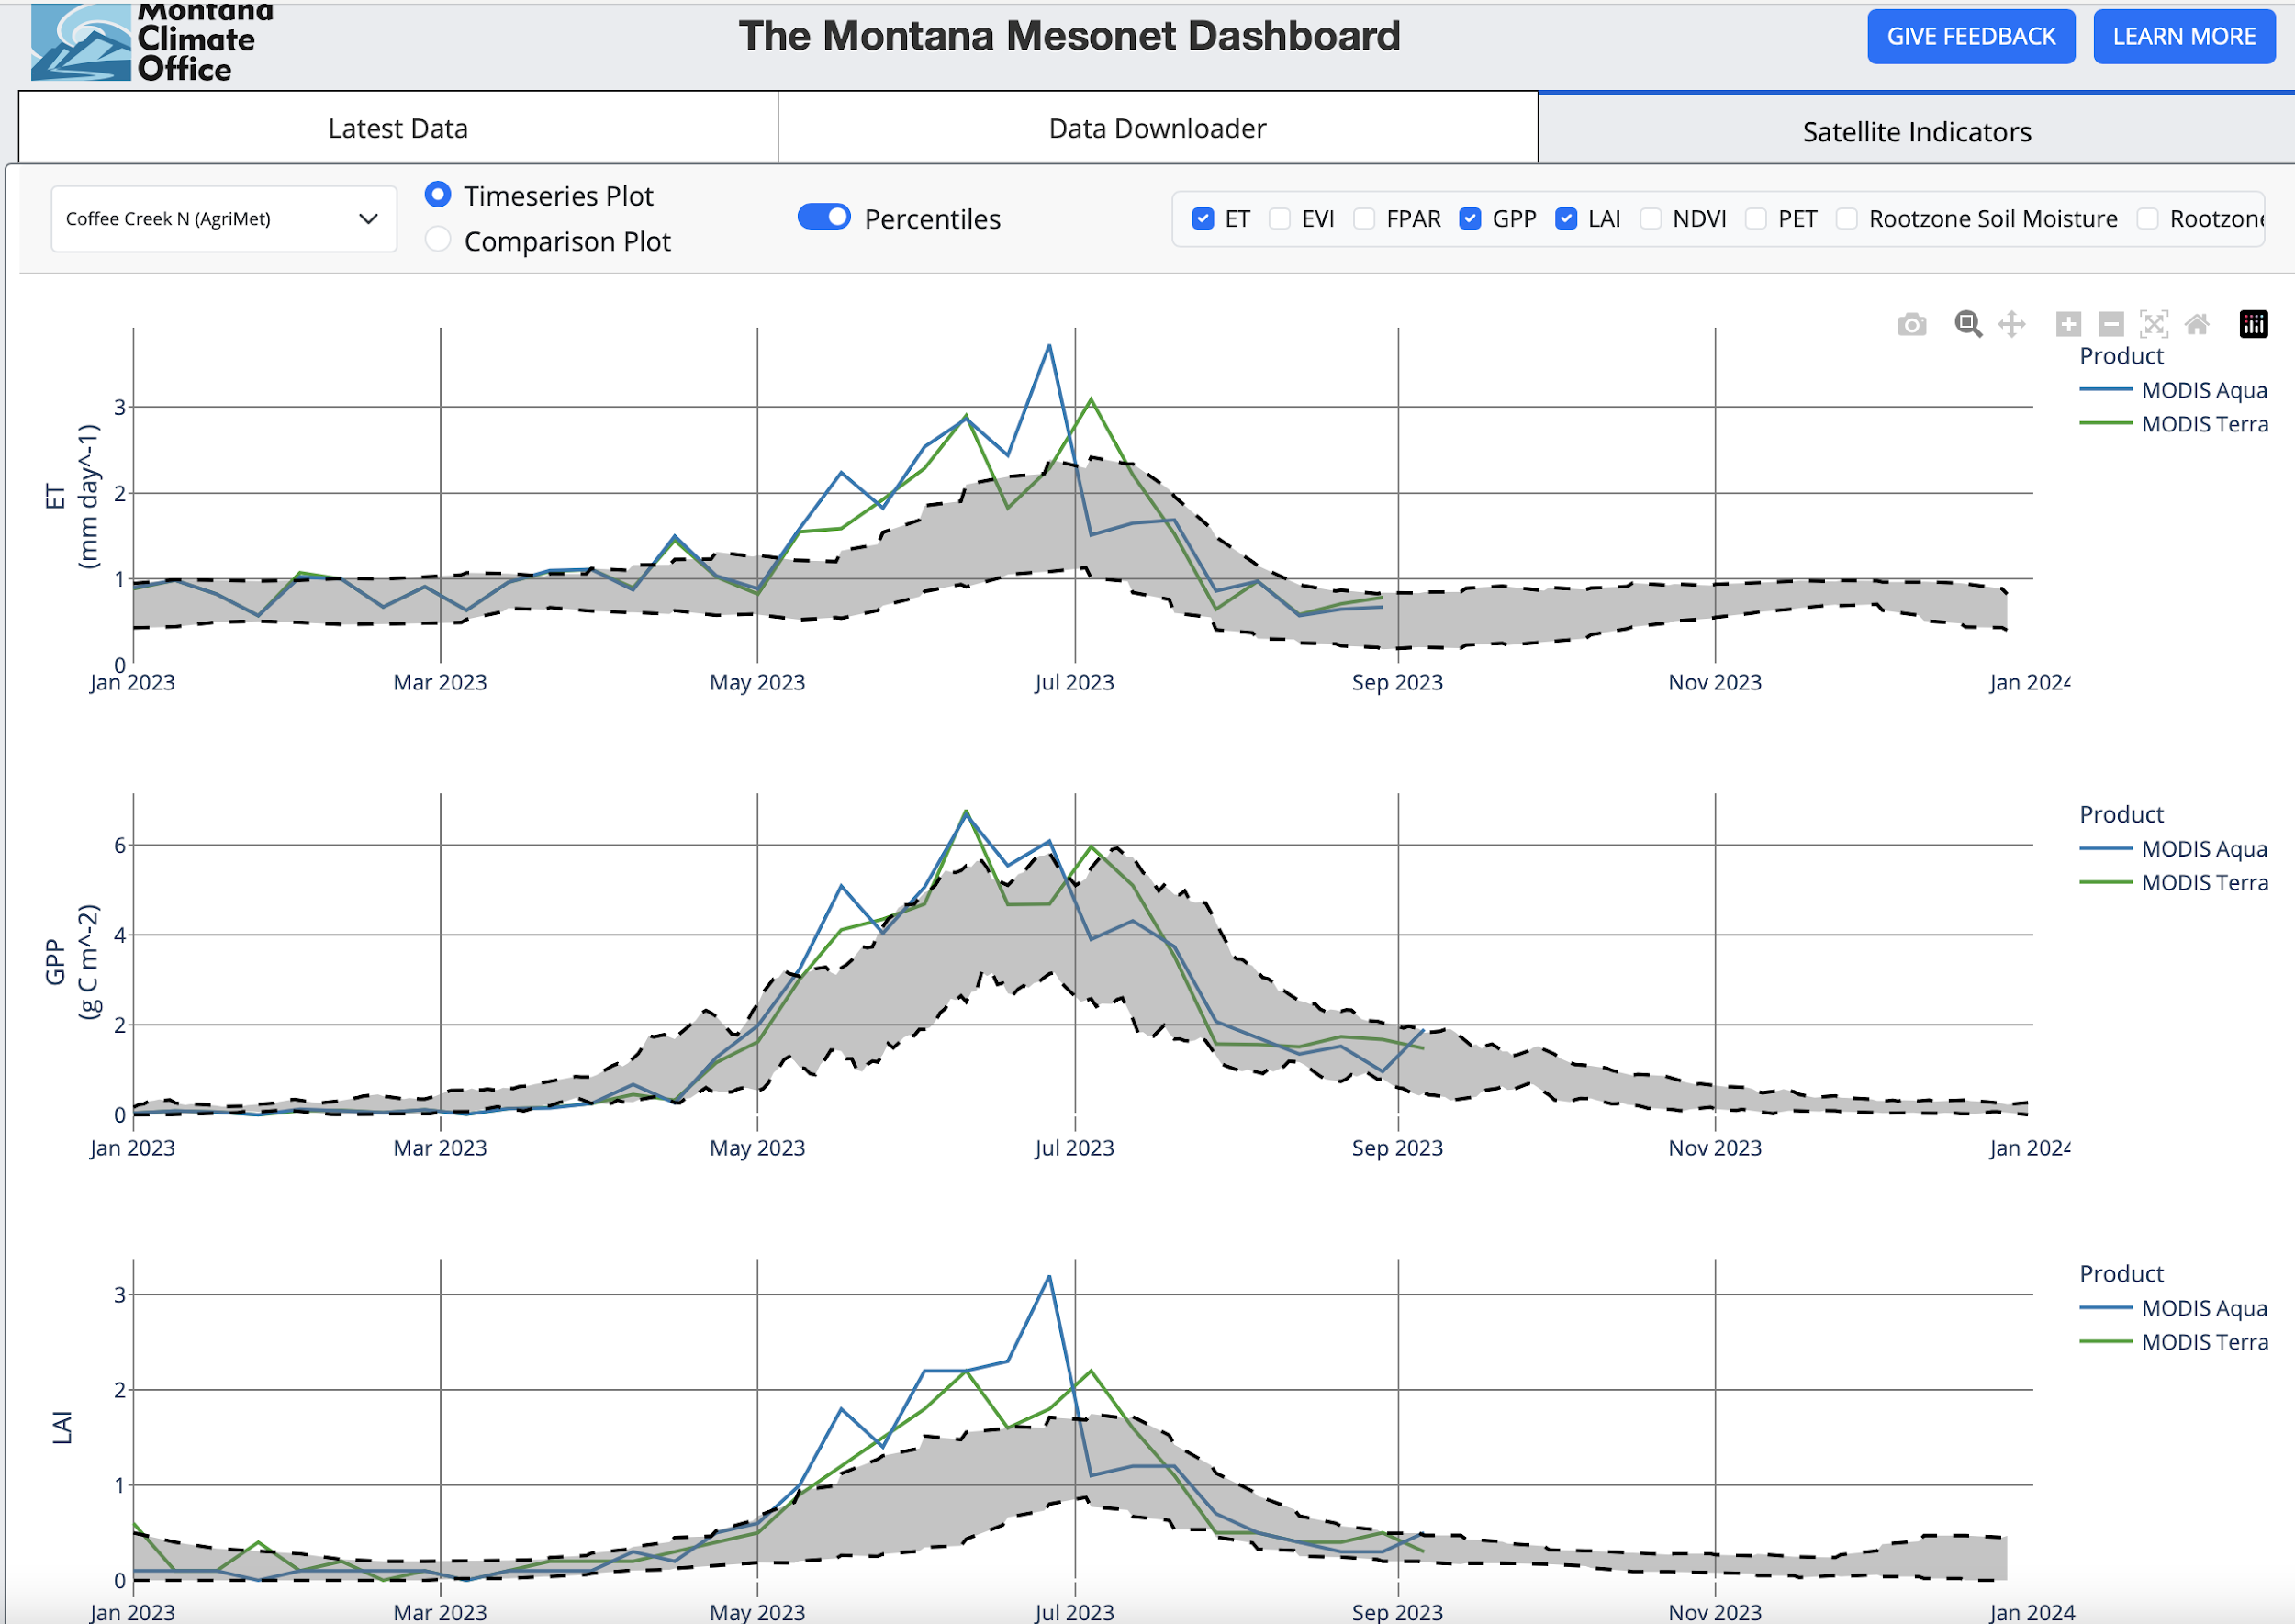
Mesonet Data – Operational Agriculture & Rangeland Tools to Enhance On Farm Savings
Tureck Ranch – Denton, MT
”It’s been one of the most productive years (2023) that I can remember” – Judy Tureck

Slide 10
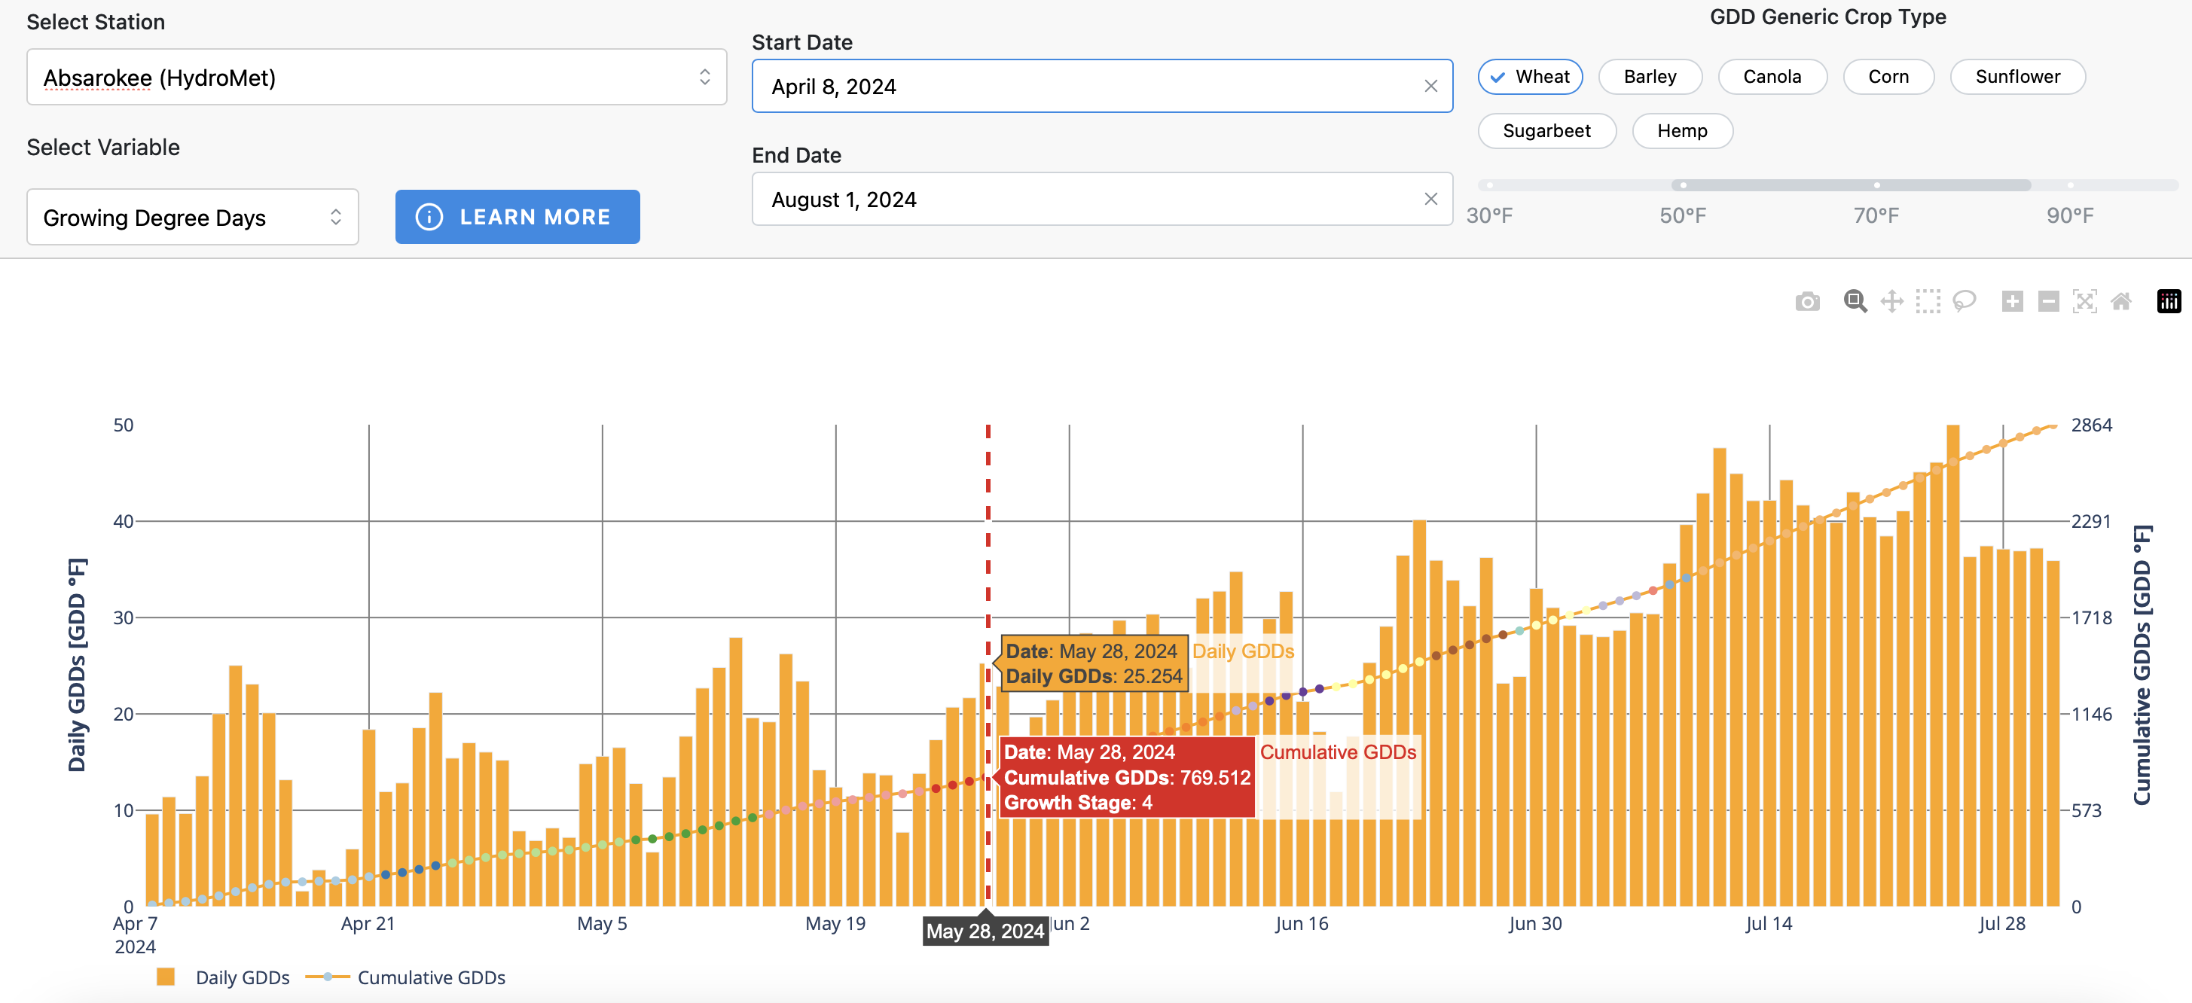
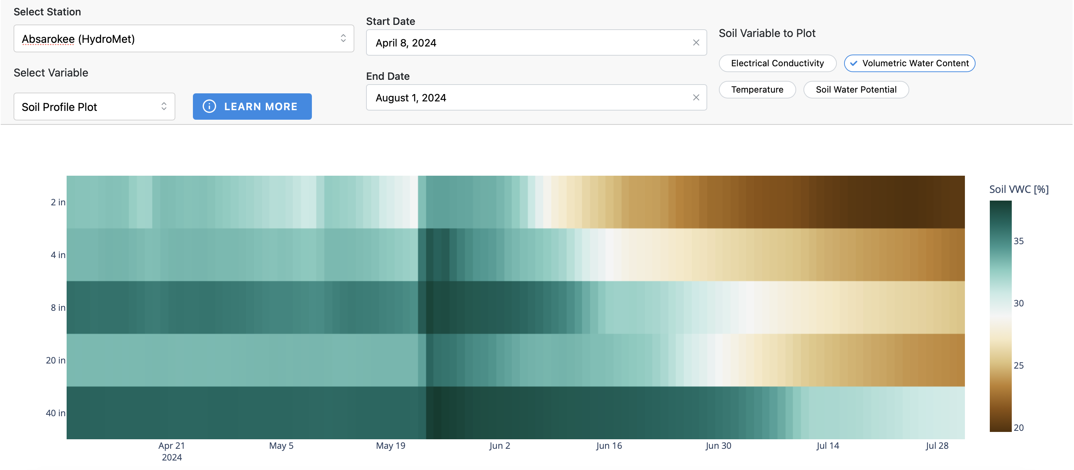

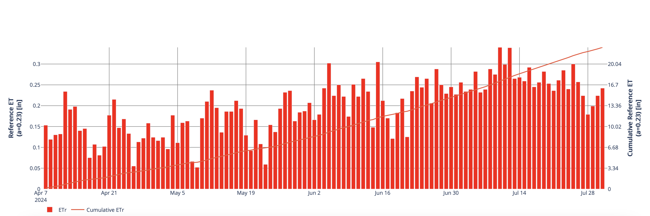
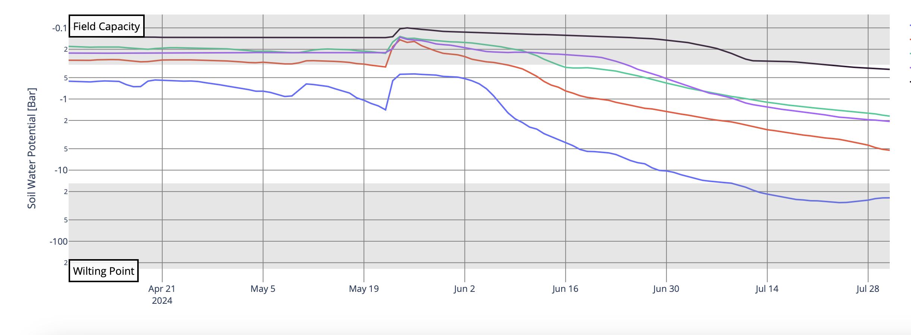

Mesonet Data – Precision Agriculture & Rangeland Tools to Enhance On Farm Savings
Growing Degree Days for Crops
Soil Moisture Profiles
Reference ET for Irrigation Demands
Plant Available Water

Slide 11
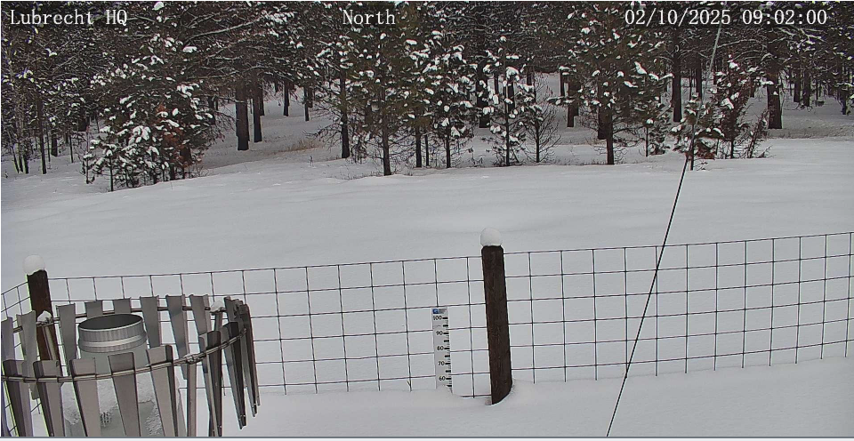
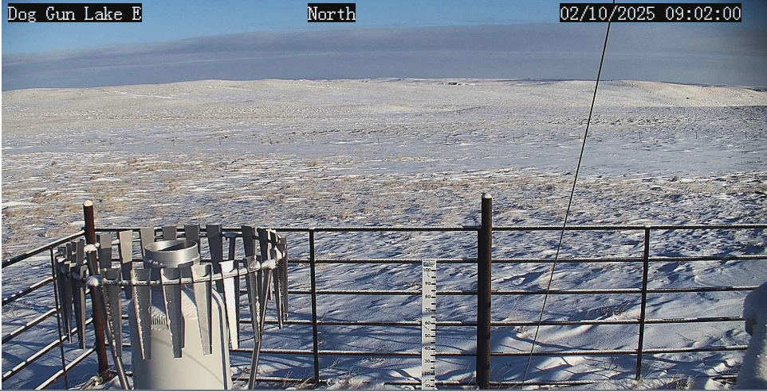
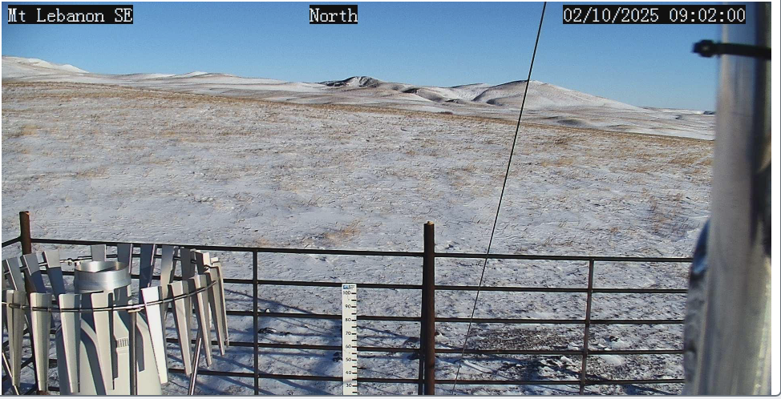
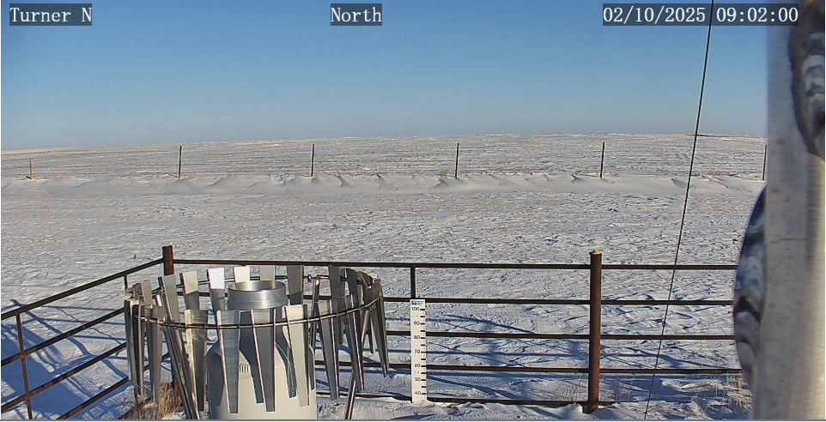
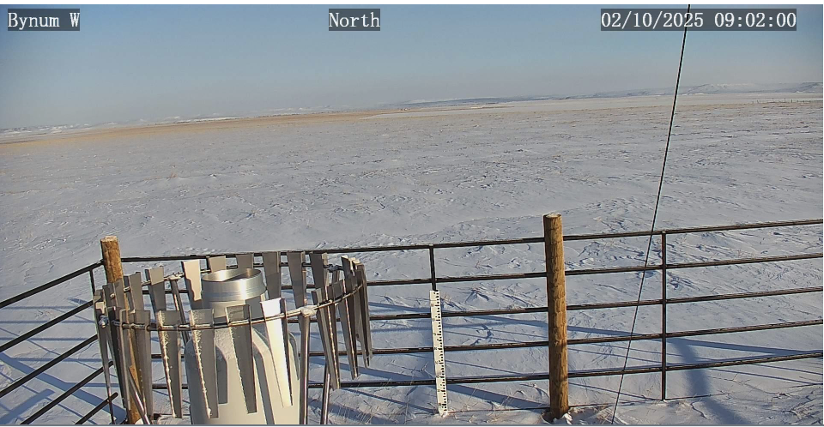
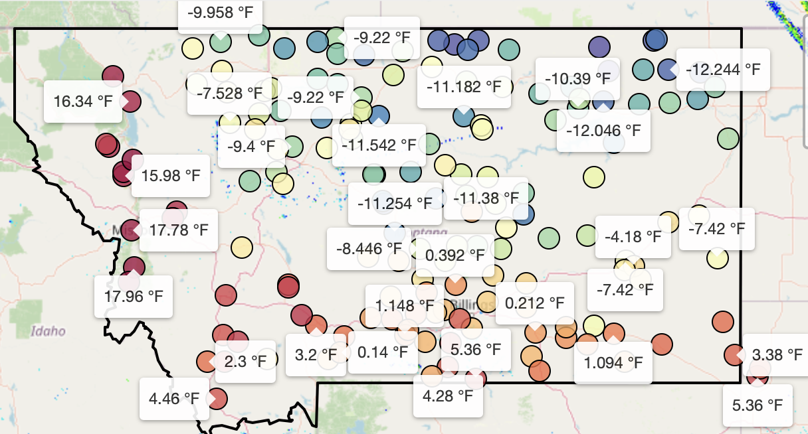
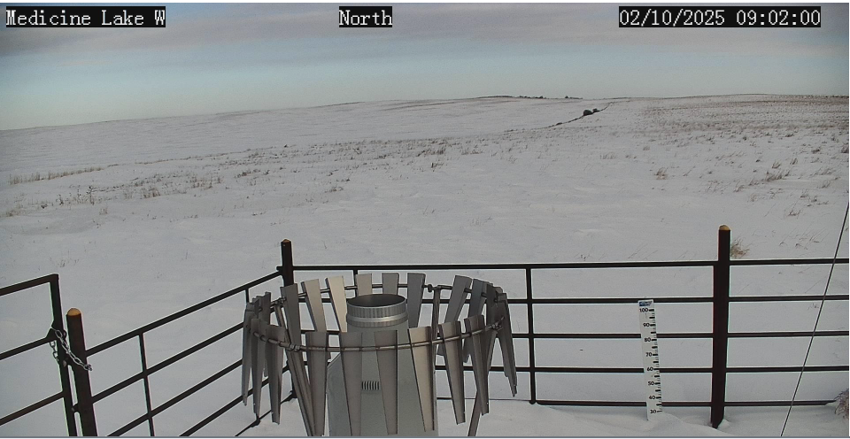
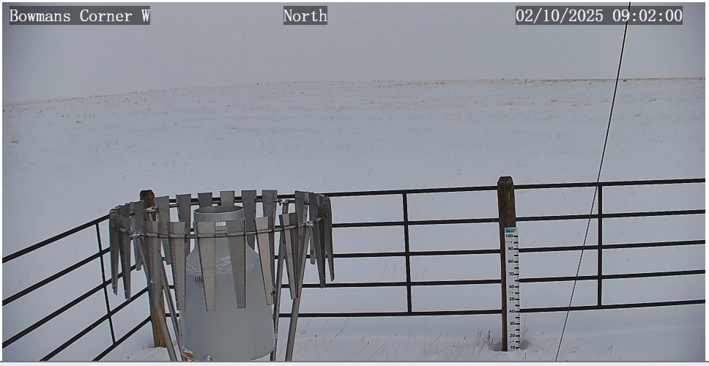
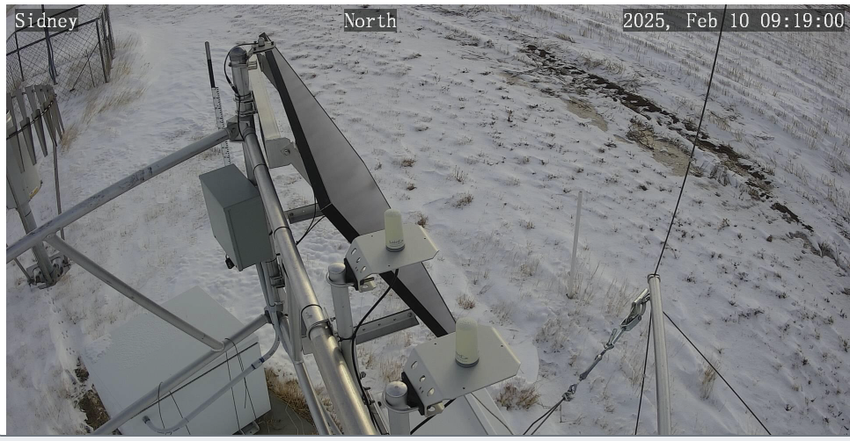
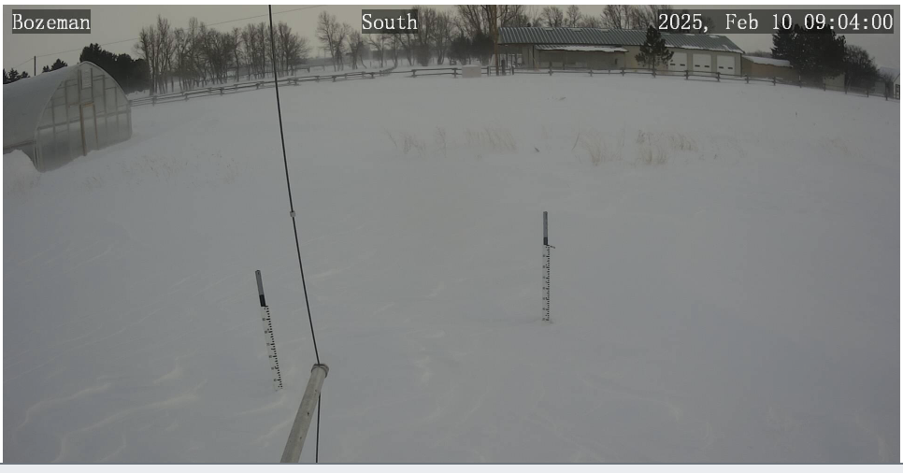
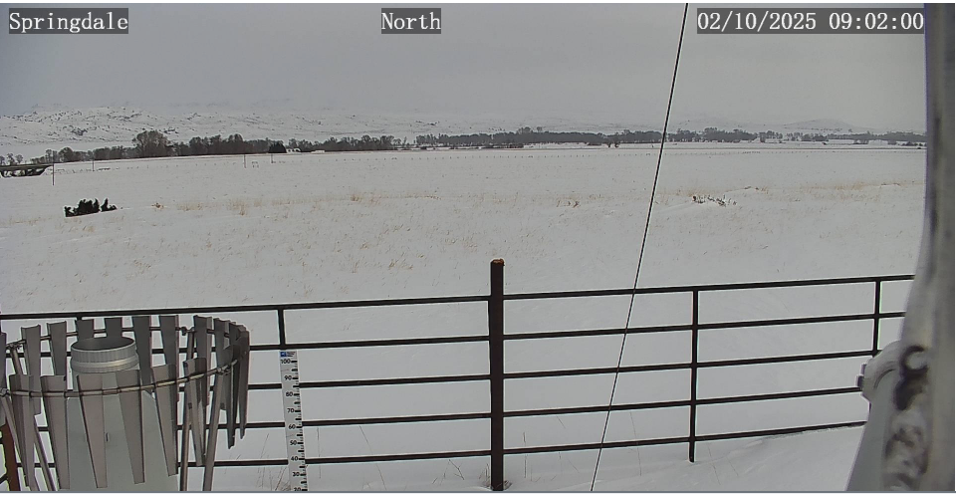
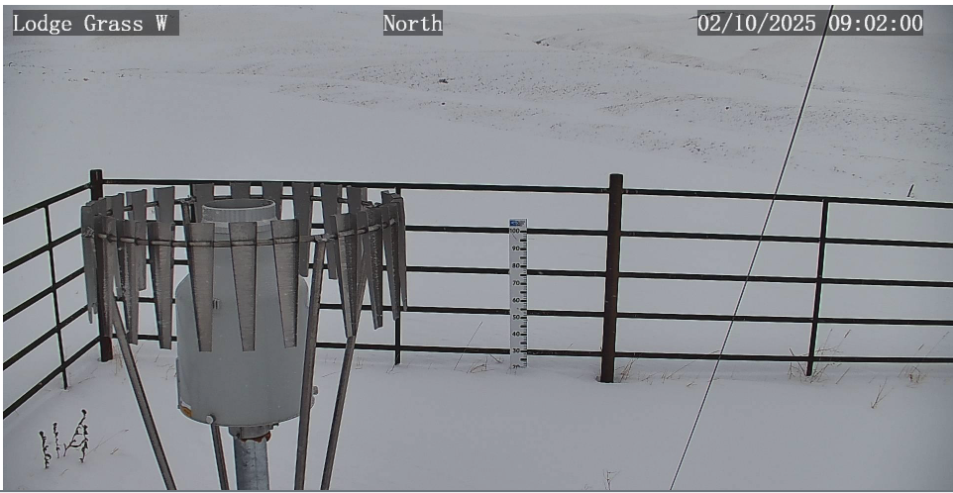
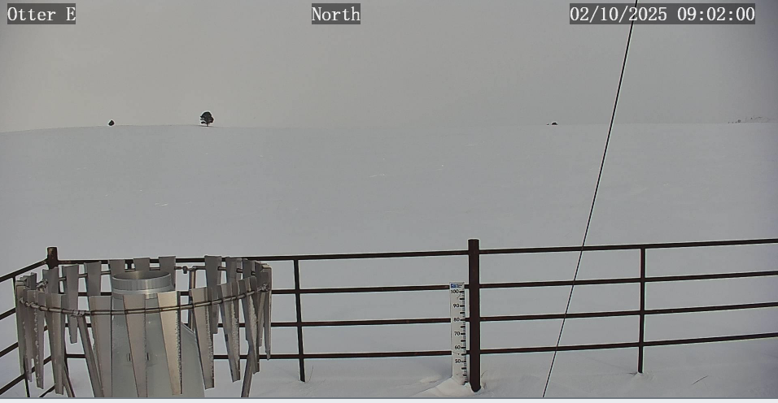
02/10/25 – Monday’s PTZ camera photos
How does the state look in terms of drought, weather, or fire?

Slide 12

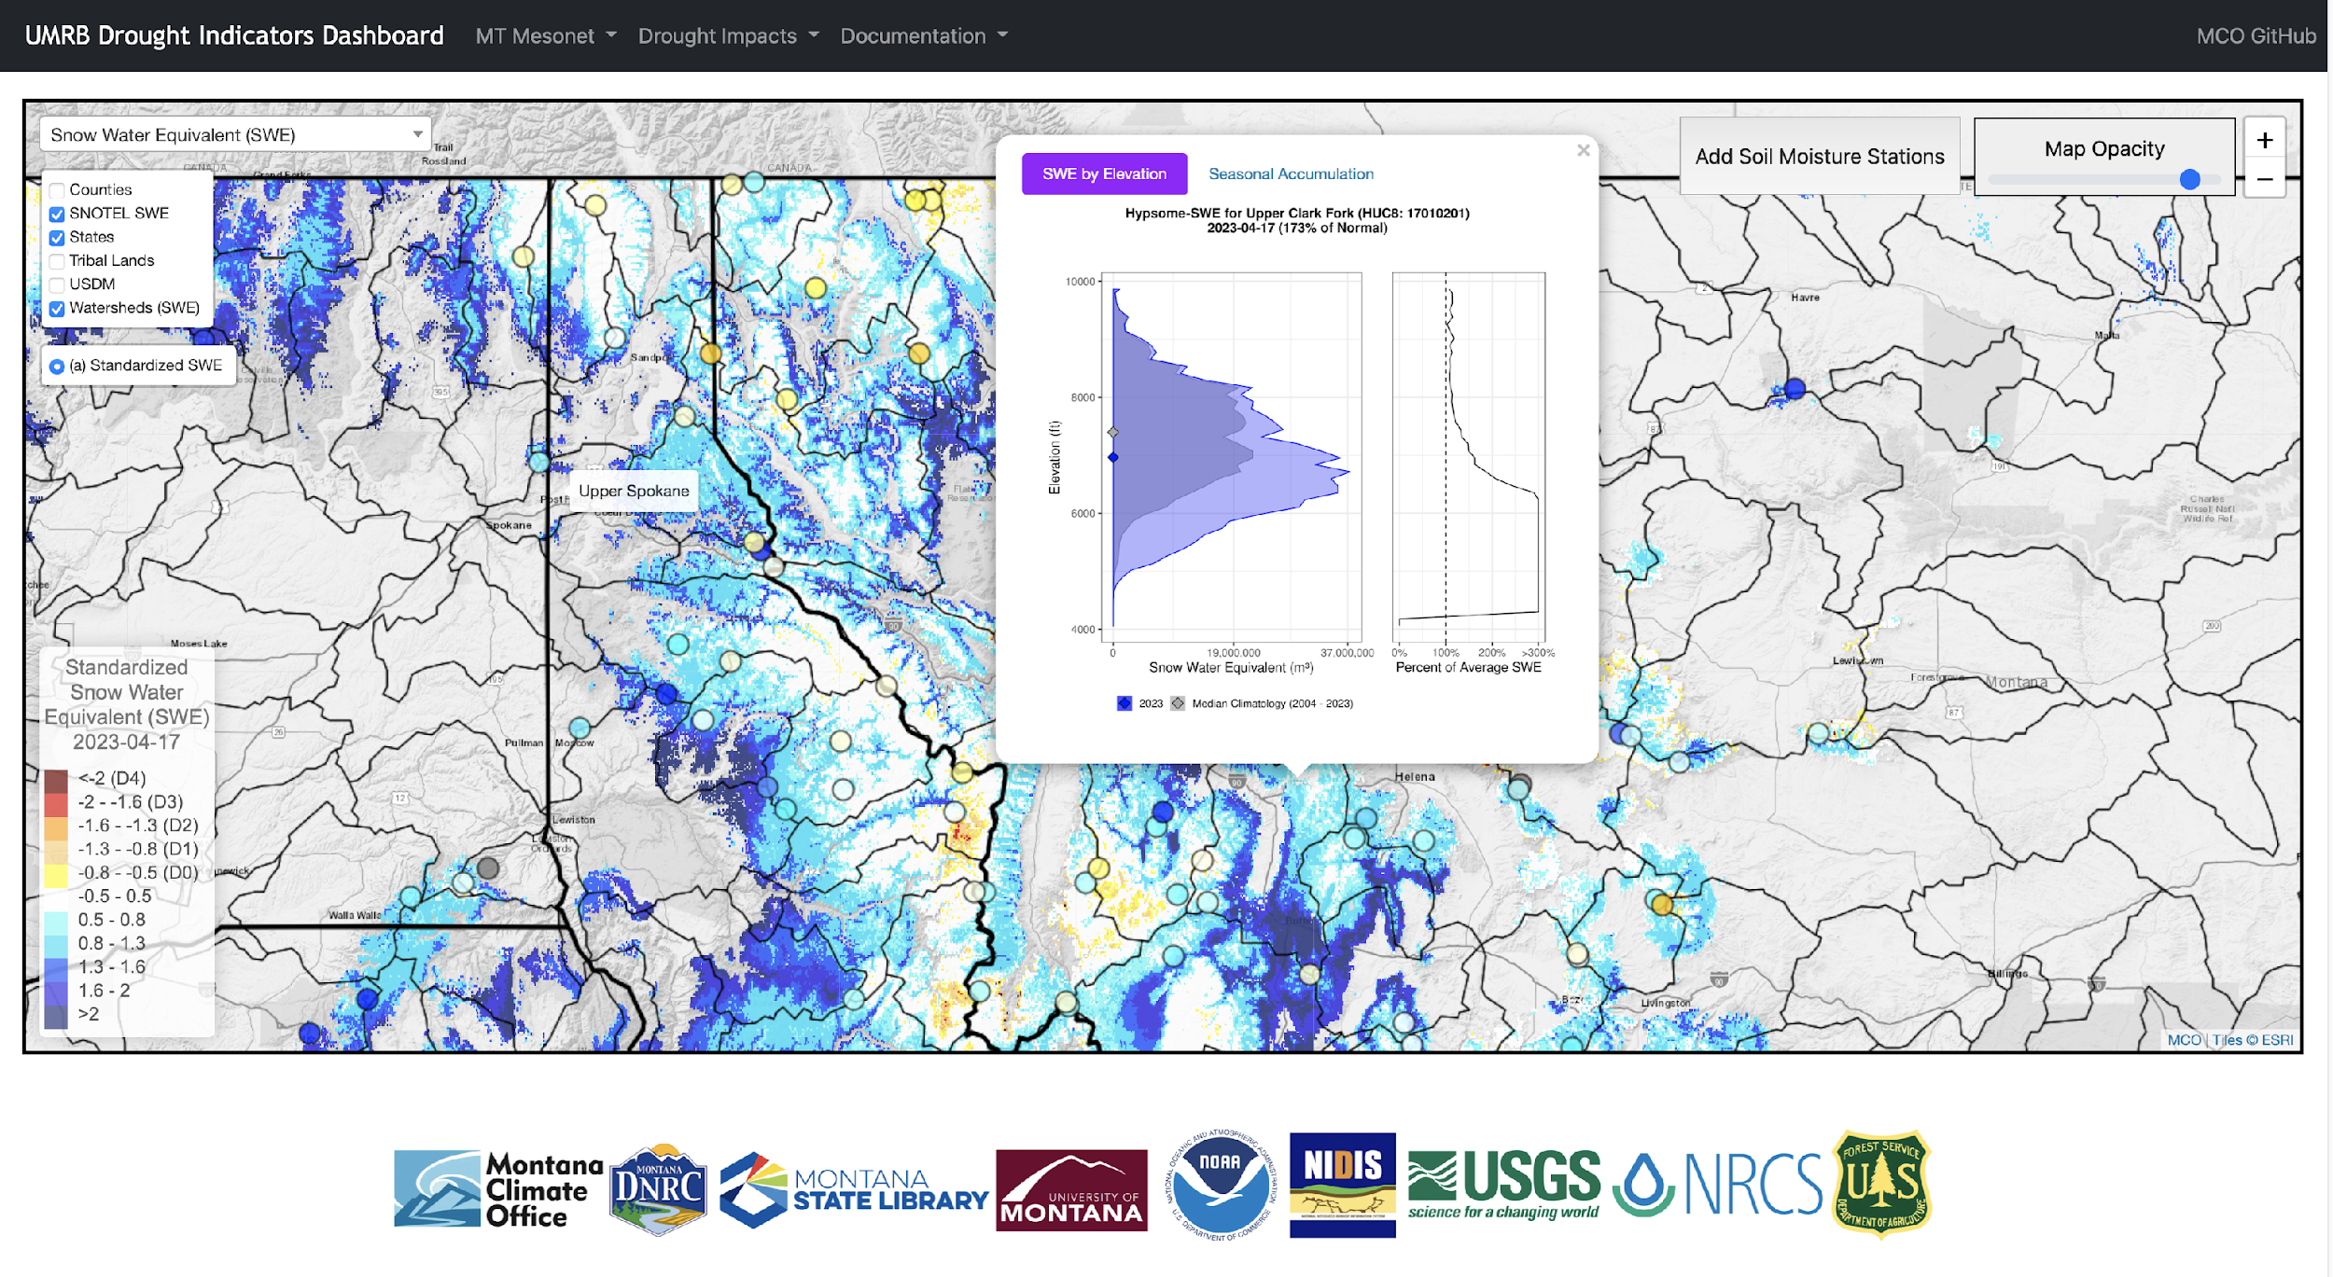
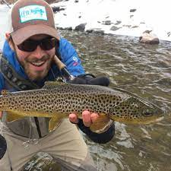
2. Better characterizations of drought & water supply conditions
“No one trusts a model except the person who wrote it; everyone trusts an observation, except the person who made it.”
The UMRB Drought Dashboard
Daily modeling of precipitation, temperature, snow, soil moisture, evapotranspiration and drought models across Montana
Science based tool for drought mapping by the state of Montana and for evidence-based reporting to the USDM
Zach
Hoylman
drought.climate.umt.edu
Notes:
No one trusts a model except the man who wrote it; everyone trusts an observation, except the man who made it. Theories crumble, but good observations never fade.

Slide 13
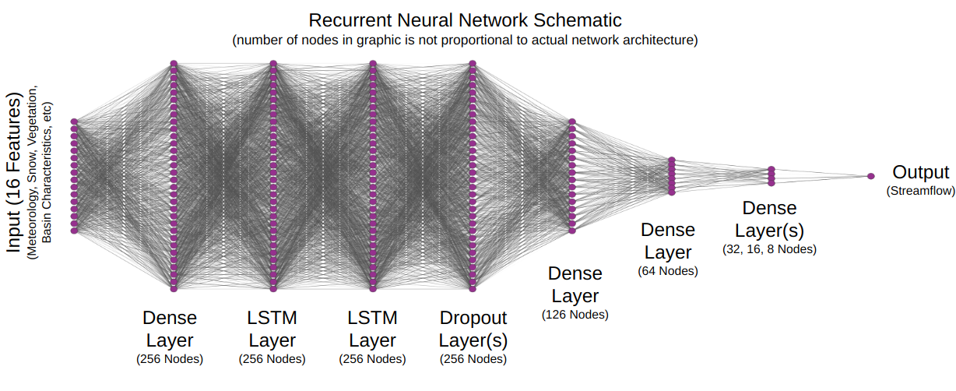
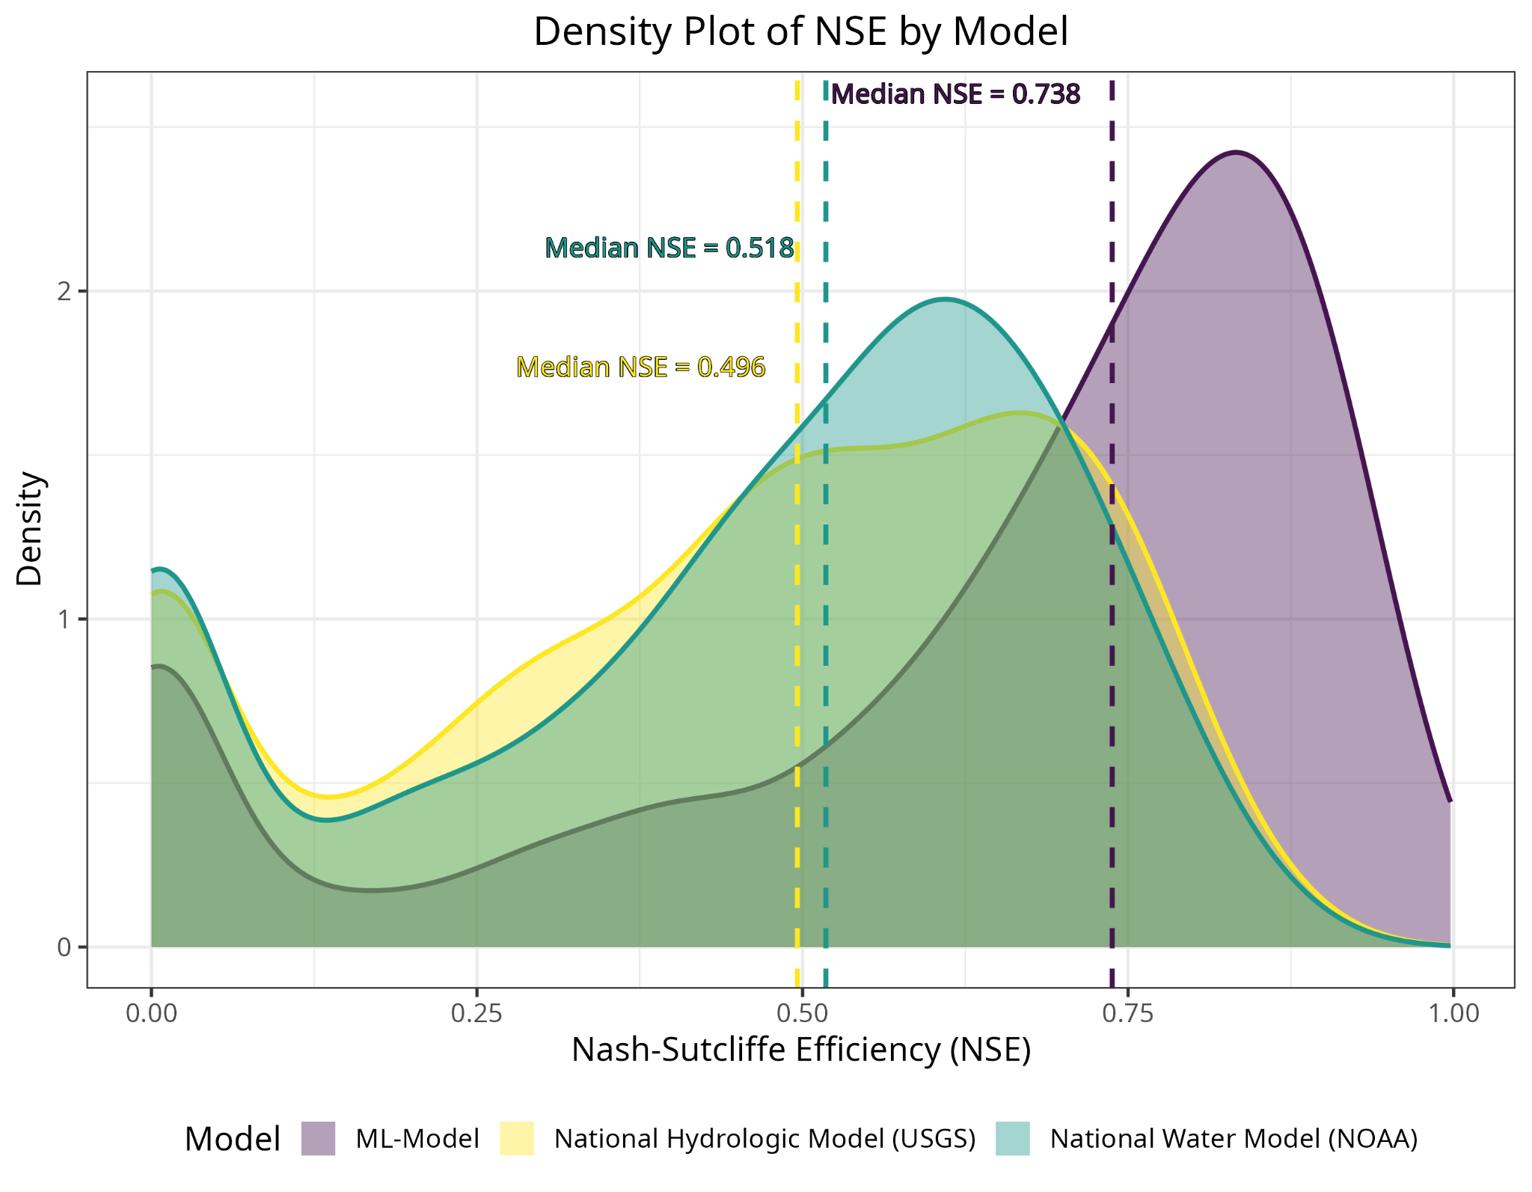
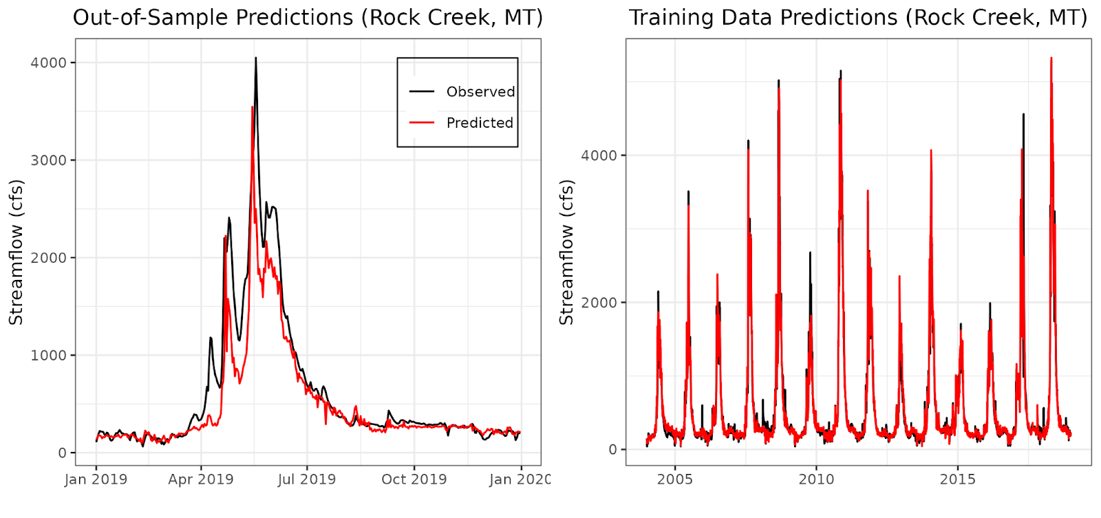
AI approaches to streamflow and soil moisture characterization
LSTM models for streamflow and soil moisture predictions
Daily streamflow predictions in all MT ungauged basins (HUC10)
Daily and weekly forecasts for flood early warning
Operational on the MT Drought Dashboard
Field scale soil moisture is on the way!
https://climate.umt.edu/streamflow/

Slide 14
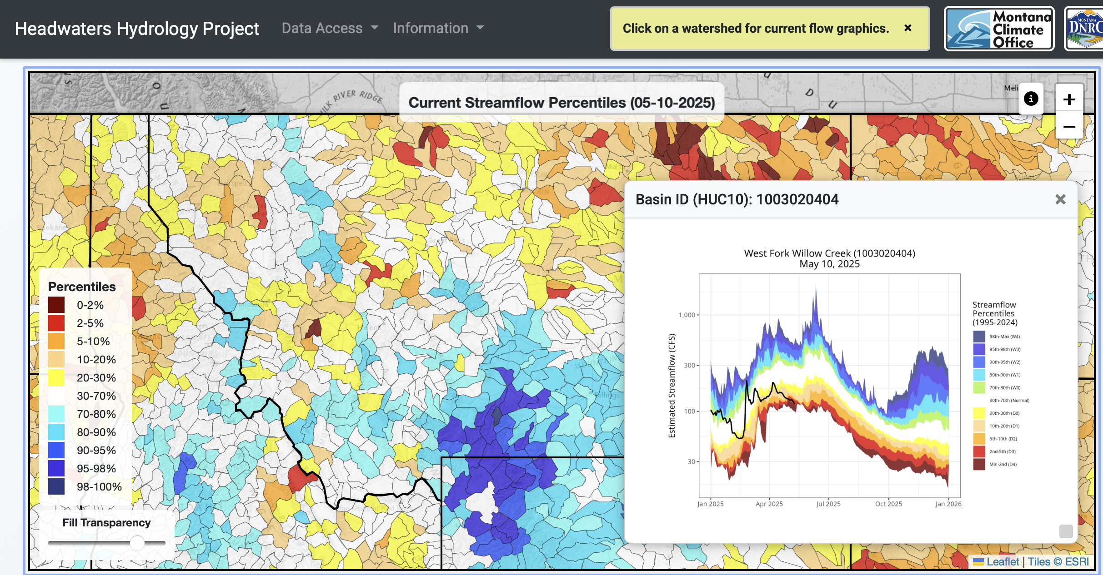
Machine Learning - Streamflow Everywhere
https://climate.umt.edu/streamflow/

Slide 15
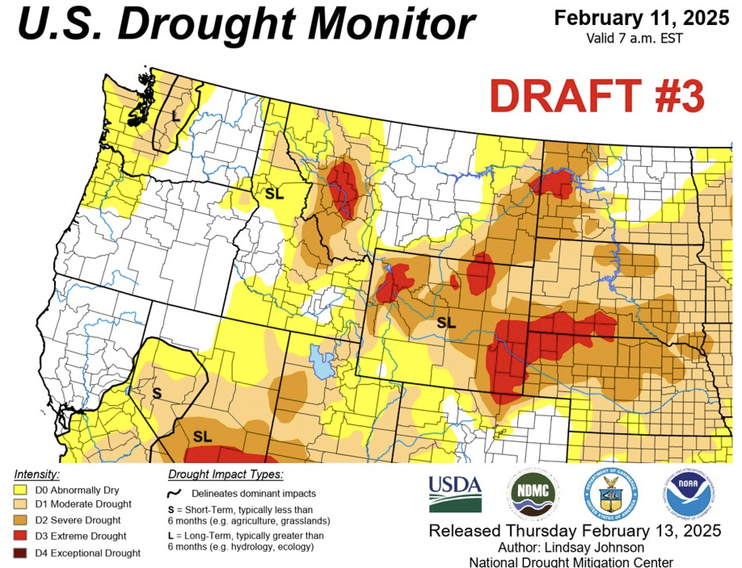
3. Updates to MT’s Drought Coordination Process
Sunday & Monday Morning:
Montana author assembles proposed changes to USDM based upon analysis of station data, modelled data and impact reports
Authorship rotates every two weeks for five volunteers: Michael Downey (DNRC), Jane Fogelman (NOAA), Troy Blanford (DNRC), Zach Hoylman (MCO) and Kelsey Jencso (MCO).
Repeat this process 52 times each year
Monday Early Afternoon:
Author sends initial analysis and summary to Montana Drought Listserv for review and consensus.
Tuesday:
MT author makes changes and sends the proposed map with a justification to the National Drought Monitor author. The USDM author releases a series of 3 drafts with “back and forth” between state authors.
Wednesday:
USDM author makes final decisions, and the final national map is released Thursday morning.
It takes objective data and a well justified argument to make our case to the USDM each week!
Notes:
Highlight that this process is new - 2017

Slide 16
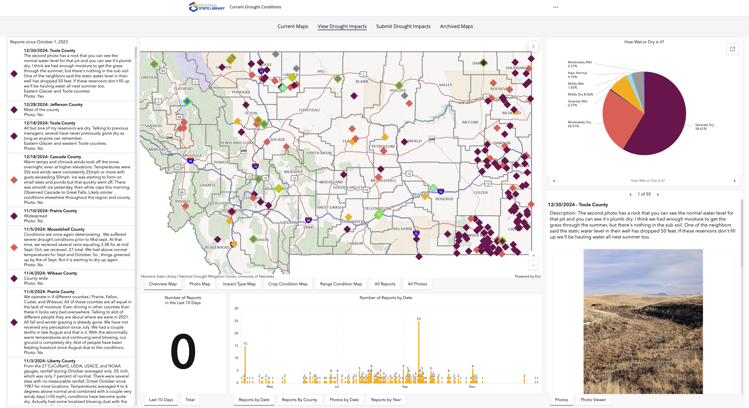
3. Updates to MT’s Drought Coordination Process – Drought Impacts Reporter
Mechanism for producers to report drought conditions and impacts across the state
Our Drought Committee monitors these impact reports on a weekly basis
This is a great way to incorporate feedback and we focus on areas where there is misalignment between indicators and impact reports
https://drought.climate.umt.edu - Select the Drought Impacts Tab

Slide 17
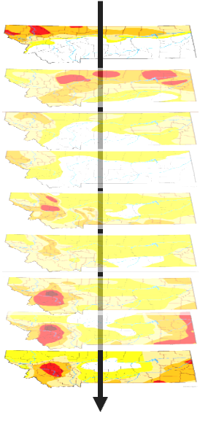
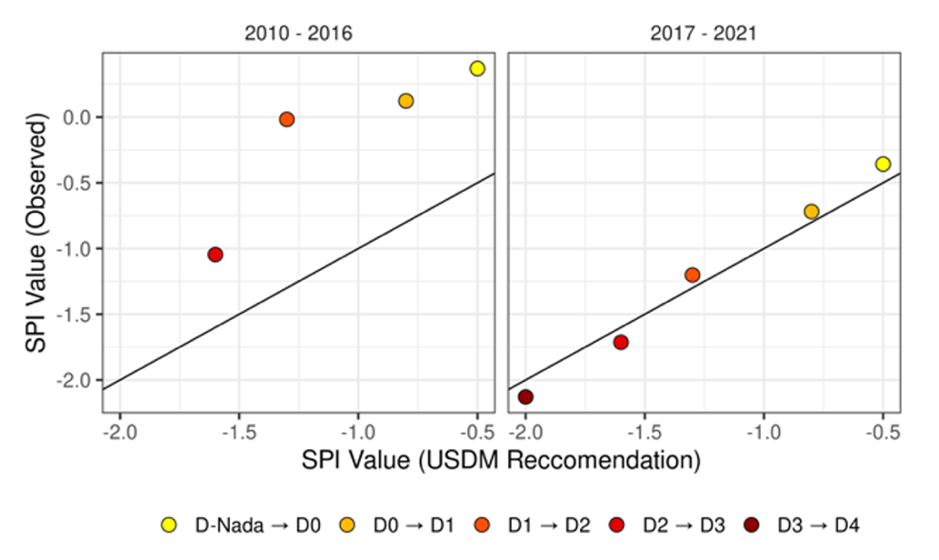
Progress towards better drought & water supply assessments
2010-2016
2018-2024
Median Precip. Anomaly Across Observed USDM Drought Maps
Precip. Anomaly Required for D1-D4 Drought
Improved observations, models, and coordination since the 2017 drought have contributed to more accurate drought predictions in Montana. We still have a long way to go……..

Slide 18
Summary
Our unique geography contributes to spatial differences in where, how often and how fast weather events impact Montanan’s livelihoods and our economy – and it’s a big state
Accurate monitoring and assessment are critical to informing our daily and seasonal response to drought & floods
These frameworks are critical to the allocation of hundreds of millions of dollars for food security, infrastructure, and protection of livelihoods and lives.

Slide 19
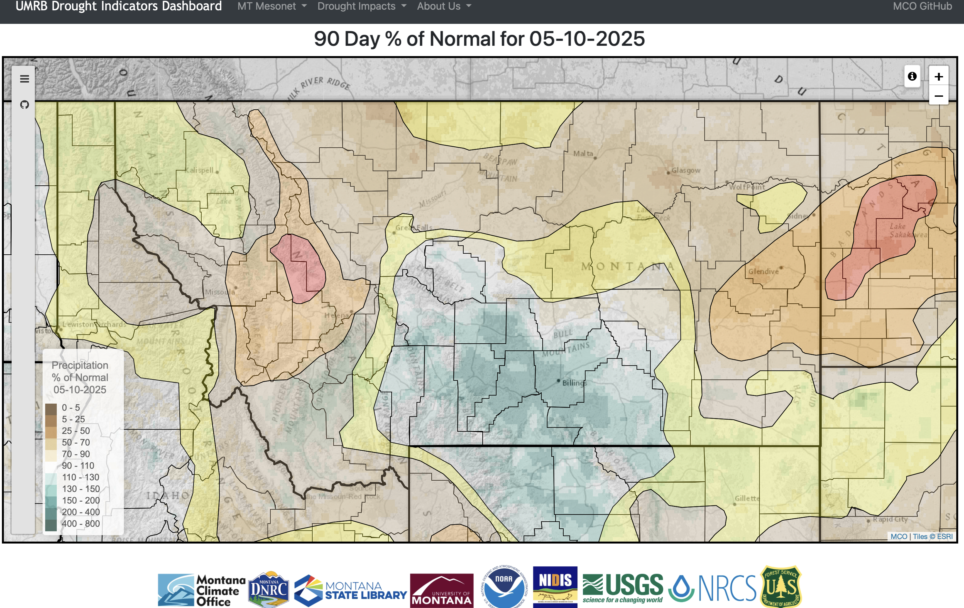
Seasonal Outlook
We’ve had an anomalously low amount of precipitation this winter and spring (and longer).
Precipitation has been between 25-75% of normal in the last 90 days across the Hi-Line.
We are already in D1-D2 drought conditions.

Slide 20
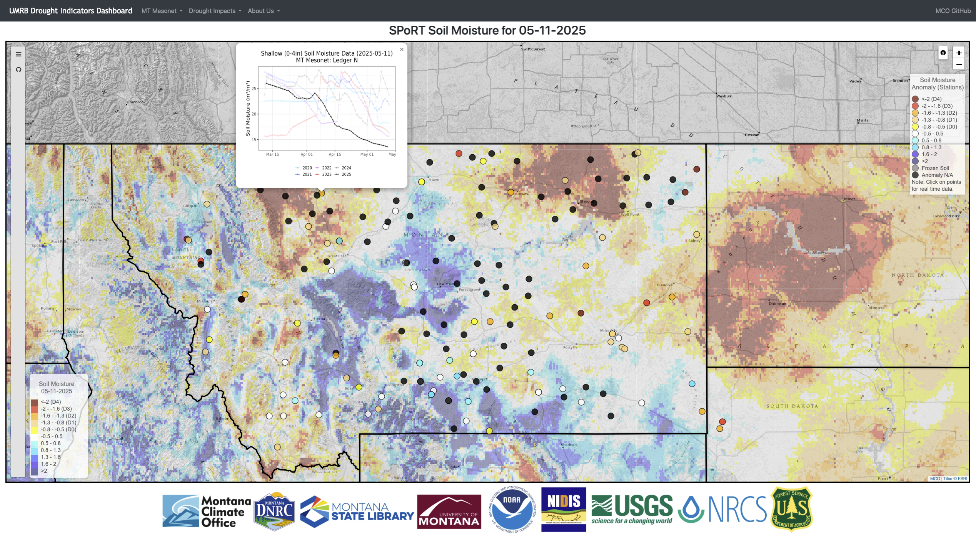
Seasonal Outlook – Soil Moisture is Key!
Soil Moisture is anomalously low from the Rocky Mountain Front and across the Hi-Line; also in Eastern MT surrounding Glendive

Slide 21
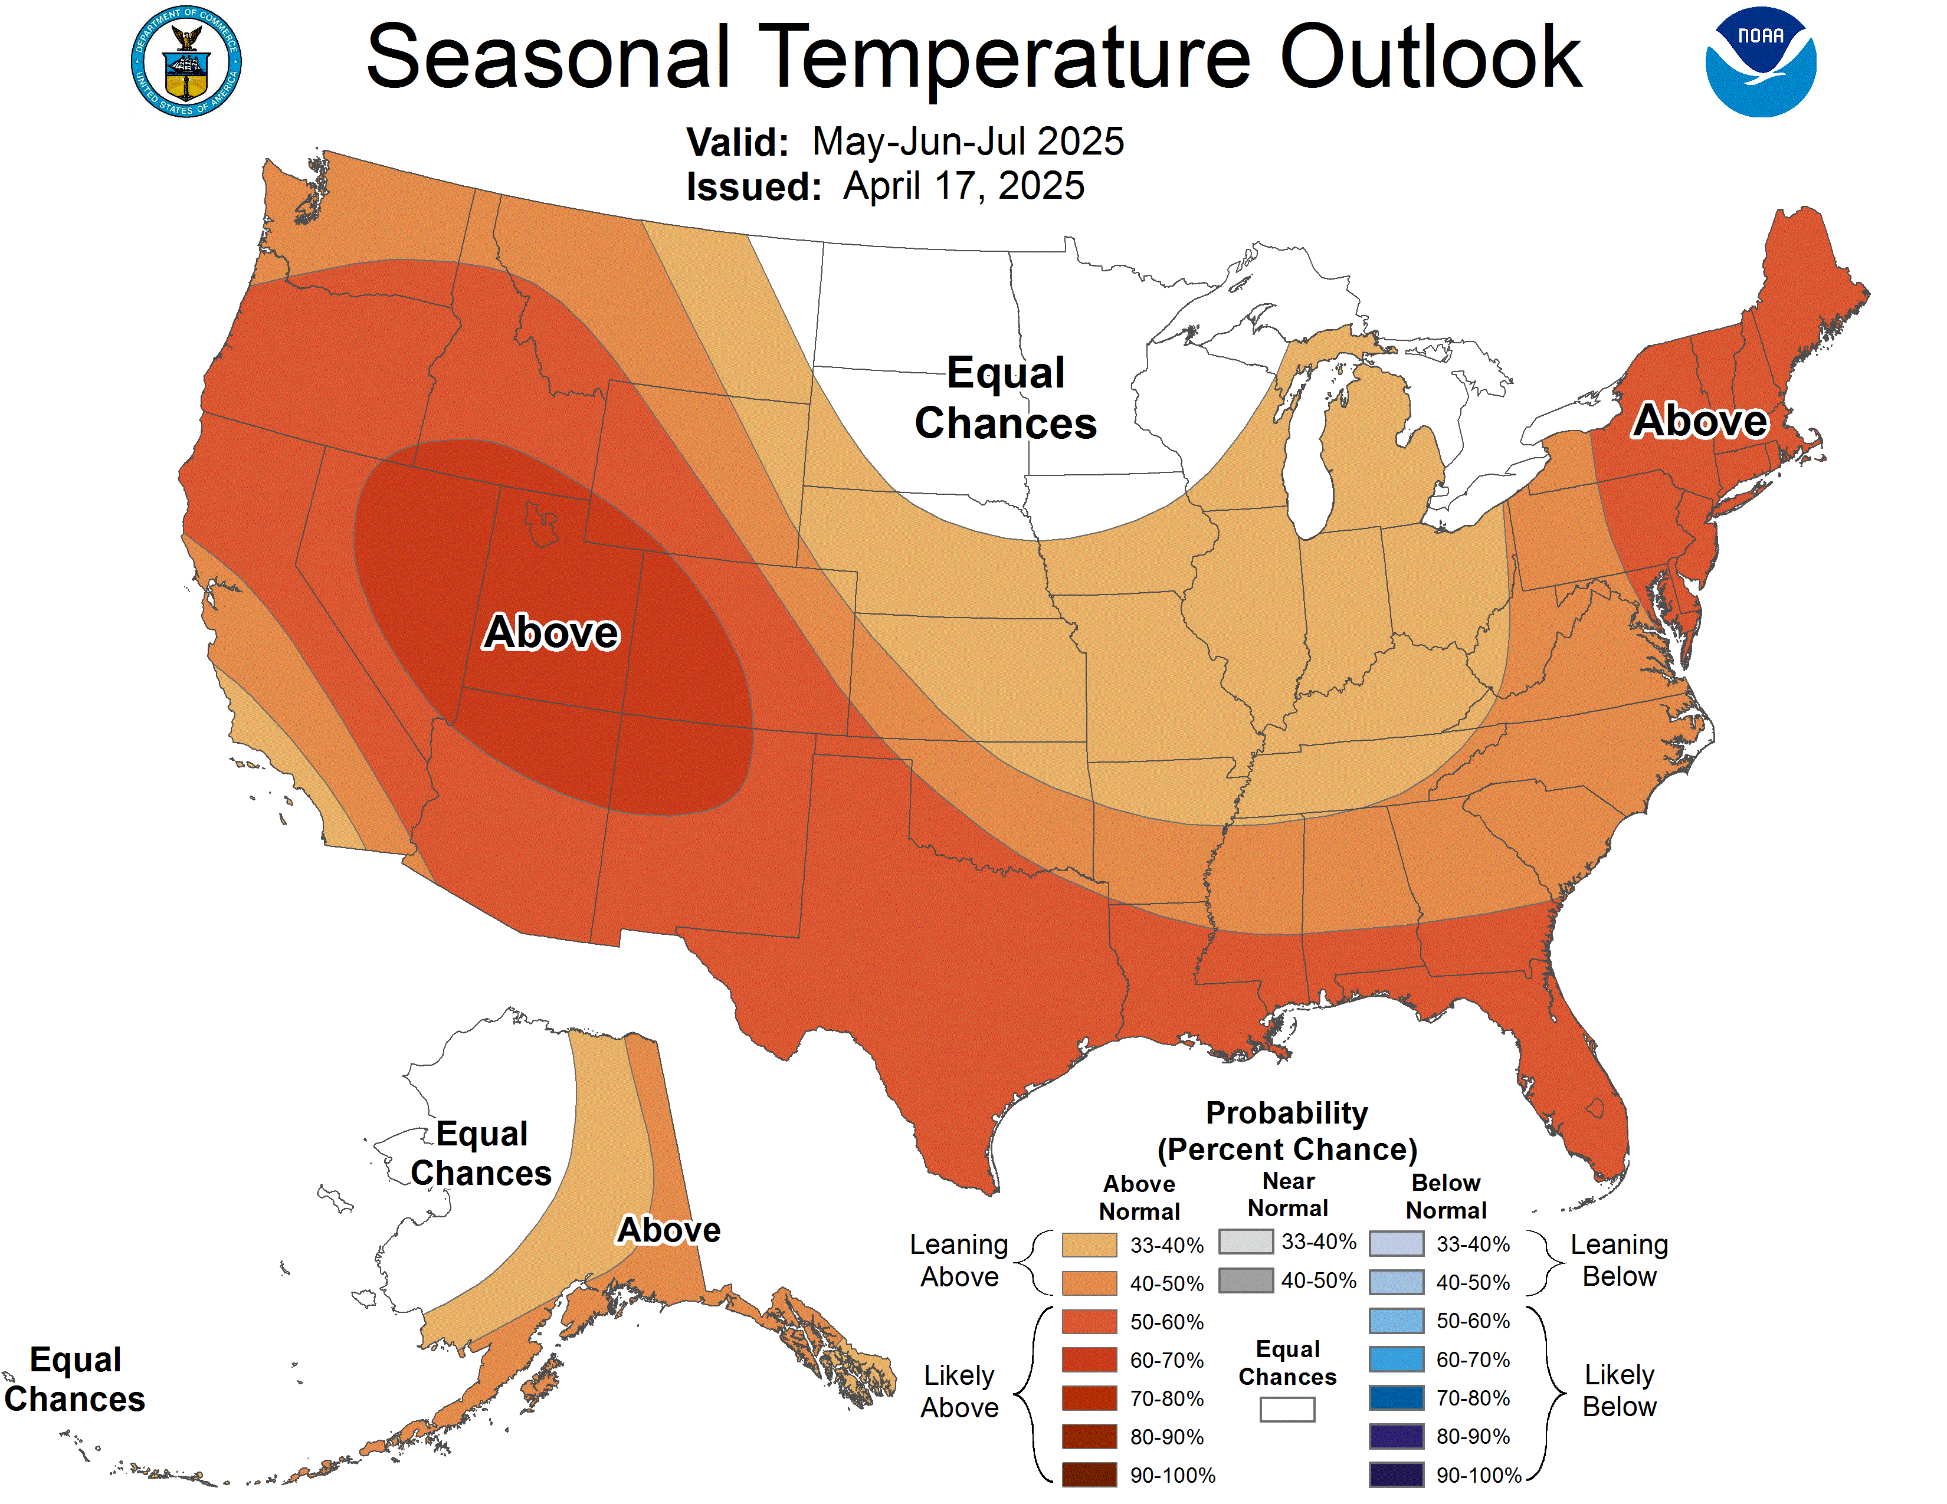
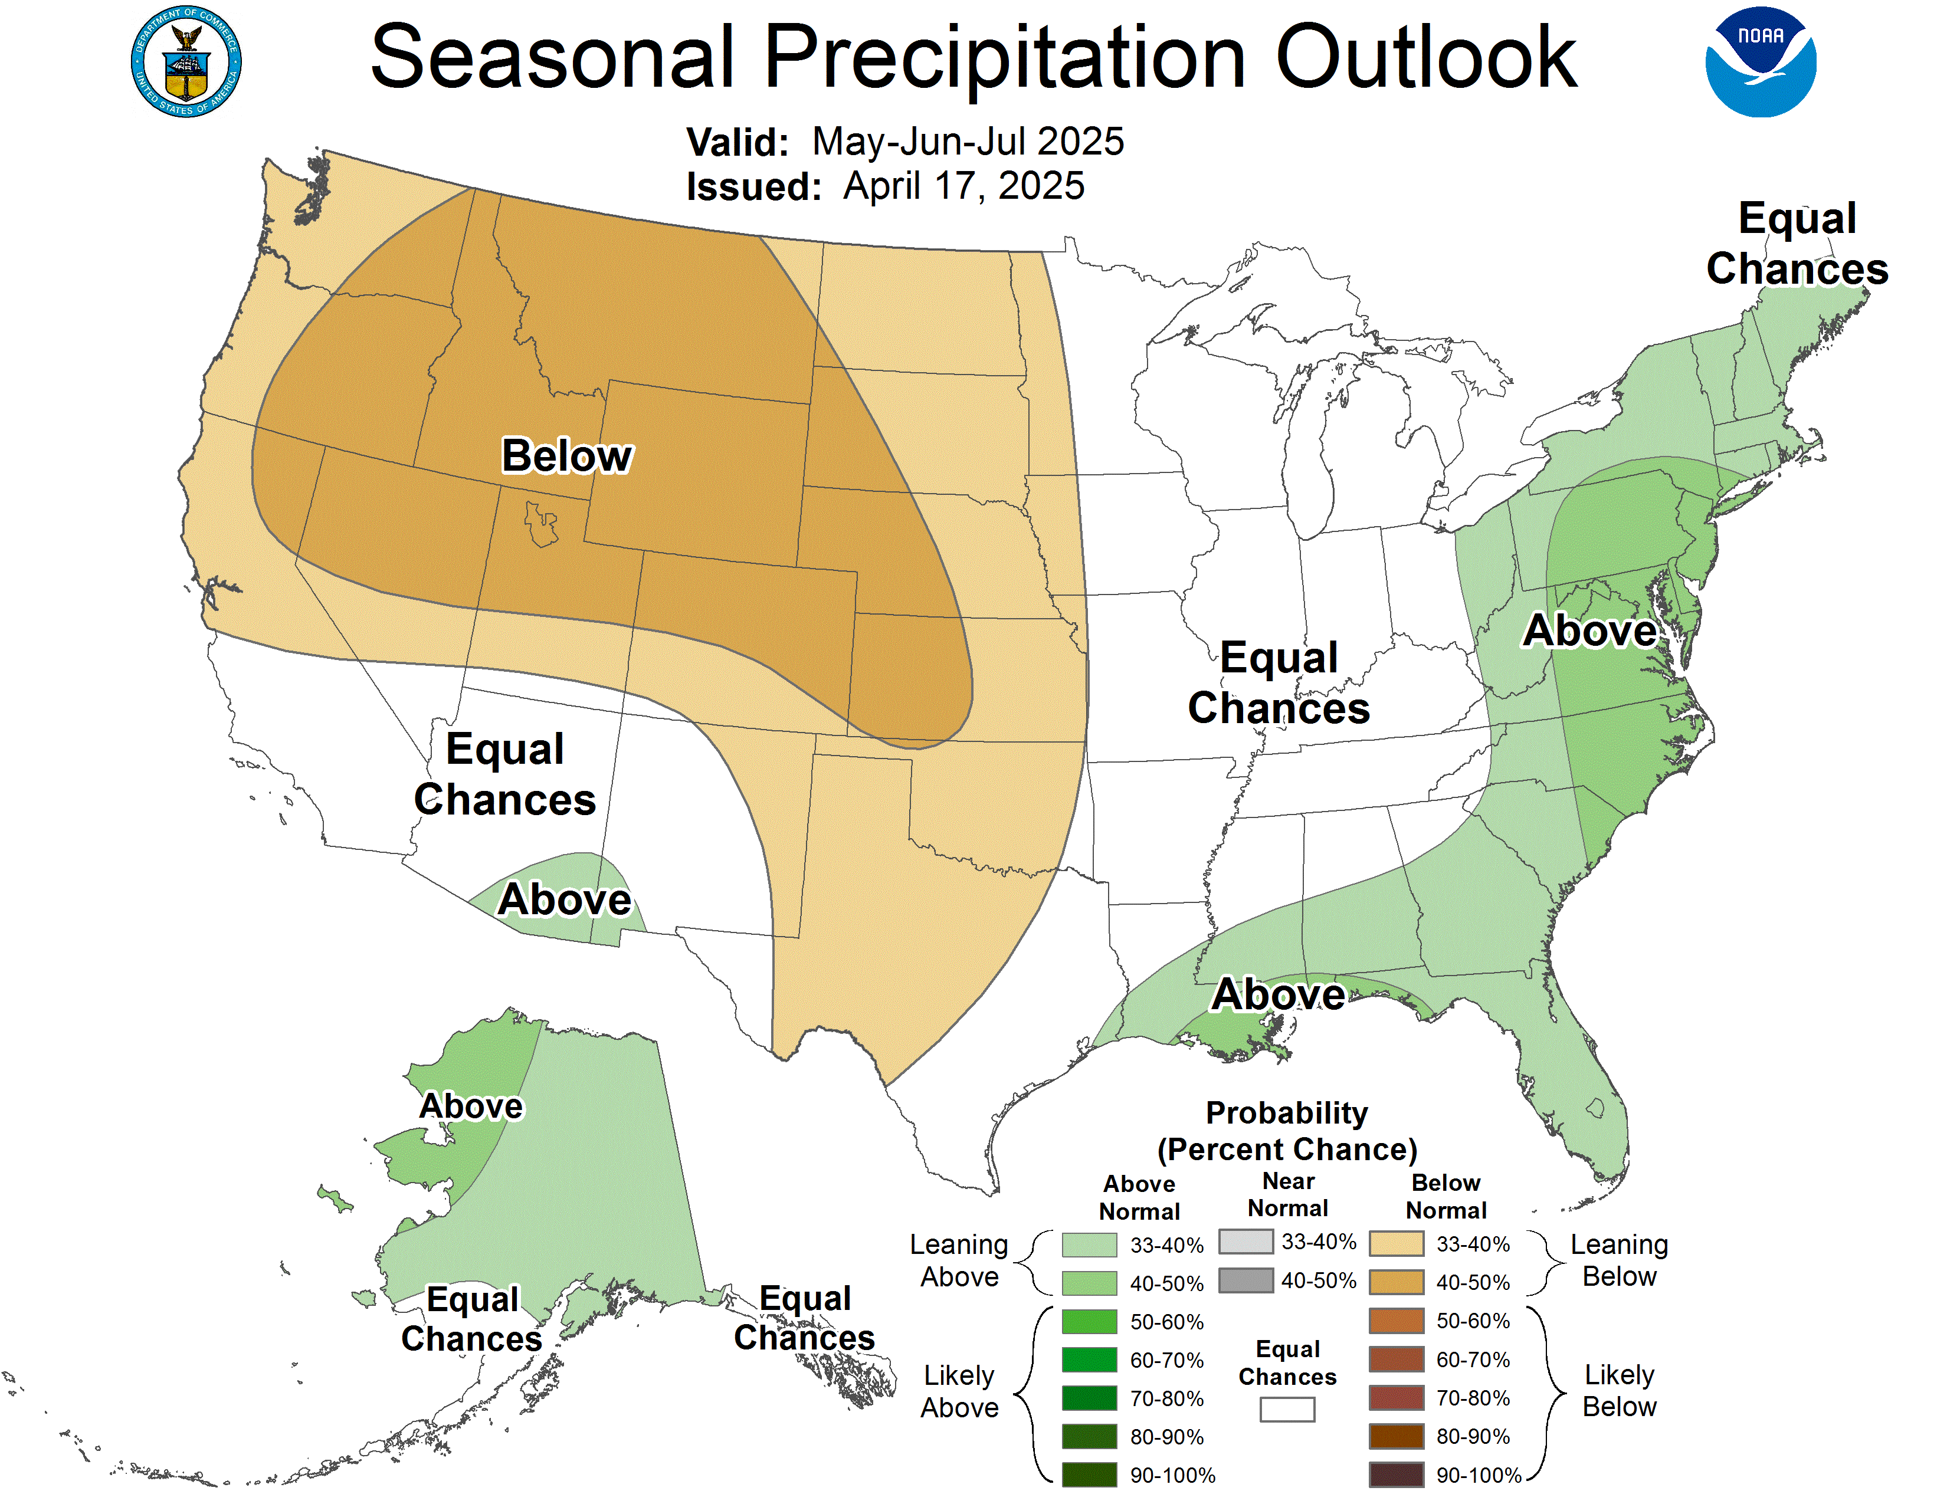
Seasonal Outlook
Odds are tilted towards an intensification of drought this spring through summer

Slide 22

Questions?
state.climatologist@umontana.edu
Web Resources:
MCO Web Page: https://climate.umt.edu
Climate Data Explorer: https://mco.cfc.umt.edu/datasets
Drought Tracker: https://drought.climate.umt.edu
Seasonal Newsletters: https://climate.umt.edu/mtdrought
Montana Mesonet: https://climate.umt.edu/mesonet

Slide 23
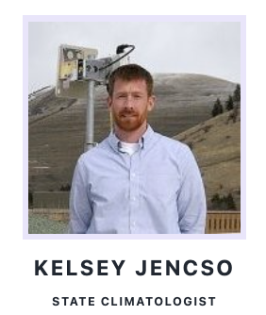
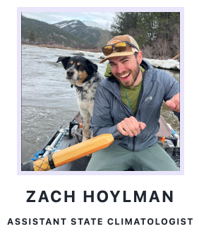



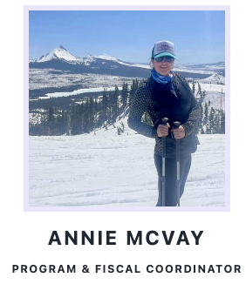

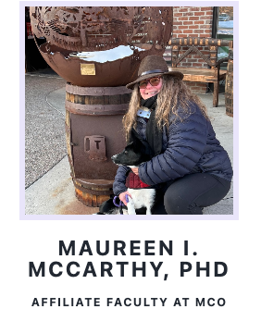





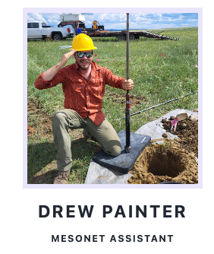











The Montana Climate Office
Staff at the Montana Climate Office
CHRISTINE LAYEUX
CHRISTINE LAYEUX
EXTENSION

